Slide 1
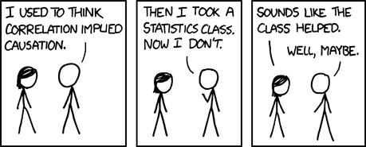
Predictive Analysis
2020-03-23 – IS201 - Prof Redd
“These unique challenges will pass in due time.” -President Russel M. Nelson, “Message of Hope During COVID-19 Outbreak https://newsroom.churchofjesuschrist.org/article/president-nelson-message-covid-19
XKCD: https://xkcd.com/552/

Slide 2

Correlation and Causation
https://www.youtube.com/watch?v=HUti6vGctQM

Slide 3

Online Meeting Reminders
Mute your mic when not speaking.
Use the Zoom Chat Box for asking questions.
Use the Participants box to “raise your hand” and give feedback.
Lectures are recorded and will be posted shortly after each class period.
Add a photo to your Zoom profile.
Turning your camera on is optional but nice to have.
Fill out the “How was class today?” survey.

Slide 4
New Challenges
It’s harder to follow along if your computer is occupied doing Zoom.
Multiple screens are an option.
Use the zoom app on your phone for class and use your computer to follow along with the class.
Last week I didn’t post the “TP R Us” solver sample before class.
Virtual TA Labs and Help
How is that going?

Slide 5
Announcements
Keep an eye on LearningSuite – Announcements, Schedule, and Materials will all be there!
Get your domain name ASAP. We’ll start building websites next week!
Details are in the LearningSuite Schedule
You’ll get a bunch of spam email offering to help you build your website. Ignore them. They will dissipate in 2-3 days.
Homework
Solver due today
Statistics due Wednesday
Exam due on Saturday.
Assignments due at 11:59pm MOUNTAIN TIME.
Wednesday’s class will be an Exam Review.

Slide 6
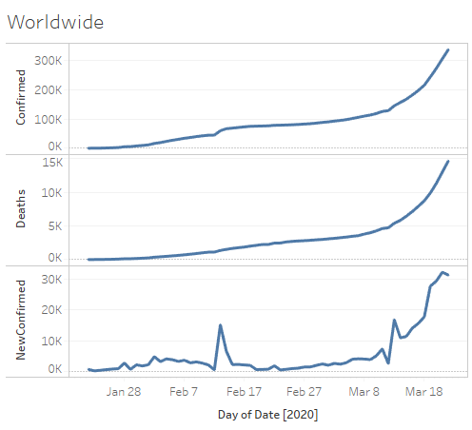
COVID-19 Data Update
https://brandtredd.org/files/IS201/COVID-19-data

Slide 7
Type of Variables
Categorical: Differentiates according to a meaningful measure
Region, Education Level, Marital Status, Gender,
Dichotomous: Has one of two values that can be assigned 0 and 1
Gender, homeowner, married
Nominal: Difference do not have any ordering
Region, Occupation, Hair Color
Numeric: Can have a meaningful number assigned
Continuous
Counts of items, amounts of money, measures of units, etc.
Ordinal: Categorical variables that have an ordering but not a well-defined valuation of one value to the next.
Education level, Difficulty rating, Ordered “chunks”
Dichotomous: Assign 0 and 1 to values

Slide 8
Dataset for Class Today
“Bike Buyers Data Formatted” from MyEducator 5.4
Same data used in the lesson videos

Slide 9
Bivariate Statistics
To what degree do two variables correlate, or predict each other?
Scatter Plots in Excel
Make a scatter plot
Add a Trend Line
m = Slope
R² = The Coefficient of Determination: The proportion of the difference in y attributable to x. (Also works for multivariate analysis)
Requires numeric variables
Correlation
r = The Correlation Coefficient: The probability that x predicts y (range -1 to =1)
CORREL(): calculates r for any two columns (variables)
Data Tab – Data Analysis – Correlation: Calculates r for all combinations in a table.
ANOVA: A One-Way Analysis of Variance
Can measure the relationship between a nominal (categorical) variable and a numeric variable
F-statistic: Larger values indicate that the differences among values are more likely to be due to differences among categories
P-Value – Probability that the differences are due to chance (< 0.05 is “statistically significant”)
t-test
How well does the difference between two categories predict an outcome
P-Value – Probability that the differences are due to chance (< 0.05 is “statistically significant”)

Slide 10
Bivariate Samples In Excel
Scatter Plot with Trend Line and Legend
Correlation Table
ANOVA
t-Test

Slide 11
Does R² = r² ?
Sometimes, it’s complicated.
r = the Correlation Coefficient.
Range is -1 to +1
Value is the probability that x predicts y. For example, 0.5 means that when x increases then 50% of the time y will also increase. -0.5 means that when x increases, 50% of the time y will decrease. -1 and +1 are both considered strong correlations.
R² = the Coefficient of Determination
Range is 0 to 1
The proportion of the variance in y that is predictable from x.
In bivariate statistics, it’s pretty much the same as r2.
In multivariate statistics it’s helpful for finding how much each independent variable contributes to the outcome.
See https://en.wikipedia.org/wiki/Coefficient_of_determination

Slide 12
Multivariate Statistics
To what degree do several independent variables contribute to the overall outcome.
Multiple Linear Regression
R² = The Coefficient of Determination
Prediction Calculator in Excel

Slide 13
Most important factors affecting student achievement.
Variation Attributable to Factor
60% | Background (race, parental achievement, etc.)
8.5% | Teacher Effectiveness
12.5% | Other School-related factors
19% | Unexplained
Values approximated from: https://www.ewa.org/sites/main/files/file-attachments/teachereffectiveness.final_.pdf

Slide 14
Multivariate Sample In Excel
Regression Analysis
Prediction

Slide 15
Summary
To estimate the relationship between two variables, calculate the correlation using either a Correlation Table (from Data Analysis) or, if you only have two variables, the CORREL() function.
To test whether the relationship between a Categorical Variable and a numeric variable is statistically significant use ANOVA (from Data Analysis)
To calculate the probability that differences between pairs of categorical values are statistically significant, calculate the t-statistic p-value using the TTEST() function
To estimate the effect of several variables, do a Multiple Regression Analysis.

