Slide 1
Introduction to Programming and to VBA
IS201 – Brandt Redd – Session 10

Slide 2

Turing Machines Explained
https://www.youtube.com/watch?v=dNRDvLACg5Q

Slide 3
Announcements
Flowchart HW Due Today!
Next week, Monday Classes on Tuesday!
Module 4.4. VBA Navigation HW Due on Tuesday the 18th
Programming requires a different way of thinking. This is where it gets tough!
Don’t wait until due dates for help!

Slide 4
Extra Credit Opportunities
SONA Behavioral Research Lab: https://cogneuro.byu.edu/sona
Each 30 minutes of participation is worth ¼ of total possible extra credit.
You should be receiving an email invitation from the SONA Lab.
Apply what you learn (DB/SQL, VBA, Web Development, or Data Analytics) to a project at work or another venture
Send a report to Prof. Redd
This will max out your extra credit

Slide 5
A Little Theory

Slide 6
Universal Turing Machine
A Finite State Machine that can accomplish a fundamental set of operations.
Alan Turing proved that any Universal Turing Machine (UTM) can simulate any other UTM – given unlimited resources (time and data capacity).
A machine – or programming language – is called “Turing Complete” if it can perform the functions of a UTM.
VBA, a procedural language, is Turing Complete
SQL, a declarative language, is not Turing Complete (at least not the query portion we have learned). It can only solve a certain class of problems.

Slide 7
HTML, a Declarative Language
<html>
<body>
<title>What’s Up in Learning Technology</title>
<a href=“https://www.ofthat.com/”>full article</a>
<p>With the turn of the decade I have read a lot of pessimistic articles about education and learning technology. Most start with the lamentation that there has been little overall progress in student achievement over the last couple of decades – which is true, unfortunately. But what they fail to note are the many small and medium scale successes.</p>
</body>
</html

Slide 8
VBA, a Procedural Language
Sub InputOutput()
Dim Length As Double
Dim Width As Double
Length = InputBox("Enter Length")
Width = InputBox("Enter Width")
MsgBox "Area is " + Str(Length * Width)
End Sub

Slide 9
Outline
Today: Structured Programming
Wednesday: Object-Oriented Programming with Excel Objects
Tuesday, 18 Feb: VBA Practice and Nested Loops
Wednesday, 19 Feb: VBA Batch Processing (Advanced Loops)

Slide 10
Structured Programming
Procedure
VBA: Sub (meaning Subroutine)
Function
VBA: Function
Comment
VBA: 'Single Quote
Variable
VBA: Dim … As
Conditional
VBA: If … Then ... Else … ElseIf … End If
Case
VBA: Select Case … Case … End Select
Loops
VBA: Do Until
VBA: For Next
VBA: For Each

Slide 11
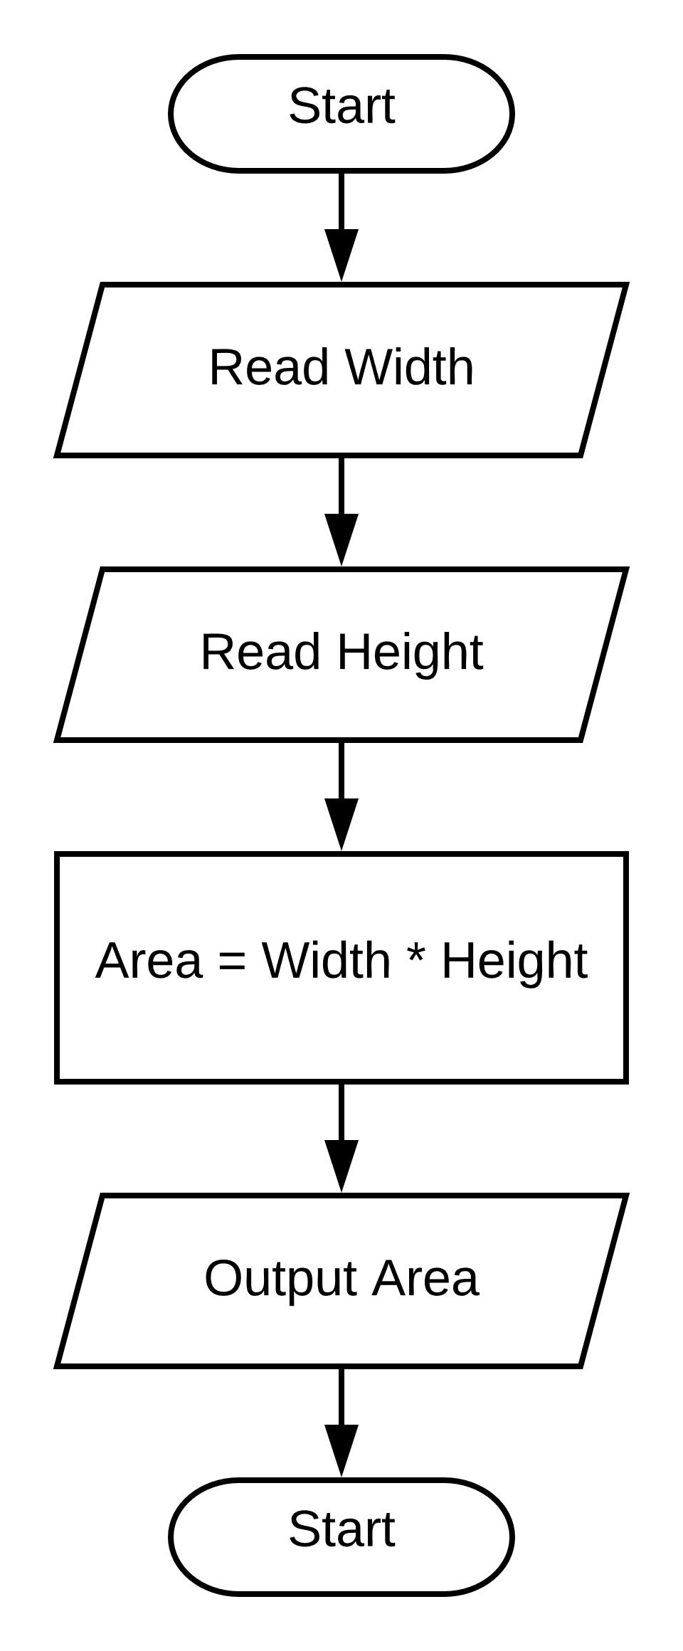
Calculate the area of a rectangle.
Variables:
Width
Height
Area

Slide 12
Variable Types in VBA
Type | Data Type | Range | Bytes | Bits
Integer | “Short” Integers | -32768 to 32767 | 2 | 16
Long | “Long” Integers | -2,147,483,648 to 2,147,483,647 | 4 | 32
Single | Real number with single precision | ±2.4 × 10³⁸ | 4 | 32
Double | Real number with double precision | ±4.9 × 10³²⁴ | 8 | 64
String | Text of all sorts | Strings up to 2 billion characters in length. | 1 byte per character
Boolean | Logical “True” or “False” | “True”, “False” | 2 | 1
Currency | Monetary values with up to 4 decimal places. Avoids rounding. | ±922 Trillion | 8 | 64
Date | Combination of both date and time | 0100-01-01 to 9999-12-31 | 8 | 64
Variant | Any of the above types. |  | 16 | 128

Slide 13
Structured Programming
✓Procedure
VBA: Sub (meaning Subroutine)
Function
VBA: Function
✓Comment
VBA: 'Single Quote
✓Variable
VBA: Dim … As
Conditional
VBA: If … Then ... Else … ElseIf … End If
Case
VBA: Select Case … Case … End Select
Loops
VBA: Do Until
VBA: For Next
VBA: For Each

Slide 14
Function Sample

Slide 15
Structured Programming
✓Procedure
VBA: Sub (meaning Subroutine)
✓Function
VBA: Function
✓Comment
VBA: 'Single Quote
✓Variable
VBA: Dim … As
Conditional
VBA: If … Then ... Else … ElseIf … End If
Case
VBA: Select Case … Case … End Select
Loops
VBA: Do Until
VBA: For Next
VBA: For Each

Slide 16
Conditionals
We are going to take the name of a disease as input. When the program is run, if the name of the disease is “Hay Fever”, then post a message box saying, “Take some allergy medicine”. If the name of the disease is “Sore Throat” then post a message box saying, “Gargle salt water”. Otherwise, post a message box that says, “Go see a doctor.”

Slide 17
Structured Programming
✓Procedure
VBA: Sub (meaning Subroutine)
✓Function
VBA: Function
✓Comment
VBA: 'Single Quote
✓Variable
VBA: Dim … As
✓Conditional
VBA: If … Then ... Else … ElseIf … End If
✓Case
VBA: Select Case … Case … End Select
Loops
VBA: Do Until Loop
VBA: Do Loop Until
VBA: While Wend
VBA: For Next
VBA: For Each

Slide 18
Loops
Finally, writing a program is faster than doing the work by hand.

Slide 19
Structured Programming
✓Procedure
VBA: Sub (meaning Subroutine)
✓Function
VBA: Function
✓Comment
VBA: 'Single Quote
✓Variable
VBA: Dim … As
✓Conditional
VBA: If … Then ... Else … ElseIf … End If
✓Case
VBA: Select Case … Case … End Select
✓Loops
VBA: Do Until Loop
VBA: Do Loop Until
VBA: While Wend
VBA: For Next
VBA: For Each

