Slide 1
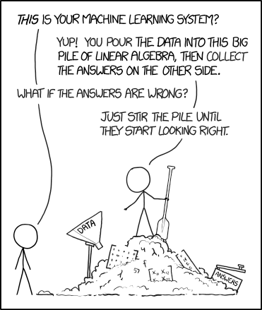
Business Intelligence Exam Review
2020-03-25 – IS201 - Prof Redd
“These unique challenges will pass in due time.” -President Russel M. Nelson, “Message of Hope During COVID-19 Outbreak https://newsroom.churchofjesuschrist.org/article/president-nelson-message-covid-19
XKCD: https://xkcd.com/1838/

Slide 2
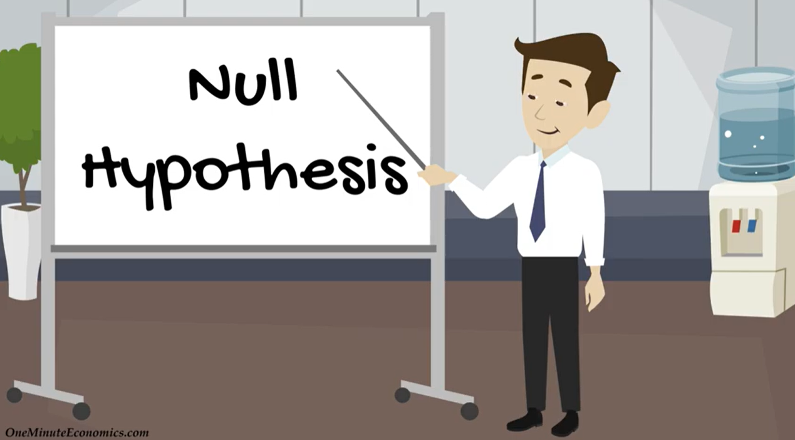
Today’s Video: P-Value and the Null Hypothesis
https://www.youtube.com/watch?v=nb75_GFPD9A

Slide 3
Dataset for Class Today
Excel Spreadsheet: https://brandtredd.org/files/IS201/BI-Exam-Practice.xlsx or LearningSuite – Content – Data Sets – BI Exam Practice Spreadsheet

Slide 4

Online Meeting Reminders
Mute your mic when not speaking.
Use the Zoom Chat Box for asking questions.
Use the Participants box to “raise your hand” and give feedback.
Lectures are recorded and will be posted shortly after each class period.
Add a photo to your Zoom profile.
Turning your camera on is optional but nice to have.
Fill out the “How was class today?” survey.
Learning Suite – Content – Polls – “How was class today?”

Slide 5
Announcements
Statistics HW Due today!
It will be good preparation for the exam, about half of which is statistics.
Digital Dialog
I had failed to make the discussions available. That has been fixed.
Two messages so far. Hopefully more to come.
Get your domain name ASAP. We’ll start building websites next week!
Details are in the LearningSuite Schedule
Video instructions are at the beginning of MyEducator 6.6
You’ll get a bunch of spam email offering to help you build your website. Ignore them. They will dissipate in 2-3 days.
Exam due on Saturday.
Assignments due at 11:59pm MOUNTAIN TIME.
Next week we start on Web Development

Slide 6
Exam Summary
Online, Two Hours. Better to submit incomplete than to go over time.
Immediately upon starting, download the Excel spreadsheet on which most of the questions will depend.
Four analysis tasks. In each case, perform the task, save the result in the spreadsheet and answer the associated questions.
At the end of the exam, upload the spreadsheet as evidence of your work.
From the 5.6 description
Includes: Excel Solver, Excel Statistics including Correlation, t-test, ANOVA, Regression
Includes: BI Stack questions
Does not include: Tableau charts, dashboard, or multiple regression prediction.
“Assume a 95% confidence level when considering statistical significance.”
What does this mean for a P-Value? It should be less than 0.05.

Slide 7
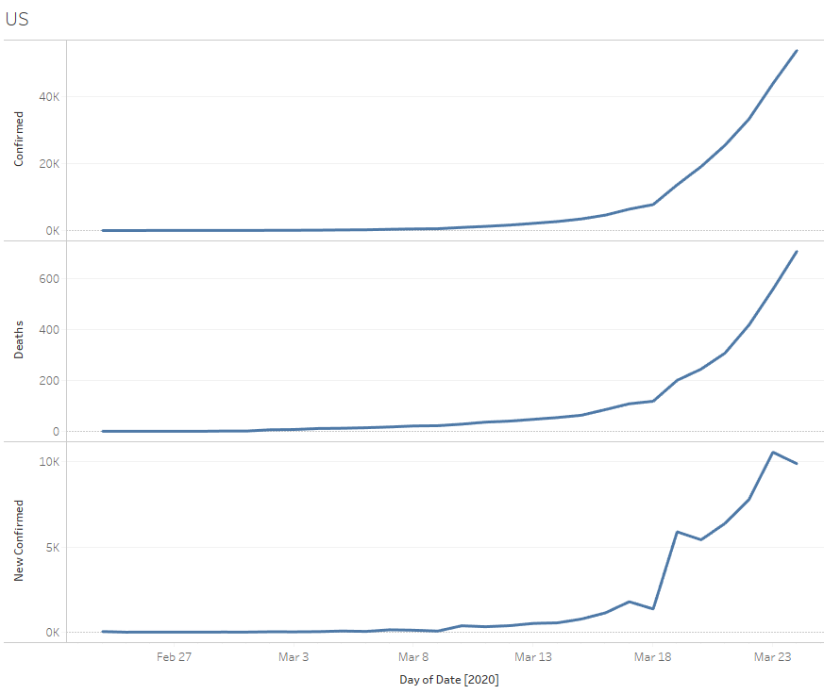
COVID-19 Data Update
https://brandtredd.org/files/IS201/COVID-19-data

Slide 8
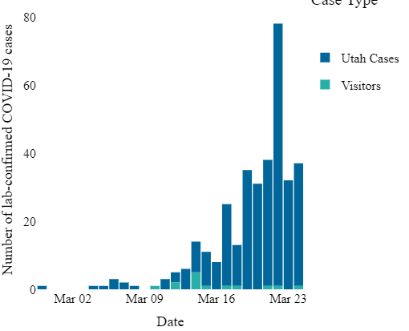
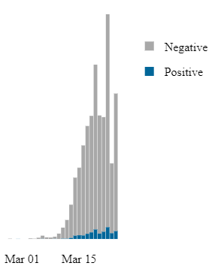
Utah COVID-19
New Cases
Tests Performed
https://coronavirus.utah.gov/case-counts/

Slide 9
Statistics Review
BI-Exam-Practice.xlsx in Excel (find it in LearningSuite – Content – Data Sets)
Solver
Correlation
Regression
ANOVA
ttest

Slide 10
BI Statistics Summary
You may not remember exactly how to do these things but if you remember the following, you’ll be able to find instructions on the web.
To optimize one outcome with several input variables use Solver.
To estimate the relationship between two variables, calculate the correlation using either a Correlation Table (from Data Analysis) or, if you only have two variables, the CORREL() function.
To test whether the relationship between a Categorical Variable and a numeric variable is statistically significant use ANOVA (from Data Analysis)
To calculate the probability that differences between pairs of categorical values are statistically significant, calculate the t-statistic p-value using the TTEST() function
To estimate the effect of several variables, do a Regression (from Data Analysis)

Slide 11
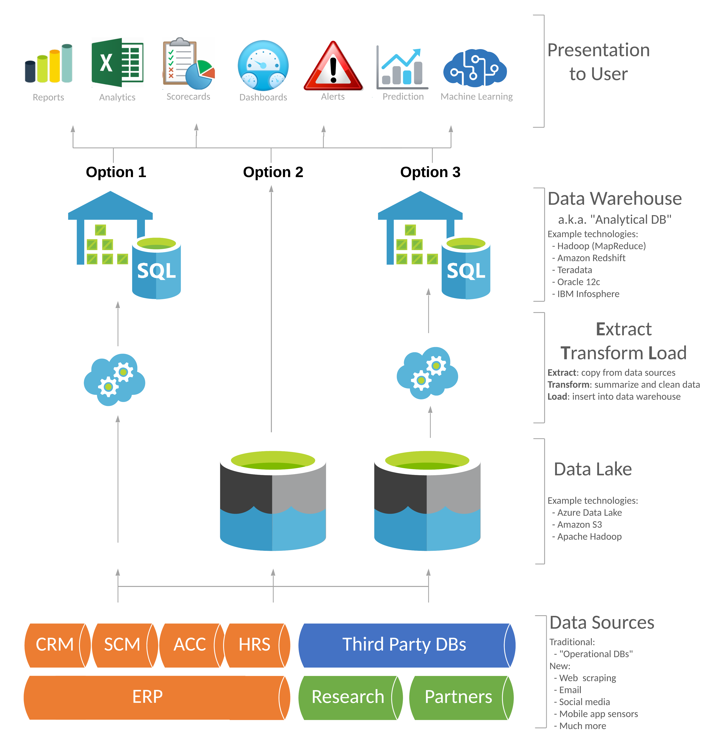
BI Stack Review
What are the data sources?
What function does ETL accomplish?
How would you identify the Key Influencers for your business?
What are Key Performance Indicators (KPIs) and how are they distinct from Key Influencers?
What makes for a good measure?

Slide 12
Exam Prep Recommendations
Re-read chapter 5.1
Practice 1-2 Solver problems.
Do a correlation and regression analysis – preferably on the same data set.
Use the data set from this review or one from MyEducator
Do an ANOVA analysis on categorical data
Use the TTEST function to compare two categories in categorical data
Stay safe from COVID-19:
Practice #PhysicalDistancing with #SocialClosening
Wash hands (a lot!)
Don’t touch your face, especially if you’ve been in public areas.

