Slide 1
Our Last Class Together
2020-04-13 – IS201 - Prof Redd
“When we have conquered this﻿—and we will﻿—may we be equally committed to freeing the world from the virus of hunger, freeing neighborhoods and nations from the virus of poverty. May we hope for schools where students are taught﻿—not terrified they will be shot﻿—and for the gift of personal dignity for every child of God, unmarred by any form of racial, ethnic, or religious prejudice.” - Elder Jeffrey R. Holland – April 2020 General Conference, Sunday Morning Session.

Slide 2
Announcements
Digital Dialog
Will remain open until after your final projects are due.
A few have participated. Contributions count toward extra credit.
Web Development Final Project
Due Date: This Saturday, April 18
No Extensions or Exceptions are possible as that is the scheduled date of your final exam.
Accounts for 15% of your final grade.

Slide 3
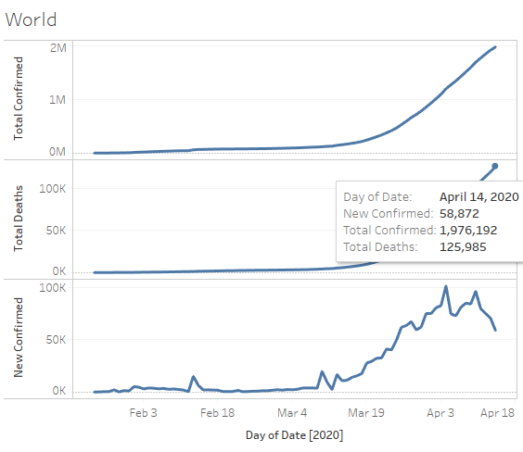
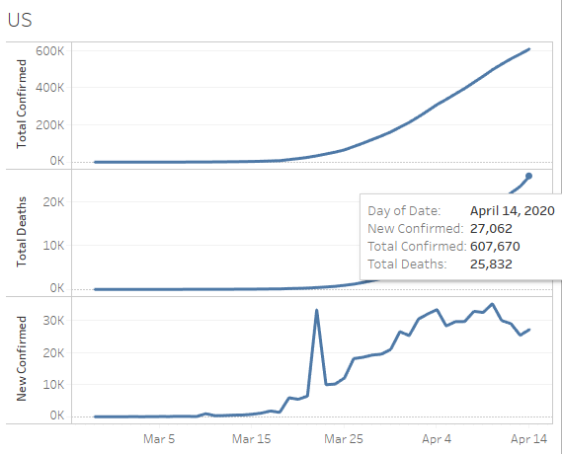
COVID-19 Data Update
https://brandtredd.org/COVID-19

Slide 4
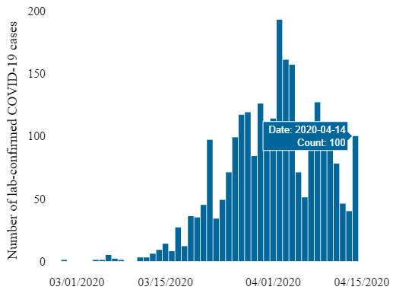
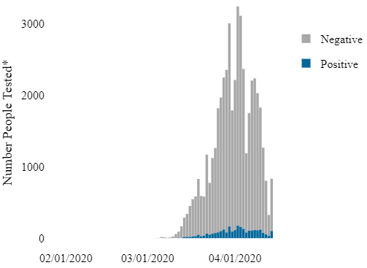
Utah COVID-19
State of Utah
New Cases
Number Tested
https://coronavirus.utah.gov/case-counts/

Slide 5
Agenda
A Little More on the Walkthrough
Image with Alt Text
Ordered List
Unordered List
Contact Information on Resume
Absolute vs Flow Positioning (Tableau Page)
Anything you want me to demonstrate for your Final Project
Working with GitHub and GitHub Pages

Slide 6
Staying Connected
Connect with me on LinkedIn: https://linkedin.com/in/brandtredd
Other connection options on my web page: https://brandtredd.org
Stay safe and well through the COVID-19 Crisis!!

