Slide 1

Tableau Forecast, Excel Solver
2020-03-18 – IS201 - Prof Redd

Slide 2
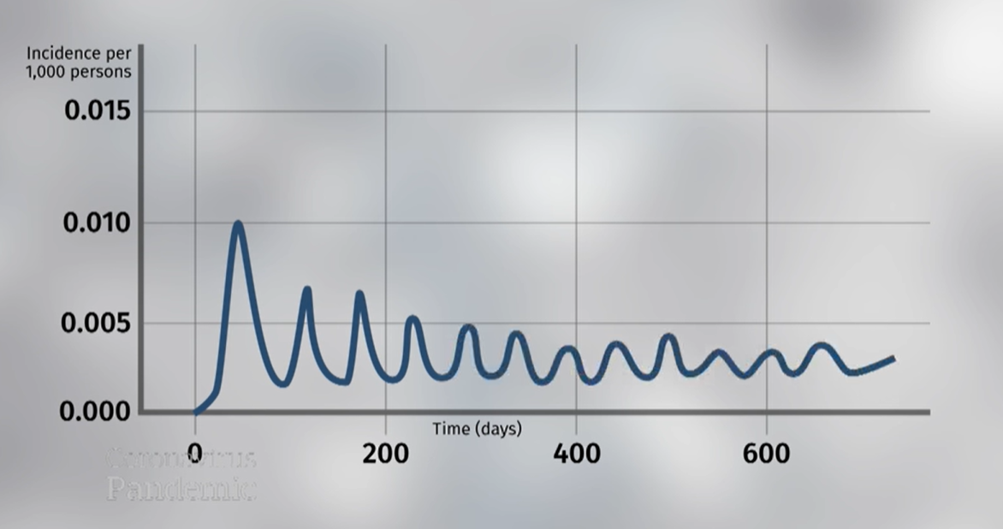
COVID-19: Modeling suggests we’re in it for the long haul
https://www.youtube.com/watch?v=M-0y3hmbDCI&start=156sdfsdfsd

Slide 3
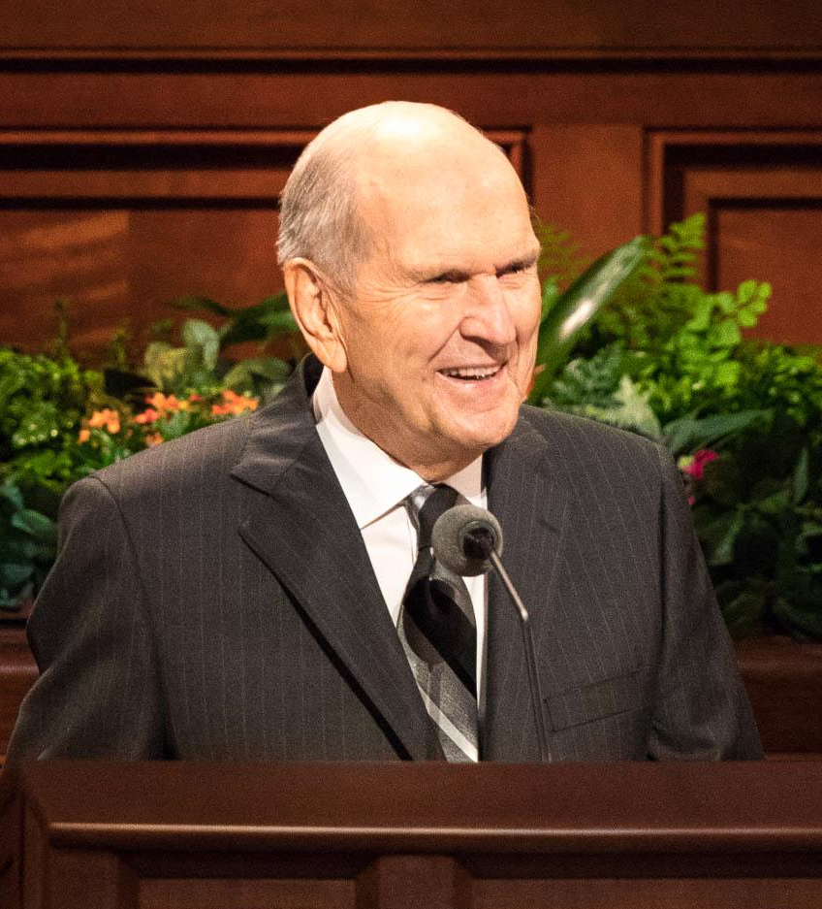
“These unique challenges will pass in due time.” -President Russel M. Nelson, “Message of Hope During COVID-19 Outbreak https://newsroom.churchofjesuschrist.org/article/president-nelson-message-covid-19
“The great latter-day work of which we are a part was established, on schedule, to bless a waiting and weeping world.” -President Russel. M. Nelson, “The Future of the Church: Preparing the World for the Savior’s Second Coming” (Ensign, April 2020 https://www.churchofjesuschrist.org/study/ensign/2020/04/the-future-of-the-church-preparing-the-world-for-the-saviors-second-coming

Slide 4
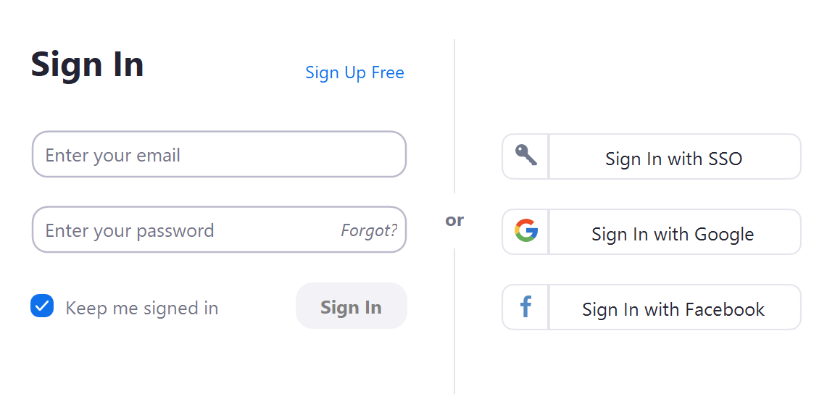
Zoom Preparation
Install Zoom (If you’re seeing this you have already done so.)
For your friends: https://zoom.us/downloads
Run zoom and create your own account.
Creating an account is not required. But it will automatically make your name and, optionally, a photo available to other participants. That’s really helpful to your instructor.
You can sign in with Google or Facebook but I don’t recommend it. Best to segment your accounts to preserve some degree of privacy.
You can “Sign in with SSO” and use your BYU ID.
You can “Sign up for Free” and use your email and a password.

Slide 5
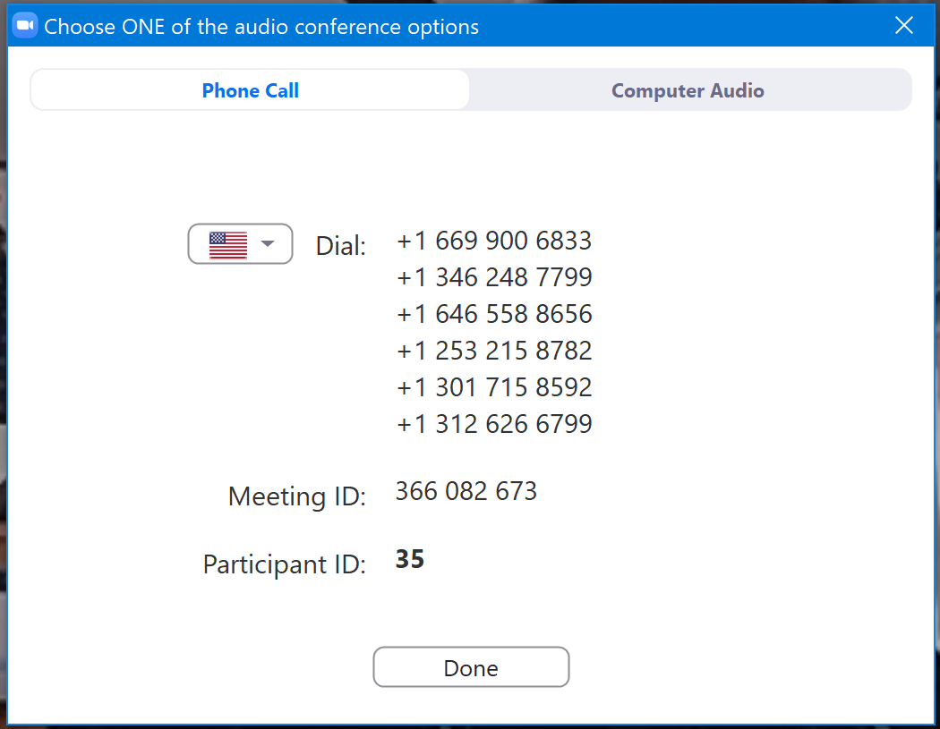
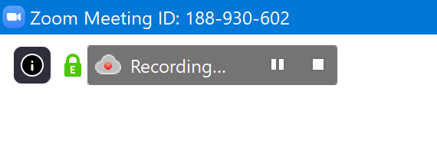
Zoom Meetings: Basics
Click the link to join a meeting
E.g. https://byu.zoom.us/j/188930602
Video
Turning on your camera is optional. If you turn it on, everyone can see you.
Audio:
You can use the computer or dial in by phone.
If you have a slower internet connection, phone will be a better choice.
Mute yourself when you are not talking so that background noise doesn’t bother other participants.
Some meetings, like this one, will mute you automatically when you join. You will have to unmute before you can talk.
Recordings:
Some meetings will be recorded.
Anything you say or put into the chat will be included in the recording.
You can tell if recording is on by looking for this in the upper-left:

Slide 6
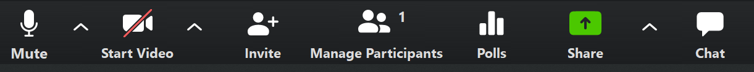
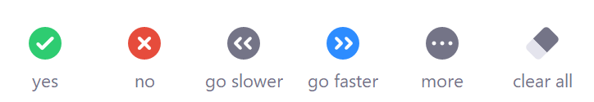
Zoom Meetings: Your Controls
Mute: Turns on and off your microphone.
(Start/Stop) Video: Turns on and off your camera.
Participants: Let’s you see who else is in the class. Also displays the icons you can use to send feedback:
Polls: The instructor may use this feature to gather live feedback from the class.
Share: Lets you share your screen with other participants. Typically only the instructor will do this.
Leave/End Meeting: Hang up when the meeting is over or when you need to leave.

Slide 7

Zoom Meetings: Participation
Click the “Chat” icon to open the chat box.
The best way to ask questions is to type them into the chat.
Participants
Click the participants icon to see who else is in the class, to see their icons, and to set your own.

Slide 8
Announcements
Details are in your email and on LearningSuite
Classes will be at the same time – only online instead of in-person.
Connection info is in LearningSuite – Content – Online Classes with Zoom
Classes will be recorded with links to the recordings in LearningSuite – Content – Slides, Videos, and Lecture Notes
TA Lab has also moved online. See LearningSuite – Content – TA Help for details
Tableau Project (5.3) due date has been moved to Friday. All other due dates are unchanged. Please contact me if you have any concerns.
Office hours remain online and at the same schedule, but they have changed to Zoom instead of Google Hangouts. See LearningSuite – Content – Office Hours
Digital Dialog – I will be encouraging more use as we are no longer in person.
“How Was Class Today?” Poll – New Question about your connectivity. Please respond!

Slide 9
Tableau – COVID-19 Analysis and Forecast
Dataset: https://brandtredd.org/files/IS201/COVID-19-data
Also in LearningSuite – Content – Data Sets

Slide 10
Excel Solver
Glossary
Objective Function
Decision Variables
Constraints
Example
TP-R-Us

