Slide 1
Descriptive Analysis with Tableau
IS201 – 2020-03-11 - Prof Redd

Slide 2
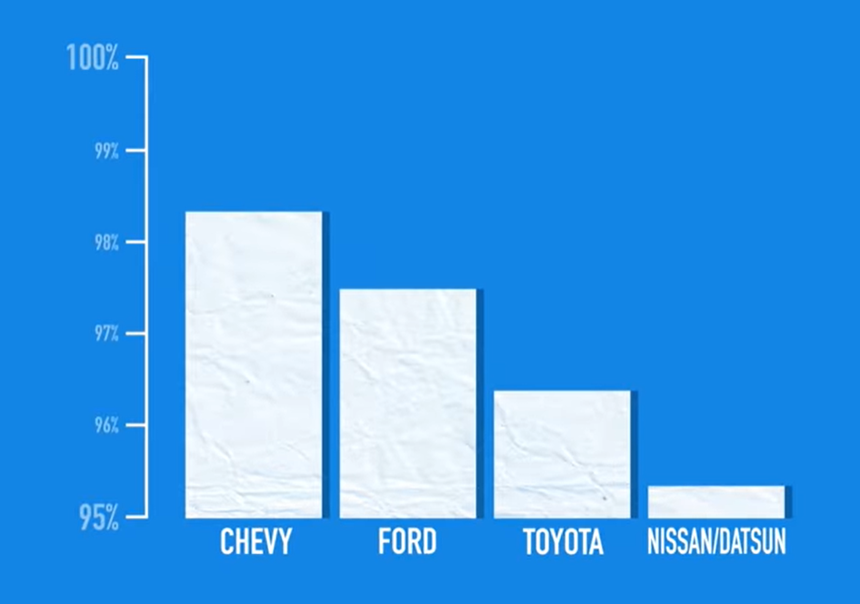
Misleading Graphs
How to Spot a Misleading Graph https://www.youtube.com/watch?v=E91bGT9BjYk

Slide 3
Coming Up!
Descriptive Analysis with Tableau (5.3) – Today and Monday, 3/16
Business Optimization with Excel Solver (5.5) - Wednesday, 3/18
Predictive Analysis with Excel and Basic Stats (5.4) - Monday, 3/23
Exam Review and Special Topics in Business Intelligence - Wednesday, 3/25
BI Midterm - Due Saturday, 3/28

Slide 4
COVID-19 – Coronavirus
So far, BYU is continuing classes as normal.
General Conference will be exclusively on TV and online
https://newsroom.churchofjesuschrist.org/article/april-2020-general-conference-format-change
Limited threat in Provo but that will likely change.
Do the following:
Wash hands frequently
Use hand sanitizer
Use (and tolerate) alternatives to shaking hands
Don’t touch your face if your hands haven’t been washed or sanitized
Have a 14-day supply of food and necessities in case you get sick
If it gets worse in Provo
Class will move online to Zoom
See https://www.byu.edu/coronavirus for the latest from BYU

Slide 5
Get a Domain Name!
This will be where your website from the next unit lives.
BYU will register one domain for you free of charge.
Registering a domain on another registrar (e.g. GoDaddy.com, Namecheap.com, Domain.com) costs between $9 and $15 for the first year and $22 to $25 for subsequent years.
It will be an independent domain, NOT a derivative of byu.edu.
Go to https://domains.byu.edu.
A sampling of the 28 domains I own: brandtredd.org, ofthat.com, edmatrix.org, thatwhichunites.us, redd.org, filemeta.org, provoflats.com

Slide 6

BI Midterm
20 Questions, 1 Excel Workbook Turn-In
Optimization with Solver – 6 multiple-choice questions based on 2 prompts
Predictive Analytics with Excel - 9 multiple-choice questions based on 2 prompts
The BI Stack – 5 multiple-choice questions
The workbook itself will not be graded (used as proof of completion)
No Tableau questions – Tableau is strictly homework.

Slide 7
BI Unit Summary
The BI Stack (5.1)
Descriptive Analysis with Excel PivotTables and Charts (5.2)
Skipped because that’s covered in IS 110. Worthy of review, but not on the exam.
Descriptive Analysis with Tableau (5.3)
Business Optimization with Excel Solver (5.5)
Predictive Analysis with Excel – Basic Statistics (5.4)
Correlation, Regression, Variance, p-Value, etc.

Slide 8
Tableau Examples
Getting to Know You Data Set: LearningSuite – Content – Data Sets
Kickstarter Data Set: MyEducator – 5.3 – Kickstarter Campaigns Practice Data

