Slide 1
Web Development HTML with CSS
2020-04-01 – IS201 - Prof Redd
To follow along in today’s lesson, download and unpack the base website from Monday
https://brandtredd.org/files/IS201/BollardSample.zip
Or: Learning Suite – Content – Slides, Videos, and Lecture Notes
“These unique challenges will pass in due time.” -President Russel M. Nelson, “Message of Hope During COVID-19 Outbreak https://newsroom.churchofjesuschrist.org/article/president-nelson-message-covid-19

Slide 2
Announcements (Mostly Repeats)
Digital Dialog
Share your website ideas there.
Get your domain name ASAP.
Details are in the LearningSuite Schedule
Only two more assignments
WebDev Walkthrough – Due Wednesday, April 8
Web Development Final Project – Due April 15
Get started well before April 8
The final project is also your final exam!
Accounts for 15% of your final grade.
The assignment is to build a personal resume site. If you want to do some other, professional, site. Please get my permission in advance.

Slide 3
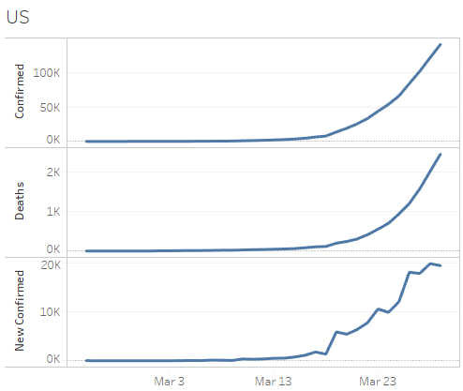
COVID-19 Data Update
https://brandtredd.org/files/IS201/COVID-19-data

Slide 4
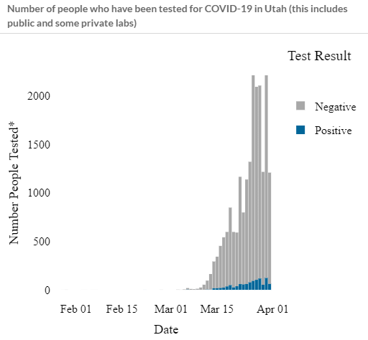
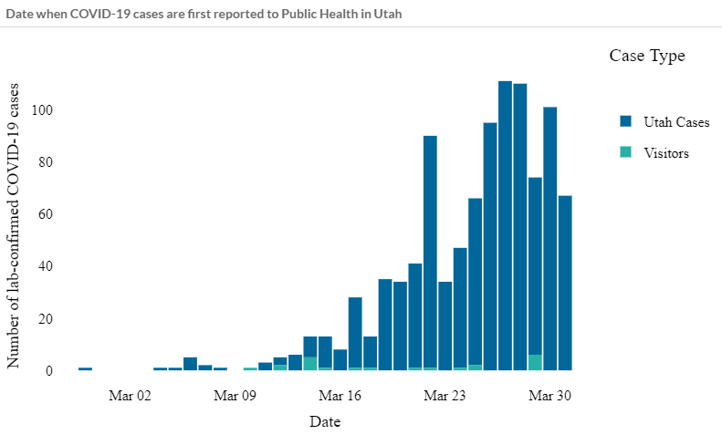
Utah COVID-19
New Cases
Tests Performed
https://coronavirus.utah.gov/case-counts/

Slide 5
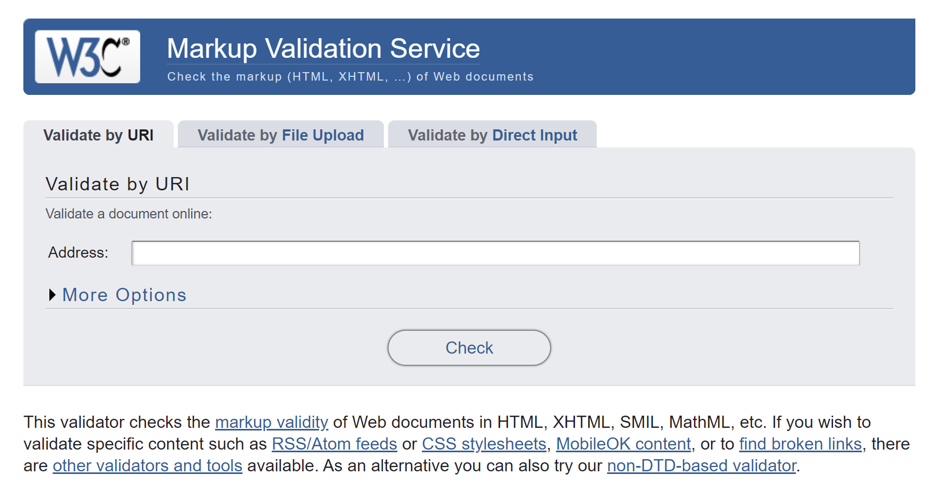
Webpage Validation:
https://validator.w3.org

Slide 6
HTML Tags
Visual Markup
<b> (bold)
<i> (italic)
<u> (underline)
<br/> (line break)
<sup> (superscript)
<center>
<table>
<s> (strikethrough)
<small>
Semantic Markup
<h1> <h8> (headings)
<header>
<footer>
<main>
<article>
<p> (paragraph)
<q> (quotation)
<blockquote>
<code>
<em>, <strong>
<ul>, <li>
Functional Markup
<div>
<span>
<img src="" alt="">
<a href="“>
<audio>
<video>
A good HTML Reference is at: https://www.w3schools.com/tags/default.asp

Slide 7
Stylesheet Elements
font-family:
font-size:
font-weight:
font-style:
font: (all of the above)
color
text-align: (right, left, center)
text-decoration: (underline)
padding:
margin:
border:
background-color:
background-image:
background-repeat:
background-position
A good CSS Reference is at: https://www.w3schools.com/cssref/default.asp

