Slide 1
SQL – Part 2 Structured Query Language
IS201 - 27 Jan 2020

Slide 2

Exploits of a Mom
Credit: Randall Munroe XKCD https://www.xkcd.com/327/

Slide 3
SQL Injection Attack
Name:
Robert
Name:
Robert’); Drop Table St
Birthdate:
2003-11-17
Birthdate:
2003-11-17
SELECT * FROM users
WHERE name = ‘Robert’
AND birthdate = ‘2003-11-17’
SELECT * FROM users
WHERE name = ‘Robert’);
DROP TABLE Students;--’ AND birthdate = ‘2003-11-17

Slide 4
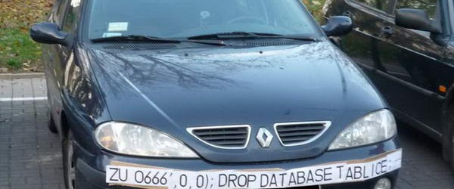


Slide 5
Announcements (Mostly Repeats)
No Homework or Quiz Due Today
Do the whole Lesson 3.3 – spend some time on it!
SQL Project Due Friday
Start early. This will take you hours and you will probably need help from the TAs.
Midterm on Data Storage and Extraction due Saturday (all of this info is in MyEducator)
A Big one – you have 2 hours 30 minutes to complete
Data Quality: 6 Questions, 24 points
ERDs: 8 Questions, 32 points
SQL Multiple Choice: 8 Questions, 32 points
SQL Skills (written): 9 Questions, 72 points
150 minutes / 31 questions = 4.8 minutes per question. SQL will take longer than multiple choice.
Do the “How Was Class Today” survey!

Slide 6
Some Datasets
https://data.world/jamesgaskin/movies
https://data.world/bredd/gettingtoknowyou
https://data.world/bredd/numbers
National Center for Education Statistics: https://nces.ed.gov/
See Learning Suite – Content – Data Sets

