Slide 1
Job Salaries of Data Positions
BAX-421 Final Project
Yuqing (Brandy) Huang
Notes:
Welcome to my presentation, my topic: data set is job salaries of data positions in the world

Slide 2

Question1: What are the total salaries paid by each company size (small, medium, large) across different countries?
Only show those have all three company sizes
From countries: developed countries
From company size: medium > large > small (percentage of medium companies might be higher)
Notes:
Filter out those with all company sizes(which are small, medium and large)
Choose top 5 salaries paid countries to do this comparison
We can see that 4 of them are developed countries
Right hand site: is a chart
Total salaries in medium company size is basically higher in the first four countries, indicate countries has more medium size companies

Slide 3
Question2: Which job titles have the highest average salaries for employees working fully remotely (remote_ratio = 100)?
For better comparison, filter remote rate = 100, which means totally work from home
Use average to generalize each job position group
Related to job level and exact position
Notes:
Remote—salaries
Generalize
Show top 5

Slide 4
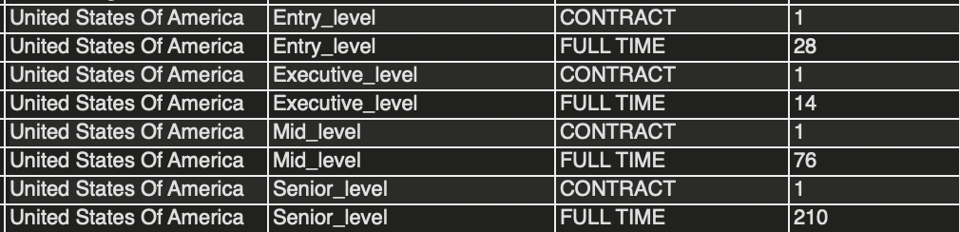
Question3: What is the distribution of employment types (full-time, part-time, etc.) in different experience levels across various countries?
Basically full-time or contract workers
Each experience level is represented
Country representative:
US
Notes:
Basically, less freelance and part time worker
Use US as an example--have all types of employee levels
Again, basically full time and contract and out of these two employment types, full time has larger amount.

Slide 5

Question4: What is the average exchange rate of salary currencies to USD for each year in the currency_exchange table, and how does it vary across time?
The exchange rate increased by around 0.3 generally from 2020-2022
Trend: Devaluation of US dollar
Covid-19 period
Inflation accelerated in 2021 and 2022
Increased Government Spending and Fiscal Stimulus
Notes:
Ask about the currency value issue.

Slide 6
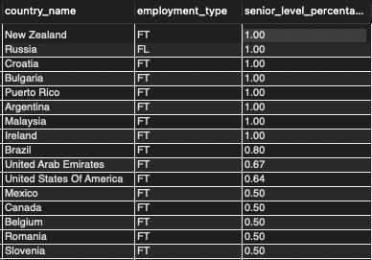
Question5: For each country, which employment type has the highest percentage of senior-level employees (experience_level = 'SE')?
Full-time jobs
Some achieve 100%
Notes:
Filter those whose percentage is larger than 0.5
Apart from russia has freelance worker, all the others are full time
Data issue?

Slide 7
Question6: What are the top 5 job titles with the highest salaries in companies?
Related to job levels(Lead/principle/director)
Data scientist/analyst/engineer
Notes:
Basically the same as questions 2, but do not consider remote rate any more.
Similar result

Slide 8
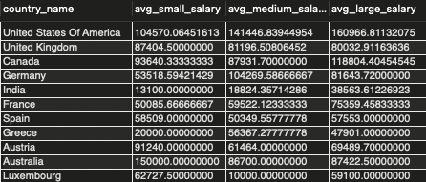
Question7: Which country has the most diverse company sizes (small, medium, large) and what are the average salaries for each size within that country?
The data is ordered by number of distinct company sizes and number of each sizes
US is the country that most diverse
Most are western developed countries

Slide 9
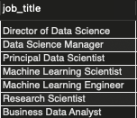
Question8: Identify the job titles that consistently appear in the top 10 highest-paying jobs based on work_year?
7 out of 10 consistently appear
Machine learning related job opportunities
Notes:
7 jobs consistently appear in 3 years
There are two new job name that appear so far, which are machine learning scientist and machine learning engineer, so it may be a trend of the data postions

Slide 10
Take Away
US is the one has most diverse data positions
Machine learning related positions might be some new high-paid jobs
Generally, US is also the one pay highest salaries among all other countries
Risk: US currency USD is facing a devaluation situation, so for international workers, high salaries does not mean high value

