Slide 1


App Trader Project
Group
SELECT socks, sandals
FROM dads_closet;

Slide 2
Considerations
2
3
4
1
App in Both Stores
Purchase Price
Rating/Lifespan
Review Count

Slide 3
Recommended Top 10 Apps
 | App Name | Average Rating | Review Count
1 | PewDiePie's Tuber Simulator | 4.9 | 1590317
2 | Domino's Pizza USA | 4.9 | 1291559
3 | Egg, Inc. | 4.9 | 659234
4 | The Guardian | 4.9 | 256168
5 | ASOS | 4.9 | 191536
6 | Geometry Dash Lite | 4.8 | 6552010
7 | Fernanfloo | 4.7 | 529481
8 | Clash of Clans | 4.6 | 47020500
9 | Clash Royale | 4.6 | 23399496
10 | Shadow Fight 2 | 4.6 | 11079662

Slide 4
Lowest Ranking Apps by Considerations
App Name | Net Profit | Higher Price
AnatomyMapp | -69900 | 14.99
Baldur's Gate: Enhanced Edition | -9900 | 9.99
FINAL FANTASY V | -49900 | 14.99
Muscle Premium - Human Anatomy, Kinesiology, Bones | -159900 | 24.99
XCOMÂ®: Enemy Within | -9900 | 9.99

Slide 5
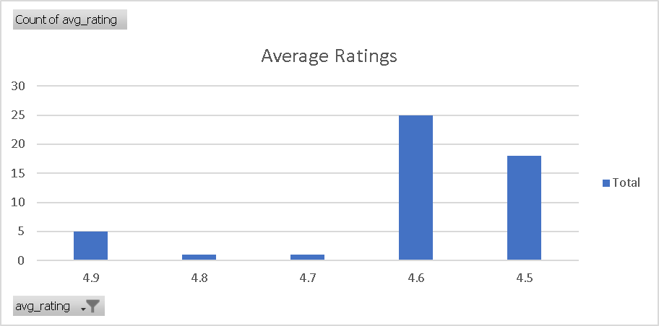
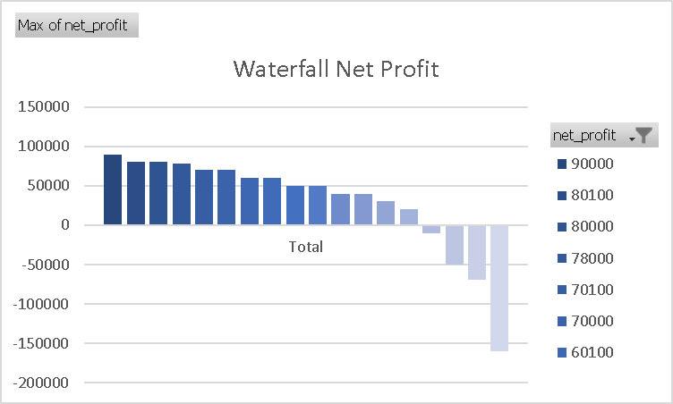
Range of Profits and Ratings

Slide 6
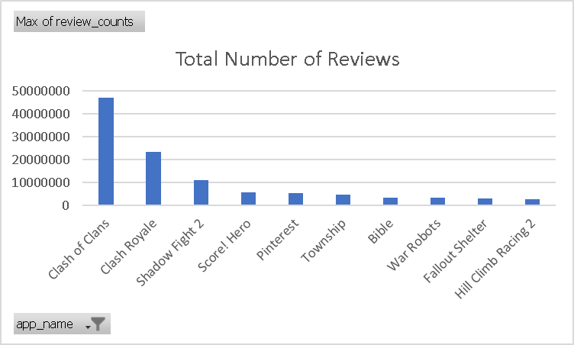
Tie Breaker

Slide 7
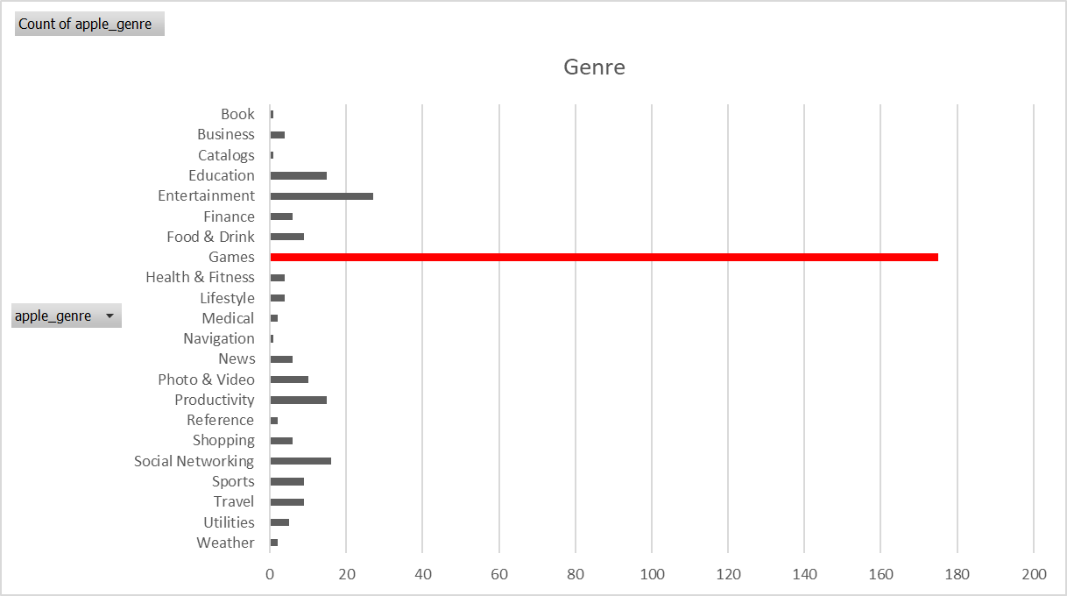
Games by and far outpaced any other genre of app

Slide 8
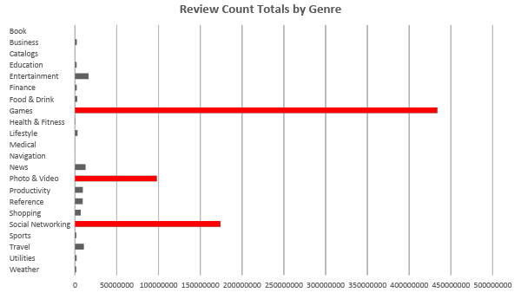
People who leave reviews tend to have strong negative or positive opinions

Slide 9
Recommended Top 10 Apps
 | App Name | Average Rating | Review Count
1 | PewDiePie's Tuber Simulator | 4.9 | 1590317
2 | Domino's Pizza USA | 4.9 | 1291559
3 | Egg, Inc. | 4.9 | 659234
4 | The Guardian | 4.9 | 256168
5 | ASOS | 4.9 | 191536
6 | Geometry Dash Lite | 4.8 | 6552010
7 | Fernanfloo | 4.7 | 529481
8 | Clash of Clans | 4.6 | 47020500
9 | Clash Royale | 4.6 | 23399496
10 | Shadow Fight 2 | 4.6 | 11079662

