Slide 1
Challenge!

Slide 2
Overview
General Challenge Tasks utilizing all the skills you’ve learned so far!
Hints to the challenge
Solution to the challenge
Challenges are going to be difficult, so try breaking down the problem into individual tasks!

Slide 3
Challenge
How many payment transactions were greater than $5.00?
Ans : count = 3618

Slide 4
Hints
You will need to use the payment table
You will also need to use COUNT and WHERE along with some comparison operator

Slide 5
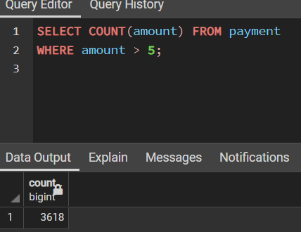
SOLUTION
SELECT COUNT(amount) FROM payment
WHERE amount > 5;

Slide 6
Challenge
How many actors have a first name that starts with the letter P?

Slide 7
Hints
You will need to use the actor table
You will also need to use LIKE and a wildcard operator, such as % or _

Slide 8
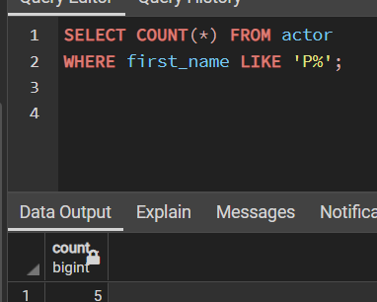
SOLUTION
SELECT COUNT(*) FROM actor
WHERE first_name LIKE 'P%';

Slide 9
Challenge
How many unique districts are our customers from?

Slide 10
Hints
You will need to use the address table
You will also need to use COUNT and DISTINCT

Slide 11
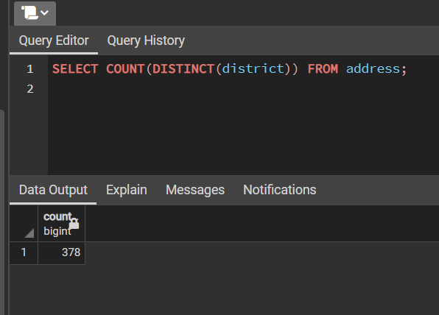
SOLUTION
SELECT COUNT(DISTINCT(district))
FROM address;

Slide 12
Challenge
Retrieve the list of names for those distinct districts from the previous question.

Slide 13
Hints
You will again need to use the address table
This will be very similar to the previous challenge

Slide 14
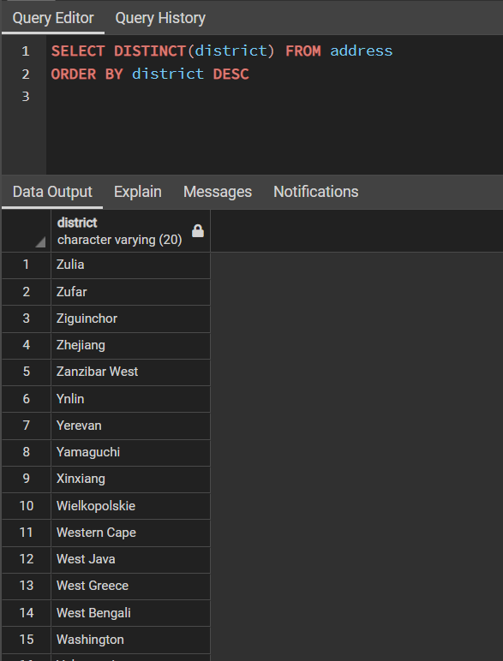
SOLUTION
SELECT DISTINCT(district) FROM address;

Slide 15
Challenge
How many films have a rating of R and a replacement cost between $5 and $15?

Slide 16
Hints
You will need to use the film table.
You may also need to use BETWEEN and a WHERE statement with a comparison operator.

Slide 17
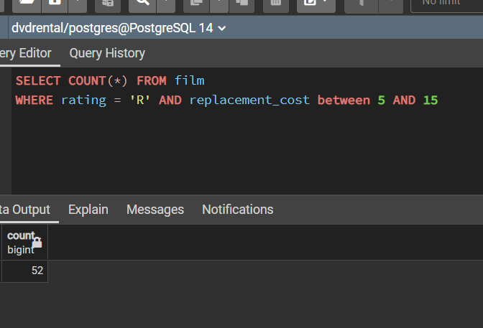
SOLUTION
SELECT COUNT(*) FROM film
WHERE rating = 'R'
AND replacement_cost BETWEEN 5 AND 15;

Slide 18
Challenge
How many films have the word Truman somewhere in the title?

Slide 19
Hints
You will need to use the film table
You will also need to use LIKE with a wildcard operator

Slide 20
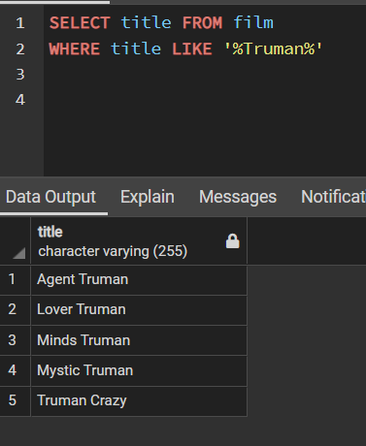
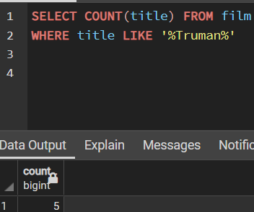
SOLUTION
SELECT COUNT(*) FROM film
WHERE title LIKE '%Truman%';

Slide 21
Great job!
Let’s go learn some more!

