Slide 1
Advanced PHP Programming
eCommerce

Slide 2
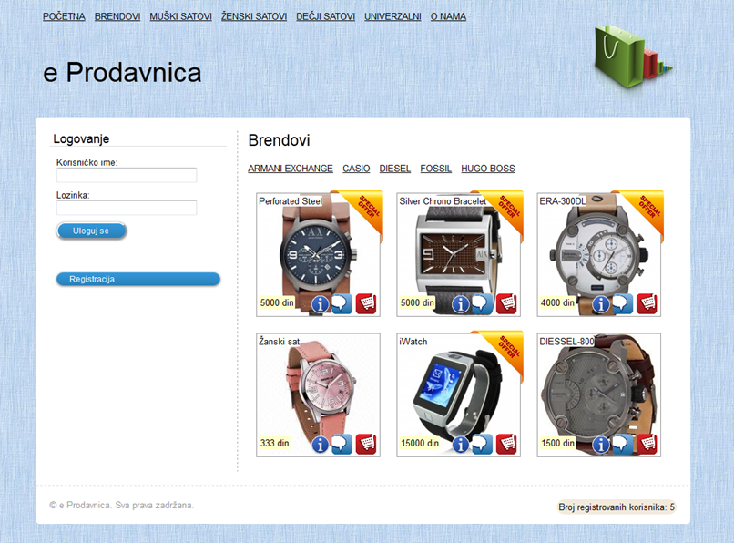

Slide 3
DB - Tables
articles
article_id | article_name | article_price | article_lager | article_type | article_action | article_description | brend_id
users
user_id | username | password | first_name | last_name | email | active
brends
brend_id | brend_name | brend_description
comments
comment_id | user_id | article_id | comment | time
carts
cart_id | article_id | user_id | cart_user_status | cart_admin_status | cart_code

Slide 4
DB - Views
cart_code
cart_code
CREATE VIEW test AS SELECT DISTINCT cart_code FROM carts
closed_cart_code
cart_code
CREATE VIEW test AS SELECT DISTINCT
cart_code FROM carts WHERE cart_admin_status = 0
AND cart_user_status = 1
brends
cart_code
CREATE VIEW test AS SELECT DISTINCT
cart_code FROM carts WHERE cart_admin_status = 1

Slide 5
Veze
carts
users
articles
brends
comments

Slide 6

PDO - Uvod
Mogi PHP programeri najpre nauče da pristupaju bazi podataka uz pomoć MySQL ili MySQLi ekstenzija. Od PHP 5.1, postoji nešto bolji način za to. PHP Data Objects (PDO) obezbeđuje metode za pripremu uzjava i rad sa objektima.
Jednostavnom izmenom connection stringa promena baze podataka postaje jednostavnija i brža jer PDO obezbeđuje lak pristup većem broju baza podataka.

Slide 7
PDO – Database support
PDO_DBLIB ( FreeTDS / Microsoft SQL Server / Sybase )
PDO_FIREBIRD ( Firebird/Interbase 6 )
PDO_IBM ( IBM DB2 )
PDO_INFORMIX ( IBM Informix Dynamic Server )
PDO_MYSQL ( MySQL 3.x/4.x/5.x )
PDO_OCI ( Oracle Call Interface )
PDO_ODBC ( ODBC v3 (IBM DB2, unixODBC and win32 ODBC) )
PDO_PGSQL ( PostgreSQL )
PDO_SQLITE ( SQLite 3 and SQLite 2 )
PDO_4D ( 4D )
Provera driver-a za baze podataka:
print_r(PDO::getAvailableDrivers());

Slide 8
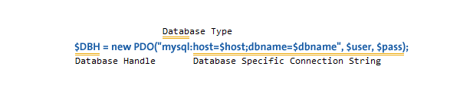
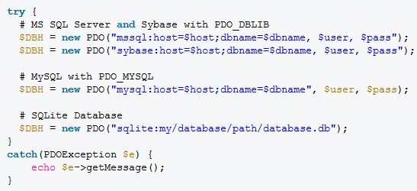
PDO - Connection
Zatvaranje konekcije: $DBH = null;

Slide 9

PDO – Insert and Update
Upisivanje novih ili editovanje postojećih podataka u bazi jedan je od najcešćih zahteva pri radu sa bazom podataka. Korišćenjem PDO ekstenzije ovaj proces se uobičajeno sastoji od 2 koraka. Situacija je ista i za INSERT i za UPDATE.
# STH means "Statement Handle"
$STH = $DBH->prepare("INSERT INTO table_name ( first_name ) VALUES ( ‘Thomas' )");
$STH->execute();

Slide 10
PDO – Prepared Statements
Korišćenje pripremljenih izjava pomaže zaštiti od SQL injection-a.
Pripremljene izjave su prekompilovane SQL izjave koje se mogu pozivati više puta. Dodavanje podataka smešta se u placeholdere koji štite od SQL injection napada.
Postoje imenovani i neimenovani placeholderi.

Slide 11
PDO – Prepared Statements
# no placeholders – Izbegavati!
$STH = $DBH->("INSERT INTO users (name, addr, city) values ($name, $addr, $city)");
# unnamed placeholders
$STH = $DBH->("INSERT INTO users (name, addr, city) values (?, ?, ?);
# named placeholders
$STH = $DBH->("INSERT INTO users (name, addr, city) value (:name, :addr, :city)");

Slide 12
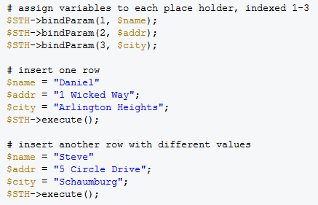

PDO – Unnamed (positional) placeholders

Slide 13
PDO – Named placeholders
$STH = $DBH->("INSERT INTO users (name, addr, city) value (:name, :addr, :city)");
$STH->execute($data);

Slide 14
PDO - obj
class person {
public $name;
public $addr;
public $city;
function __construct($n,$a,$c) {
$this->name = $n;
$this->addr = $a;
$this->city = $c;
}
}
$cathy = new person('Cathy','9 Dark and Twisty','Cardiff');
$STH = $DBH->("INSERT INTO users (name, addr, city) value (:name, :addr, :city)");
$STH->execute((array)$cathy);

Slide 15
PDO – fetch()
$STH = $DBH->query('SELECT name, addr, city FROM users');
# setting the fetch mode
$STH->setFetchMode(PDO::FETCH_ASSOC);
while($row = $STH->fetch()) {
echo $row['name'] . "\n";
echo $row['addr'] . "\n";
echo $row['city'] . "\n";
}

