Slide 1
Puppy Provenance
Final Database Project By:
Robert Hughes
Brannan Kovachev

Slide 2
Overview
‘Puppy Provenance’ is the start of a theoretical web app for a Dog Breeding Business.
The CRUD and integrated Database allow an Administrator to add Puppies to their inventory as needed.
Each Puppy’s list of relevant fields can be updated, barring those relevant to the primary key or otherwise logically immutable (such as gender). These fields are referenced in a few scenarios such as determining the Puppy’s price or finding the names of its parents.
Should it be desired to delete a Puppy from the table, whether it is due to an error on an immutable field or a real-world change in circumstances, the user can do this from the main Read page as well.

Slide 3
Overview Cont.
Notes on Adding a Puppy:
When adding a Puppy, user input determines a number of fields however some fields are purposefully set to NULL as the application makes the assumption that these fields are unknown. These fields are the eventual reserving client’s ID, whether they would like to license the Puppy, and whether the Puppy was delivered to them. However, these remaining fields can easily be updated by selecting the ‘Edit’ button on the relevant Puppy in the main table once the real world events have resolved themselves.
For Reference:
Brannan was responsible for the CR and Robert was responsible for the UD.

Slide 4
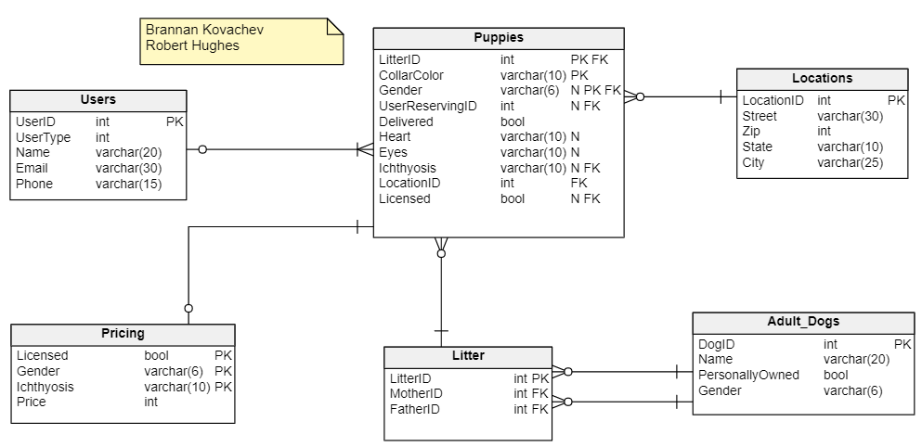
ERD

Slide 5
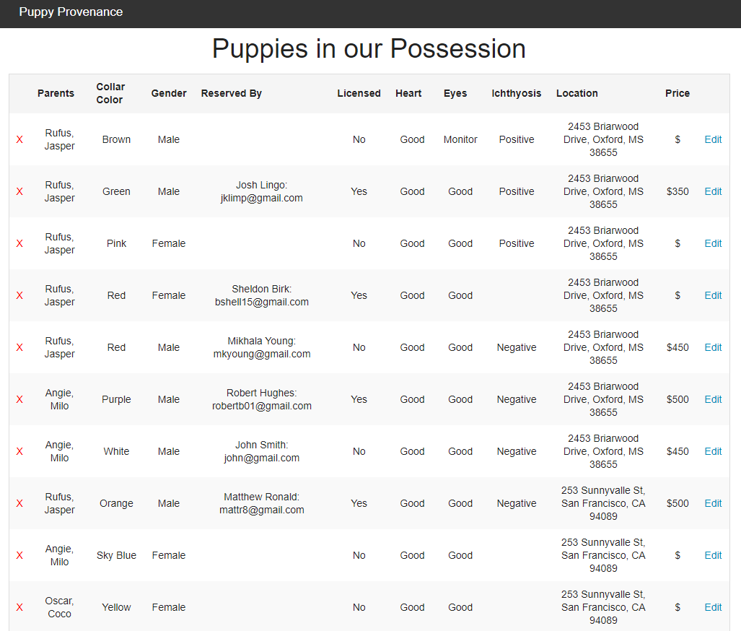
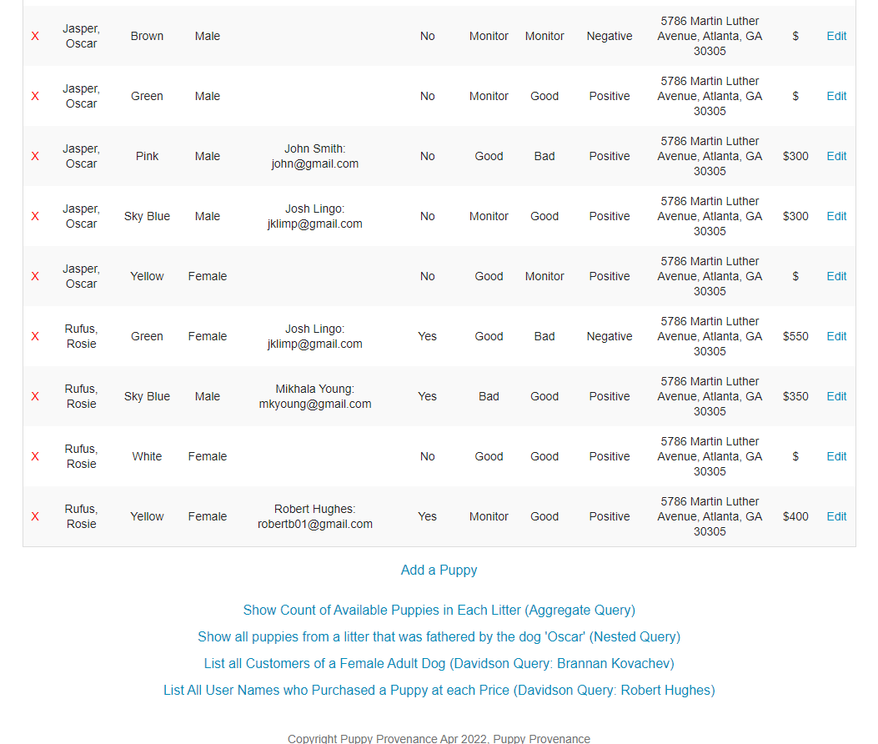
(a large number of additional rows exist in between these screenshots)
R in CRUD: Brannan Kovachev
https://turing.cs.olemiss.edu/~bekovach/FinalProject/puppyRead.php
Clickable Link

Slide 6
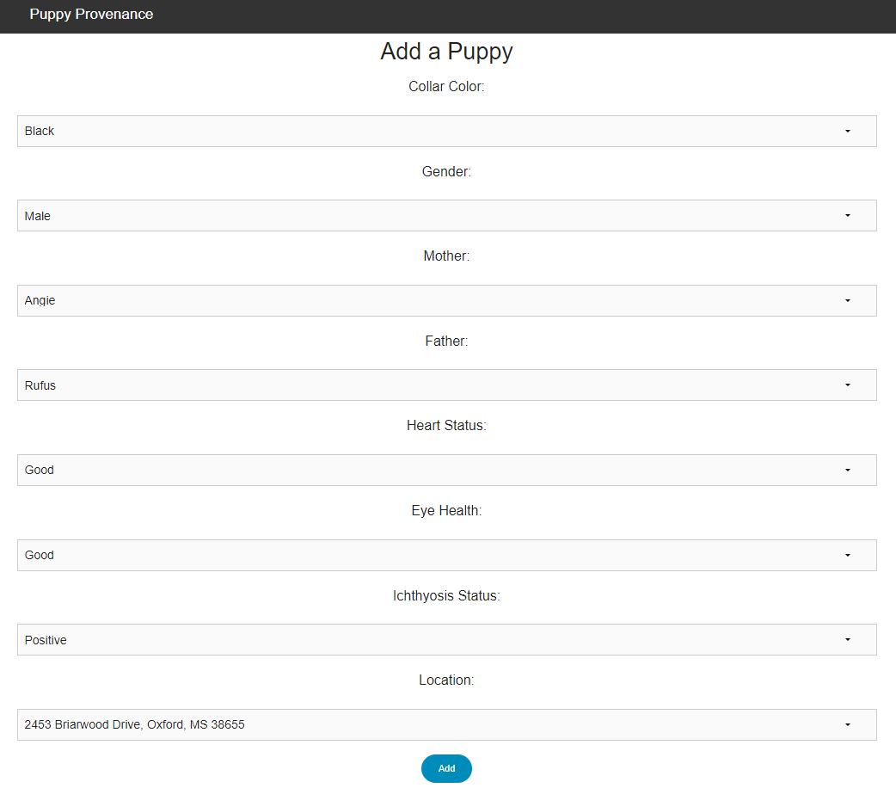
C in CRUD: Brannan Kovachev
https://turing.cs.olemiss.edu/~bekovach/FinalProject/puppyCreate.php
Clickable Link

Slide 7
While the Delete Page exists as a PHP file, it redirects back to the Read Page immediately after execution.
After the query is run, the user is shown a message stating whether it succeeded or not on the Read Page.
For clarity, a Puppy can be deleted by pressing the red X next to its name.
D in CRUD: Robert Hughes
https://turing.cs.olemiss.edu/~rbhughes/FinalProject/puppyRead.php
Clickable Link

Slide 8
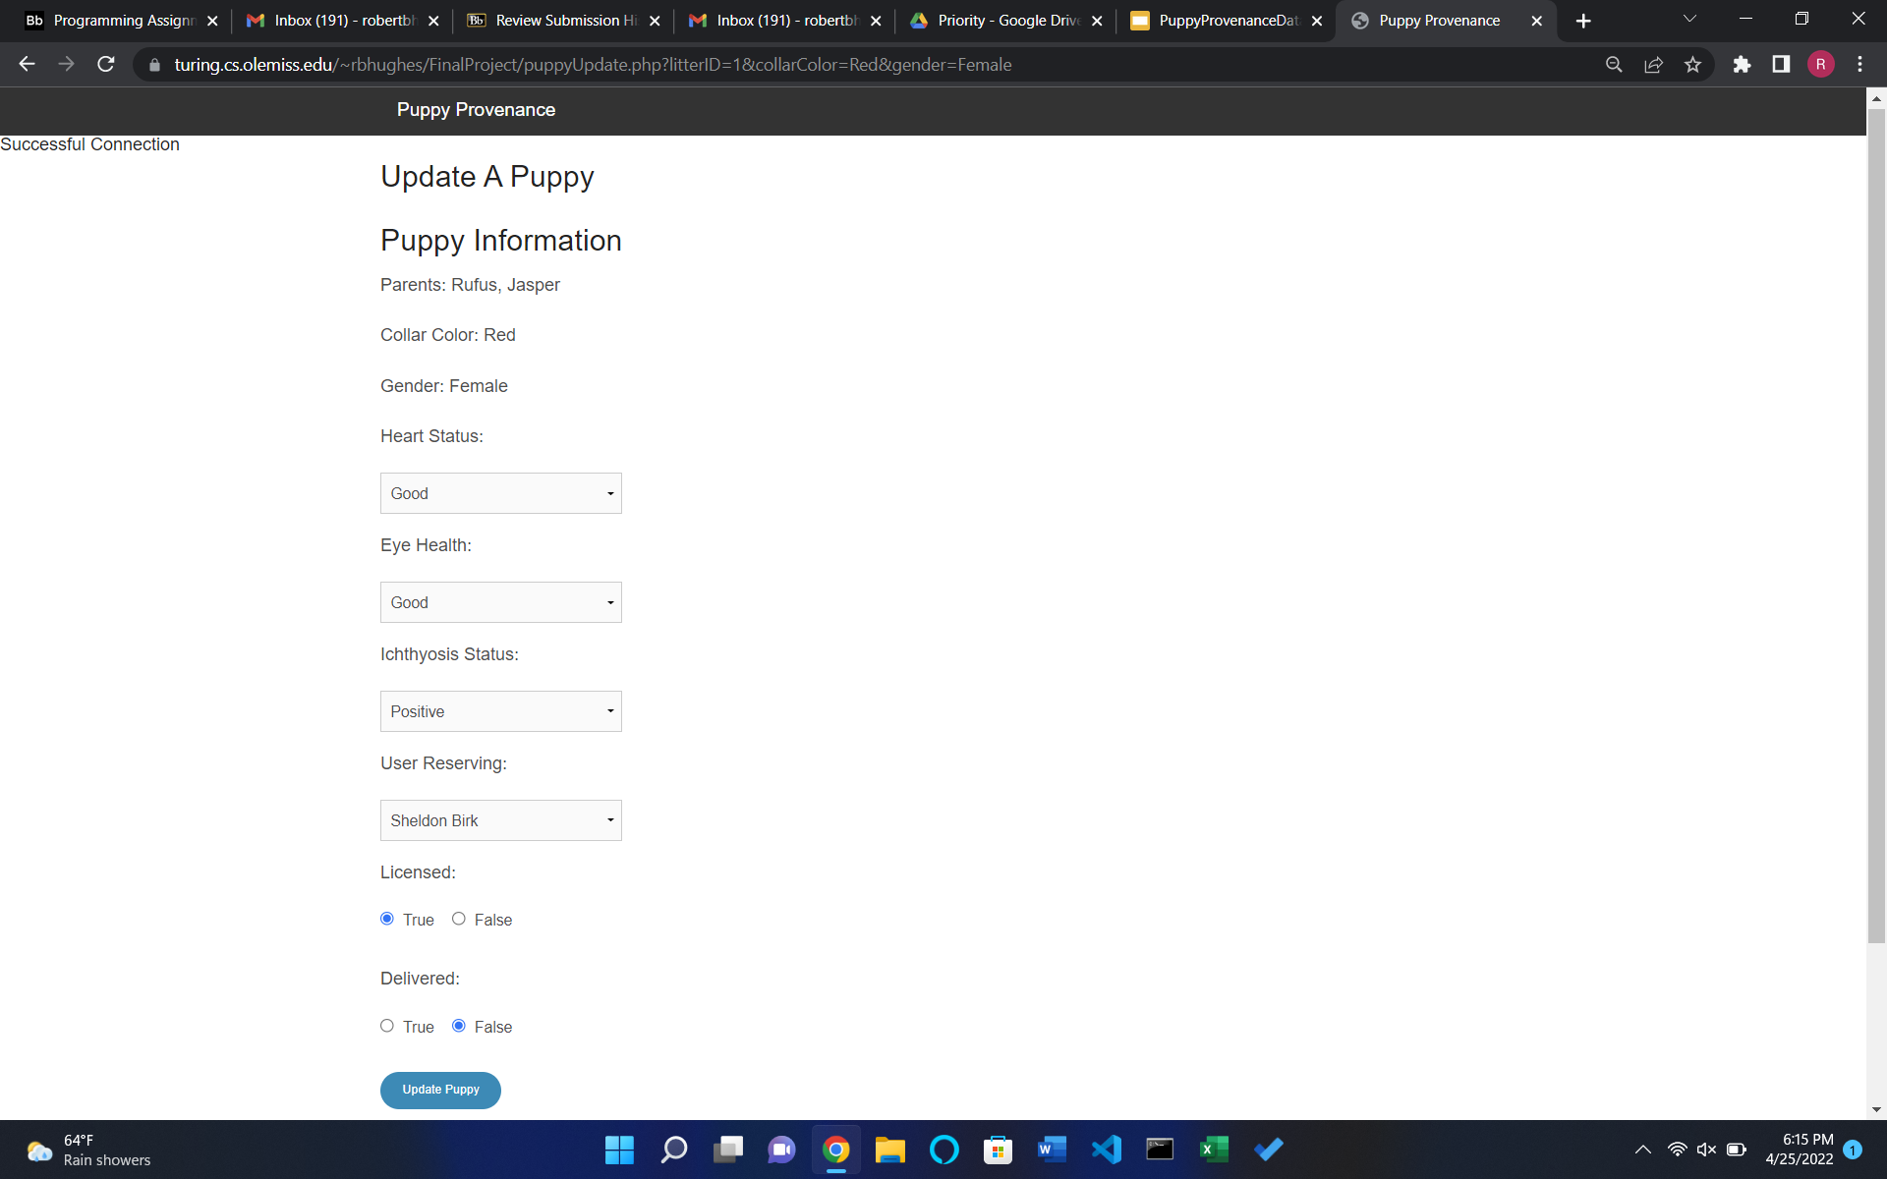
The Update Page pulls primary key information from the Read php page and is accessed from the “Edit” button next to each entry. These keys are used to autofill/autoselect each non-PK attribute
U in CRUD: Robert Hughes
https://turing.cs.olemiss.edu/~rbhughes/FinalProject/puppyRead.php
Clickable Link

Slide 9
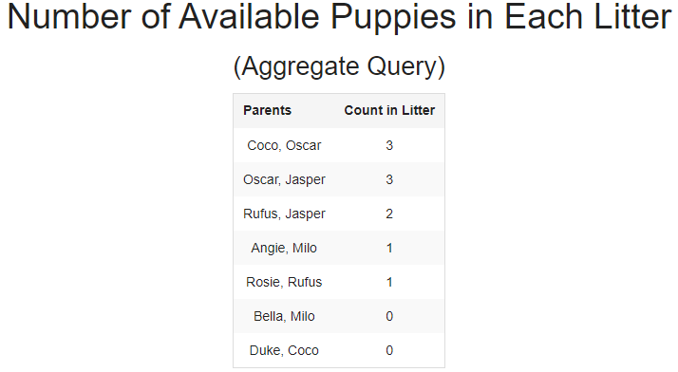
Query 1: Aggregate Query
by Brannan Kovachev
This query selects the mother and father of a litter as well as counting the available puppies in that litter, displaying them in descending order by that count.
An available puppy is one that does not have a user reserving it.
The Derived Table in the query retrieves a concatenation of the Parents according to the LitterID. This is not our required Query using concatenation. The parents are included as a more pleasant substitute to the LitterID.
SELECT Parents, COUNT(CASE WHEN UserReservingID IS NULL THEN 1 END) AS 'Number of Available Puppies'
From Puppies JOIN (
SELECT GROUP_CONCAT(Adult_Dogs.Name SEPARATOR ', ') AS Parents, Litter.LitterID
FROM Litter JOIN Adult_Dogs ON Litter.MotherID = Adult_Dogs.DogID OR Litter.FatherID = Adult_Dogs.DogID
GROUP BY(Litter.LitterID)) AS T
ON Puppies.LitterID = T.LitterID
GROUP BY(Puppies.LitterID)
ORDER BY COUNT(CASE WHEN UserReservingID IS NULL THEN 1 END) DESC;

Slide 10
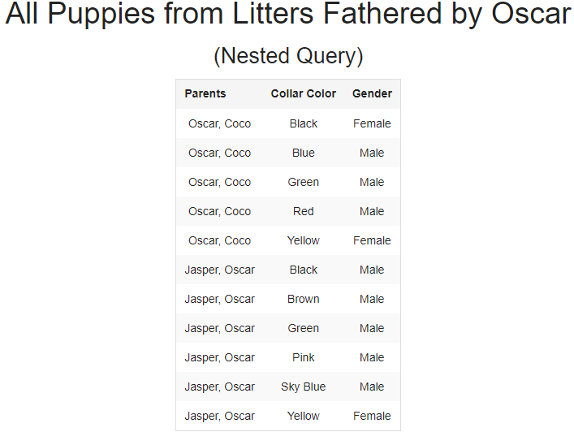
Query 2: Nested Query
by Robert Hughes
This Query lists all Puppies from a litter that was Fathered by the dog ‘Oscar.’
Similarly to the previous query, the Derived Table in the query retrieves a concatenation of the Parents according to the LitterID. This is not our required Query using concatenation. The parents are included just for fun.
SELECT Parents, Puppies.CollarColor, Puppies.Gender
FROM Puppies JOIN(SELECT GROUP_CONCAT(Adult_Dogs.Name SEPARATOR ', ') AS Parents, Litter.LitterID
FROM Litter JOIN Adult_Dogs ON Litter.MotherID = Adult_Dogs.DogID OR Litter.FatherID = Adult_Dogs.DogID
GROUP BY(Litter.LitterID)) AS P ON Puppies.LitterID = P.LitterID
WHERE Puppies.LitterID IN (
SELECT Litter.LitterID
FROM Litter JOIN Adult_Dogs ON Litter.FatherID = Adult_Dogs.DogID
WHERE Adult_Dogs.Name = 'Oscar');

Slide 11
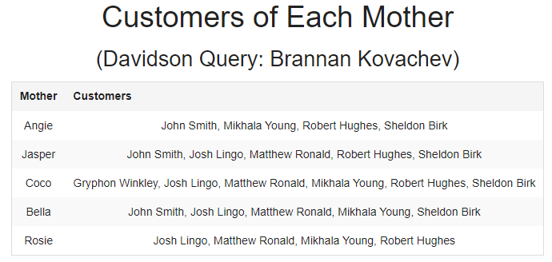
Query 3: Davidson Query
by Brannan Kovachev
This Query selects all the Customers of a particular Mother Dog and concatenates them.
This is one of our Queries that requires Group_Concat and as such has at least 4 meaningful records in the concatenation.
SELECT Adult_Dogs.Name, GROUP_CONCAT(DISTINCT Users.Name SEPARATOR ', ') AS Names
FROM Users JOIN Puppies on Puppies.UserReservingID = Users.UserID NATURAL JOIN Litter
join Adult_Dogs on Litter.MotherID = Adult_Dogs.DogID
Group BY(Adult_Dogs.DogID);

Slide 12
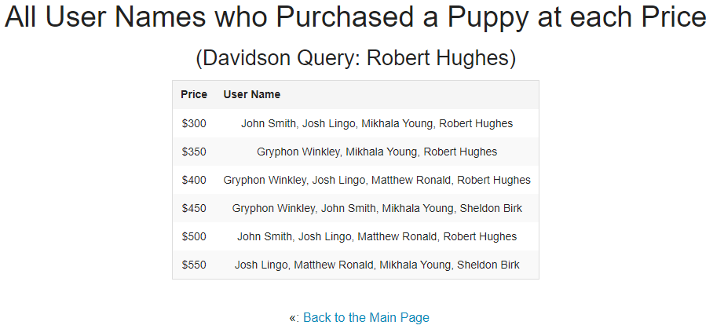
Query 4: Davidson Query
by Robert Hughes
This Query selects all the Customers who purchased a Puppy at a particular Price Point.
This is one of our Queries that requires Group_Concat and as such has at least 4 meaningful records in the concatenation.
SELECT Pricing.Price, GROUP_CONCAT(DISTINCT Users.Name SEPARATOR ', ') AS Names
FROM Pricing NATURAL JOIN Puppies JOIN Users ON Puppies.UserReservingID = Users.UserID
GROUP BY(Pricing.Price);

