Slide 1
Virtual Concierge

Slide 2
About Us

Slide 3
Our Problem

Slide 4
Implementation

Slide 5
Uses

Slide 6
Get Creative

Slide 7
Does Anyone Have Experience

Slide 8
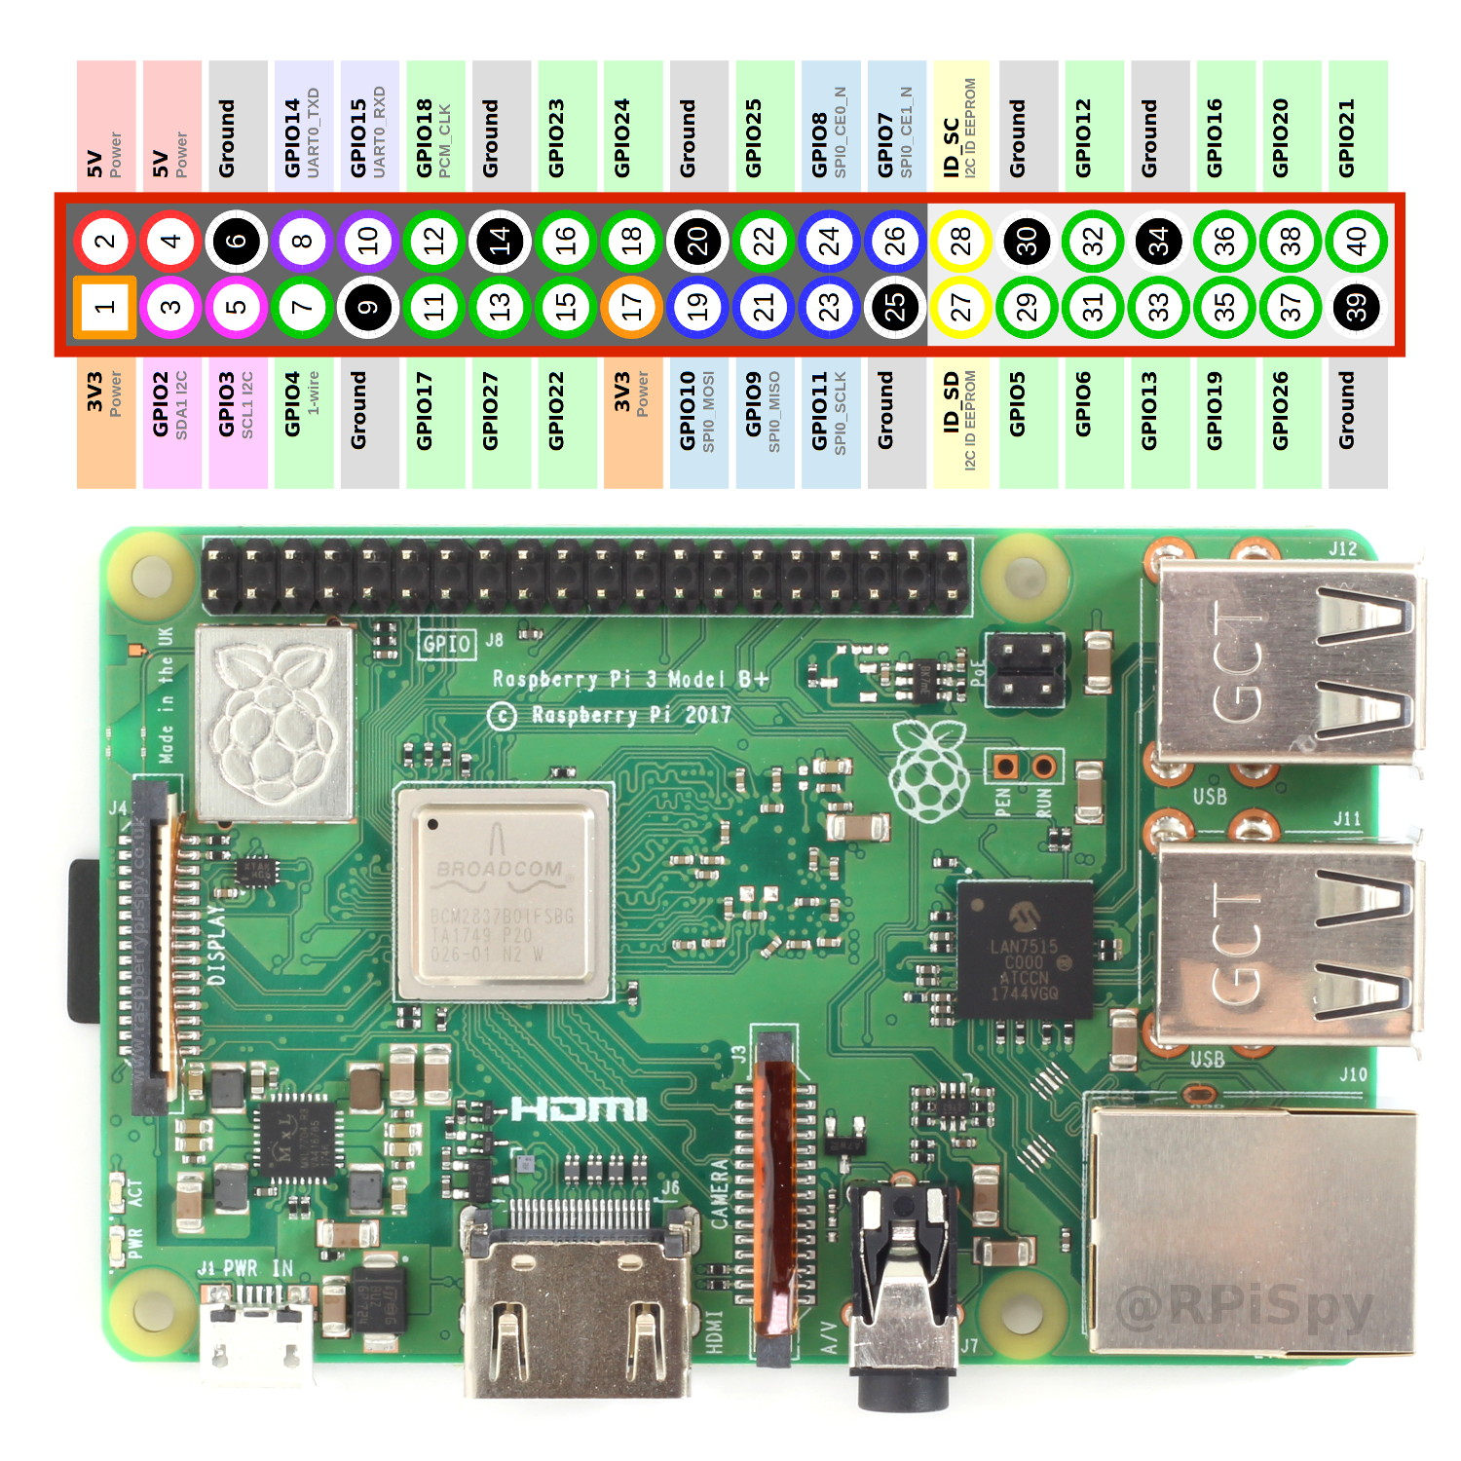
Hardware/Limitations

Slide 9
IBM Watson

Slide 10
Watson Speech-to-Text

Slide 11
Watson Assistant

Slide 12
Intent

Slide 13
Entity

Slide 14
Dialog

Slide 15


Slide 16
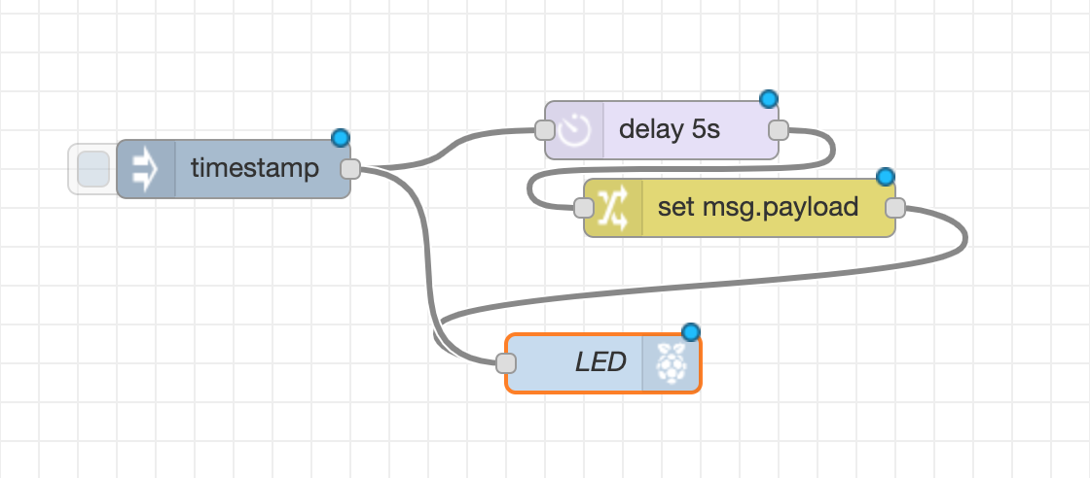
Flows

Slide 17
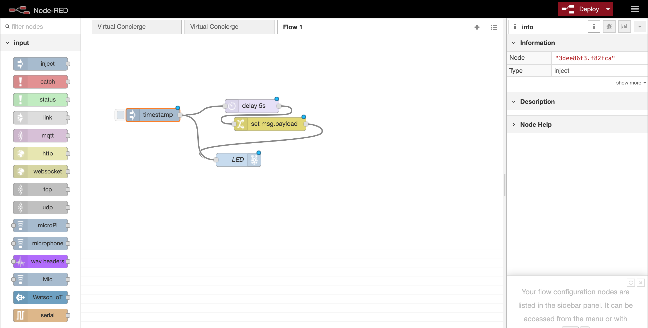

Slide 18
Side Bar

Slide 19
Info/Debugging Window

Slide 20
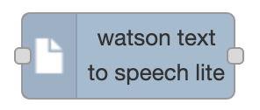









Different Nodes

Slide 21
Demo Time

Slide 22
Get Creative

Slide 23
Other Ideas
Check hours
Ask if open

Slide 24
Integrating With Watson Discovery

Slide 25
Other Resources

Slide 26
Contact Us

