Slide 1
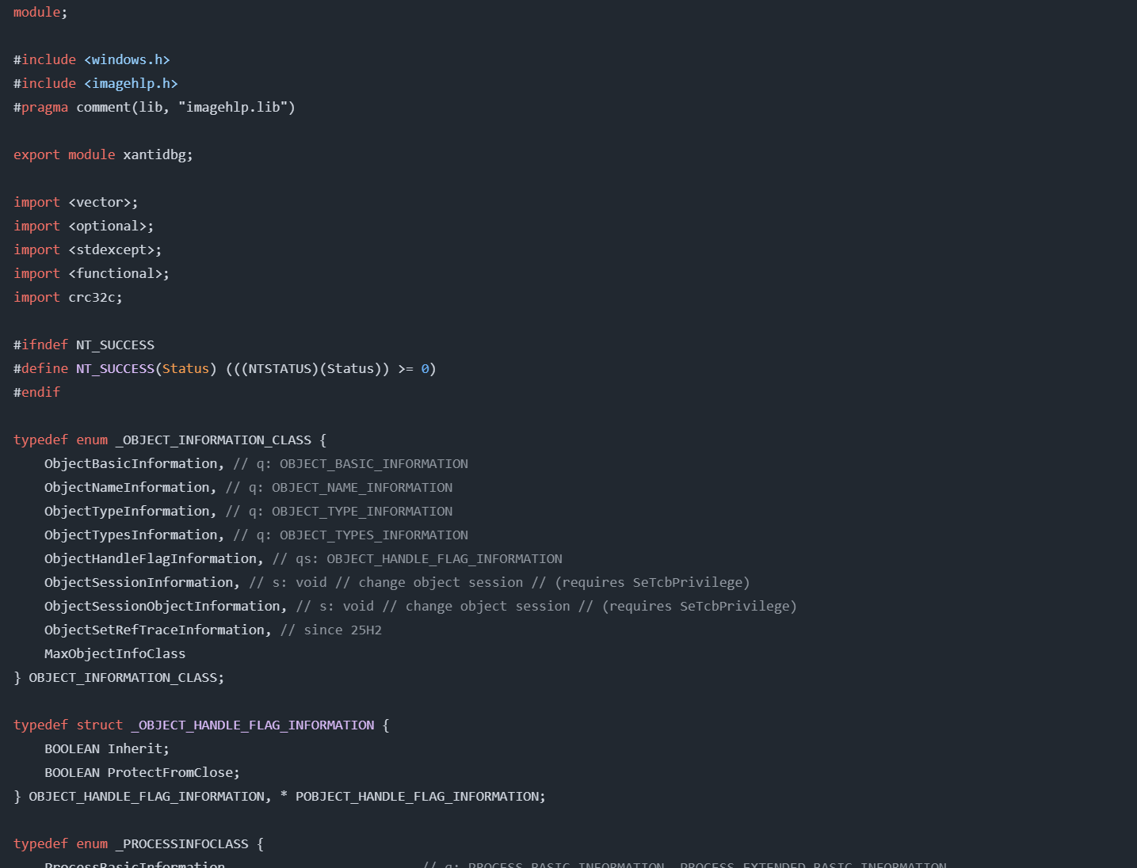



Debugger Detected!
Detected by
When a debugger is detected, there is a 10% chance of causing a blue screen of death (BSOD) and a 90% chance of this window popping up.
Hopefully you'll see this window again next time you're debugging :P

