Slide 1


Dr. B.C. Roy Engineering College, Durgapur Department of Computer Science and Engineering
Topic: AI-BASED DISEASE DETECTION SYSTEM USING ENSEMBLE ML ALGORITHMS & DEEP LEARNING
Presented By :-
Name: AIYUSH BANERJEE (12000121008)
AVINAV CHATTERJEE (12000121015)
BRATAJIT DAS (12000121017)
Project Supervisor: Prof. Hiranmay Samaddar
Group No: 1

Slide 2
CONTENTS
01
02
03
04
INTRODUCTION
LITERATURE REVIEW
OBJECTIVES
METHODOLOGY
05
RESULTS AND
DISCUSSIONS
06
CONCLUSION

Slide 3
INTRODUCTION
In today's healthcare landscape, timely and accurate disease detection is a typically important task for effective treatment and management.
Traditional disease detection methods often lack efficiency and mainly focuses on single disease prediction.
Our research proposes an AI-based Disease Detection System using Ensemble Machine Learning (ML) Algorithms and Deep Learning (DL) techniques which aims to predict a wide range of diseases, including common and rare ones.

Slide 4
Ensemble ML algorithms, including Random Forest, AdaBoost, Gradient Boost, Bagging and Stacking are employed to enhance prediction accuracy.
Deep learning techniques such as Convolutional Neural Networks (CNNs) and Artificial Neural Networks (ANNs) are utilized to extract complex patterns from medical data.
By employing Ensemble Machine Learning Techniques and Deep Learning Algorithms, we aim to achieve accurate predictions for diseases such as Heart Disease, Liver Disease, Chronic Kidney Disease, Parkinson’s Disease, Lung Cancer, Brain Stroke, Pneumonia, Malaria and Melanoma.

Slide 5
LITERATURE REVIEW
Source | Purpose | Disease Diagnosed | Algorithm’s Used | Conclusion Derived
Gopisetti et al.^{[1]} | To develop web app for disease prediction | Diabetes, Heart Disease, Kidney Disease, Cancer | KNN, SVM, Decision Tree, Random Forest, Logistic Regression, Naive Bayes | Accurate predictions with classical ML algorithms
Vijayan et al.^{[2]} | To develop Flask API-based detection system | Brain Stroke, COVID-19, Pneumonia | Sequential CNN, VGG16 | Effective disease prediction with deep learning
Srivastava et al.^{[3]} | Evaluate deep learning techniques | Melanoma | InceptionV3, Xception, InceptionResNetV2 | Compared models on imbalanced vs. balanced datasets

Slide 6
LITERATURE REVIEW(Contd.)
Source | Purpose | Disease Diagnosed | Algorithm’s Used | Conclusion Derived
Kumar et al.^{[4]} | Compare SVM kernel methods | Renal Disorders, Diabetes, Cardiovascular Disease | SVM-Linear, SVM-Polynomial, SVM-Gaussian, SVM-Laplace | SVM-LR achieved high accuracies for Renal Disorders (98.9%), Diabetes Mellitus (98.9%), and Cardiovascular Disease (90.9%)
Shukla et al.^{[5]} | Early-stage prediction using ML | Heart Disease, Parkinson's, Breast Cancer, Diabetes | Logistic Regression, SVM, Decision Tree, Random Forest | SVM and LR outperformed other ML Algorithms.
Ture et al.^{[6]} | Predict various diseases using Random Forest | Heart Disease, Kidney Disease, Diabetes | Random Forest | Achieved high accuracy for heart disease (98.52%) and kidney disease (98.73%)

Slide 7
PROBLEM STATEMENT
“Traditional disease detection systems, which often rely on single machine learning algorithms, face limitations in accurately predicting multiple diseases. To address this, the challenge is to develop a robust and efficient multimodal system using ensemble machine learning and deep learning techniques. This system aims to improve diagnostic accuracy by combining predictions from multiple models, offering a comprehensive tool for predicting various diseases simultaneously.”

Slide 8
RESEARCH OBJECTIVES
To develop a robust system capable of forecasting multiple common and rare diseases using a single user interface.
To Implement various ensemble machine learning techniques such as Bagging, Boosting, and Stacking, along with deep learning algorithms like sequential CNN, MobileNet V2, and ResNet-50, with the expectation of increasing accuracy, as ensembles combine the strengths of multiple weak learners and classical machine learning algorithms.
To utilize multiple datasets specific to each disease to ensure the highest possible accuracy in prediction results.
To create a web application using Flask to integrate machine learning models for the prediction of a wide range of diseases.

Slide 9
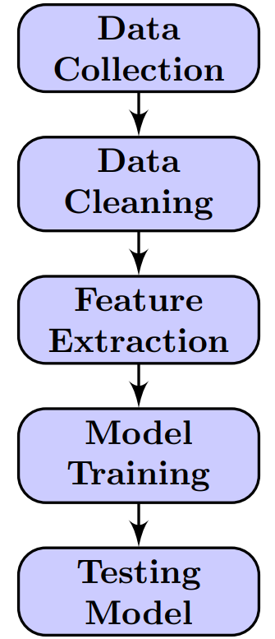
METHODOLOGY
Data Collection: Datasets were meticulously gathered from Kaggle and the UCI Machine Learning Repository, targeting diseases like Heart Disease, Liver Disease, Chronic Kidney Disease, and Malaria. Each dataset comprises detailed patient information, including demographics, symptoms, and test results, forming the foundational data required for training machine learning and deep learning models.
Data Cleaning: In this critical preprocessing phase, missing values in the datasets are managed through techniques like mean imputation or row elimination. Zero values are also addressed, ensuring data consistency. Features are scaled to a common range, standardizing the dataset and preventing any single feature from disproportionately influencing the model training process.

Slide 10
METHODOLOGY(Contd.)
Feature Extraction: The most relevant features, such as patient age, symptoms, and lab results, are systematically extracted from the datasets. This step ensures that the machine learning and deep learning models focus on the critical data that directly impacts disease prediction, optimizing the accuracy and effectiveness of the predictive models.
Model Training: Ensemble machine learning techniques, including Bagging, Stacking, and Boosting, along with Artificial Neural Networks (ANN), are employed to train the models. These approaches combine the strengths of multiple models, capturing complex data patterns, and reducing errors.
Testing Model: Performance metrics such as accuracy, precision, recall, and F1-score are used to evaluate these models, helping determine the most effective algorithm for implementation in the disease detection system’s backend.

Slide 11
RESULTS AND DISCUSSSIONS
Different ensemble machine learning techniques have been explored to find the optimal configuration. The results can be evaluated using various performance metrics. Additionally, a comparative analysis and computation line graph has been generated to visualize and compare the performance and time of different algorithms and configurations.
Table 1: Performance Metrics of best performing Ensemble Machine Learning Algorithms for each dataset.
Disease Dataset | Algorithm’s used | Accuracy | Precision | Recall | F1-Score
Heart Disease | Stacking Classifier | 0.90 | 0.90 | 0.91 | 0.93
Liver disease | Stacking Classifier | 0.84 | 0.85 | 0.86 | 0.85
Chronic Kidney Disease (CKD) | Bagging Classifier | 0.98 | 0.99 | 0.98 | 0.98
Parkinson's Disease | Gradient Boosting Classifier | 0.94 | 0.95 | 0.96 | 0.95
Lung Cancer | Stacking Classifier | 0.96 | 0.97 | 0.97 | 0.96
Brain Stroke | Bagging Classifier | 0.98 | 0.98 | 0.97 | 0.97

Slide 12
PERFORMANCE COMPARISON BASED ON ENSEMBLE MACHINE LEARNING TECHNIQUES AND ARTIFICAL NEURAL NETWORK
Ensemble techniques showed high accuracy in disease prediction, with stacking models using logistic regression as base learners achieving accuracies between 84% and 96% for diseases like heart disease and lung cancer.
Bagging methods with random forests excelled in predicting chronic kidney disease and brain stroke, reaching an accuracy of 98%.
Gradient boosting algorithm performed particularly well for Parkinson's disease, achieving an accuracy of 94%.
Compared to traditional machine learning algorithms like logistic regression, naïve Bayes, SVM, and K-nearest neighbors, ensemble techniques demonstrate superior performance, making them crucial for improving predictive accuracy in healthcare.
Ensemble algorithms boosted the average accuracy of each disease prediction by 3 – 5 %, enhancing overall model reliability.

Slide 13
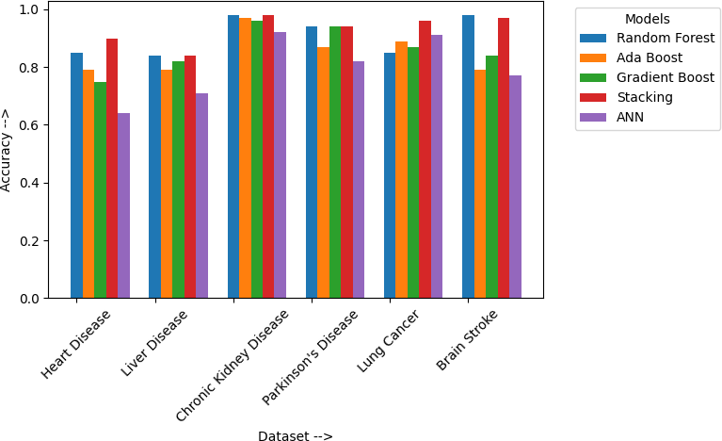
PERFORMANCE COMPARISON BASED ON GRAPHICAL ANALYSIS
The above graph illustrates the accuracy of various ensemble machine learning models in disease prediction across different datasets. The stacking classifier with logistic regression as the meta model consistently outperforms others, demonstrating high accuracy for heart disease, liver disease, and lung cancer. Random forest excels in predicting chronic kidney disease and brain stroke with a 98% accuracy. This visualization highlights the effectiveness of different machine learning models in navigating complex medical data, offering valuable insights for improving diagnostic methods and patient care.

Slide 14
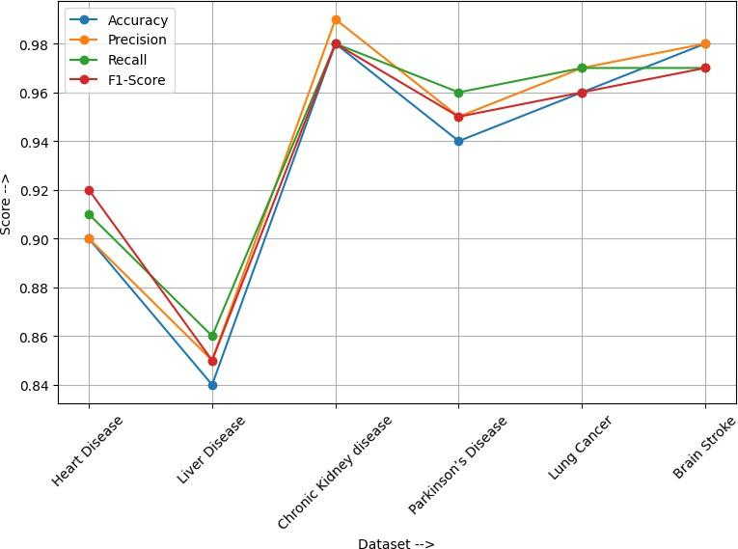
The line graph showcases the performance metrics for top algorithms across medical datasets like Heart Disease, Liver Disease, CKD, Parkinson’s, Lung Cancer, and Brain Stroke. Bagging with Random Forest leads in CKD and Brain Stroke, excelling in Accuracy, Precision, Recall, and F1-Score. Stacking models with Logistic Regression and Naïve Bayes also perform well, guiding effective algorithm selection for improved diagnostic accuracy and patient care.

Slide 15
CONCLUSION
Comprehensive Disease Prediction System: Through the utilization of Ensemble Machine Learning Techniques and Deep Learning Algorithms, we have developed a comprehensive disease prediction system capable of forecasting multiple common and rare diseases with high accuracy.
Enhanced Model Performance: Our rigorous training and validation processes, coupled with parameter tuning and cross-validation techniques, have resulted in models that exhibit superior performance across a range of evaluation metrics, including accuracy, precision, recall, and F1-score.
Robustness and Generalization: By evaluating models based on precision, recall, F1-score, mean absolute error, mean squared error, and confusion matrix analysis, we have ensured the robustness and generalization of our disease prediction system, enabling reliable predictions for diverse patient populations.
Utility in Healthcare Practice: Our findings demonstrate the potential of machine learning approaches in revolutionizing disease diagnosis and management. The developed web application utilizing Flask provides a user-friendly interface for healthcare professionals, facilitating timely and accurate disease prediction to improve patient outcomes.

Slide 16
REFERENCES
Gopisetti, L. D., Kummera, S. K. L., Pattamsetti, S. R., Kuna, S., Parsi, N., & Kodali, H. P. (2023, January). Multiple disease prediction system using machine learning and streamlit. In 2023 5th International Conference on Smart Systems and Inventive Technology (ICSSIT) (pp. 923-931). IEEE.
Vijayan, R., Mareeswari, V., & Jaswanth, A. B. (2024, February). Triple Diseases Prediction System using Deep Learning Techniques. In 2024 Second International Conference on Emerging Trends in Information Technology and Engineering (ICETITE) (pp. 1-7). IEEE.
Srivastava, U. P., Shedge, K. M., Koirala, T. K., & Ghosal, P. (2023, November). A Transfer Learning based GUI for Skin Cancer Diagnosis and Classification using Dermoscopic Images. In 2023 IEEE Silchar Subsection Conference (SILCON) (pp. 1-8). IEEE.
Kumar, D. A., Jyothi, U., Mohan, K. J., Mounica, V., & Nageswari, A. (2023, September). Kernel-Based SVM Classifiers for Multi-Disease Forecasting: A Meta-Analysis. In 2023 4th International Conference on Smart Electronics and Communication (ICOSEC) (pp. 841-847). IEEE.
Shukla, R., & Sawant, R. (2023, August). Multiple Disease Prediction System Using Machine Learning. In 2023 International Conference on Electrical, Electronics, Communication and Computers (ELEXCOM) (pp. 1-6). IEEE.
Ture, T., Sawant, A., Singh, R., & Patil, C. Multiple Disease Prediction System.

Slide 17
THANK YOU!

