Slide 1
Smart Toilet
Felix Feistritzer, Michael Wettl, Matthias Winkler

Slide 2






Slide 3
Data Ingestion / Transformation
Door Detection
Light measurement
Air quality readings

Slide 4
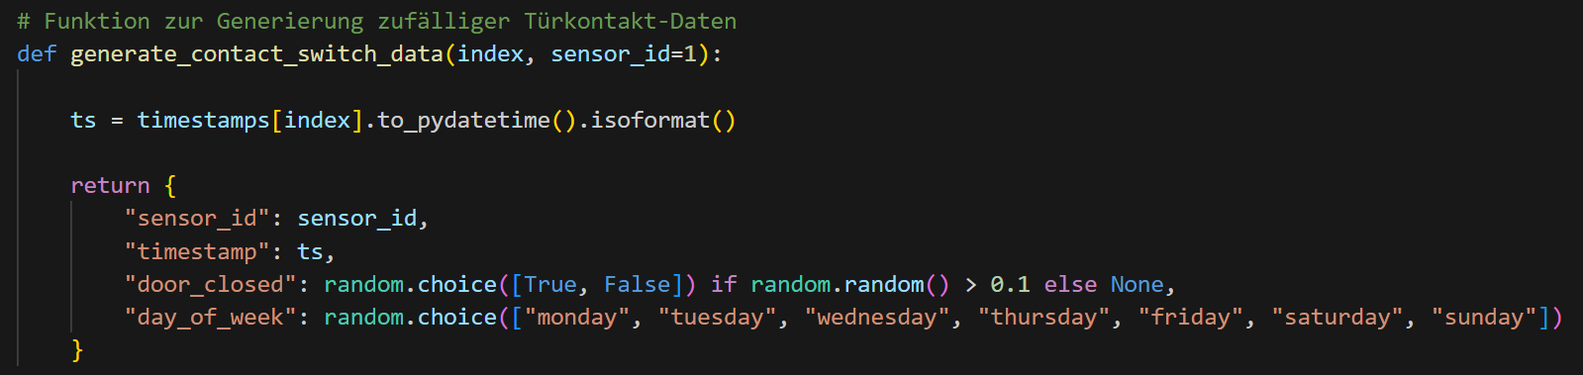
Door Detection

Slide 5
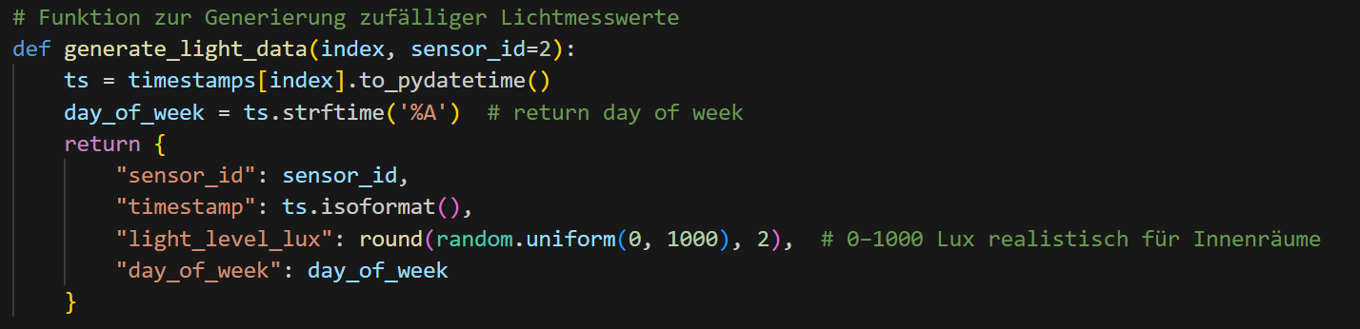
Light measurement

Slide 6
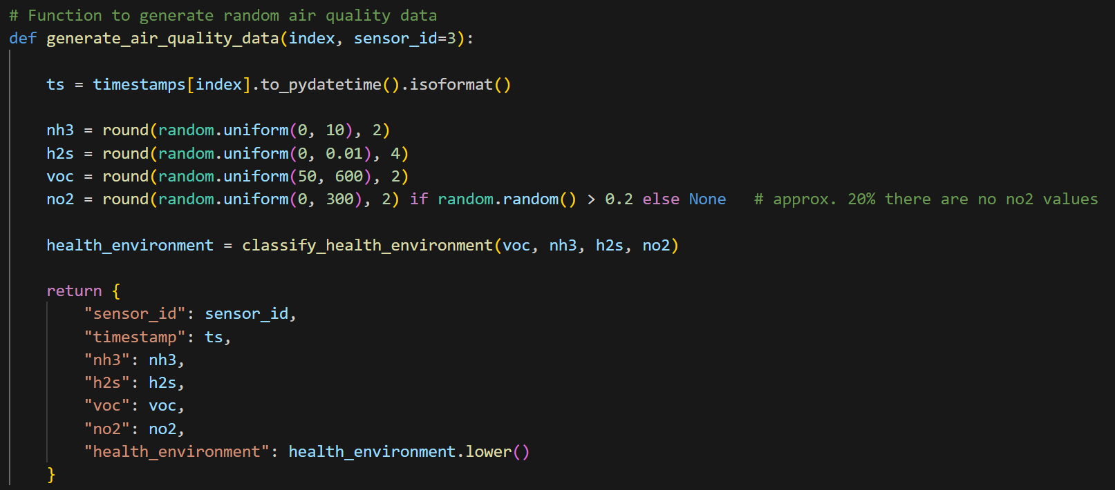
Air Quality

Slide 7
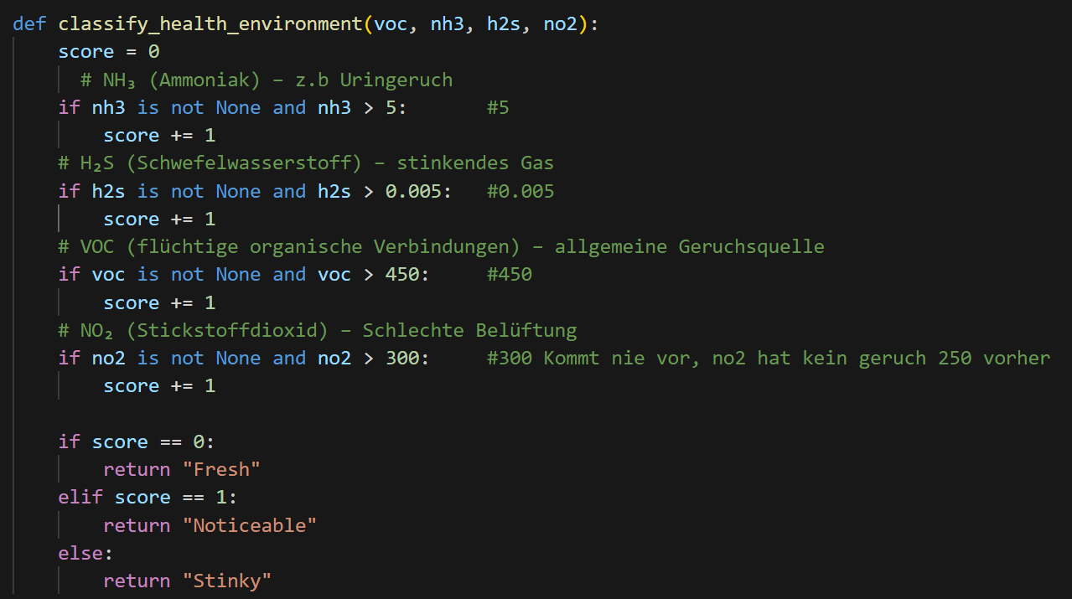

Slide 8
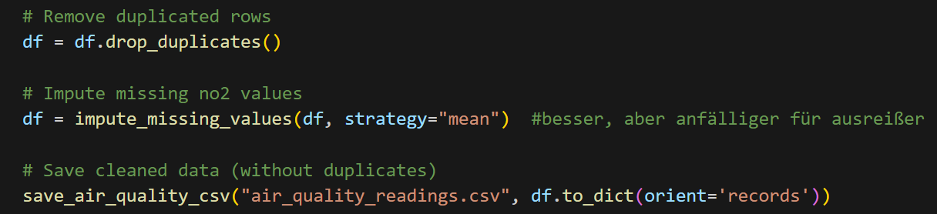
Data Transformation

Slide 9
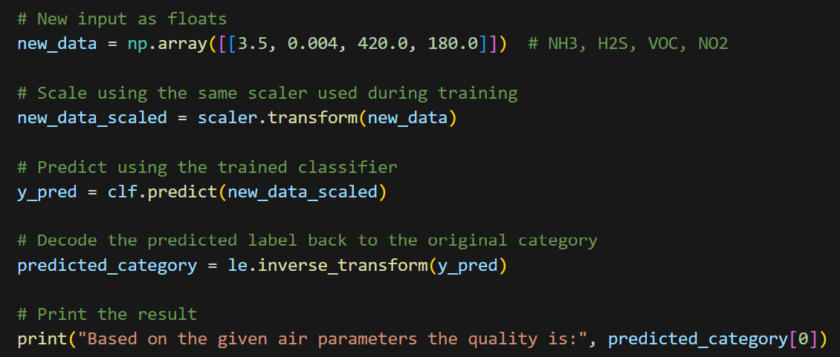
Predictive Modelling

