Slide 1
Smart Toilet
Felix Feistritzer, Michael Wettl, Matthias Winkler

Slide 2






Slide 3
Data Ingestion / Transformation
Door Detection
Light measurement
Air quality readings

Slide 4
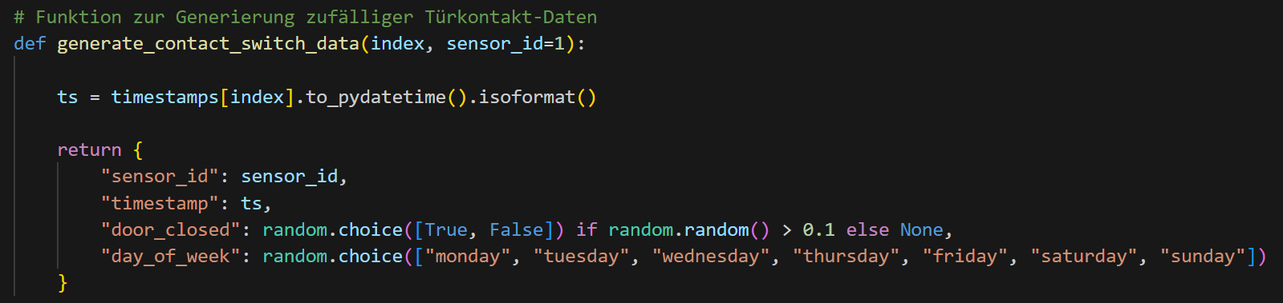
Door Detection

Slide 5
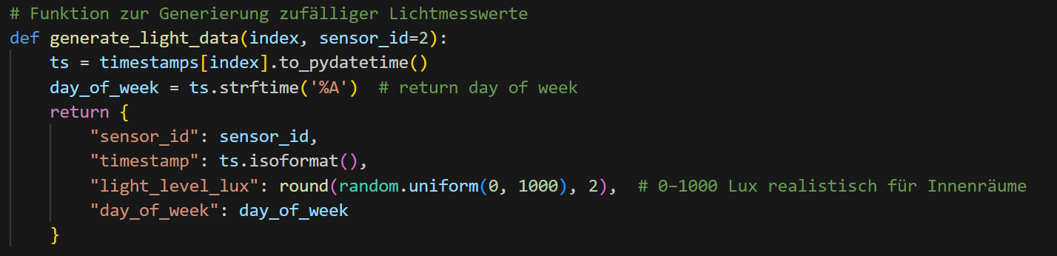
Light measurement

Slide 6
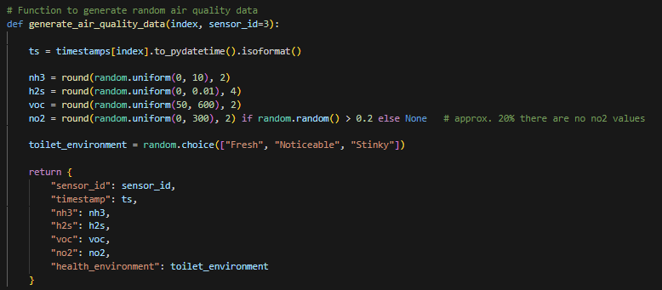
Air Quality
Notes:
NH3 – ammonia
H2S – hydrogen sulfide
VOC – volatile organic compounds
NO2 – nitrogen dioxide

Slide 7
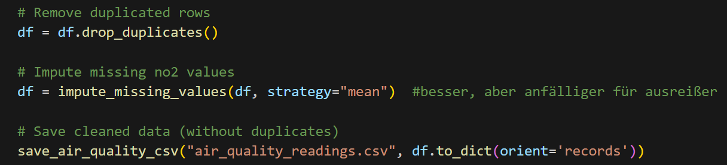
Data Transformation

Slide 8
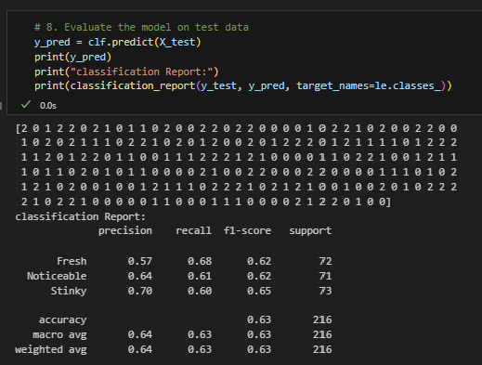
Predictive Modelling
Notes:
RandomForestClassifier

Slide 9
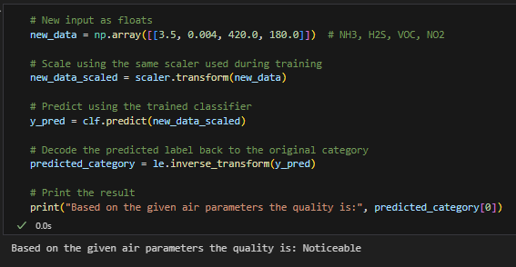

Slide 10
SQL
Tables
Insert data
SQL-Diagramm
SQL-Queries

Slide 11
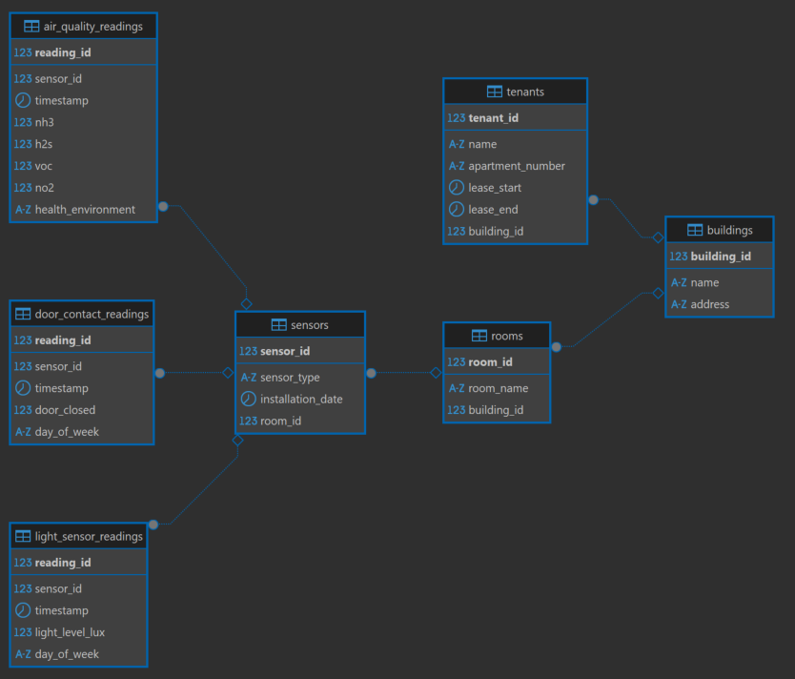

Slide 12
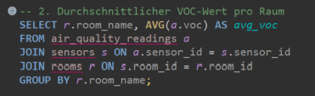

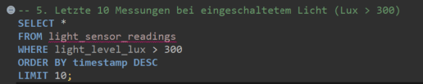

Slide 13
„Why settle for dumb toilets when you can sh*t (flush) with intelligence!“
- Some AI

