Slide 1
A
APERTURE · TREASURY INTELLIGENCE
A cash-management portal
ABN AMRO can call its own.
White-label corporate digital banking — multi-bank cash, liquidity, payments and FX, delivered on ABN AMRO rails, under ABN AMRO’s brand.
See every flow,
every account,
every entity.
Prepared for ABN AMRO · Corporate & Transaction Banking
Confidential discussion document · 18 May 2026

Slide 2
WHY THIS CONVERSATION
Treasury moved on. The portal is now the relationship.
Corporate treasurers no longer live in bank statements and file uploads. They live in a screen — and the bank that owns that screen owns the data, the flow, and the next mandate.
YESTERDAY — BANK-CENTRIC
TODAY — TREASURER-CENTRIC
One bank, one portal, one set of balances
End-of-day statements, manual consolidation
Treasurer stitches the picture in spreadsheets
The bank is a utility, easily swapped
Every bank, every account, one live cockpit
Real-time positions, FX-honest, self-serve
The portal does the synthesis, not the treasurer
The portal is the relationship — and it is sticky
APERTURE × ABN AMRO
Confidential — prepared for ABN AMRO
01

Slide 3
THE OPPORTUNITY
Where this leaves ABN AMRO
Forces on your corporate franchise
Clients fragment cash across many banks — including competitors
Expectations are set by fintech-grade UX, not legacy host-to-host
Building a modern portal in-house is multi-year and high-risk
TMS vendors & aggregators are quietly disintermediating the bank
THE PLAY
Give the treasurer the best multi-bank cockpit on the market — and put ABN AMRO’s name on it.
The portal becomes the client’s daily home. Retention, primary-bank status, and new digital fee revenue follow the screen.
APERTURE × ABN AMRO
Confidential — prepared for ABN AMRO
02

Slide 4
INTRODUCING APERTURE
A portal you deploy — not a project you start
Aperture is a production-ready corporate digital-banking platform with a cash-management core, designed from day one to be white-labelled and multi-tenant.
Production-ready
White-label & multi-tenant
Cash-management core
Multi-bank by design
A working platform today — not slideware. Live multi-bank data, real liquidity engines.
Your brand, your domain, your clients — isolated per corporate, themed to ABN AMRO.
Positions, liquidity, payments, FX and intercompany — the treasurer’s full mandate.
Aggregates ABN AMRO and third-party banks — the view no single bank can offer.
APERTURE × ABN AMRO
Confidential — prepared for ABN AMRO
03

Slide 5
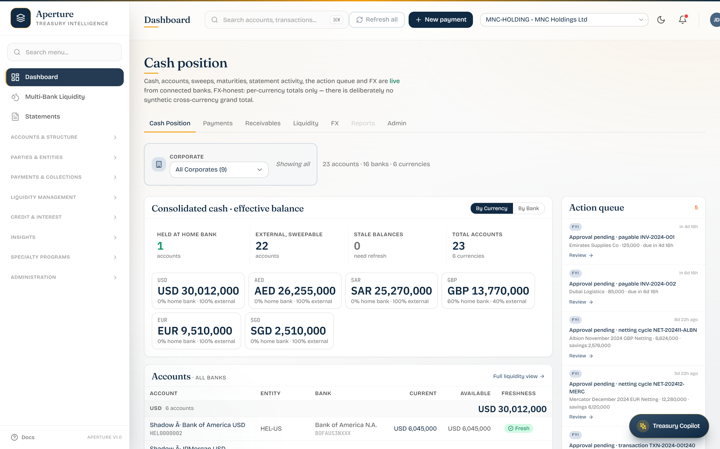
THE BIG IDEA
Own the corporate treasurer’s morning
The daily landing: consolidated cash, action queue, FX — live across every bank.
A position treasurers trust: per-currency truth, no synthetic cross-currency total.
Live freshness per account — stale balances flagged before they bite.
Every glance reinforces the ABN AMRO relationship.
ABN AMRO–branded Cash Position cockpit — the first screen the treasurer opens, every day.
APERTURE × ABN AMRO
Confidential — prepared for ABN AMRO
04

Slide 6
SCOPE
One portal, the whole cash-management mandate
Cash visibility
Multi-bank liquidity
Payments & approvals
Consolidated, FX-honest position across every bank & currency.
Balances, freshness and distribution across all banks — incl. competitors.
ISO 20022 payments, POBO/COBO, multi-level approval workspace.
Liquidity structures
FX
Treasury intelligence
Sweeps, pooling, in-house bank, netting — modelled before you commit.
Sourced, executable rates in the treasurer’s flow, next to the position.
Natural-language assistant over positions, sweeps and statements.
APERTURE × ABN AMRO
Confidential — prepared for ABN AMRO
05

Slide 7
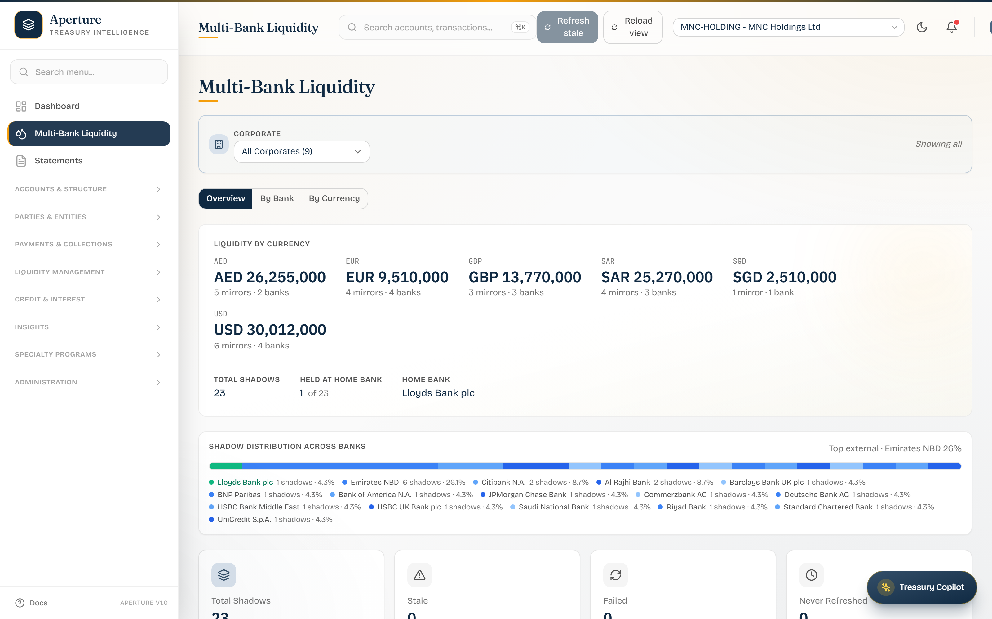
CAPABILITY · MULTI-BANK LIQUIDITY
Every bank. Even the ones that aren’t you.
Aggregates balances across all banks — including competitors.
Home-bank vs external split, value-weighted distribution.
The control-tower view no single bank can show its client.
Strategic effect: ABN AMRO becomes the client’s liquidity hub.
Multi-Bank Liquidity — aggregate position and cross-bank distribution.
APERTURE × ABN AMRO
Confidential — prepared for ABN AMRO
06

Slide 8
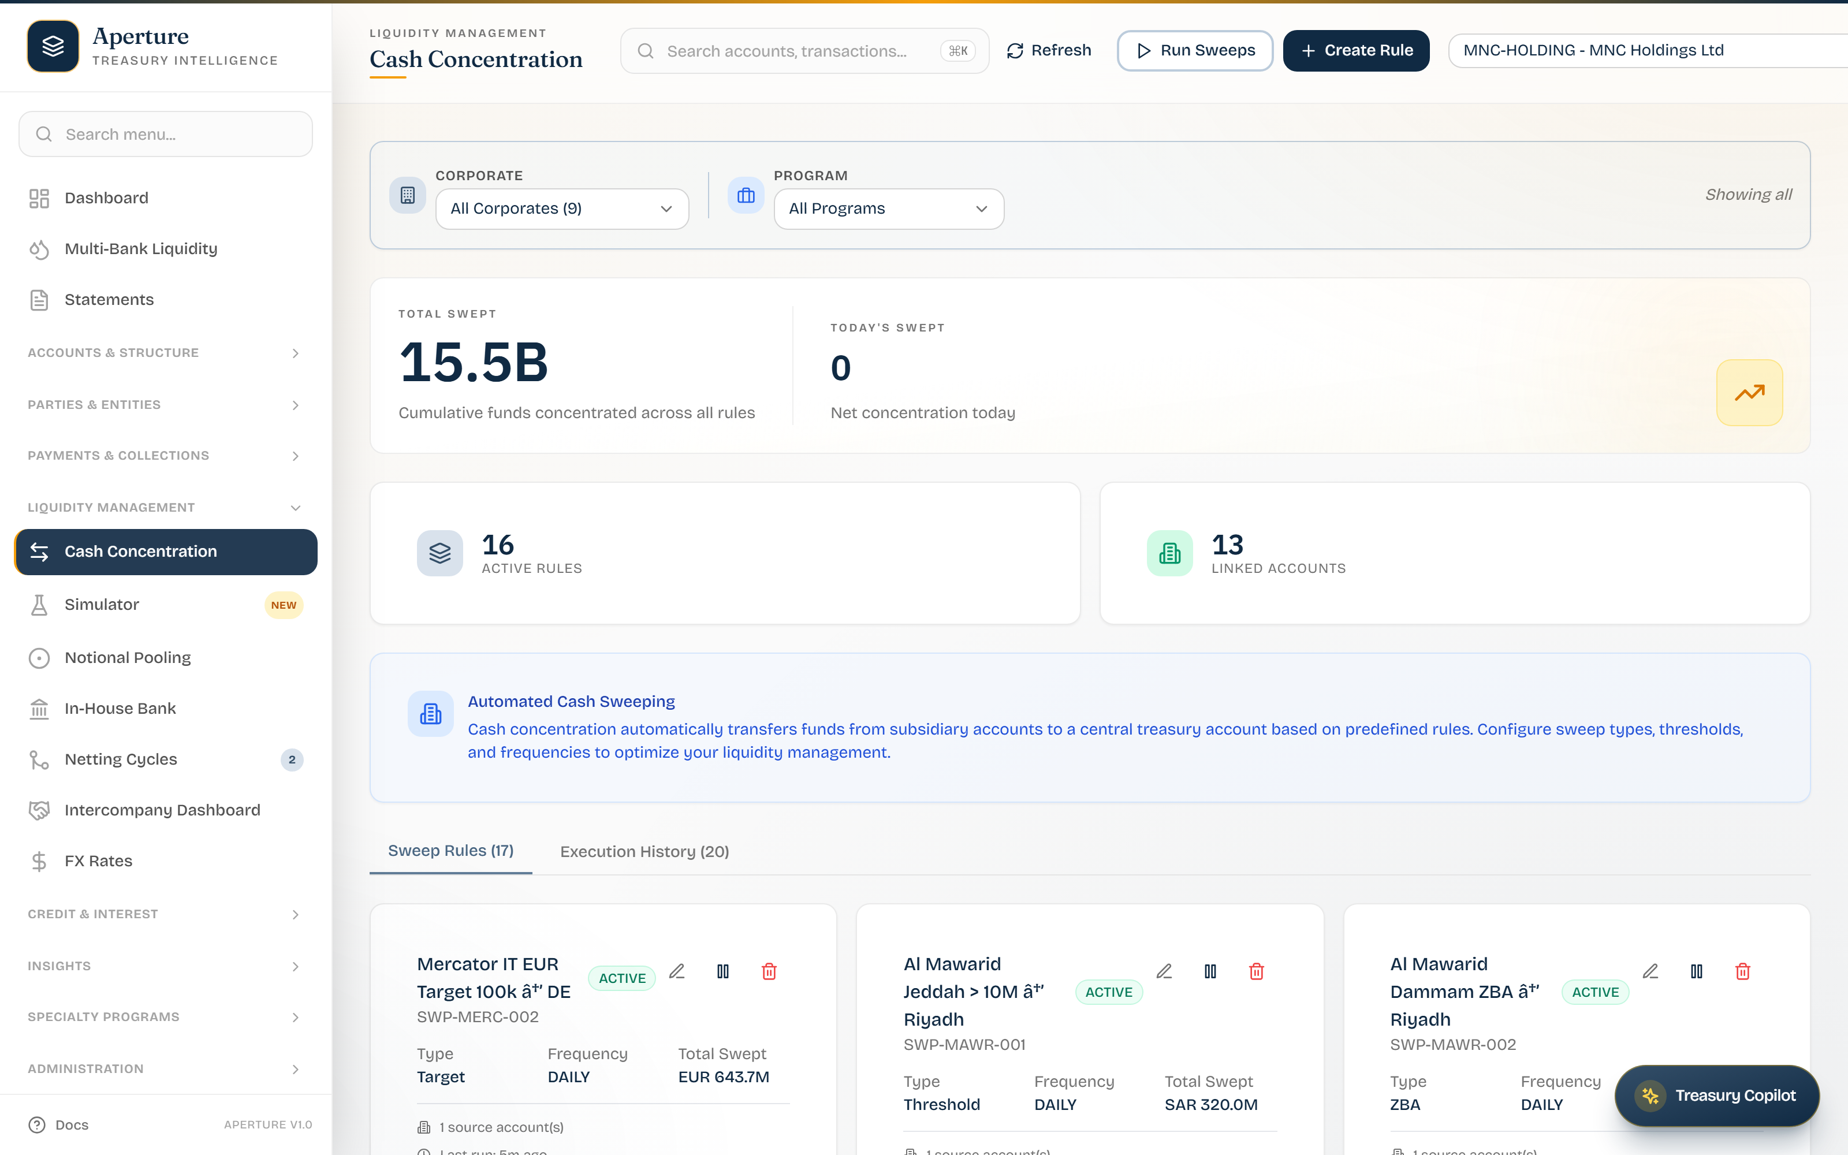
CAPABILITY · LIQUIDITY STRUCTURES
Cross-bank cash concentration
Orchestrate sweeps across banks, not just within ABN AMRO.
Rule-based: target balances, thresholds, schedules.
Concentrate idle cash to where it earns or offsets.
Treasurer sees what moved, what is queued, what is blocked.
Cash Concentration — cross-bank sweep orchestration.
APERTURE × ABN AMRO
Confidential — prepared for ABN AMRO
07

Slide 9
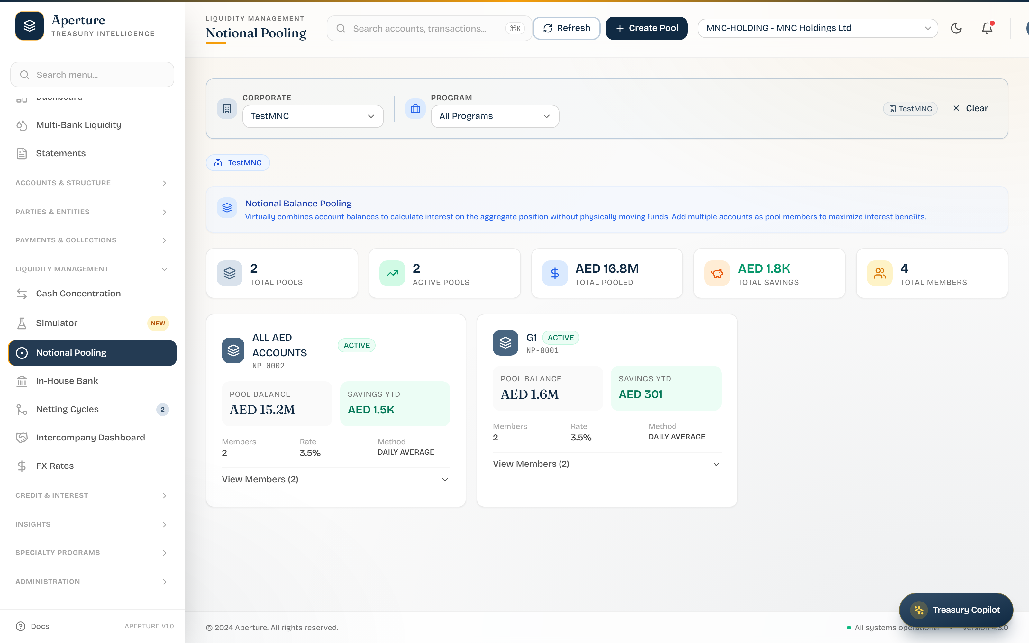
CAPABILITY · LIQUIDITY STRUCTURES
Notional pooling & interest optimisation
Notional pools without physically moving cash.
Offset debit and credit positions across entities.
Interest benefit applied and visible to the treasurer.
Structure-aware: entities, currencies, participants.
Notional Pooling — pool structures and interest optimisation.
APERTURE × ABN AMRO
Confidential — prepared for ABN AMRO
08

Slide 10
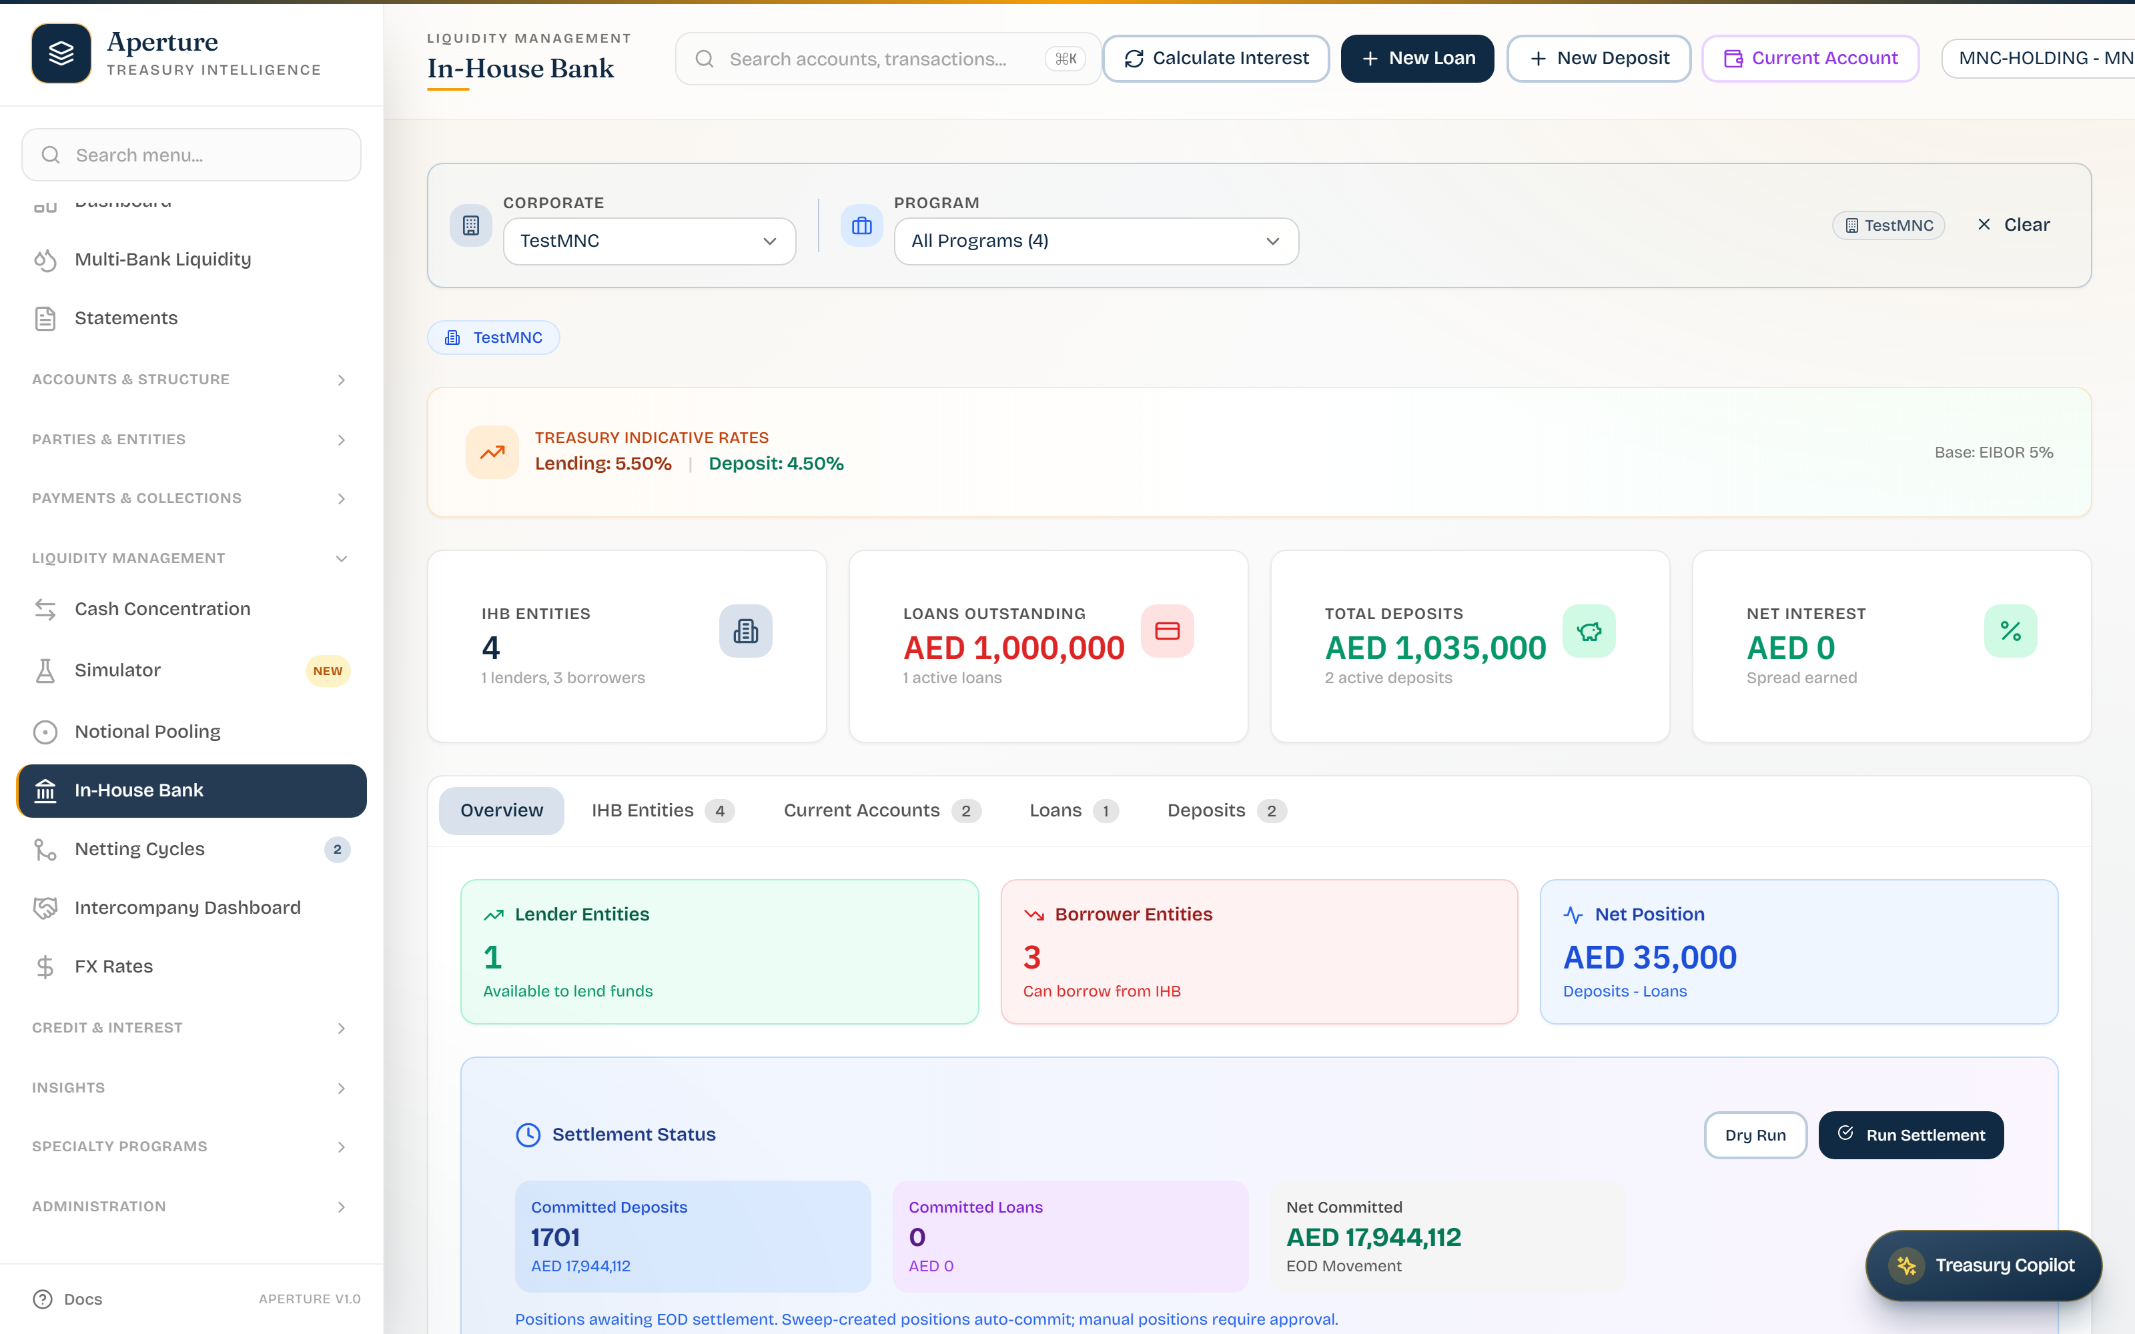
CAPABILITY · LIQUIDITY STRUCTURES
In-house bank: intercompany at scale
Internal loans and deposits between group entities.
POBO / COBO — pay and collect on behalf of subsidiaries.
Cuts external payment volume, fees and float.
Group treasury becomes its own bank — on your rails.
In-House Bank — intercompany loans, deposits and positions.
APERTURE × ABN AMRO
Confidential — prepared for ABN AMRO
09

Slide 11
CAPABILITY · DECISION SUPPORT
Model the structure before you commit
Sandbox by design
Optimisation Score
WHY IT MATTERS FOR ABN AMRO
Design shadows, sweep rules and pools on your live model — with zero live writes.
Every scenario scored, FX- and charge-aware — trade-offs quantified, not guessed.
Treasurers won’t restructure cash on a hunch. A safe, scored what-if tool turns “should we change the pool?” into an ABN AMRO-led, evidence-backed conversation — and the changes that follow run on your rails.
Diff & compare
Fork & propose
Diff a design against the live structure; compare scenarios side by side.
Fork alternatives, promote the winner via a Propose hand-off — fully audited.
APERTURE × ABN AMRO
Confidential — prepared for ABN AMRO
10

Slide 12
CAPABILITY · LIQUIDITY STRUCTURES
Netting that pays for itself
Cycle-based netting
Fewer FX trades
WHY IT MATTERS FOR ABN AMRO
Collapse many gross intercompany settlements into a few net ones.
Net exposures before they hit the market — lower spread cost.
A netting engine is a hard build clients won’t do alone — offering it on your portal deepens the mandate and the fee relationship, while the savings make the portal self-justifying to the client’s CFO.
Fewer wires & fees
Auditable
Each removed settlement removes a transfer charge and float.
Every cycle: participants, gross, net and saving — fully traceable.
APERTURE × ABN AMRO
Confidential — prepared for ABN AMRO
11

Slide 13
CAPABILITY · PAYMENTS & COLLECTIONS
Payments, approvals, ISO 20022
Approval workspace
ISO 20022 native
WHY IT MATTERS FOR ABN AMRO
Multi-level approvals with expiry awareness — approve/reject on the row.
pain.001 / camt / CBPR+ and SWIFT references inline.
Payments is where trust is won or lost. A controlled, standards-native workspace on ABN AMRO rails keeps high-value flow — and the data that comes with it — inside your franchise.
POBO / COBO
Controlled & audited
Pay and collect on behalf of subsidiaries, first-class.
Limits, segregation of duties, full trail on every instruction.
APERTURE × ABN AMRO
Confidential — prepared for ABN AMRO
12

Slide 14
CAPABILITY · FX
FX in the treasurer’s flow
Sourced rates
In context
WHY IT MATTERS FOR ABN AMRO
Reuters / central-bank / partner feeds, attributed and timestamped.
Rates sit next to the exposure that needs them — no app-switching.
FX is a prime fee line. Surfacing dealable, sourced rates where the treasurer already works routes more flow to ABN AMRO’s desk instead of a third-party platform.
Honest by design
Path to execute
Only what the data supports is shown — no fabricated moves.
From “see the exposure” to “act on it” without leaving the portal.
APERTURE × ABN AMRO
Confidential — prepared for ABN AMRO
13

Slide 15
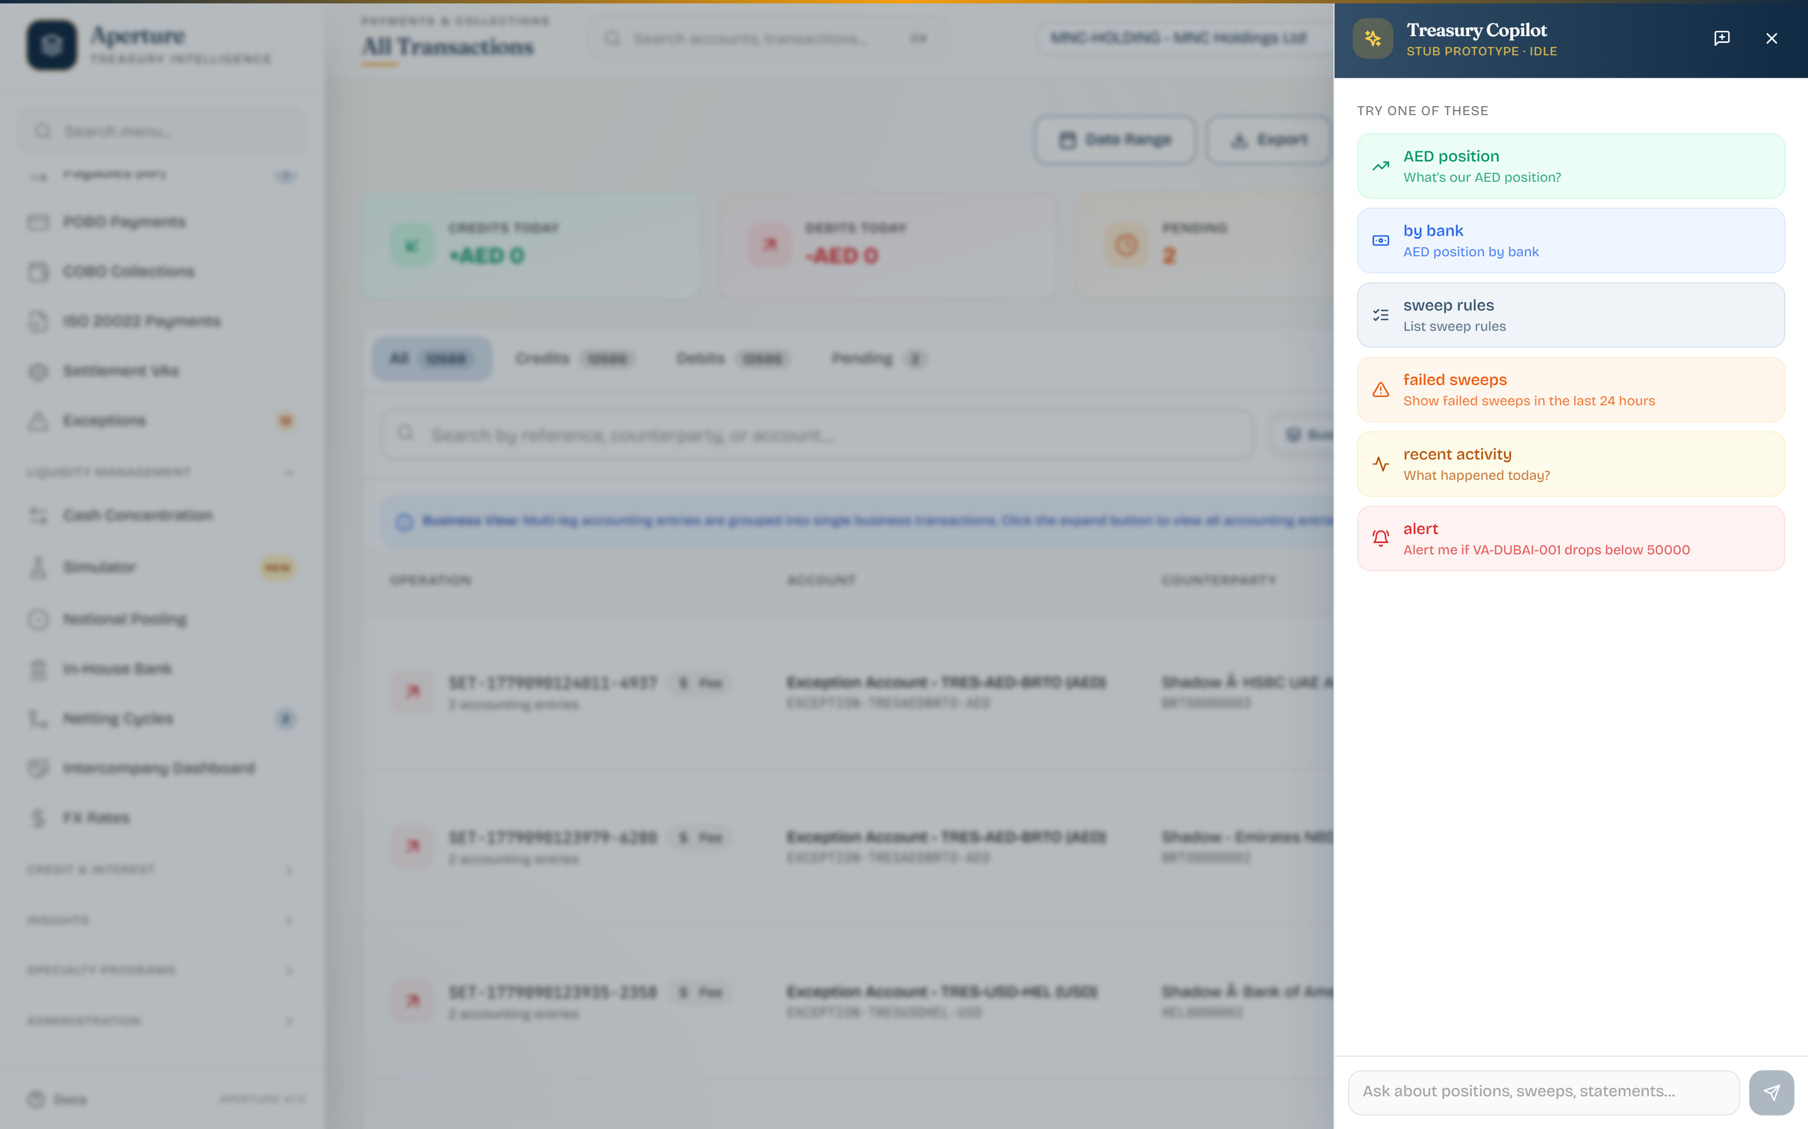
CAPABILITY · TREASURY INTELLIGENCE
Ask treasury anything
Natural-language assistant over positions, sweeps, statements.
“What’s our AED position?” · “Show failed sweeps today.”
A differentiator few bank portals offer today.
Preview now, with a clear roadmap to deeper automation.
Treasury Copilot — natural-language treasury assistant (preview).
APERTURE × ABN AMRO
Confidential — prepared for ABN AMRO
14

Slide 16
UNDER THE HOOD
Engineered for a bank to deploy
Modern, supportable stack
Security & access
ISO 20022 native
Resilience: BaNCS fallback
Java 21 / Spring Boot 3, PostgreSQL, Docker — technology your engineering can own.
OAuth2 / Spring Security, scoped multi-tenant isolation, full audit trail.
pain / camt / CBPR+ messaging — speaks the language of your core and the network.
Store-locally, sync-later when the core is unreachable — treasury keeps working.
Honest by construction
The product refuses to fabricate numbers it cannot source — no fake cross-currency totals, no invented FX moves. For a treasurer making real decisions, that restraint is the feature.
APERTURE × ABN AMRO
Confidential — prepared for ABN AMRO
15

Slide 17
DEPLOYMENT MODEL
Your brand. Your rails. Your clients.
ABN AMRO corporate clients
ABN AMRO-branded Aperture portal
ABN AMRO core / BaNCS + third-party banks
▶
▶
Treasurers & finance teams, multi-entity, multi-currency
White-label theme · multi-tenant · API-first · your domain
ISO 20022 · host-to-host · partner-bank APIs
Brandable theme & domain — it reads as an ABN AMRO product end-to-end
Multi-tenant isolation per corporate client; scoped data and access
API-first integration to your core, BaNCS and partner banks
Phased go-live: pilot cohort → expand → full rollout
APERTURE × ABN AMRO
Confidential — prepared for ABN AMRO
16

Slide 18
THE CASE
Why Aperture, and why now
Build in-house
Generic TMS / aggregator
Aperture, white-label
Multi-year, high execution risk
Opportunity cost while clients churn
You still maintain it forever
Not your brand — disintermediates you
Client loyalty shifts to the vendor
Limited multi-bank, your data leaks out
Your brand, live in months not years
Multi-bank cockpit clients stay in
Retention, primacy, new fee revenue
Outcome for ABN AMRO: stickier corporate relationships · primary-bank status defended · faster time-to-market · a new digital revenue line.
APERTURE × ABN AMRO
Confidential — prepared for ABN AMRO
17

Slide 19
NEXT STEPS
Let’s put ABN AMRO’s name on it.
1
2
3
Discovery & branding
Branded pilot
Phased rollout
Half-day workshop: brand, priority client cohort, integration map.
8–12 weeks: ABN AMRO-themed portal, live with a small client cohort.
Expand cohorts, deepen integration, scale to the corporate base.
Aperture · See every flow, every account, every entity.
Confidential — prepared for ABN AMRO · Corporate & Transaction Banking · 18 May 2026

