Slide 1
PULSE
Payment Understanding, Lifecycle Scoring & Embeddings
Read a payment once — route it, price its risk, predict failures, promise an arrival time.
Route
Flag risk
Catch failures
Promise ETA
See ahead
One reusable model across RTGS · NEFT · IMPS · SWIFT — reading the full ISO 20022 lifecycle (pain.001 → pacs.008 → camt.054)

Slide 2
Why it matters
Four operational outcomes — from one model the team builds once.
Fewer failed payments
Faster, kept promises
Catch cap / limit / SLA breaches before submission — not after a customer call.
Tell the customer when funds land: seconds, minutes, or hours — by rail.
Less manual review
Lower build cost
Focus analysts on the risky few; auto-categorise the routine many.
One backbone, many tasks. A new question = a small add-on, not a new model.

Slide 3
Smart routing — send it the right way
Pick the fastest rail that will actually clear.
SCENARIO
MODEL PREDICTS
WHY IT MATTERS
₹60,000, account-to-account, domestic
IMPS or NEFT — amount-band choice
Fastest valid rail, no cap breach, no guesswork
₹3,00,000, domestic
RTGS-eligible (≥ ₹2 lakh)
Right rail for high-value, real-time settlement
$125,000, India → US, BIC/IBAN
SWIFT (cross-border) — confidence 1.00
Correctly separates cross-border from domestic

Slide 4
Catch failures before they happen
Every prevented reject is a call avoided and a customer kept.
SCENARIO
MODEL PREDICTS
WHY IT MATTERS
₹7.5 lakh attempted via IMPS
Breaches the ₹5L IMPS cap → guaranteed reject
Deterministic intake guard — blocked before submission, right tool not guesswork
₹50,000 sent via RTGS
Below the ₹2 lakh RTGS floor → reject
Stop it before it leaves the building
Instant payment, beneficiary bank slow
Elevated SLA-breach / technical-decline risk
Model pre-empts the timeout; set retry / fallback

Slide 5
Promise an arrival time
Accurate settlement promises — and liquidity planning.
SCENARIO
MODEL PREDICTS
WHY IT MATTERS
IMPS payment
Seconds
Real-time confirmation to the customer
NEFT payment
~15 minutes (next batch)
Set the right expectation, no support ticket
SWIFT, cross-border
~22 hours (correspondent chain)
Plan funding & FX; promise a realistic date
Measured (held-out): ETA error 172 min vs a 234-min naive at initiation (pain.001, before clearing) · 195 vs 392 at full intake (n=4,000).

Slide 6
Risk & compliance triage
Point scarce analyst time at the few that need it.
SCENARIO
MODEL PREDICTS
WHY IT MATTERS
₹30 lakh, cross-border, financial counterparty
High risk + International
Route to enhanced due diligence / AML review
Cross-border to a sanctioned-exposure region
Flags a sanctions-screening hit
Hold and case-manage before settlement
Payment to a software vendor
Spend category: Technology
Auto-categorise for finance — no manual coding

Slide 7
See the payment's future (in-flight)
A digital twin of the payment lifecycle — predict the next step, not just the last.
SCENARIO
MODEL PREDICTS
WHY IT MATTERS
Payment cleared validation & enrichment
Next step likely to hit a sanctions hold
Pre-stage the case; staff ahead of the queue
Inward payment, account resolution pending
Elevated 'account not found' risk
Proactively confirm details before posting
High-value outward, settlement step ahead
Liquidity / cover shortfall risk
Reserve funding before the rail demands it
Measured (full run): 'will it credit?' sharpens 0.86 → 0.94 as messages arrive (pain.001 → pacs.008) — plus recall (camt.056) & return (pacs.004) legs modeled end-to-end.

Slide 8
Why one model — not eight
Build the hard part once; every new question is a small add-on.
One frozen model
routing
risk
exceptions
status
ETA
categorisation
in-flight twin
compliance
velocity (burst)
partial-data infill
charges estimate
next-payment forecast
~6% of a full model's parameters add a new task — proven param-efficiency (C1), so adding capabilities is cheap and fast.
And the LLM? Measured with real Phi-1.5 (C5, H200): +1.3pp accuracy on a fixed task — but accuracy was never its job. It IS the serving interface: one frozen decoder answers the whole menu by instruction, so a new question costs a sentence, not a new model.

Slide 9
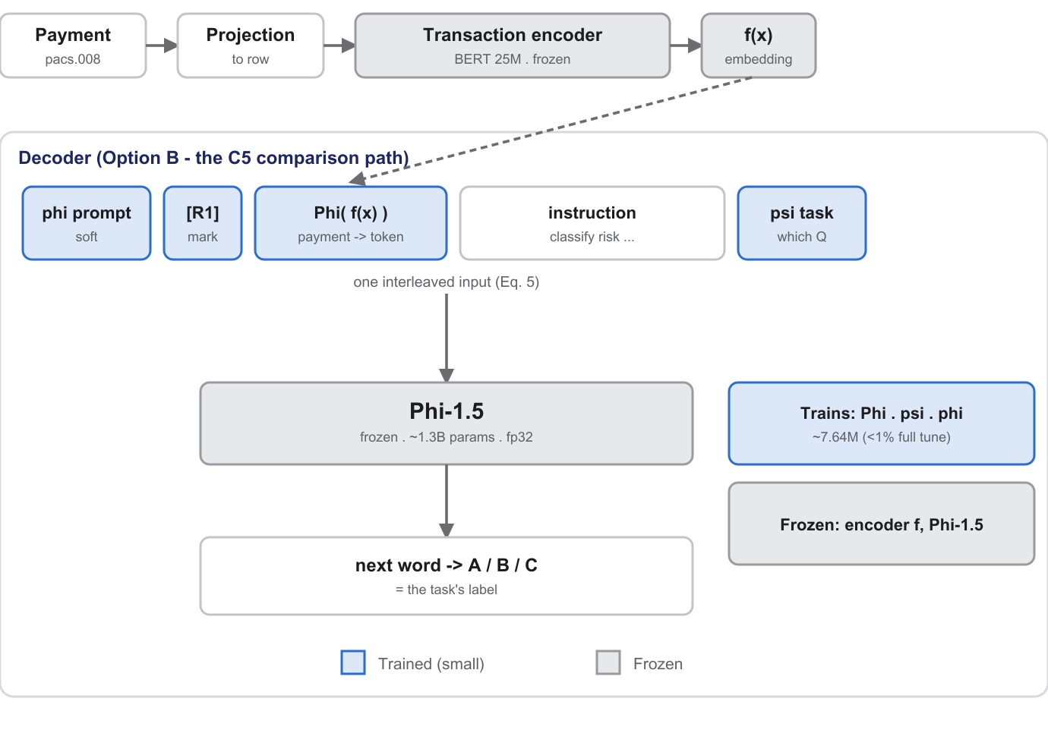
Under the hood — pretrained adapters on a frozen backbone
Redrawn from Raman et al. (arXiv:2410.07851, §4 / Eq. 5). Grey never trains; blue is the ~7.64M-parameter adapter trio.
This IS the serving interface. One frozen decoder answers rail, status, risk, geography, expense and the ETA band by instruction (POST /score/ask) — a new question costs an instruction string, not a new head + refit. C5 measured the accuracy cost vs a probe: 0.932 vs 0.919. Regression ETA and rare-event PDs stay on probes — the decoder emits answer tokens, not numbers.

Slide 10
The data — what PULSE needs
Left: the serving contract per endpoint. Right: how the synthetic training data is generated (all seeded — same command, same bytes).
Endpoint | Required data
/score/intake | 19 payment fields: accounts & ultimate parties, amount + currency, settlement date & method, identifier type, names, countries, industries
/score/inflight | the message trail so far: end_to_end_id, seq, msg_type, tx_sts, minutes offset + the payment fields
/score/velocity | per-account history (≥2 rows): account id, dates + feature columns — engine-supplied, stateless
/forecast/next | per-account history (≥3 rows) incl. counterparty ids
/forecast/liquidity | the day's outward book (intake fields)
origination fusion | pain.001 channel context at t=0: channel, device, session, auth attributes (bank-internal, pre-ISO)
1 Account universe
4,000 synthetic corporates: industries, countries, account / IFSC / BIC identifiers
2 Payments
amounts + scope pick the eligible rail: ≥₹2L unlocks RTGS, ≤₹5L allows IMPS, cross-border → SWIFT; a slice arrives deliberately mis-routed
3 Exceptions
a hazard model injects 16 exception types (sanctions, liquidity, format…) at lifecycle steps → terminal status, settle time, charges
4 Lifecycle expansion
each payment becomes its ISO trail — pain.001→pacs.008→pacs.002→camt.054, recalls (camt.056) & returns (pacs.004) — timestamps anchored to the events
5 Planted couplings
3% cancellations; origination ATO risk ×8-coupled to later recalls; optional salary/rent/supplier cadences for forecasting
No real transaction data anywhere. The generators are the falsifiability tool: labels with known causes let a claim fail loudly.

Slide 11
Status today — trained on CPU, claims verified on GPU
End-to-end on synthetic data; full-scale claim runs reproduced on an H200.
20,000
100
CSV → CSV
payments trained
held-out test payments scored
input and output files
Held-out n=4,000: rail 0.56 probe vs 0.65 tree (4-class, harder without UPI) · ETA 195 min vs 392 naive · status 0.28 (weak — tree territory, reported openly)
At initiation (pain.001, before clearing): ETA 172 vs 234 naive · charges MAE 117 vs 203 · 'will it credit' 0.86 → 0.94 as messages arrive.
+ full ISO 20022 lifecycle modeled
+ recall & return legs (camt.056/pacs.004)
+ charges head · gpi tracker statuses
Maturity: a working prototype on synthetic data. Cold-start caveat: brand-new accounts degrade accuracy (identity features matter) — a known focus for the real-data phase. Next: real transaction data, scale, AML / network-graph.

Slide 12
Every prediction, measured
One backbone, fifteen read-outs — wins and losses reported alike. Full-scale (H200) numbers.
Prediction | Measured result | Baseline | Verdict
ETA to settlement | MAE 172 min at initiation · 195 at n=4,000 | 234 / 392 naive | Model wins
Charges | MAE 117 | 203 naive | Model wins (−42%)
'Will it credit?' — streaming, in-flight | PR-AUC 0.86 → 0.94 as messages arrive | 0.86 prevalence | Model wins — lifecycle-native
Velocity burst — account timing | PR-AUC 0.82 time-aware (full corpus) | 0.22 order-blind | Model wins (+60pp)
Account takeover at origination (channel context) | PR-AUC 0.03 ISO-only → 1.00 with pain.001 channel data | ISO fields alone are blind | Model wins — multi-source
Next payment: when? (forecast) | MAE 23.5 days, held-out customers | 25.9 / 32.5 naive gaps | Model wins
Next payment: will one occur / how much? | occurrence 0.58 · amount: median naive wins | tree 0.65 · median naive | Naives competitive
Rail routing | 0.56 probe · 0.65 on cleanly-routed · SWIFT F1 1.00 | tree 0.65 · majority 0.48 | Tree competitive
Risk (paper §5 task) | 0.58 on the fresh 100 | tree comparable | Tree competitive (C2)
STP outcome at initiation | 0.28 acc / 0.21 macro-F1 | majority 0.74 | Weak — tree territory
Reject reason (ISO status code) | 0.10 acc | 'none' dominates | Weak — tree territory
Recall / return likelihood (camt.056 / pacs.004) | ≈ prevalence (3.0% / 1.8% positive) | — | Too rare at 20k — needs scale
Next-message order (sequence encoder) | sequence ≈ pooled (−0.5pp, full run) | bag-of-messages | Honest null — no order signal
Caps · floors · geo-cover · duplicates | exact by construction | — | Rules & guards, not ML
Missing-field infill (imputation) | structured fields only | — | IDs / dates → lookup, not inference
Green = the frozen backbone beats its baseline. Amber / red = a tuned tree or naive matches or wins on complete-record labels — the paper's C2 finding, reported openly and routed to the right tool. Grey = deliberately not ML.

Slide 13
Actual predictions — a sample
5 of 100 held-out payments · CSV in → CSV out (test_predictions_100.csv, GPU-trained bundle).
Amount | Scope | True rail | Predicted (conf) | Risk | Status | ETA | Top exception risk
833 INR | domestic | IMPS | IMPS (0.62) | Low ✓ | STP ✓ | 0 min | format_error 0.04
250,799 INR | domestic | RTGS | RTGS (0.81) | High ✓ | REJECTED (true STP) | 28 min | fraud_hold 0.04
208,988 INR | x-border | SWIFT | SWIFT (1.00) | High (true Med) | REJECTED (true STP) | 878 min (true 1140) | sanctions_hit 0.05
7,410 INR | domestic | RTGS * | NEFT (0.63) | Low ✓ | REJECTED ✓ | 236 min | below_min 0.06
13,137 INR | domestic | IMPS | IMPS (0.57) | Low ✓ | STP ✓ | 826 min | format_error 0.04
Green = matches truth; ✓ = predicted outcome matched too. The ₹7,410 'RTGS *' arrived mis-routed (below the ₹2L floor) — the model re-routes it to NEFT AND correctly predicts the reject. The SWIFT row's status/risk misses are shown as-is, not cherry-picked.
This fresh 100 (known accounts, new payments): rail 0.60 — 0.65 on cleanly-routed · risk 0.58 · status 0.18 (small-n; stable n=4,000: 0.28). Stable eval: rail 0.56 vs tree 0.65 · ETA 195 vs 392 naive.

Slide 14
Honest about where it stands
Proven
209 automated tests green · reproducible · full-scale claims measured on an H200 GPU · independently code-reviewed
Where it wins
ETA & charges from the payment itself · in-flight calls from partial (pain.001) data · timing/sequence signals (+60pp) · multi-source fusion (ATO 0.03 → 1.00)
Where a simple tree still wins
feature-rule scoring on complete records — confirmed twice: LoRA adapters close 40.7% of the gap (C9), full-token read-outs +72% (C10), neither reaches the tree. We route those tasks to trees & guards, openly
Today vs next
synthetic data today → real transaction data + network/AML graph next
PULSE — one model, many payment decisions: efficient, faithful to the research, honestly measured.

Slide 15
Annexure 1 — intake API, five scenarios
POST /score/intake — real request/response pairs against the served bundle (calibrated). Misses shown as-is.
Scenario | Returned | Reading
UC-1 ₹833 domestic, known accounts (true: IMPS, STP) | IMPS (0.624) · STP · ETA 0m · risk Low | Both correct
UC-2 ₹2,50,799 high-value (true: RTGS, STP) | RTGS (0.812) · REJECTED · risk High | Rail + risk right; status wrong — the weak head, shown failing
UC-3 cross-border BIC/IBAN, IN→BR (true settle 1,140m) | SWIFT (1) · ETA 878.2m · risk High · top exc sanctions_hit | Confidence 1.00 on scope
UC-4 ₹7,410 arrives tagged RTGS — below the ₹2L floor (true: REJECTED) | re-routes to NEFT (0.631) · REJECTED | Catches the mis-route AND the reject
UC-5 cold start — all account ids brand new | NEFT (0.001) · REPAIRED | Confidence collapses to 0.001 — documented, gateway should distrust
Full JSON: docs/annex_capture.json · paper Annexure A · regenerate against any bundle with the capture script.

Slide 16
Annexure 2 — in-flight lifecycle & explanations
POST /score/inflight — the same payment object, scored as its message trail grows.
UC-7 · healthy, first message only
UC-8 · recalled & returned
pacs.008
pacs.008→pacs.002→camt.054→camt.056→camt.029→pacs.004
booked 0.9571 STP 0.7475 · REJ 0.0248 cancel 0.0259 · return 0.0063 if it fails: ED05 @ 0.5882
booked 0.8522 STP 0.808 · REJ 0.0575 cancel 0.044 · return 0.0625 if it fails: AC04 @ 0.9665
Return probability rises 10× (0.0063 → 0.0625) and the conditional reject reason snaps to AC04 (account closed) at 0.97 once the recall/return trail lands.
explain:true on UC-3 — occlusion drivers: identifier_type (risk +0.5831, rail +0.2905) · Ccy (risk -0.2017, rail +0.4739) · IntrBkSttlmAmt (risk +0.5572, rail -0.0059)

Slide 17
Annexure 3 — behaviour & treasury APIs
Velocity, next-payment forecast, and the liquidity curve — engine sends history, PULSE returns calibrated numbers.
Endpoint | Sent | Returned
POST /score/velocity | two account histories (6 txns each) | bursting acct 1RR9184S: burst_proba 0.5 · quiet acct: 0
POST /forecast/next | salaried customer (20 payments) + irregular (12) | salary: P(next≤35d) 0.75, gap 9.9d · irregular: 0.6103, gap 26.1d
POST /forecast/liquidity | the day's book — 100 outward payments, ₹36.6L | outflow by bucket: <1m ₹151k · 1-15m ₹179k · 15-60m ₹255k · 1-4h ₹69k · 4-24h ₹2309k · >24h ₹696k
The salaried account earns the higher occurrence probability and the shorter gap — cadence read from history alone. Liquidity buckets are amount-conserving: they sum to the book total.

