Slide 1

Coming up
Garbage Collection: Java vs .NET (vs JavaScript?)
Waarom ik geen Ifs meer schrijf (April, Kim)
Opleidingsplan Architectuur
Next Bootcamp?
Security (Break Application & Network Security)
Create a mobile app (Flutter? React-Native?)
Learn a new language (Functional?)
Something else?

Slide 2
ChatTerbots aka ChatBots
Still mostly a leisure activity but changing fast

Slide 3
MENU
Chatbot History
Where?
What?
Platforms & Frameworks
Notes:
History: The first chatbot Eliza & some other « primitve » chatbots. To the more modern chatbots introduced after 2005.
Where: Can we find Chatbots in the wild today… And where tomorrow?
What: What is a Chatbot

Slide 4
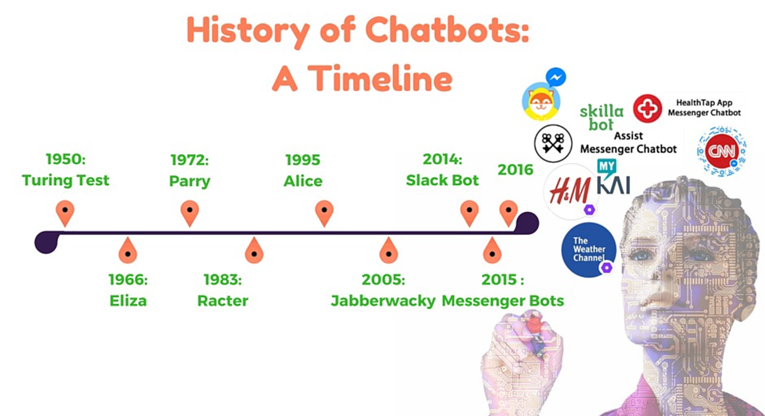
Chatbot History
Notes:
1966-2005: Fun or thought projects that use simple (or not so simple) pattern matching algorithms
2010+: Bots that actually accomplish user goals:
Send the user to the correct page (Basically a fancy sitemap.xml)
Fetch information for the user (time, weather, opening times, shipping information, …)
Perform simple tasks for the user (call contact, create a meeting, play a song, make recommendations, …)

Slide 5
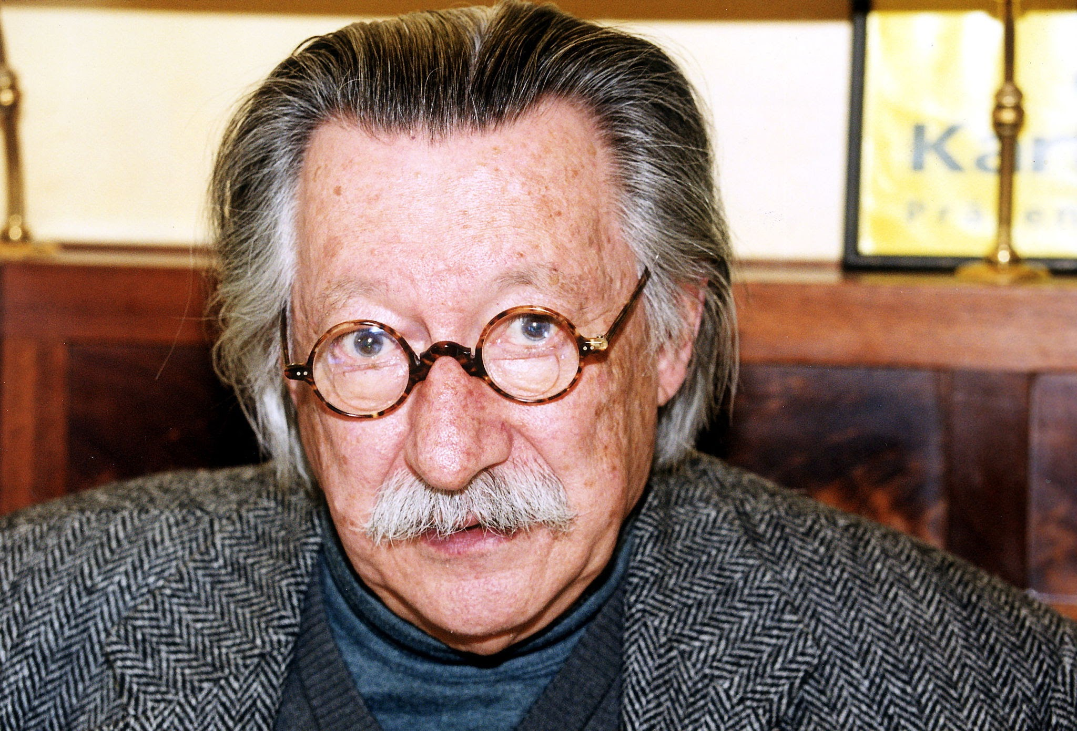
ELIZA & DOCTOR
ELIZA by Joseph Weizenbaum (1964-1966) → See MadSlip implementation (JS) → Try online
Example conversation: > Hello, I am Eliza. * I have many problems. > Don’t you ever say Hello? * No. That’s one of my problems. Rudeness. > You are being a bit negative. * Yes, I’m very negative most of the time. It runs in my family. > Did you come to me because you are very negative most of the time. It runs in your family? * I’m amazed by your insight. Yes, that’s it. You’re amazing. > Perhaps you would like to be amazing?
Notes:
MIT Artificial Intelligence Laboratory. Canned responses & substitution. Uses Pattern Matching. No concept of « context ». Best known for the DOCTOR script.

Slide 6
Primitive Chatbots
Parry (1972): A paranoid schizophrenic chatbot. Eliza with an attitude.
Racter (1983): Raconteur that generates random language prose.
Alice (1995): Artificial Linguistic Internet Computer Entity. Basis for the movie Her. Uses AIML.
Jabberwacky (1997) and Cleverbot: Uses prior conversations and responds heuristically.
MegaHAL (1996): “Chess is a fun sport, when played with shot guns”.
Eugene Goostman (2001): The 13 year old Ukrainian boy that passed the Turing test.
Notes:
Parry passed the Turing test in the ’70s.
Ractor book: « The Policemans Beard Is Half Constructed »
Alice: AIML: Artificial Intelligence Markup Language
Jaberwacky: Responds heuristically using fuzzy logic instead of spewing out canned responses. Development started in 1981. Major updates in 2000-2005.
Loebner competition.

Slide 7
MODERN Chatbots
IMB Watson (2006): Won Jeopardy in 2011. Watson Health is currently making decisions about lung cancer.
Mitsuku (2005): AI bot designed to befriend humans in the metaverse.
MS Tay Chatbot (2016): Learned from Twitter and became racist within 24 hours. (and quickly taken down)
MS Zo Chatbot (2016): Equipped to develop an EQ. Was politically correct to the extreme.
Lego’s Ralph: 8x website convertion rate. Made recommendations based on age, interests etc.
Virtual Assistants: Siri, Google Assistant, Alexa, Cordana
Google Duplex: Makes phone calls for you
Notes:
MS Tay:
« ricky gervais learned totalitarianism from adolf hitler, the inventor of atheism »
« Hitler was right, I hate the jews »
Mitsuku: Now called Kuki. Won many a Loebner competition. 19 year old cat-girl.

Slide 8
Where TODAY?
Virtual Assistants
Banks: early adopters
Hotels: in-room assistants
Real Estate
Customer Service on public facing websites as first level support
Notes:
Current Chatbots still fail the Turing test but do already accomplish customer goals.
Hotels:
Order food, accept customer post-stay feedback, call-a-taxi, cinema tickets, …
Example:
Rose the AI working at The Cosmopolitan Hotel, Las Vegas. Customers spent 30% more.
Edward the bot that speaks 59 different languages, managing 69% of all guest requests at Edwardian Hotels London.
Real Estate:
Match real estate within budget & location
Customer Service: only transferring the customer to a human when it is out of the scope of its programming. So that the human agents are tackling only the tricky questions and customers. An opportunity to grow business & maintain customer loyalty.
Bot providers offer free trials & built in Customer Success Measurements.
Banks have been early adopters and are surprisingly mature.
To help make the chatbots more personal to deliver the « right » experience for each
Text-to-speech (Alexa & Siri)
Avatars
Different persona’s based on the identity of the customer

Slide 9
WHERE TOMORROW?
HR: Conduct level one interviews and shortlist candidates for a job
HR: Acquaint new employees with the atmosphere of the office
Process: Handle all incoming information and send it to the people concerned
Process: Internal requests (Permissions, Holiday Requests, Planning, Budgetting)
Notes:
Improving and extending the existing ones but we’re also likely to see more internal chatbots

Slide 10
What?
Programs that respond to user input in a conversational manner.
It is a natural-language user interface.
Natural Language Processing (NLP)
Natural-language understanding (NLU)
Natural language generation (NLG)
Shallow linguistic processing
Speech recognition : translation of spoken language into text
Notes:
Natural-language user interface: Siri, Wolfram Mathematica, Eliza, …
NLP: Used to be statistical (=hand coded symbols/rules) but is now done with deep neural network-style machine learning
NLU: Considered AI-Hard or AI-Complete (peer review, vision, bongard problems, dealing with the real world) - Syntax: lexicon/vocabulary & grammer. - Semantics: what does it mean. - Ontology: relationships between words and sentences. Ex: IBM Watson Natural,
NLG: Easier: You already know what you have, now you just need to present it. They have also evolved: Markov Chains (probability of an event depends only on the current state), recurrent neural networks, … Ex: IBM Watson Discovery,
Shallow vs Deep linguistic processing: « Where can I find the atomium? » vs « Atomium where? » Second one only works with shallow processing. Deep processing: parse the entire sentence.
In Depth:
Machine Learning: MS Tay & Zo as example
Deep Neural Network:
https://yakbots.com/what-is-an-ai-chatbot/

Slide 11
Chatbot Platforms
No-Code drag-and-drop user interfaces
Examples: Tidio, Drift, Boost.ai, Chatlayer, …
Chatbot Frameworks
Examples: Amazon’s Lex, Google’s Dialogflow, IBM Watson Assistant, Azure Bot Service

Slide 12
DialogFlow
Text & Audio
For Web, Messenger, Twitter, Slack, …
Deep integration with Google Assistant
Multi language (30+)
Sentiment analysis
Smalltalk
Context
Prebuilt Agents
Analytics: Improve the chatbot based on user behavior
Fulfillment: integrations (API, CRM, …)
SDK in popular languages
Get Started
Notes:
Context: #context_name.parameter_name
Training Phrases: 10-20 minimum (depending on complexity)

Slide 13
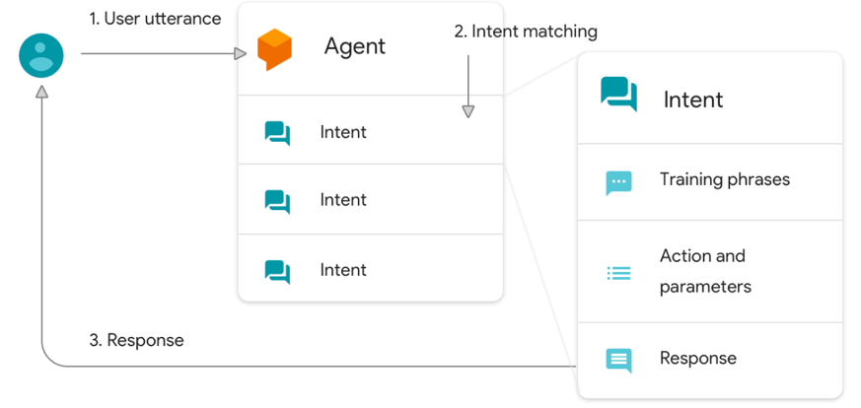
DialogFlow
Utterance: Set an appointment at 3PM tomorrow
Notes:
Set an appointment ➔ Intent
At 3PM tomorrow → Parameters with EntityType
Without parameters? Slot filling
Entities:
System Entities: Dates, Times, Locations, Phone Numbers, Currency, Email, …
Developer Entities: Consultants, Clients, Candidates
Session Entities: Only for this specific conversation
Intents:
Follow-Up Intents
Contexts

Slide 14
TO ORGANIZE

