Slide 1

CHATBOT BOOTCAMP ROLES
Notes:
Backups are in place: if you don’t like (part) of your role, contact Steven/Wouter and we can shift!

Slide 2
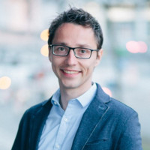

BUSINESs
Steven
Stijn
Notes:
As the owners of the itenium consulting they realize they need to introduce a chatbot to their website quickly. Their competitors have already implemented highly succesful Chatbots. In order to not become irrelevant they want a fully functional chatbot life yesterday.
Together with the functional team they will decide which features our chatbot dearly needs.

Slide 3
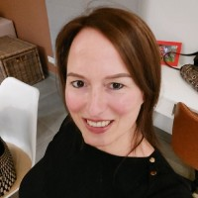
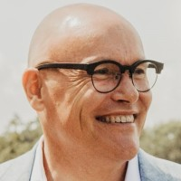
Functional ROLES
Sofie – ScrumMaster
Guides us through the planning process
Resolves conflicts in the team ;)
Chatbot tester
Mike – PO
Product backlog organisor
Guards that the business wishlist makes it into the MVP
Promo movie creator (possibly)
Chatbot tester

Slide 4
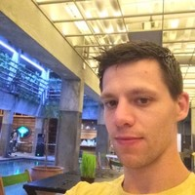
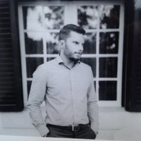
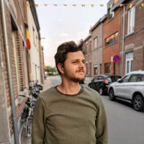

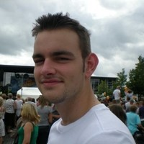

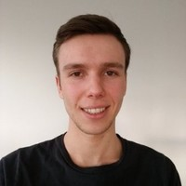
Development Team
Bert
Jonathan
Michiel
Thibault
Tomas
Thomas
Yentl
Notes:
Thomas didn’t have a LinkedIn picture 😃
Pair Programming – but we’re uneven

Slide 5
OPEN ROLES
Time Keeper:
Make sure we make it on time for lunch!
Demo Presenter:
Who will demo the Chatbot at the end of the bootcamp?
Notes:
Time Keeper: Make sure presentations or Brainstorming/MVP do not (greatly) exceed the allocated time slots.

Slide 6
PROCESS
Create Customer Journey Map
UserStories Brainstorm
Define Acceptance Criteria
Define MVP
Development & Testing

