Slide 1
Hkcert CTF write up
WANG Liujianfu Jeff
HUANG Luoming

Slide 2
Crypto:
Sign me a Flag (I)
MISC:
ST Code (I)
Sanity Check
Psychic AI
Hackforces
Challenges link: https://platform.ctf.hkcert.org/challenges
Solved problems (by our team CUHK0x)
Web:
Baby XSS again
Re:Zero
Reverse:
Gacha Simulator
ISA Intrusion
The Flag Game
PWN:
ISA Jump Scare
ISA Jogger

Slide 3
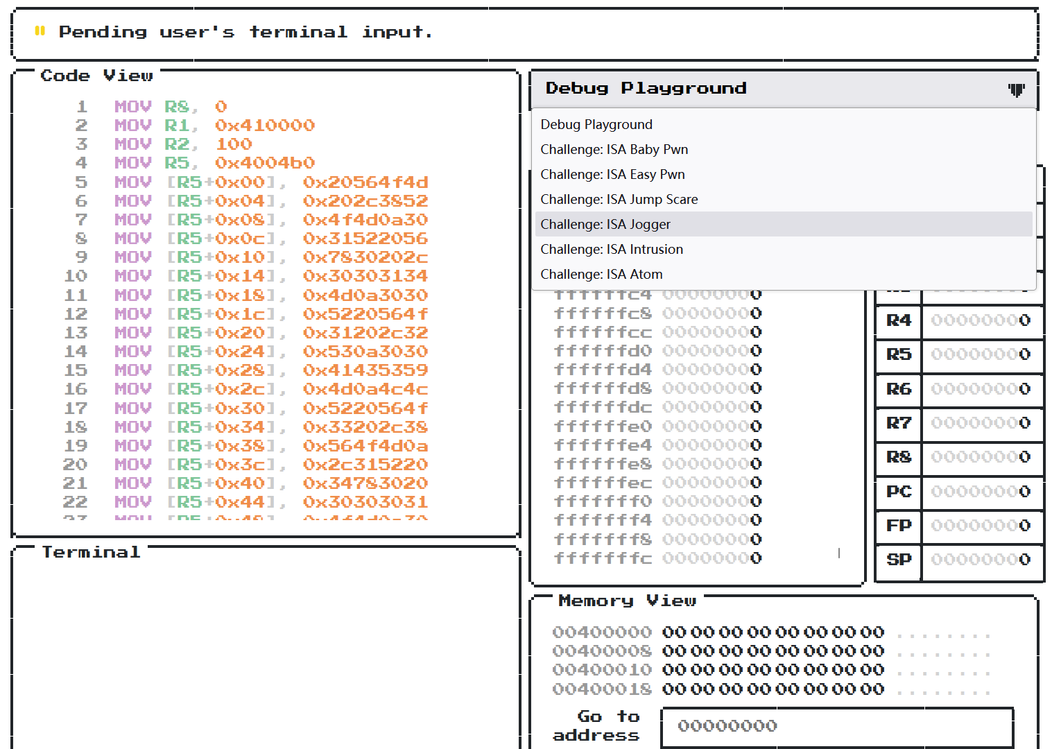
PWN: ISA
Provided with a simulated debugger

Slide 4
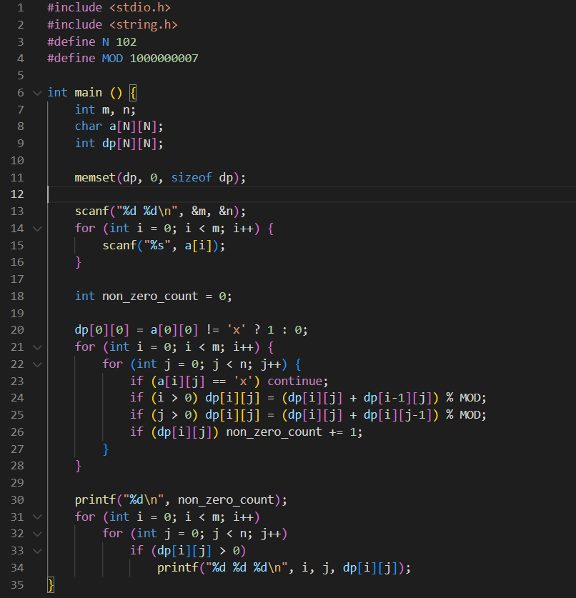



MISC: Hackforces
Given matrix a of size m*n
a[i][j] is ‘.’ (valid) or ‘x’ (invalid)
Starting from (0, 0), go to (m-1, n-1), only going forward
Calculate the number of paths from (0, 0) to (i, j) (mod 1e9+7)
Hack the program! =>
Sample input, output:

Slide 5
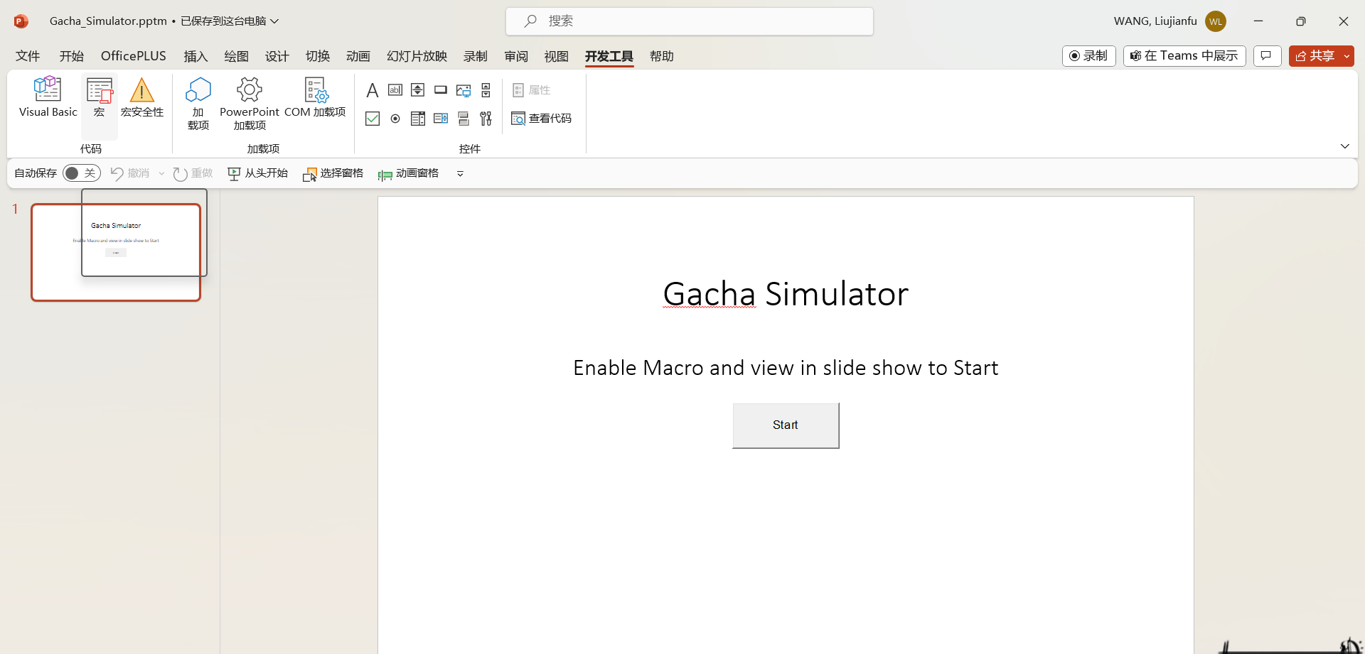
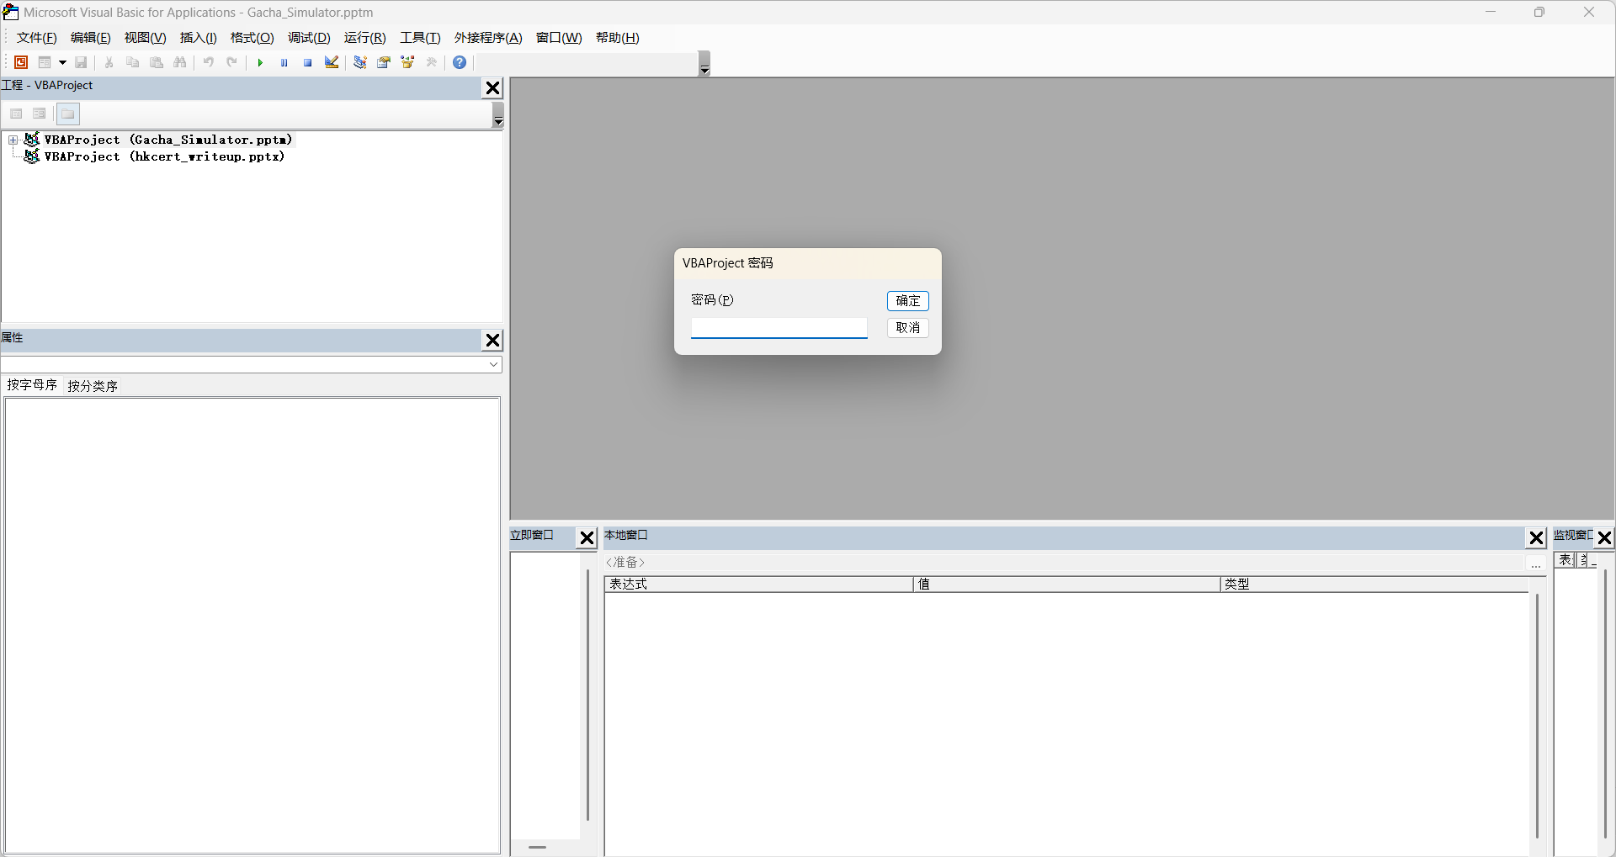
Reverse: Gacha Simulator
Given a gacha simulator (written with macro integrated in this slide)
Source code is in the VBA project but we cannot view it
https://stackoverflow.com/questions/1026483/is-there-a-way-to-crack-the-password-on-an-excel-vba-project

