Slide 1
Introduction to artificial intelligence
Technical University of Kosice
Faculty of electrical engineering and informatics
Computer modelling

Slide 2



Computational graph
Pridat parcialne derivacie
$$f= Wx$$
$$x$$
*
scores
loss
+
L
R(W)
$$W$$
Computational graph is a way to visualize and organize the series of mathematical operations that a neural network performs

Slide 3
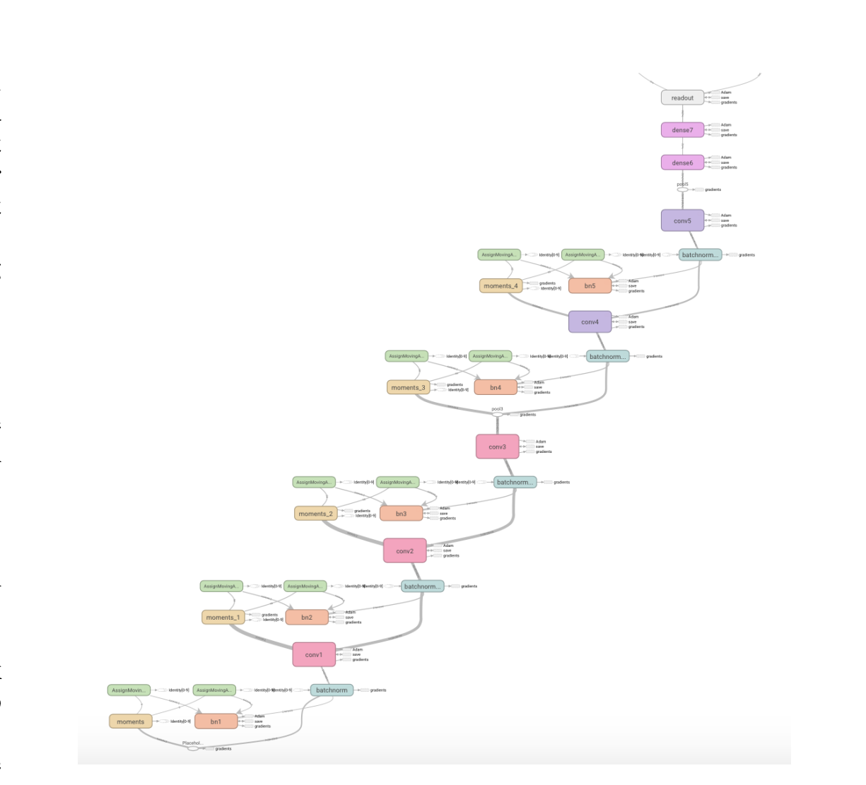

Slide 4
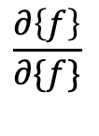

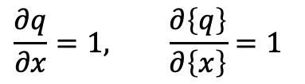


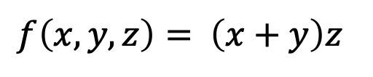

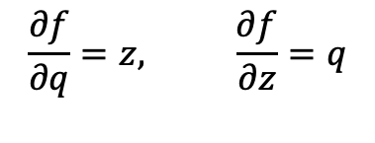
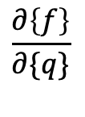




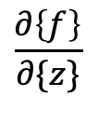

$$\frac{∂f}{∂x}$$
X = -2
$$\frac{∂\left\{f\right\}}{∂\{q\}}$$
$$−4$$
$$\frac{∂f}{∂y}$$
+
q = 3
$$f\left(x,y,z\right)= \left(x+y\right)z$$
$$−4$$
e.g. x = -2, y = 5, z = -4
f = -12
*
$$−4$$
$$q=x+y$$
$$\frac{∂q}{∂x}=1, \frac{∂\left\{q\right\}}{∂\left\{x\right\}}=1$$
y =5
$$\frac{∂\left\{f\right\}}{∂\{f\}}$$
z = -4
$$\frac{∂f}{∂q}=z, \frac{∂f}{∂z}=q$$
$$f=qz$$
$$3$$
$$\frac{∂\left\{f\right\}}{∂\{z\}}$$
What do we need?
Chain Rule
$$\frac{∂f}{∂y}=\frac{∂f}{∂q}\frac{∂q}{∂y}$$
$$\frac{∂f}{∂x} ,\frac{∂f}{∂y},\frac{∂f}{∂z}$$

Slide 5






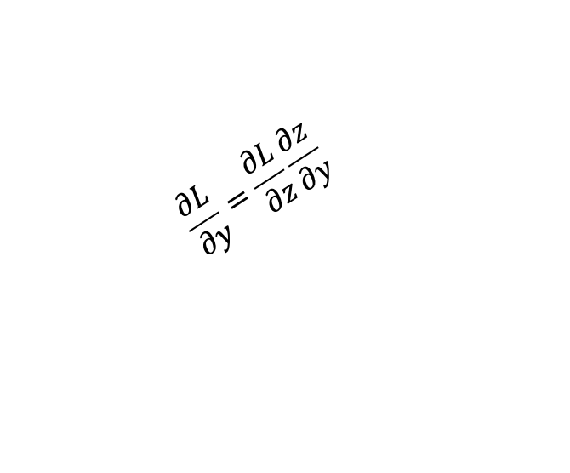

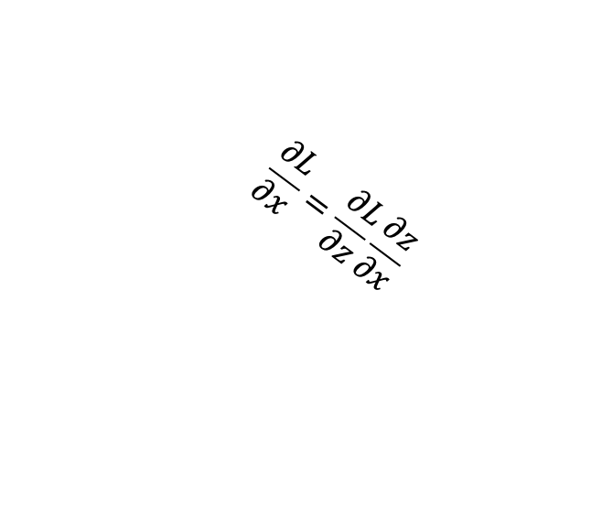
$$x$$
f
$$\frac{∂L}{∂x}=\frac{∂L}{∂z}\frac{∂z}{∂x}$$
local gradient
$$\frac{∂z}{∂x}$$
$$z$$
$$f$$
$$\frac{∂z}{∂y}$$
$$\frac{∂L}{∂z}$$
$$\frac{∂L}{∂y}=\frac{∂L}{∂z}\frac{∂z}{∂y}$$
$$y$$

Slide 6

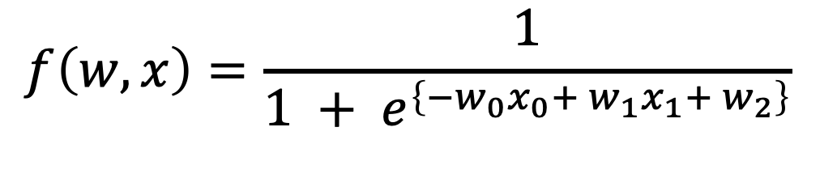


$$f\left(w,x\right)=\frac{1}{1 + e^{\left\{−w_{0}x_{0}+ w_{1}x_{1}+ w_{2}\right\}}}$$
$$2$$
*
$$−2$$
$$−1$$
+
$$−3$$
4
*
6
$$−2$$
1
1.37
0.37
-1
0.73
+
*-1
exp
+1
1\x
$$−3$$
We’re going to backpropagate everything to understand each weight on the final output

Slide 7
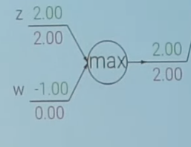




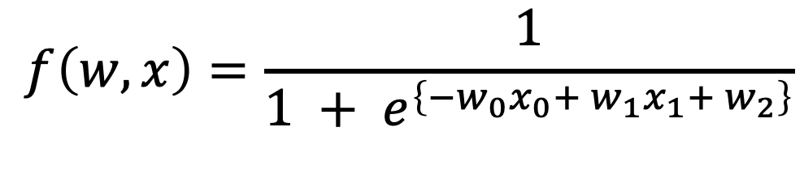

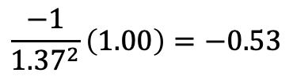







$$f\left(w,x\right)=\frac{1}{1 + e^{\left\{−w_{0}x_{0}+ w_{1}x_{1}+ w_{2}\right\}}}$$
$$2$$
$$−0.20$$
*
$$−2$$
$$−0.4$$
$$−1$$
$$0.20$$
+
$$\frac{−1}{{1.37}^{2}}\left(1.00\right)=−0.53$$
$$−3$$
$$0.20$$
4
$$0.20$$
*
6
$$−2$$
1
1.37
0.37
-1
0.73
+
*-1
exp
+1
1\x
$$0.20$$
$$−0.20$$
$$−0.53$$
$$−0.53$$
$$1.00$$
$$−3$$
$$0.20$$
+
Gradient Distributor
max
Gradient Router

Slide 8

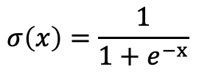




$$σ\left(x\right)=\frac{1}{1+e^{−x}}$$
$$2$$
$$−0.20$$
*
$$−2$$
$$−0.4$$
$$−1$$
Sigmoid gate
$$0.20$$
+
$$−3$$
$$0.20$$
4
$$0.20$$
*
6
$$−2$$
1
1.37
0.37
-1
0.73
+
*-1
exp
+1
1\x
$$0.20$$
$$−0.20$$
$$−0.53$$
$$−0.53$$
$$1.00$$
$$−3$$
$$0.20$$

Slide 9
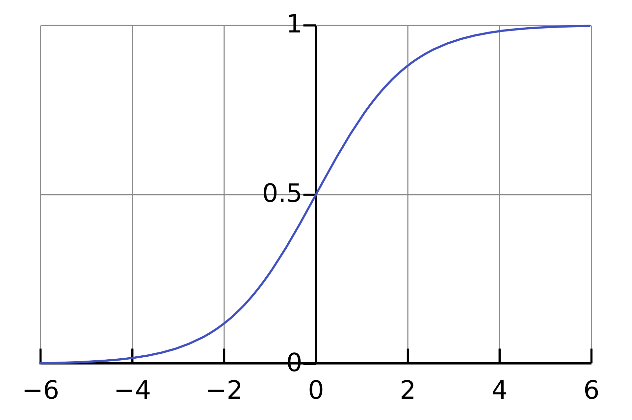

Slide 10
Pseudocode
# 2. Iterate through all nodes in a topologically sorted order.
FOR EACH node IN graph.nodes_topologically_sorted():
CALL node.forward()
RETURN output_of_final_node
FOR EACH node IN REVERSED(graph.nodes_topologically_sorted()):
# Each node's backward() method applies the chain rule locally. CALL node.backward()
# 3. After the loop, the gradients for the initial inputs are computed.
RETURN gradients_of_initial_inputs

Slide 11
Lab 03: Backpropagation examples

