Slide 1
Convolutional Neural Networks
Technical University of Kosice
Faculty of electrical engineering and informatics
Computer modelling

Slide 2
Convolutional Neural networks
Inductive biases

Slide 3


Slide 4

Convolutional Neural networks
Translational equivariance
Equivariance

Slide 5

Translational equivariance
$$\text{f}\text{(}\text{T}\text{(}\text{x}\text{)) = }\text{T}\text{(}\text{f}\text{(}\text{x}\text{))}$$
Where F is a function (learnable), T is translational operation (move object) and X is the input image

Slide 6
Locality

Slide 7
Locality
Features matter more if they are close together.

Slide 8
Hierarchical features
Early features capture simple features like edges and colors
Deeper layers combine these features to more complex patterns (shapes, eventually objects)

Slide 9
Convolutional Network
32x32x3
Activation maps
Input Image
Filter 5x5x3
Number of filters = number of activation maps
Convolve the filter with the image.
Convolving means “slide over the image spatially, computing dot products”

Slide 10
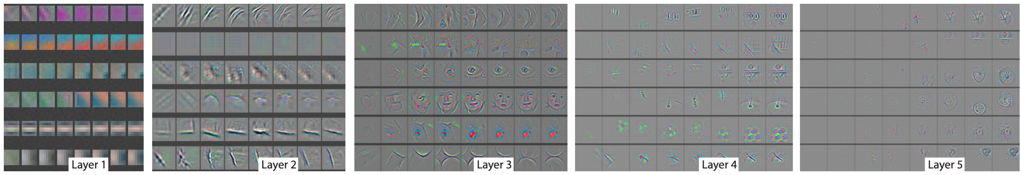
Low Level Features
Mid Level Features
High Level Features
Rubber duck!

Slide 11
Convolutional layer
Convolutional layer parametrized by kernel size, filter count, padding, stride
Normalization layers
Activation functions
Pooling layers

Slide 12
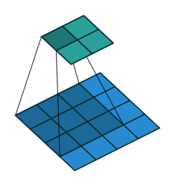
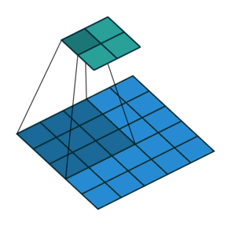
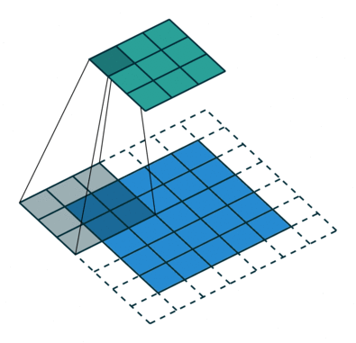
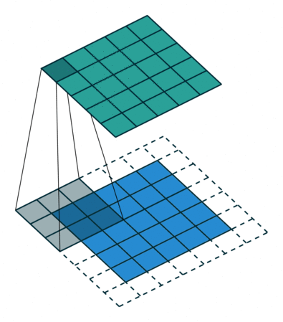
No padding, No stride
No padding, Stride
Padding, Stride
Padding, No Stride

Slide 13
Demo

Slide 14
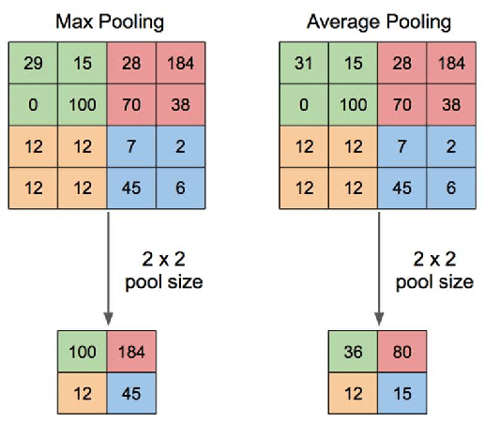
Pooling layers
Max pooling
Mean pooling
Used to downsample data (computationally efficient)

Slide 15
Demo

Slide 16
Pop quiz
How many parameters has one convolutional layer with 3x3 kernel and 64 input channels, 128 output channels?
73586 parameters

Slide 17
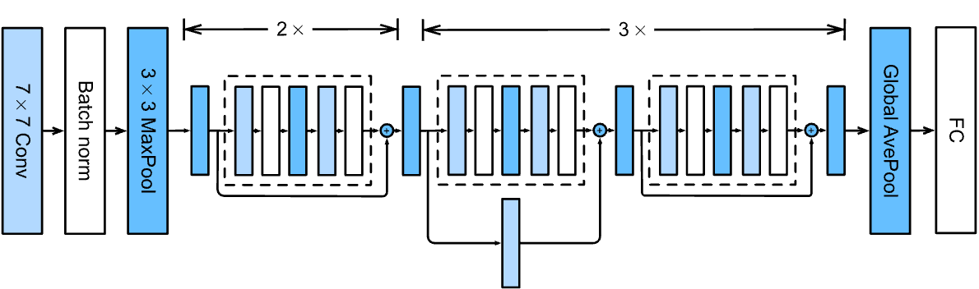
Case studies (resnet)
ResNet 18 architecture ±11.7m. parameters

Slide 18
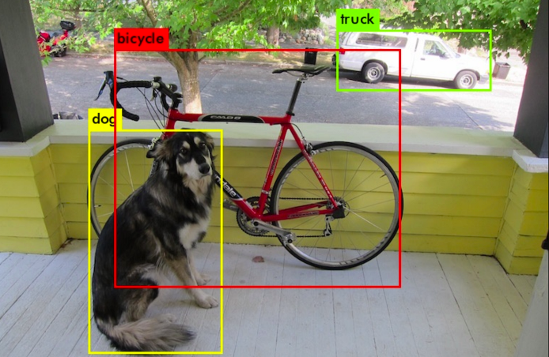
Localization

Slide 19
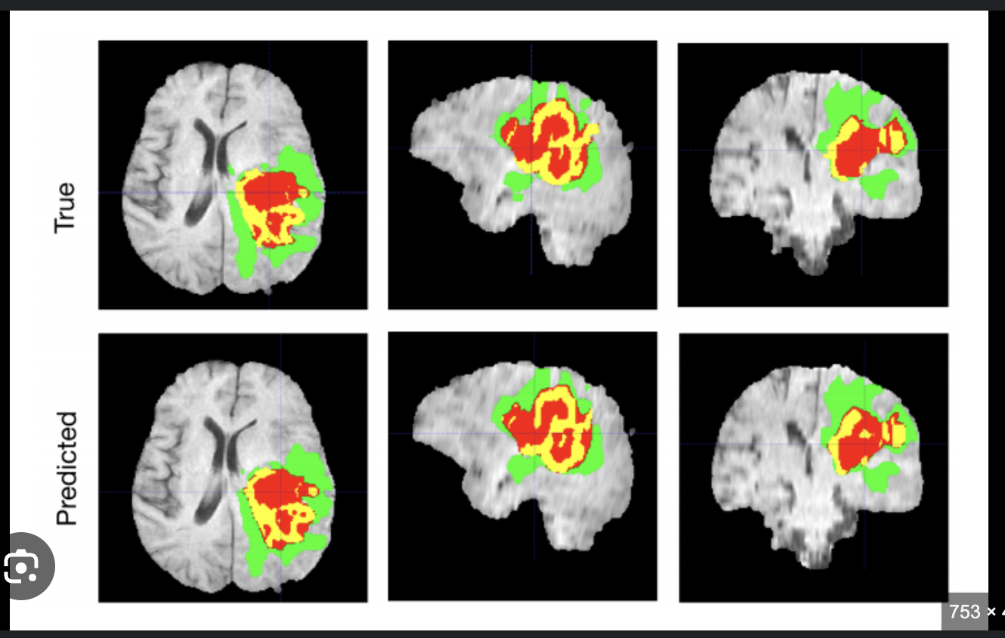
Segmentation

Slide 20
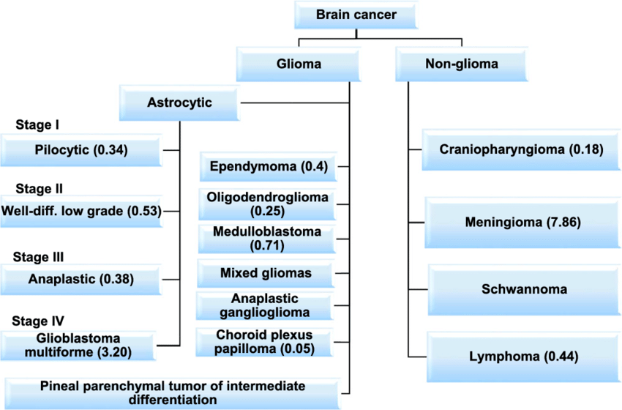
Classification tasks

