Slide 1



Plant Disease Prediction
For Sustainable Agriculture
STUDENT ID :
STU6798b13531c181738060085

Slide 2

Learning Objectives
We gained knowledge and hands-on experience in the following areas:
Deep Learning and Image Classification: understanding Convolutional Neural Networks (CNNs) and their application in plant disease detection.
Model Building and Training: developing a CNN model using TensorFlow to classify plant diseases.
Image Processing Techniques: utilizing OpenCV and PIL to preprocess images, including resizing, normalization, and color conversion.
Web App Development: building an interactive application using Streamlit to make the model accessible and user-friendly.
Model Deployment: integrating the trained model into a web interface for real-time disease prediction.
Data Handling: working with large image datasets and managing model input formats.
GOAL
Goal: To develop an AI-powered system that accurately identifies plant diseases from leaf images using Convolutional Neural Networks (CNNs).
Source :
www.freepik.com/

Slide 3
Tools and Technology used
Google Collab: for creating CNN Model
Kaggle: for getting the dataset
GitHub: for reference and data uploading
Visual Studio Code: for coding and creating app
Python: for programming and app creation
Streamlit: for building interactive web apps.
PIL (Python Imaging Library): for loading and manipulating image files within the application.
OpenCV: for image preprocessing and transformations.
TensorFlow: for building and training the CNN model for image classification.

Slide 4
Methodology
Data Collection: importing dataset from Kaggle
Addition of libraries: importing the necessary libraries required.
Model Development and training: we undergone training, validation and testing of the dataset.
Creating the graph: plotting a accuracy v/s epochs graph and understanding the accuracy.
Data Preprocessing: uploading and processing of the images.
Creating the app: app with dashboard and different pages like the home page and the disease prediction page.
Deployment with Streamlit: creating the app using Streamlit and hosting the app on a local webpage.

Slide 5
Problem Statement:
Agriculture plays a critical role in global food security, but plant diseases significantly affect productivity and can cause economic losses and sometimes also famines.
Traditionally, farmers detect diseases manually, which is:
Time-Consuming: visual inspection is slow and labor-intensive.
Error-Prone: human judgment can vary, leading to inconsistent results.
Costly: misdiagnosis can lead to inappropriate treatments and increased unnecessary costs.

Slide 6
Solution:
To address the challenges associated with manual plant disease detection, we have developed an AI-based Plant Disease Prediction System using Convolutional Neural Networks (CNNs).
Solution Features:
Automated Disease Detection
Real-Time Prediction
Accurate
User-Friendly Web Interface
The challenge is to develop an automated, reliable, and fast method for identifying plant diseases which helps the farmers in the disease detection. Our solution leverages AI to accurately detect and classify plant diseases from images, making the process efficient and scalable.
This solution will help farmers make data-driven decisions, reduce unnecessary pesticide use, promote sustainable agricultural practices and improve crop health.

Slide 7
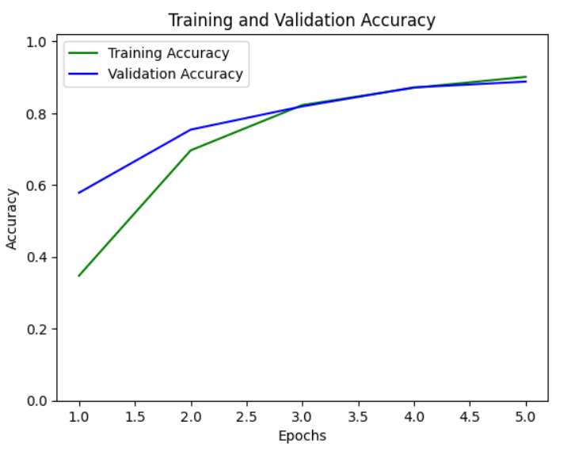
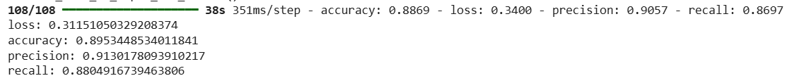
Screenshot of Output:
Figure 1: graph demonstrating accuracy v/s epochs
Figure 2: showing the accuracy, loss, precision and recall of the model.

Slide 8
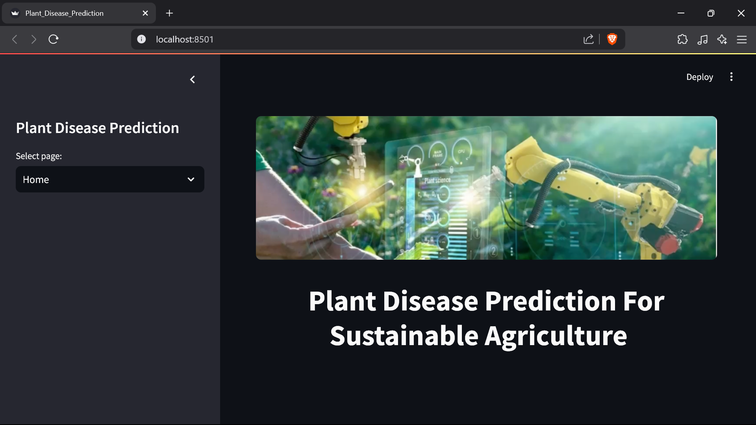
Screenshot of Output:
Figure 3: home page of the app that has been made

Slide 9
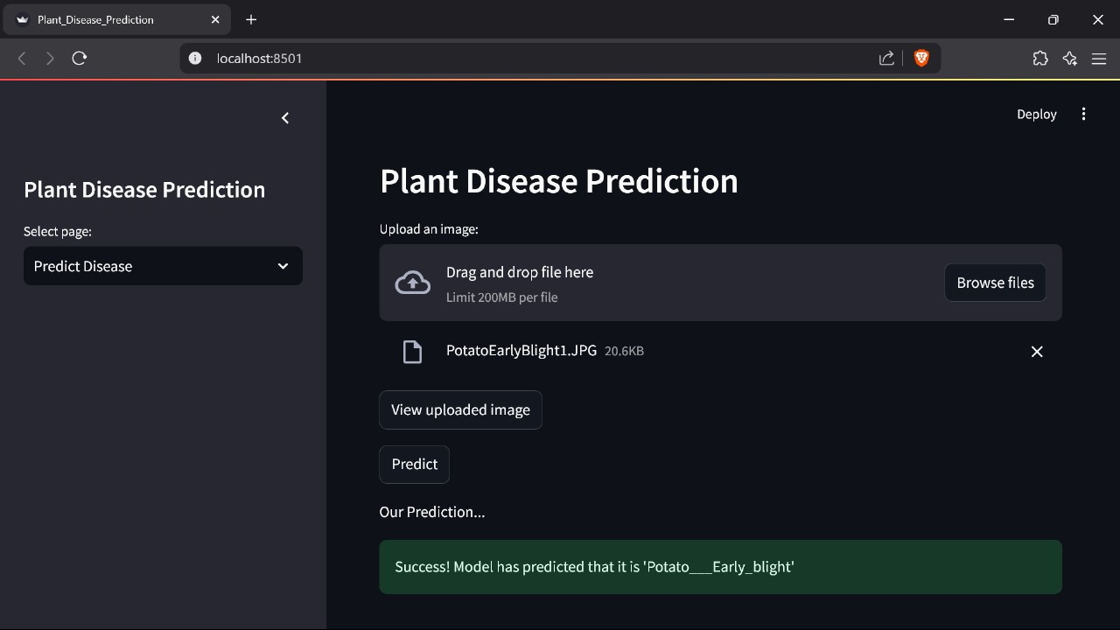
Screenshot of Output:
Figure 4: prediction of the uploaded image in the web page

Slide 10
Conclusion:
The AI-based Plant Disease Prediction system developed during this course has demonstrated the potential of leveraging deep learning to address real-world agricultural challenges. By combining Convolutional Neural Networks (CNNs) with a user-friendly web interface, the project has successfully achieved accurate and efficient plant disease detection.
Future Scope:
Model Improvement: tuning the model to enhance accuracy and reduce false predictions.
Data Expansion: integrating more crop varieties and disease types to increase versatility.
Mobile Application: developing a mobile version to increase accessibility in rural areas.
Integration with IoT: connecting with smart farming devices for automated disease monitoring
GitHub Link: https://github.com/BraveHeart20/PlantDieseaseDetection_AICTE.git

