Slide 1

A Team Pineapple product
Notes:
Hi! I’m Ian Spryn This is… And we are Team Pineapple
We are product to present our product, Magis.
Magis is a CAI program, and for those of you who don’t know what CAI is, it stands for Computer Aided Instruction.
Our product specifically teaches Java 101.
Magis stands out from other CAI programs in three primary ways

Slide 2
Why Magis?
Productive Learning Environment
Extendibility
User Interface

Slide 3
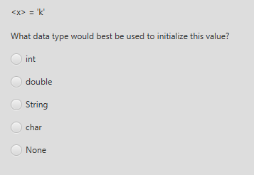
Productive Learning Environment
Big Java by Cay Horstmann
Renowned Java Book
Backbone of AP Courses
Learning vs Memorizing
How do we ensure Learning?
Dynamic Quiz generation
Notes:
Miriam
Josh
What is a Productive Learning Environment?

Slide 4
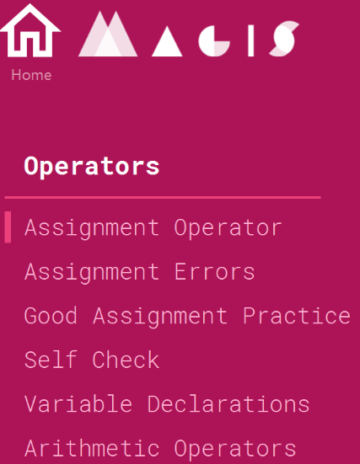
Extendibility
Quizzes and chapters
Simple nature
Notes:
Garrett
Minimal technical background

Slide 5
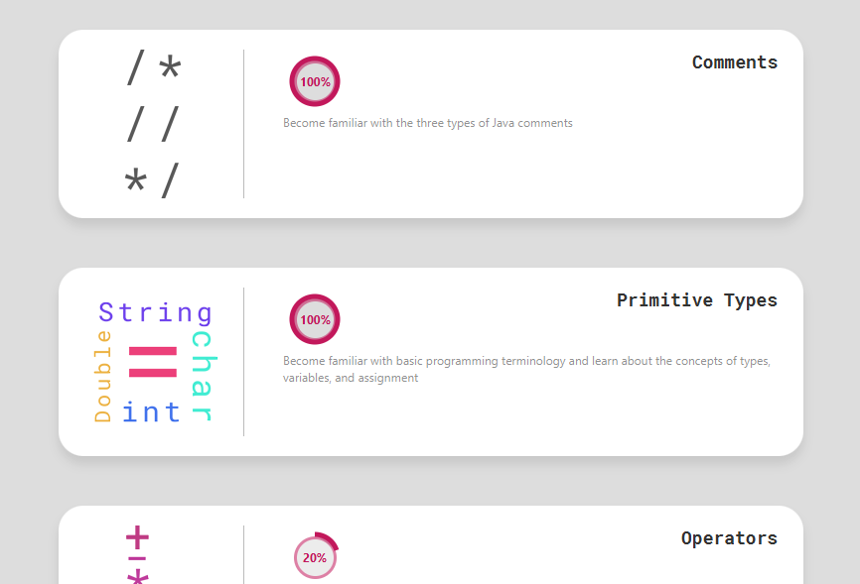
UI
Easy to learn
Consistent
Notes:
Our product has been user tested to ensure an intuitive experience such that no instruction or guidance is required to understand the product.
Magis is easy to use and its user experience is consistent across the board.
We will now give you a quick walkthrough of Magis.

Slide 6
Technical Backend
Question Generation Schema
Dynamic User Interface Creation via XML
Student Domain to track Progress and to Allow Multiple Users
Notes:
Nate

Slide 7
Question Generation Schema
Multiple Question Generators tailored to each chapter
Each generator is an object
Allows for smooth implementation of questions, answers, etc. to UI
Separate from static “conceptual” questions
Allows for unique questions to better test user
Notes:
Nate

Slide 8
XML Utilization
User Interface filled via pulling and parsing XML Files
XML Files hold data about quizzes, chapters, etc.
Allows entire program to be dynamically generated
Notes:
Ian
From the beginning, one of our many goals when building this product was to create as modular of a program as possible.
To accomplish this, we decided to use what are called XML files. In simple terms, XML files are just fancy text files.
When the program runs, it reads in three XML files, one for the chapters, another for the quiz questions, and a third one which we’ll get to in just a second
What’s helpful about this approach, is that if you decide to add new content, be it another chapter or additional quiz questions, you can do so without any additional code.
Simply open the XML file, add your content, and save. Next time you open Magis, it will contain the new material.

Slide 9
Student Domain
Tracks Progress via XML File
Allows user to pick off on last chapter he/she was on
Stores user information and allows for multiple users to login
Tracks progress for all students
Notes:
Ian
We also store student data in an XML file. This means student content can be dynamically fed into the program to create a unique learning environment for each user.
This enables features such as allowing each student to quickly pick up where they left off or seeing their progress of completion for each chapter.

Slide 10
Notes:
Conclusion: Miriam

Slide 11
Questions

