Slide 1
Debugging with LINQPad Save Time and Your Sanity
Elias Hassen
Notes:
Esri Corporate Template-Dark v3.3
16:9 version – January 21, 2016
For more templates, sample files, and icons, see https://compass.esri.com/resources/presentations/Pages/Main.aspx
To add footer text in Windows
On the Home tab, under Insert, click Text, and then click Header and Footer.
Click the Slide tab, select the Footer check box, and then type the footer text that you want.
Click either Apply or Apply to All.
To add footer text on a Mac
On the View menu, select Header and Footer.
Select the Footer check box and then type the footer text that you want.
Click either Apply or Apply to All.
If footers don't appear on the slides
If footers don't appear on title slides, in the Header and Footer dialog box make sure the Don't show on title slide check box is not selected.
If the footers are missing from other slides, the placeholders for these items might have been removed from specific slide layouts or the slide master.

Slide 2
What is LINQPAD?
A .NET Snippet centric code editor
Can reference any .NET library
Has a built-in NUGET Package manager
A SQL runner
Interactive debugger
Breakpoints within a script
Interact with Visual Studio

Slide 3
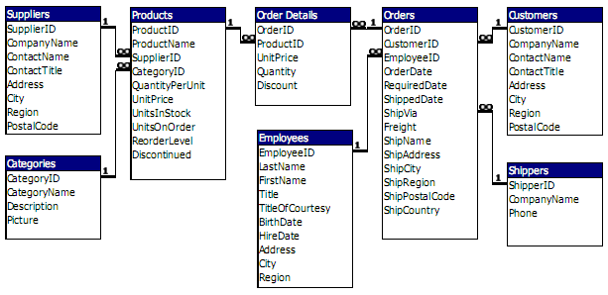
Exploring Databases – The traditional way using a schema
Demo – Explore Models
LINQPad

Slide 4
Scratchpad for Developing Solutions
Northwind DEMO - Find products which match a specific string and their categories
Explore Third-Party libraries
LINQPad

Slide 5
Resources
This Presentation: http://tinyurl.com/LINQPad
Intro to LINQPad Video by its creator http://www.oreilly.com/pub/e/909

