Slide 1

Visualization of san-Francisco payroll
2011-2019
By: Osemekhian ehilen

Slide 2
introduction
In this project, the pay of public servants in San Francisco, United States, with respect to different Job titles, status are going to be analyzed with visual representation.

Slide 3
dataset
This dataset contains the California public employee salaries from years 2011 to 2019 from kaggle with 357,407 samples.
This dataset is selected to know the various pay across various job types in a tech city.
Features | Count
Categorical | 3
Continuous | 7

Slide 4
variables
Dependent | Independent | Others
Total Pay & Benefits | Base Pay | Employee Name
 | Overtime Pay | Job Title
 | Other Pay | Year
 | Benefits | Total Pay
 | Status

Slide 5
Pre-processing
The null values for Status column was replaced with the modal class of not-null items in status column.
Zero value was assigned to continuous columns with “Not Available” entries aside base pay.
I Encoded Status column with 0 for part-time and 1 for full-time.
The appropriate data types were assigned to miss-matched columns using pandas dataframe astype method.
A flip was performed to make the “Year” column in ascending sequence.

Slide 6
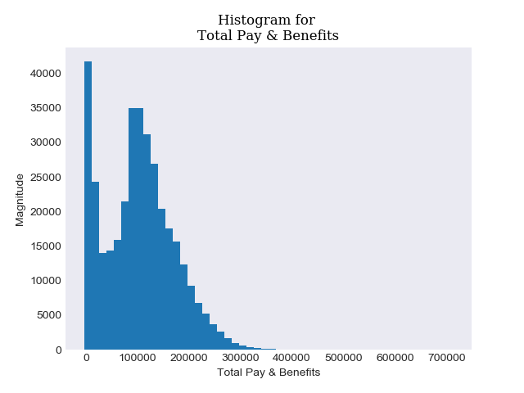
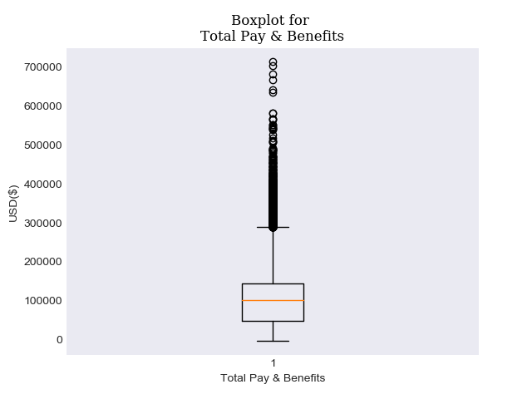
EDA

Slide 7
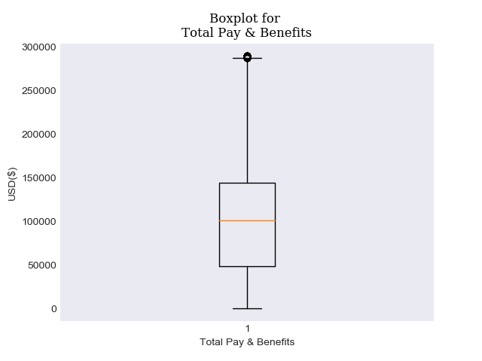
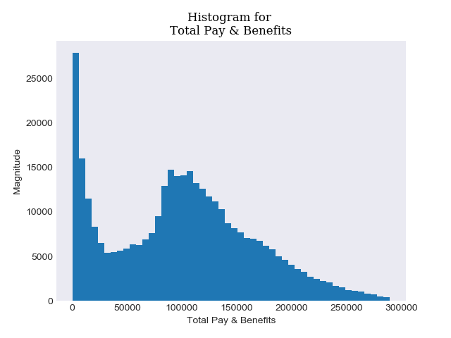
Outlier removal with i.q.r

Slide 8
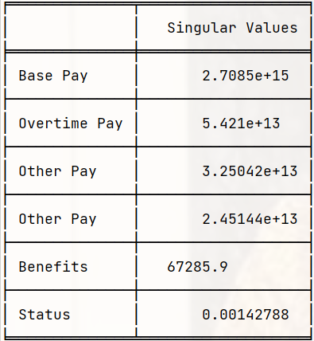
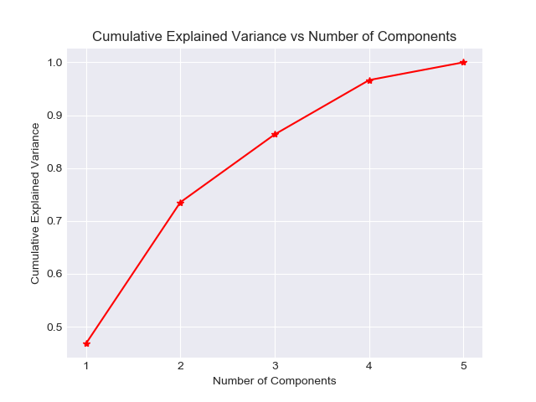
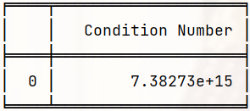
S.v.d | Condition number | PCA Analysis

Slide 9
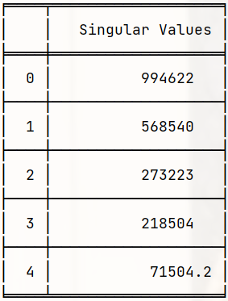
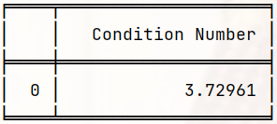
S.v.d | Condition number | PCA Analysis

Slide 10
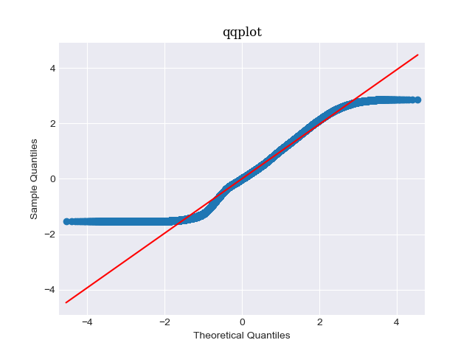
Normality test
Shapiro Result(statistic=0.9696874618530273, p-value=0.0)
With the p-value less than 0.05, it is concluded that the data is not from a Normal Distribution.

Slide 11
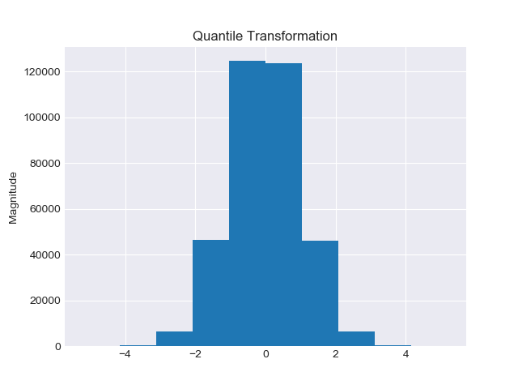
Quantile transformation
ShapiroResult(statistic=1.0000046491622925, pvalue=1.0)
With the p-value greater than 0.05, it is concluded that the data is from a Normal Distribution.
An inverse transformation is possible from sklearn package.

Slide 12
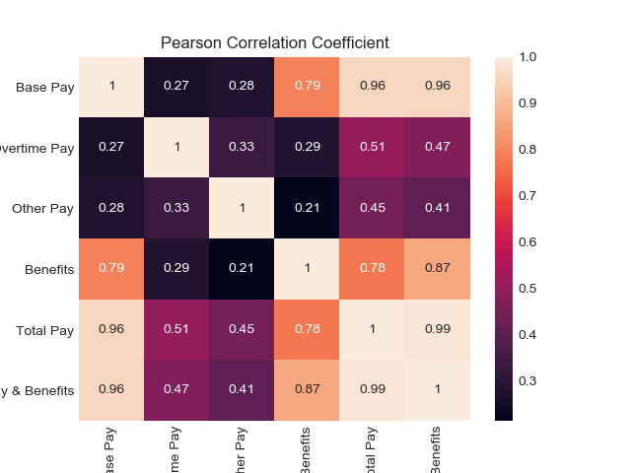
Pearson correlation coefficient

Slide 13
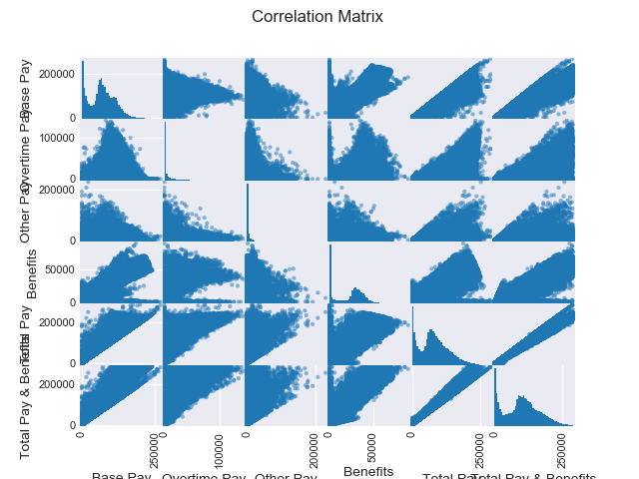

Slide 14
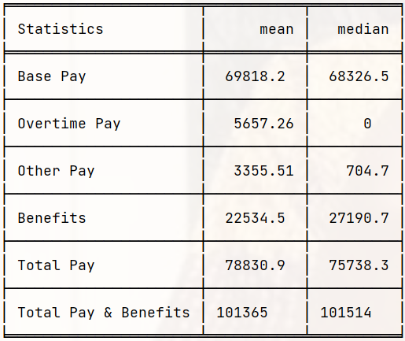
statistics

Slide 15
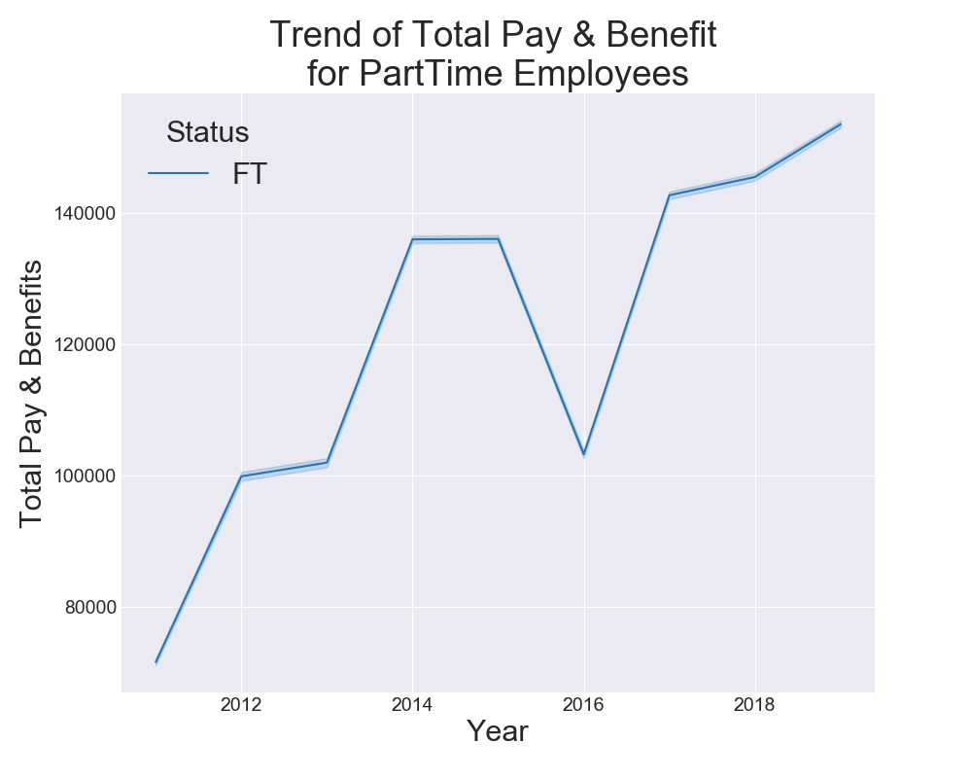
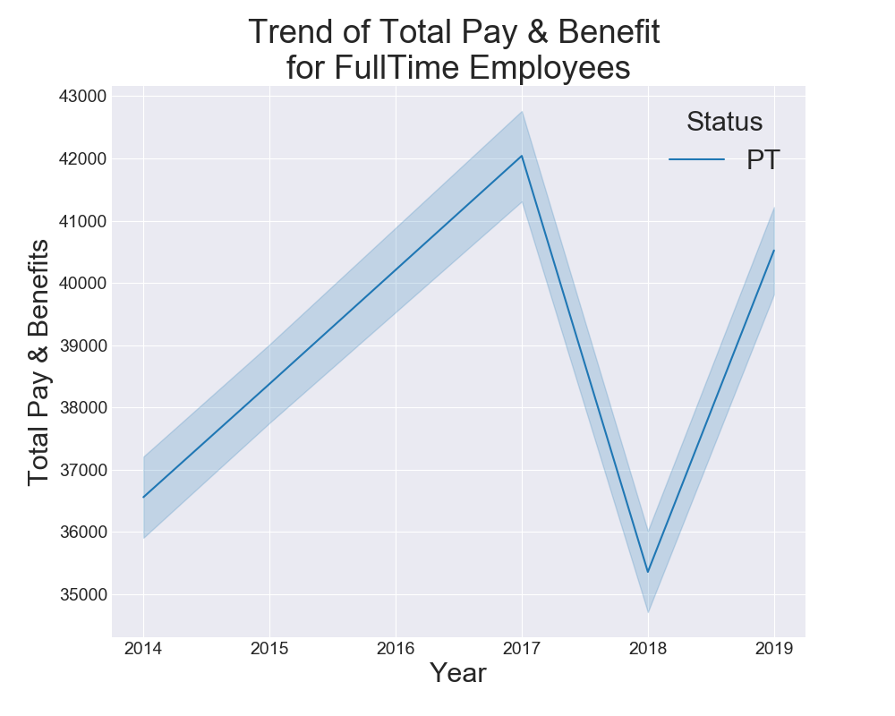
LINE PLOT ON TARGET

Slide 16
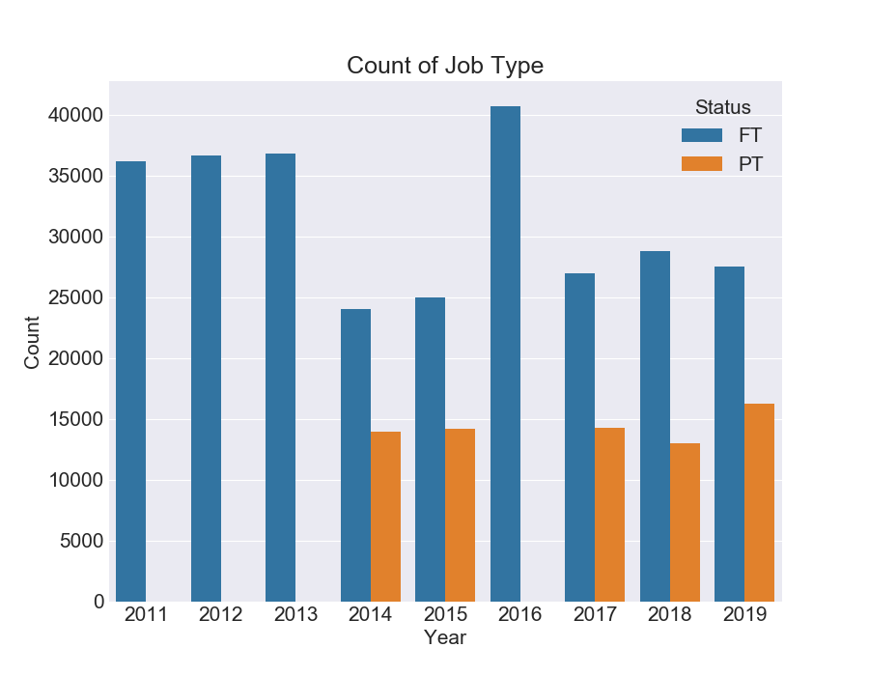
Count plot

Slide 17
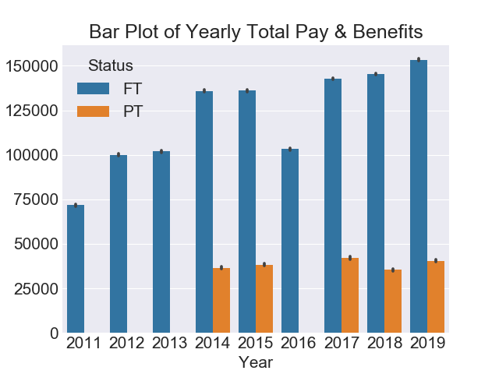
Bar plot

Slide 18
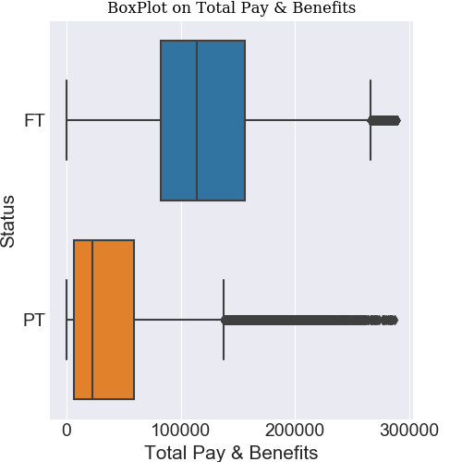
Category plot

Slide 19
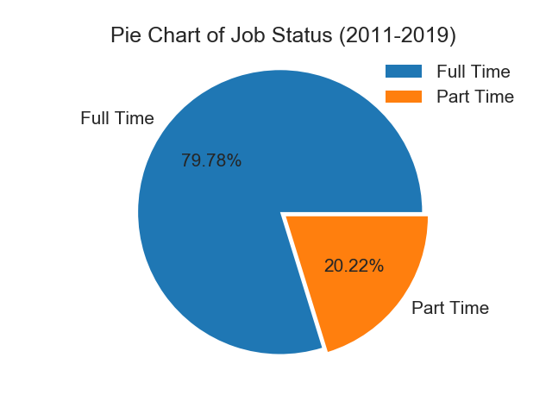
Pie chart of job status

Slide 20
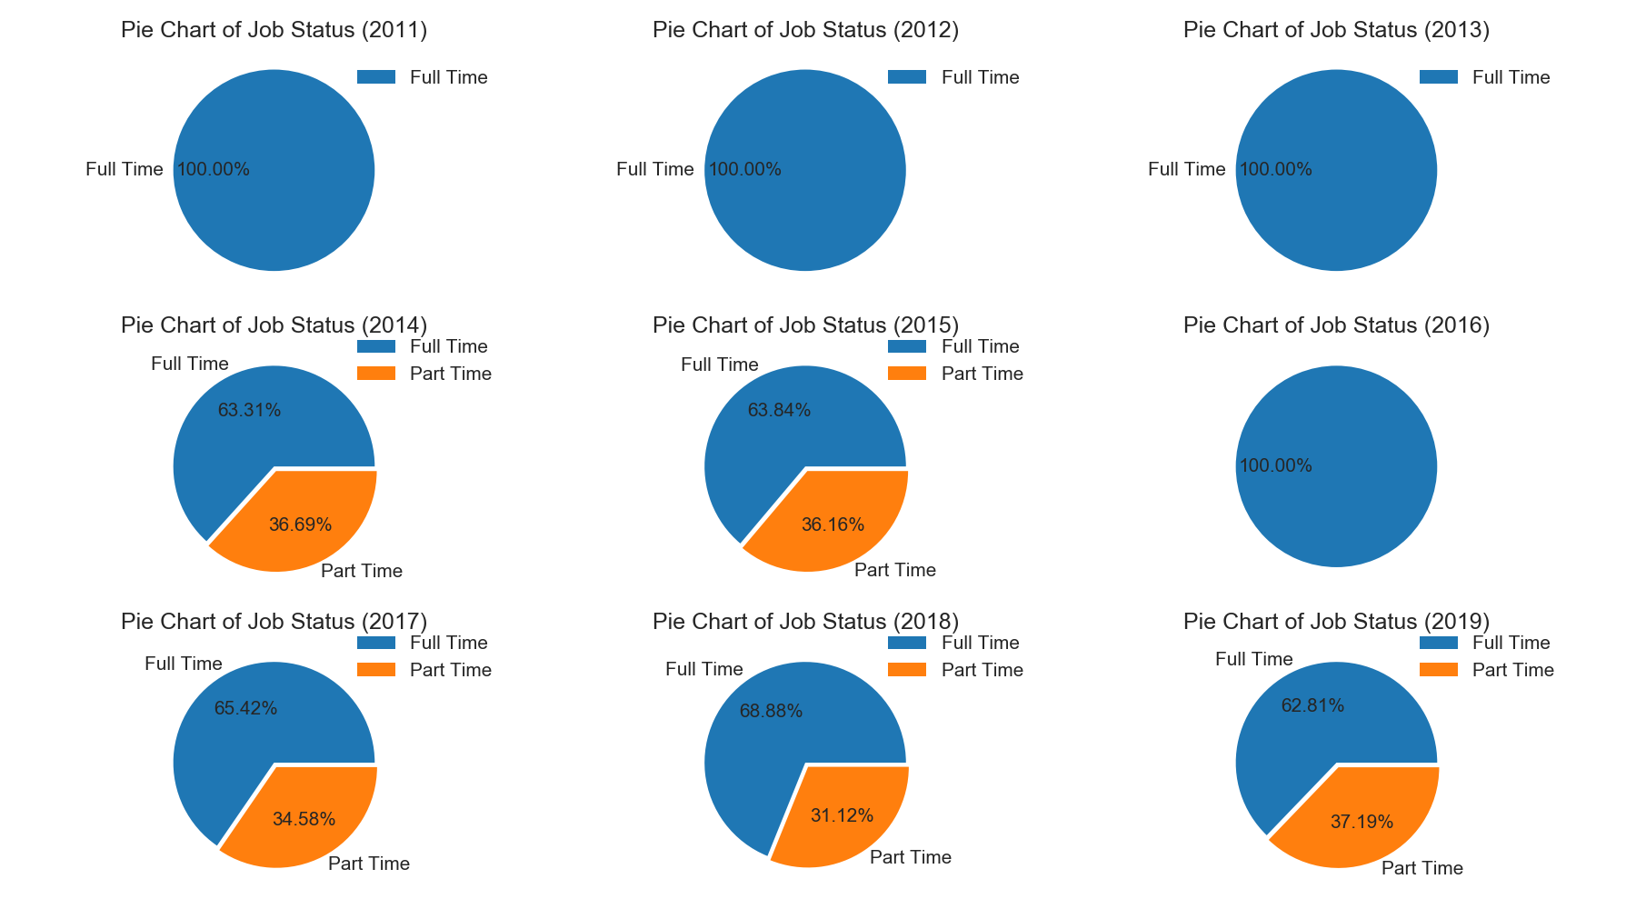
Pie chart of job status over the years

Slide 21
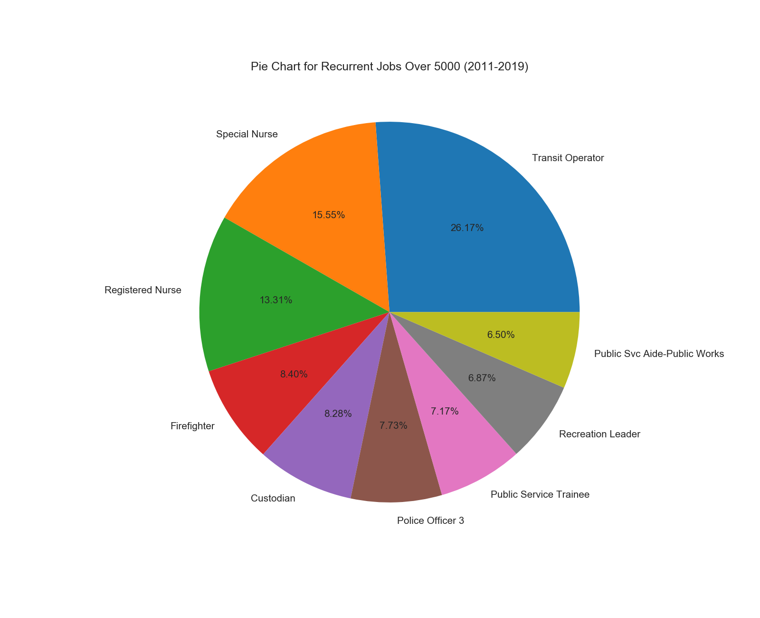

Slide 22
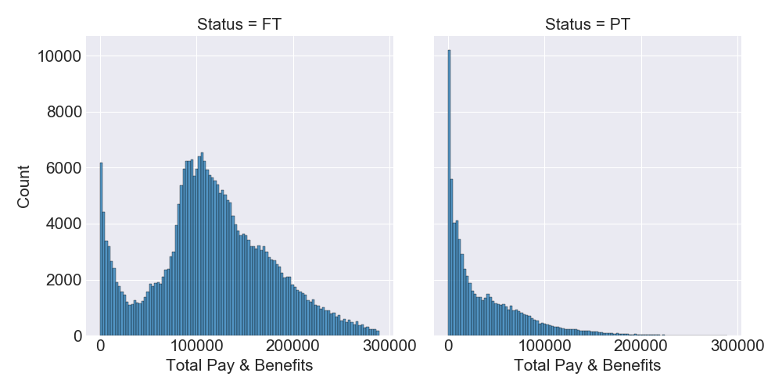
Distribution plot

Slide 23
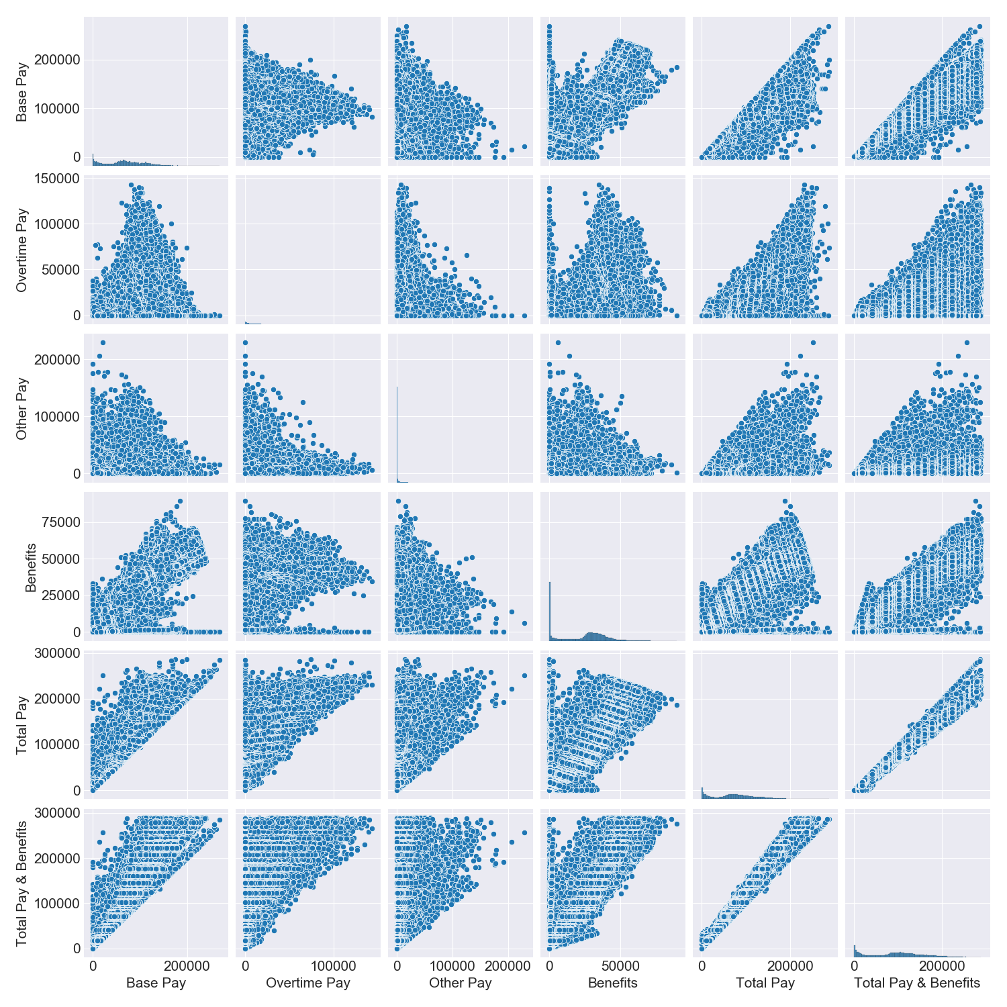
Pair plot

Slide 24
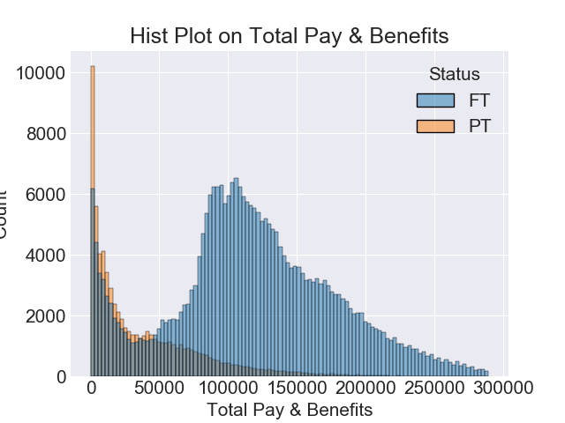
Hist plot per status

Slide 25
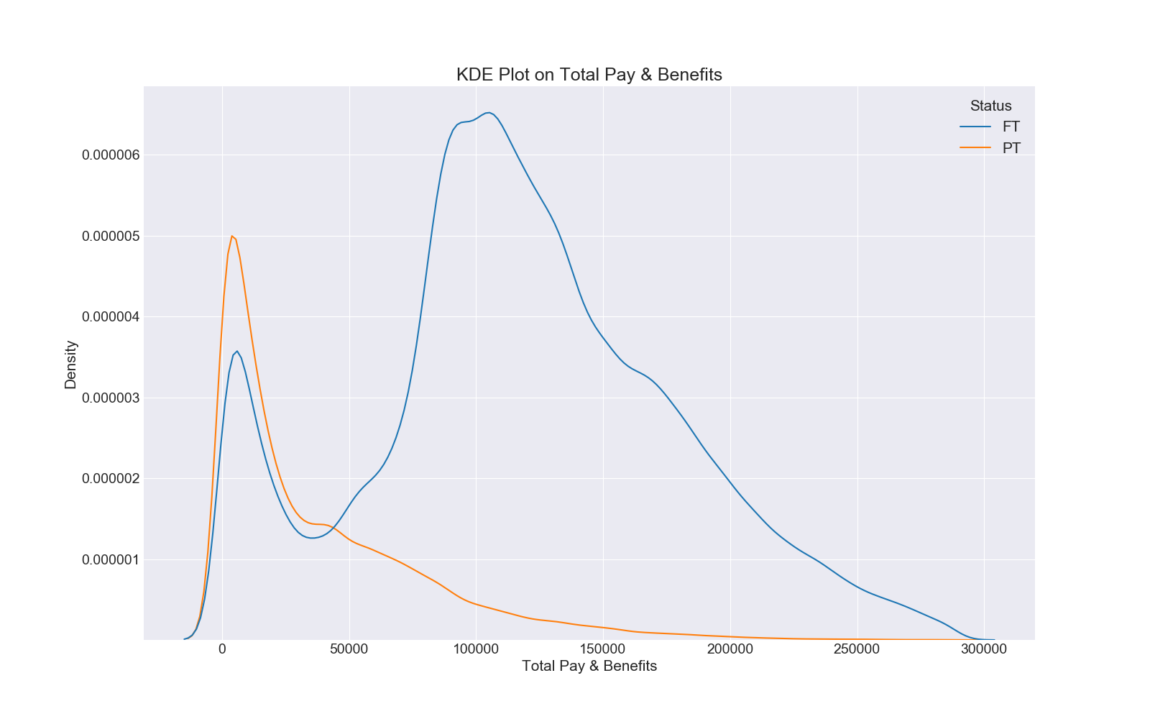
Kde plot

Slide 26
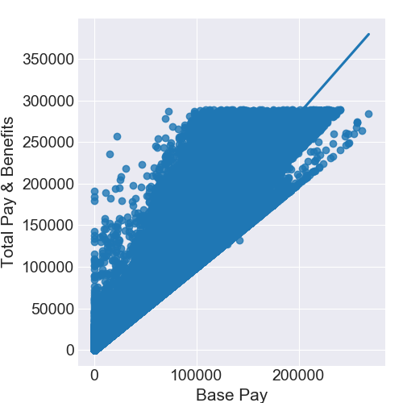
LM-PLOt

Slide 27
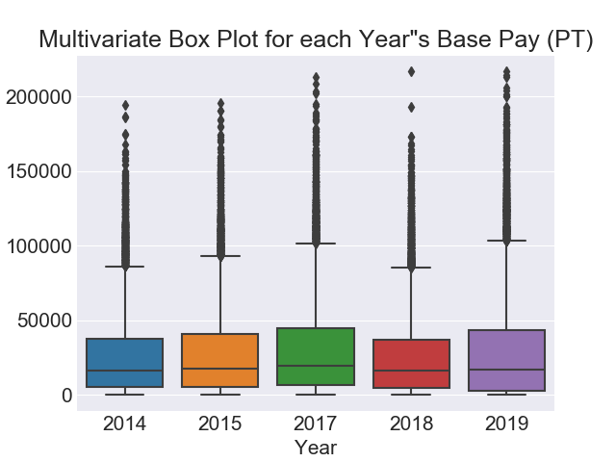
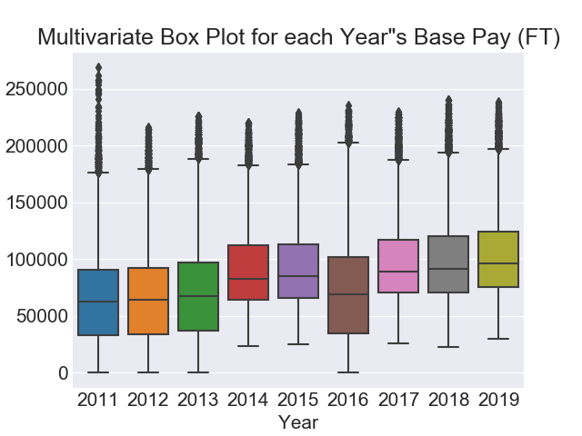
Multivariate box plot

Slide 28
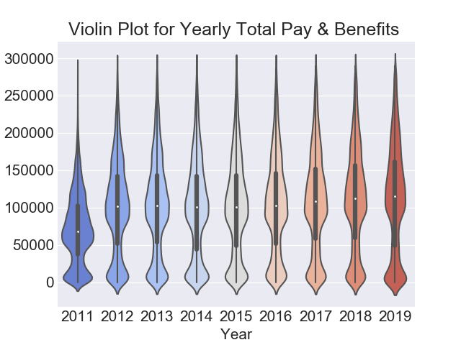
Violin plot

Slide 29
References
Image: https://www.zenefits.com/workest/what-are-payroll-internal-controls-and-why-you-need-them/
Dataset: https://www.kaggle.com/datasets/tomtillo/san-francisco-city-payrollsalary-data-20112019

