Slide 1

SIGN-LANGUAGE
GESTURE PREDICTION
Machine Learning Project
GROUP 2
Ricardo Diaz, Osemekhian Ehilen, Varun Shah

Slide 2





SIGN LANGUAGE GESTURE PREDICTION
INTRODUCTION
Communication with those with hearing disabilities is crucial and the ability for a computer to recognize and interpret these signs will make life easier; hence this project.

Slide 3

DATASET
The dataset is obtained from a kaggle competition task. The dataset consists of 37 different hand sign gestures which includes A-Z alphabet gestures, 0-9 number gestures and also a gesture for space (space between two word in sign communication).

Slide 4
DATA PRE-PROCESSING
Steps in preparing the train, validation and test:
Read images using cv2 library
Created labels for images using python dictionary
Normalized the images by dividing images by 255
Splitted features and labels into training, validation and test set

Slide 5
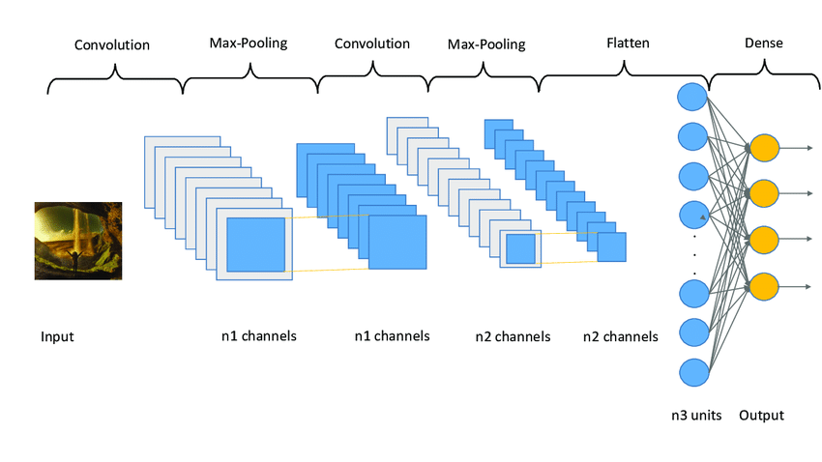

MODELING
Computer Vision with CNN

Slide 6
MODELING
Model Architecture
Type: keras sequential api
Input Shape: 50x50
Layers:
Convolution Layer: Activation Function: ‘relu’, Filters: 32, Strides: 5, Padding: ‘valid’
Max-Pooling Layer: Pool size: 2
Hidden Layer: 1. Perceptrons: 64, Activation: ‘relu’
Dropout Layer: Fraction of Input: 0.1
Output Layer: Activation: ‘softmax’

Slide 7
MODELING
Model Compiling
Optimizer: Adam
Learning Rate: 0.001
Loss Function: Sparse Categorical Cross Entropy
Batch Size: 16
Number of Epochs: 5

Slide 8
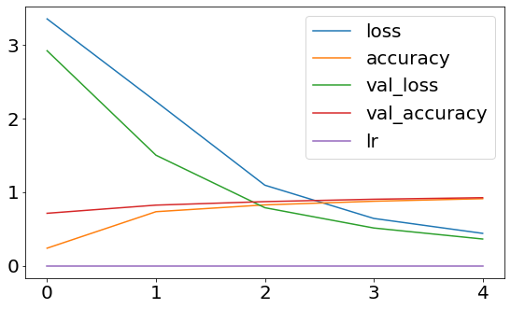
MODEL PERFORMANCE

Slide 9
MODEL PERFORMANCE
Train Scores:
Validation Loss: 0.29
Best Score: 0.94
Test Scores:
Loss: 0.3544
Accuracy: 0.9311

Slide 10
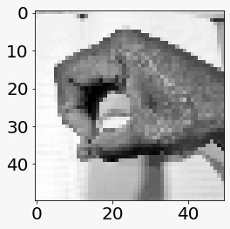
PREDICTIONS
Prediction:0
Actual: 0

Slide 11
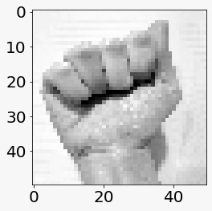
PREDICTIONS
Prediction: A
Actual: A

Slide 12
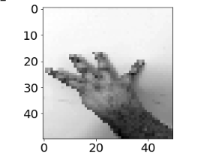
PREDICTIONS
Prediction: 1
Actual: 4

Slide 13
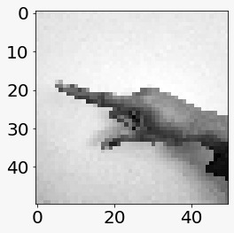
PREDICTIONS
Prediction: G
Actual: Z

Slide 14
CONCLUSION
Used CNN to train sign language images.
We got an average of 93% of accuracy score from the train and test set.
The problem we encountered was that the dataset had similar images of each class and this made it difficult for the model to predict our images correctly.
RECOMMENDATION
We would suggest to train the model with different variation of images in each class.

