Slide 1


Writing bespoke code for the OMOP CDM
Martí Català Sabaté
3rd May 2022

Slide 2





Introduction
dbplyr package
It is an R package → R advantages
User friendly
Statistical analysis
Simple commands
That works over SQL → SQL advantages
Memory problem solved
Some warnings:
Not all functions can be translated
Not always the easiest and efficient translation
User friendly (at least for us as we know how to program in it).
It can be used for the statistical analysis (compute PS, SMD, RR, logistic regression, matching…)
Simple commands to manage big tables of information (we are going to see them).
Memory problem
AURUM data: 6,600 GB (our best computer has 256 GB of RAM)
Person table: 5 GB
Drug exposure table: 190 GB
Condition occurrence table: 470 GB
In general (RAM 32/64 GB) → Nightmare
Not user friendly (at least we do not know how to use it).
Simple commands to manage big tables of information (faster than R in fact).
It can NOT be used for the statistical analysis (compute PS, SMD, RR, logistic regression, matching…)
There is NOT memory problem as it works in the “database space”.

Slide 3

Connect to database (magic words?)
server <- Sys.getenv("DB_SERVER_cdm_aurum_202106")
server_dbi <- Sys.getenv("DB_SERVER_cdm_aurum_202106_dbi")
port <- Sys.getenv("DB_PORT")
host <- Sys.getenv("DB_HOST")
user <- Sys.getenv("DB_USER")
password <- Sys.getenv("DB_PASSWORD")
db <- dbConnect(RPostgreSQL::PostgreSQL(), dbname = server_dbi, port = port,
host = host, user = user, password = password)
targetDialect <- "postgresql"
cdm_database_schema <- "public"
vocabulary_database_schema <- "public"
results_database_schema <- "results"
person_db <- tbl(db, sql(paste0("SELECT * FROM ",cdm_database_schema,".person")))
observation_period_db <- tbl(db, sql(paste0("SELECT * FROM ",cdm_database_schema,".observation_period")))
visit_occurrence_db <- tbl(db, sql(paste0("SELECT * FROM ",cdm_database_schema,".visit_occurrence")))
condition_occurrence_db <- tbl(db, sql(paste0("SELECT * FROM ",cdm_database_schema,".condition_occurrence")))
measurement_db <- tbl(db, sql(paste0("SELECT * FROM ",cdm_database_schema,".measurement")))
observation_db <- tbl(db, sql(paste0("SELECT * FROM ",cdm_database_schema,".observation")))
drug_era_db <- tbl(db, sql(paste0("SELECT * FROM ",cdm_database_schema,".drug_era")))
drug_exposure_db <- tbl(db, sql(paste0("SELECT * FROM ",cdm_database_schema,".drug_exposure")))
concept_db <- tbl(db, sql(paste0("SELECT * FROM ",vocabulary_database_schema,".concept")))
concept_ancestor_db <- tbl(db, sql(paste0("SELECT * FROM ",vocabulary_database_schema,".concept_ancestor")))
death_db <- tbl(db, sql(paste0("SELECT * FROM ",cdm_database_schema,".death")))
care_site_db <- tbl(db, sql(paste0("SELECT * FROM ",cdm_database_schema,".CARE_SITE")))
location_db <- tbl(db, sql(paste0("SELECT * FROM ",cdm_database_schema,".LOCATION")))
Depends on the database
Depends on “our computer” (the server)
Each one has its own user and password (ask Antonella, nicely )
Connect to the data base (always the same)
Depends on the database
“our” name
“database” name
Connection to each one of the tables

Slide 4
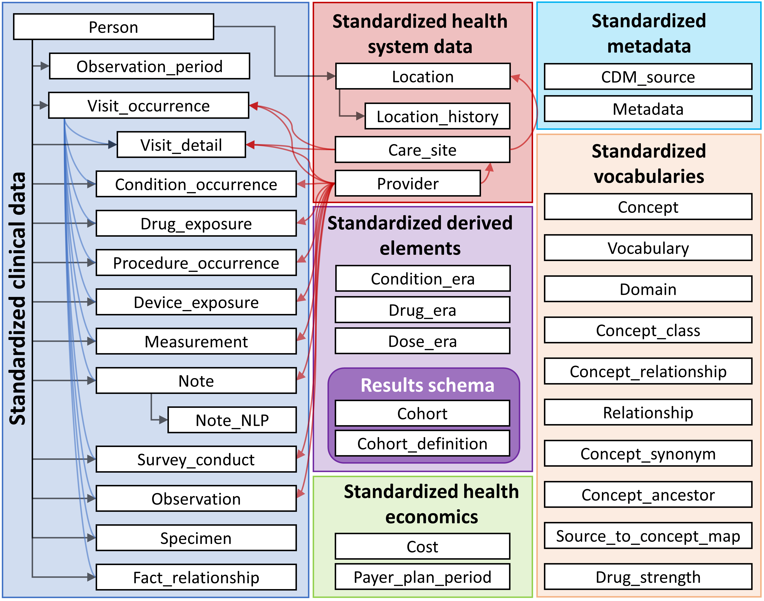

Data organization (Reminder)
We can read any of these tables.
Let’s see an example:
Connections.R

Slide 5
Basic functions
Example 1 (filter + select + %>%)
Filter function is used to obtain the rows (in our db patients) that have a desired condition.
Select function is used to obtain only the desired columns.
%>% operator is used to chain operators one after the other
Functions_1.R

Slide 6
Basic functions
Example 2 (mutate + rename + group_by + tally + distinct)
Mutate is used to create new variables (columns) in the database. They can be completely new variables or variables computed from the previous ones.
Rename is used to change the name of a column.
Group_by is used to create groups in the data (functions then are applied into this groups).
Tally is used to count the number of elements (rows).
Distinct is used to ensure that all the rows are different.
Functions_2.R

Slide 7
Where is the magic? What’s happening?
show_querry()
What dbplyr package is doing is to transform our R commands to SQL.
They are executed in the “DB side” and we see the output.
With this command we can see which are the sql commands that are being executed
Let’s see what our previous codes where doing…
SQL_commands.R

Slide 8
From DB side to R side
In fact, all this operations are carried out in the “database side” so how we can connect our environment of R with the variables that we want to obtain:
Compute() is used to force the computation of a set of commands, if compute is not used our variable only contains the set of commands and not the result.
Collect() is used to move one data set to our R environment
Pull() is used to obtain an array of the table (moving the data set to our environment, if necessary)
Compute_collect.R

Slide 9
Join tables
Join tables is a very powerful tool that allow us to merge two different tables into just one. We are going to show five ways to join two tables.
Inner_join: only elements contained in both tables.
Full_join: all element (even if they are not contained in one of the tables). NAs are introduced for absences.
Left_join: only elements in the first table are included. NAs are introduced for absences.
Right_join: only elements in the second table are included. NAs are introduced for absences.
Anti_join: only elements that are in the first table but not in the second are included.
Tables are joined using the variable specified (by=“variable”), if it is not specified all common variables are used.
Joining_tables.R

Slide 10
Build an example cohort
Female
Aged between 70 and 80 in 1/1/2022
In observation at during all 2020 (1/1/2020-1/1/2021)
Received Pfizer Vaccine against covid-19 (Drug Era 37003432)
BuildCohortSolution.R

Slide 11
Code optimization
We used the simplest codes to show the examples that we wanted to show. But they are not the fastest, we have to try to improve always the code performance.
Some tips:
Always is better to use join functions than filters, for example: inner_join & anti_join are two very useful functions.
Not to execute computations in the database side that can be executed in the R side.
Use always compute(), collect() or pull() at the end of each line of code.
Build cohorts with ATLAS (not seen) to speed-up the obtention of some events.
Avoid changing between DB side to R side and R side to DB side if it is not necessary.
Two remaining things: build cohorts with Atlas (Xintong) and upload a cohort/table at DB side.

