Slide 1
Bayesian Networks using PGMPY
ODSC 2018
Presented by
Sathwik Mohan Vangari (ML Engineer at Colaberry)

Slide 2
Agenda
Introduction
Bayes Rule and Conditional Probability
What are PGMs?
What are Bayesian Networks?
Motivation to study Bayesian Networks
Features of Bayesian Networks
Fraud Modeling
Conditional Independence and D-separation
Credit Approval Model

Slide 3
What are PGMs?
PGM
Probabilistic
Model
Graphical

Slide 4
What are Bayesian networks?
Mathematical Formalism
Directed Acyclic Graph

Slide 5
Why use Bayesian networks?
Infer Causality
Bring in domain knowledge – advantage or requirement?
Comprehensible
Works with incomplete data

Slide 6
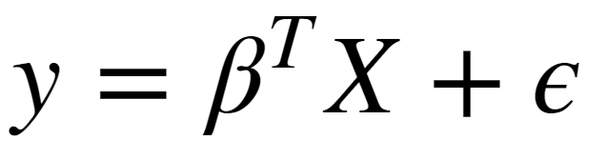
Linear Regression – 1/2
Frequentist View

Slide 7
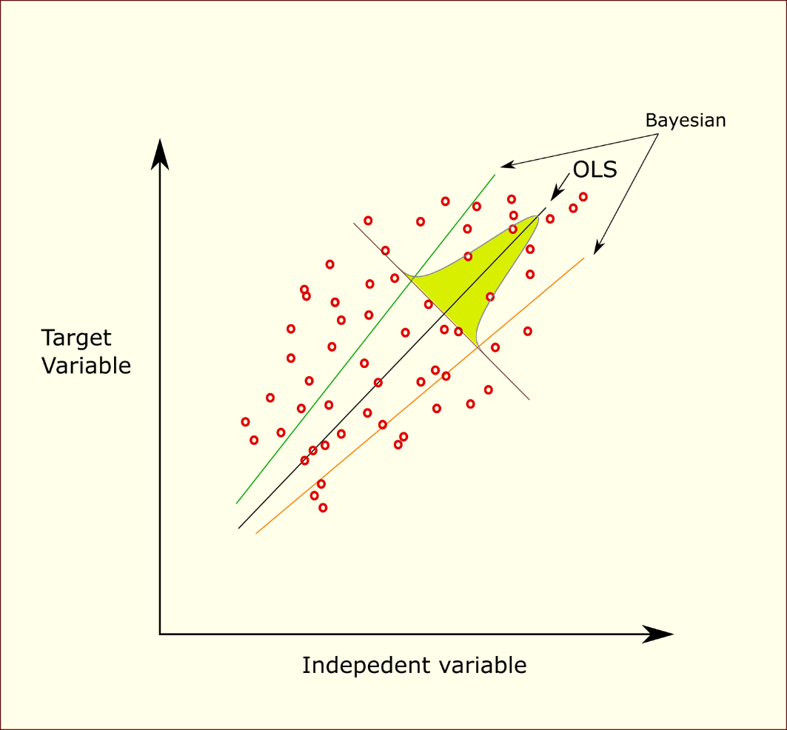
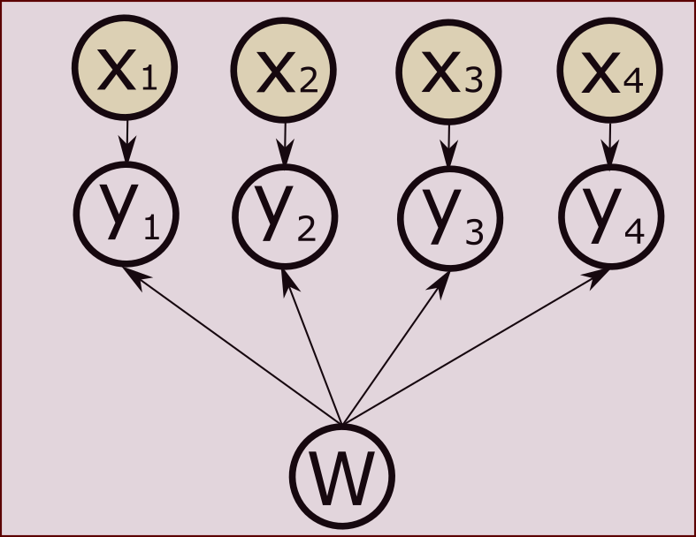
Linear regression – 2/2
Bayesian View

Slide 8
Problem formulation
Theoretical
Learned from data

Slide 9
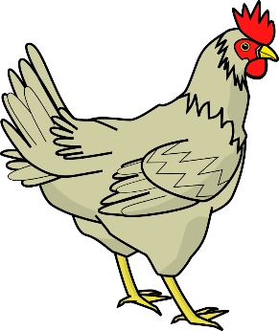

Chicken or Egg? – Theoretical

Slide 10


Chicken Or egg? - data solved

Slide 11
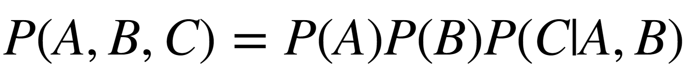
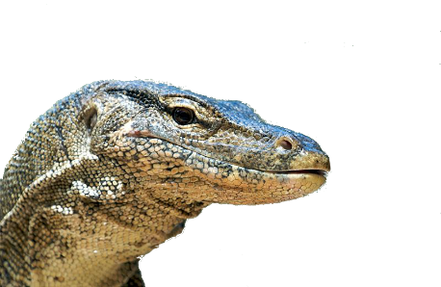
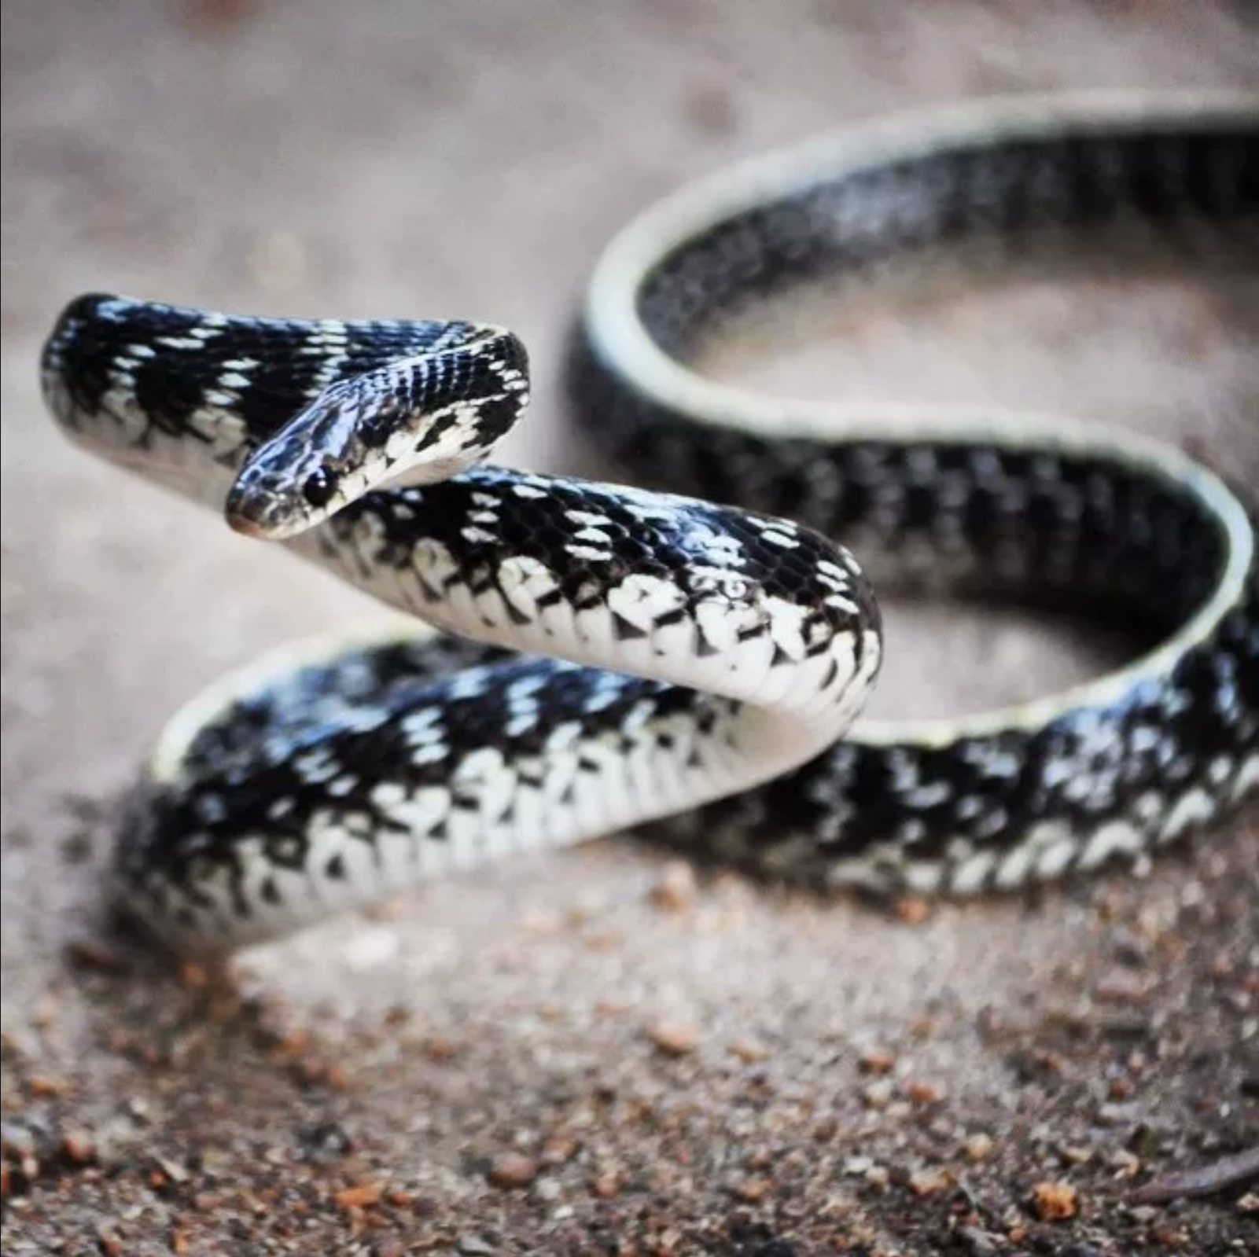
Who ate the egg?
Conditional Dependence

Slide 12
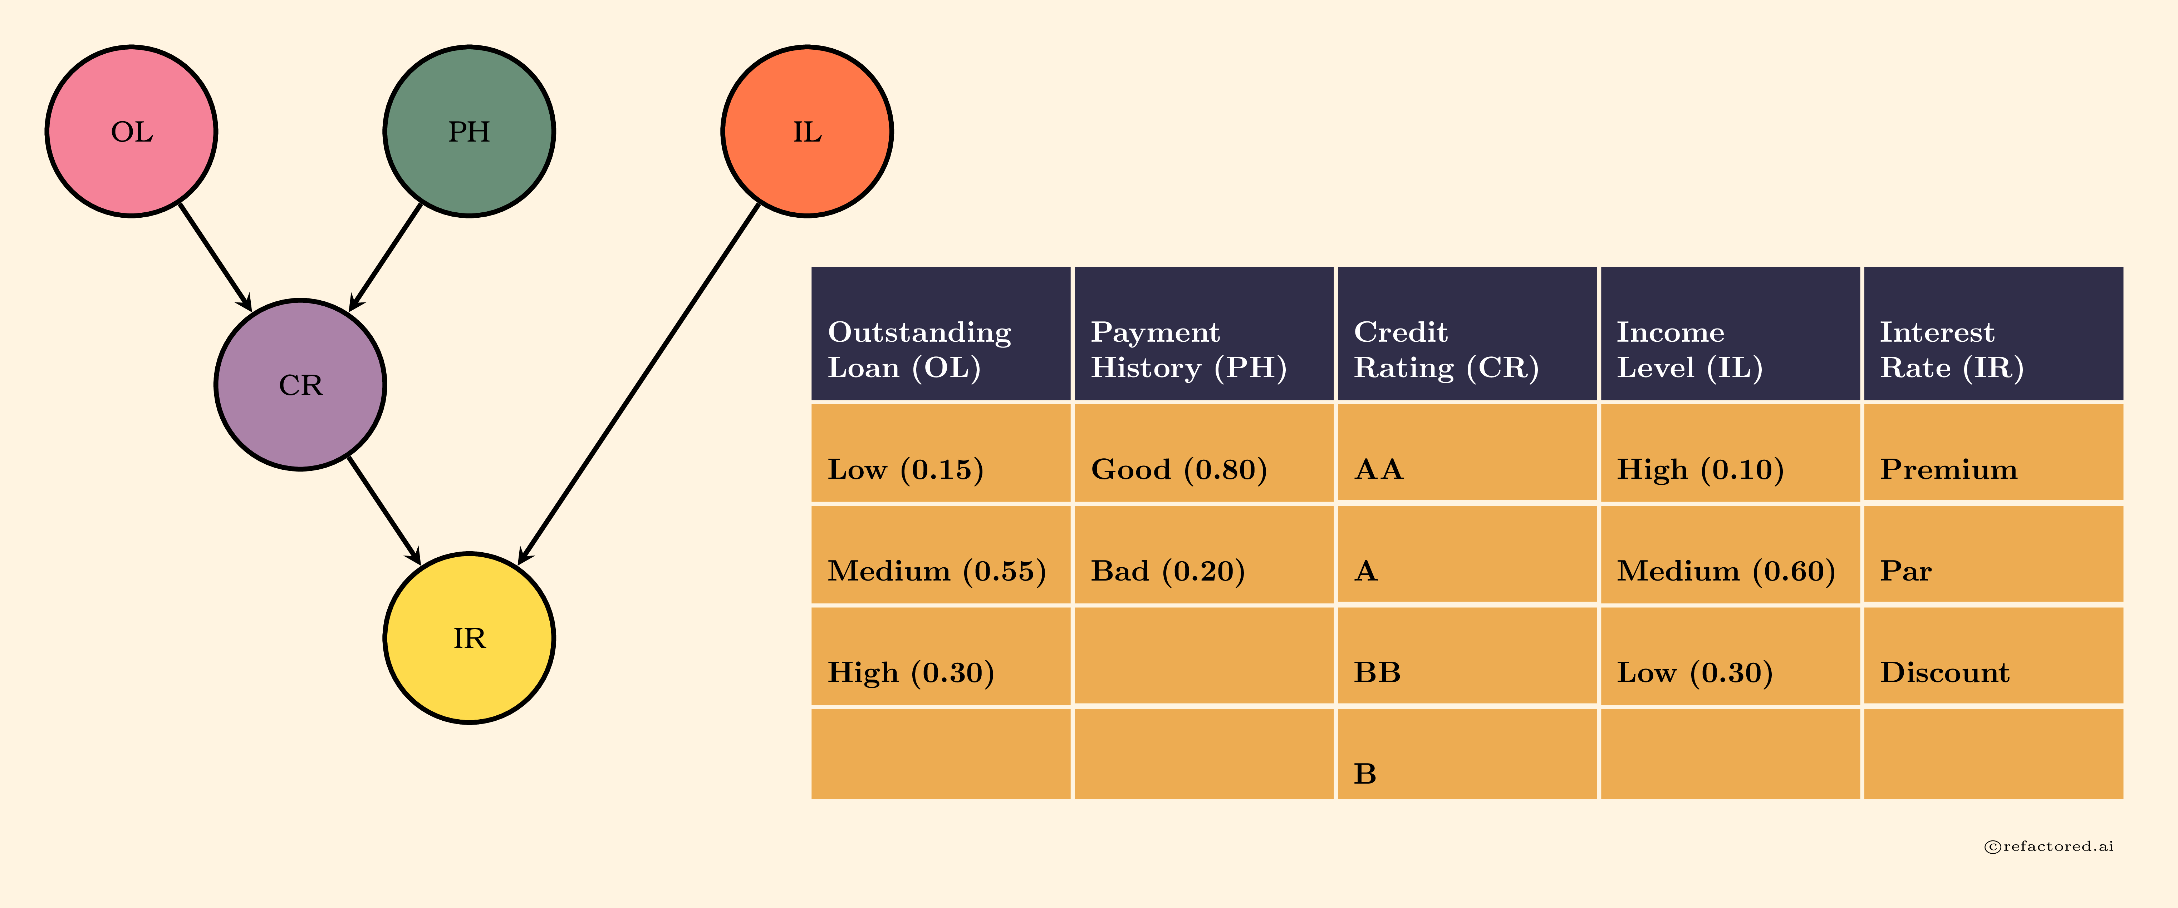
Credit Approval – Bayesian Network

Slide 13
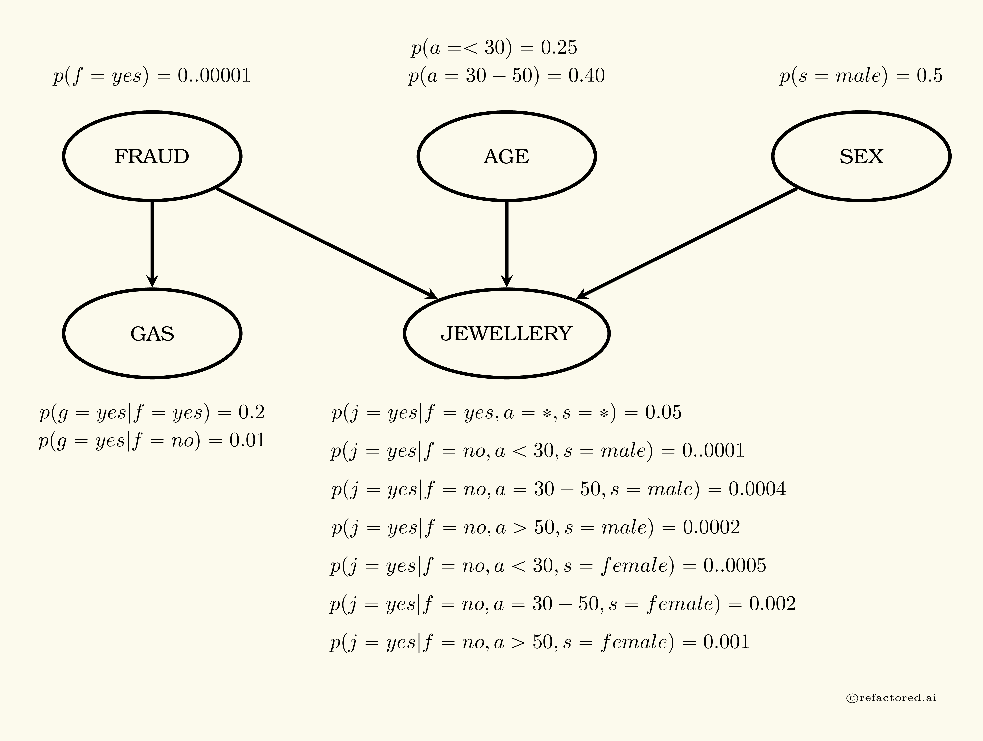
Fraud Model – Bayesian Network
David Heckerman’s Fraud Model

Slide 14
Notebook Links
Recommended: Access ODSC 2018 track on https://refactored.ai
OR
Bayesian Theory
Bayesian Networks
Bayesian Network Features
Fraud Modeling
Credit Approval

Slide 15

Reach out to us at Sathwik@colaberry.com Pawan@colaberry.com Ram@colaberry.com
Thank You!

