Slide 1
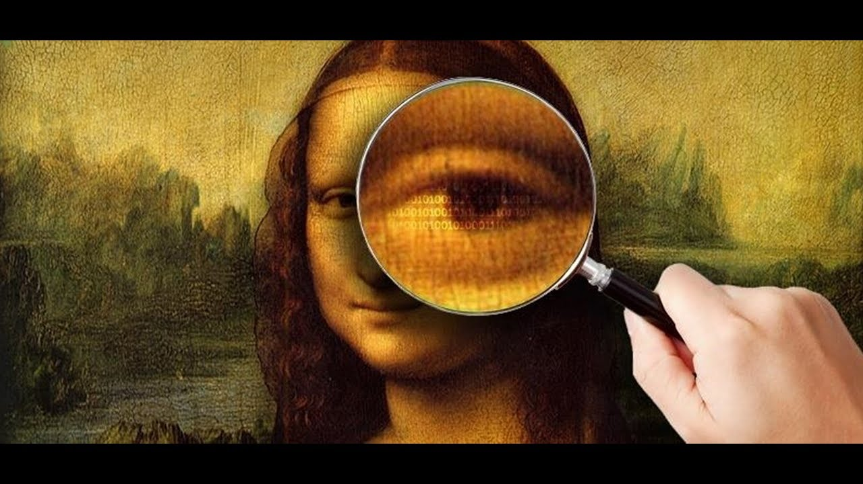
ECI 2019 Introduction to steganography and watermarking
Canónaco Sebastián
Lanzillotta Franco
Pablos Braulio

Slide 2
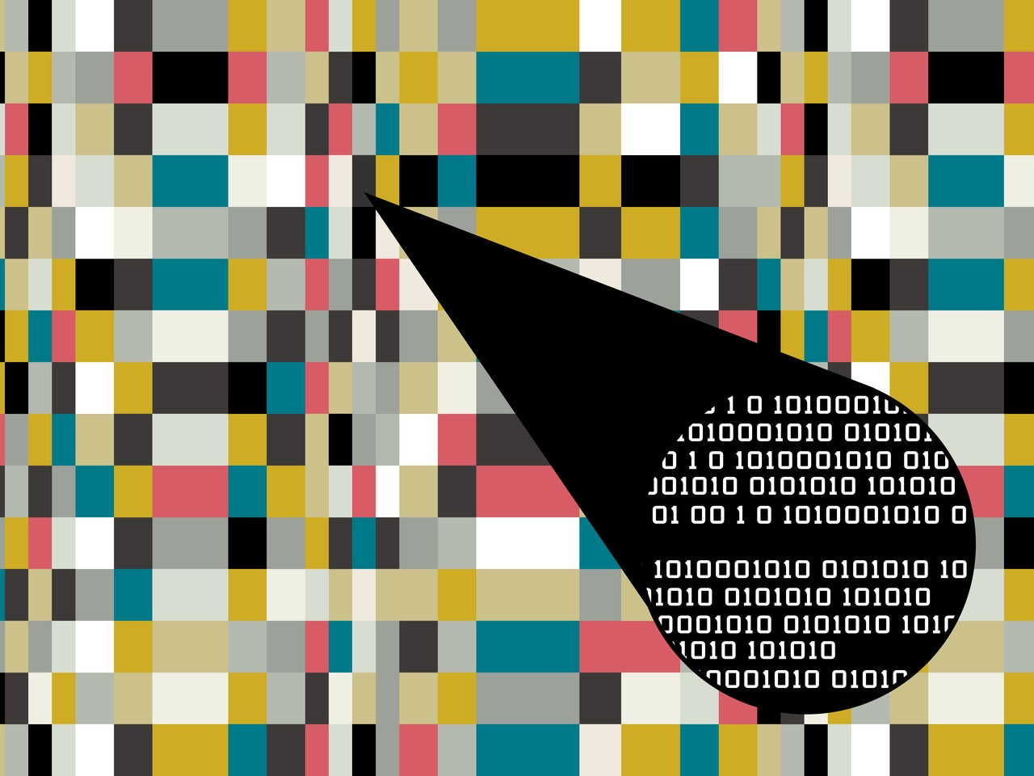
Steganography
Steganography is the study and application of techniques that allow to hide messages within other objects, establishing a cover channel that prevents the very act of communication from being noticed by external observers.

Slide 3




Where to apply stegranography?
Audio
Images
Video
Other files
Images are commonly used as cover objects due to the relatively high amount of data they contain

Slide 4

BMP images RGB format
The image format chosen is BMP file format, which stores digital images as a bitmap.
Each pixel is represented by a fixed number of bits (may it be 1, 2, 4, 8, 16, 24, 32 or more).
This array of bits is most commonly arranged in RGB format, establishing the beginning bits for red, the middle ones for green and the last ones for blue value.

Slide 5
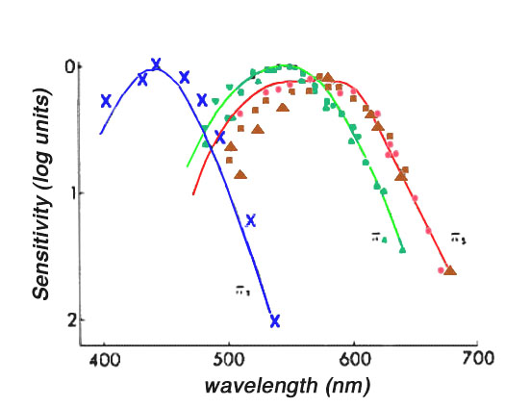
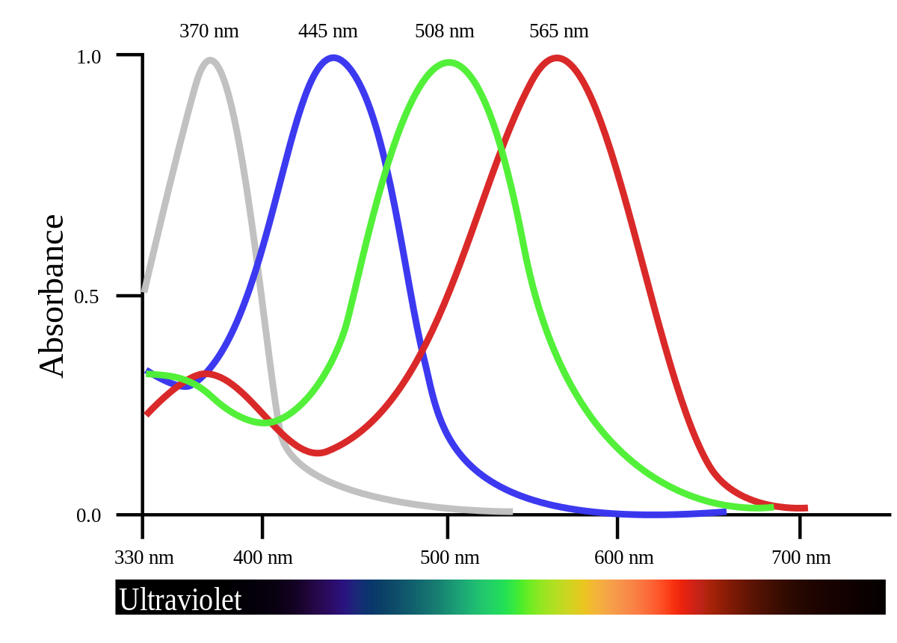
Visual perception
The blue color is the least noticeable by the human eye

Slide 6
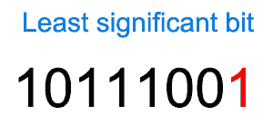
Development
The idea is to change the least significant bits of the blue color so that the information is less detectable

Slide 7
Algorithm
The algorithm is pretty simple: the bits of the character are taken in chunks of k bits, which are then stored in the k least significant bits of some consecutive pixels.
If the last chunk is of a size less than k then only the needed less significant bits of the next pixel will be used.
Before inserting the next character, there is the possibility of a pseudo-random padding being introduced.
First, for adding a padding at all the binary exclusive or (xor) operation between the amount of pixels left available for padding (its total is calculated at the beginning of the hiding algorithm) and the last pixel used for steganography must result in a 1 in the least significant bit. If this condition is fulfilled, then the jump is calculated as follows:
jump = ((padding_left xor prev_pixel) % (char size * k) + 1) % (padding left + 1)
% representing the calculation of the remainder of a division between integer numbers and the char size equalling 8, as ASCII is used as the encoding.

Slide 8
Algorithm
The procedure for recovering the hidden message is straightforward: after extracting k and the text size from within the first pixels of the image the reverse algorithm for inserting a character must be applied. Also, the calculation of the padding jumps is executed in the very same manner. This results in that the recipient of the message only needs to know this algorithm for recovering it, as the original image has no more porpurse after the text has been hidden.

Slide 9
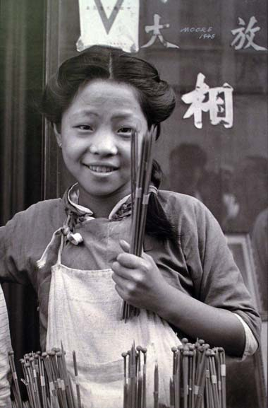
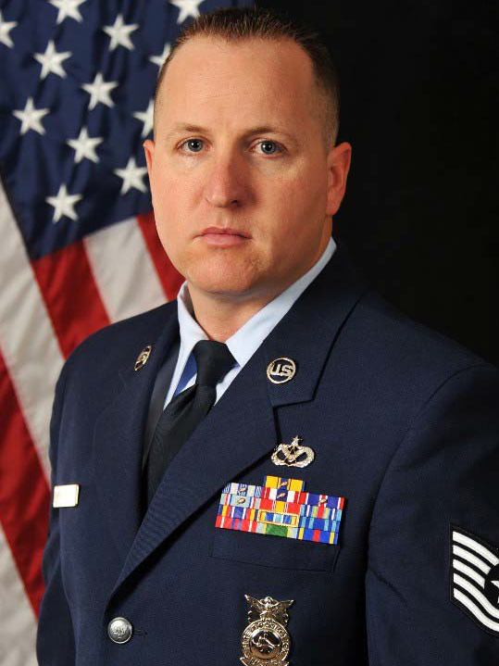

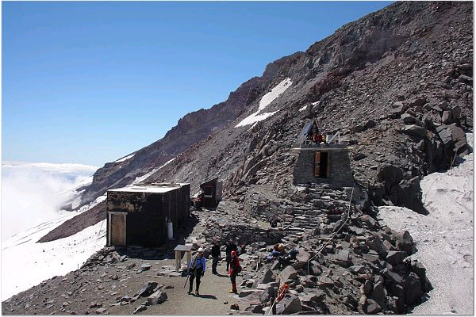
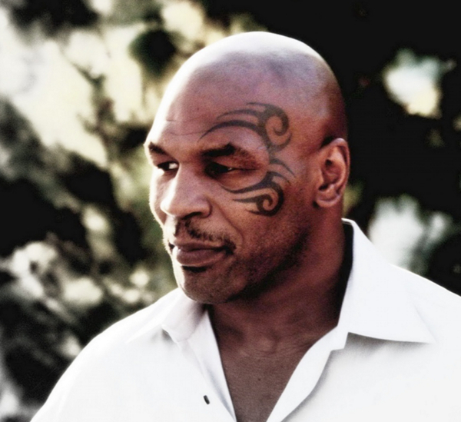
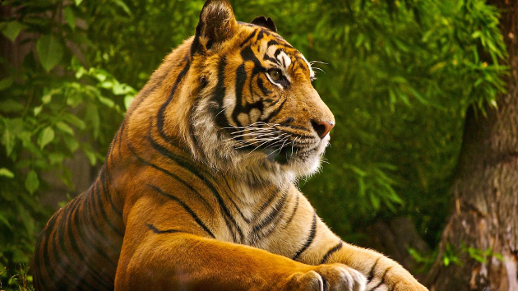
Procediment
Open nature
Portrait

Slide 10
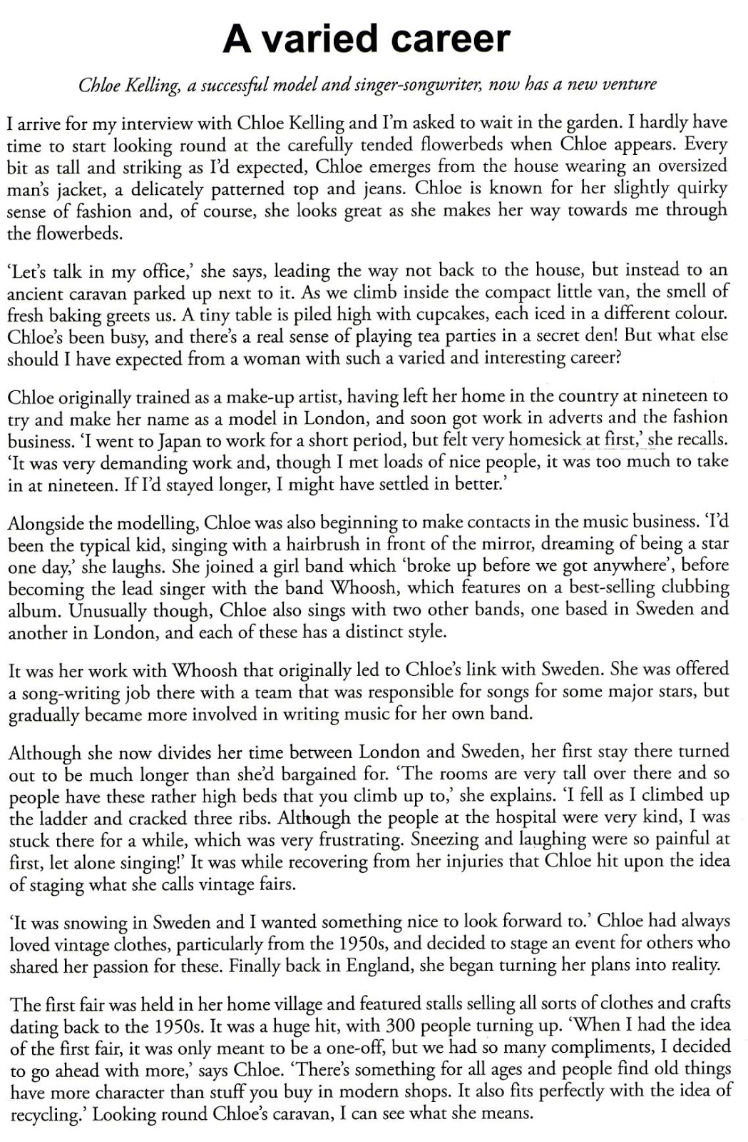
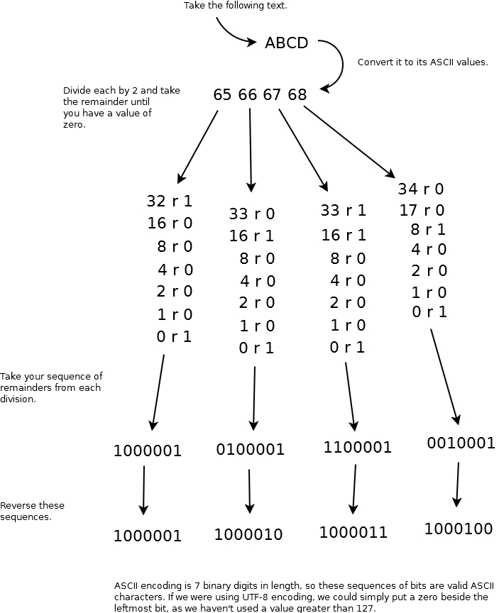
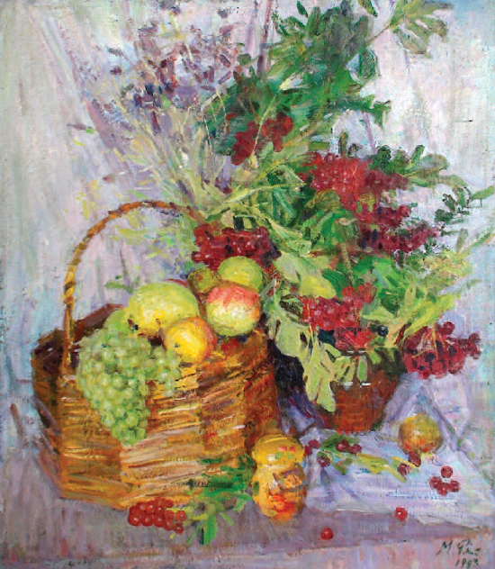
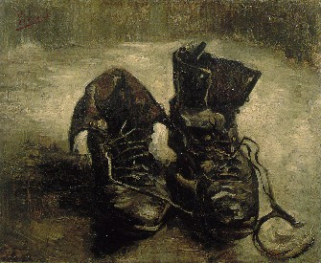
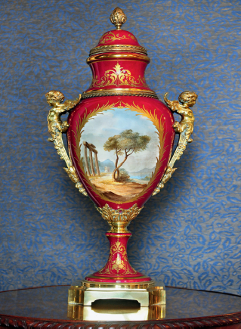
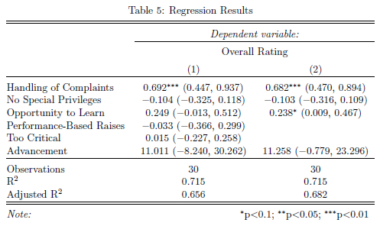
Procediment
Still life
Text

Slide 11



Results
Each picture was used to hide messages, varying the k parameter and the length of the text to hide.
For each time, it was calculated three values that represent the effectiveness of the algorithm hiding the given text. These are: the mean squared error (MSE), the peak signal-to-noise ratio (PSNR) and the structural similarity (SSIM).
where m and n denote the size of the image, X(i,j) is the value of a pixel in the original image and X'(i,j) is its value in the stego image
where MAXi is the maximum among the pixels
where μ, σ , and σxy( represent mean, variance and covariance; C1, C2 constant

Slide 12
Results
Table 1: Open nature images worst values
# | MSE | PSNR | SSIM
1 | 13329 | 103.25 | 0.999994
2 | 3147 | 109.51 | 0.999999
3 | 3640 | 157.05 | 0.999998
Table 3: Still life images worst values
# | MSE | PSNR | SSIM
1 | 6180 | 106.59 | 0.999997
2 | 5353 | 107.21 | 0.999998
3 | 23310 | 100.14 | 0.999989
Table 2: Portrait images worst values
# | MSE | PSNR | SSIM
1 | 92615 | 94.79 | 0.999957
2 | 9794 | 104.58 | 0.999995
3 | 5541 | 107.06 | 0.999997
Table 3: Text images worst values
# | MSE | PSNR | SSIM
1 | 3541 | 109.00 | 0.999998
2 | 3 | 139.72 | 0.999999
3 | 14638 | 102.84 | 0.999993

Slide 13
Conclusions
Every message hidden correctly in an image was properly recovered.
The pseudo-random padding generates localized jumps, the spaces between adulterated pixels are relatively small. This results in the text been hidden in the lower border of the screen, as the pixels are actually counted starting from the bottom left corner of the picture.
The values of SSIM obtained were really good. This could be caused due to the small length of the text hidden in comparison to the size of the images used
A possible modification to be made in the future is to increment the amount of bits used to store the length of the text from 8 to 16 (2 bytes or characters), which would allow messages of up to 65536 characters.

Slide 14




Thanks
Canónaco Sebastián
Lanzillotta Franco
Pablos Braulio
+1 23 987 6554
alberto@email.com
www.fabrikam.com

