Slide 1


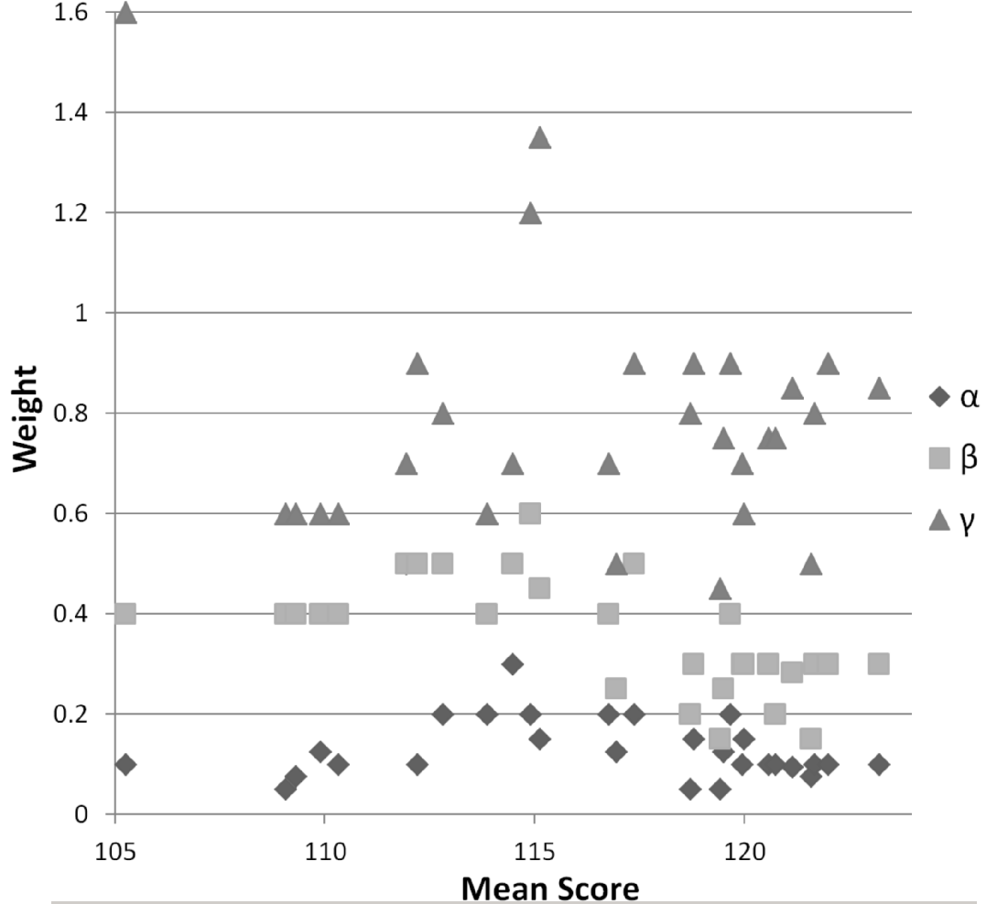
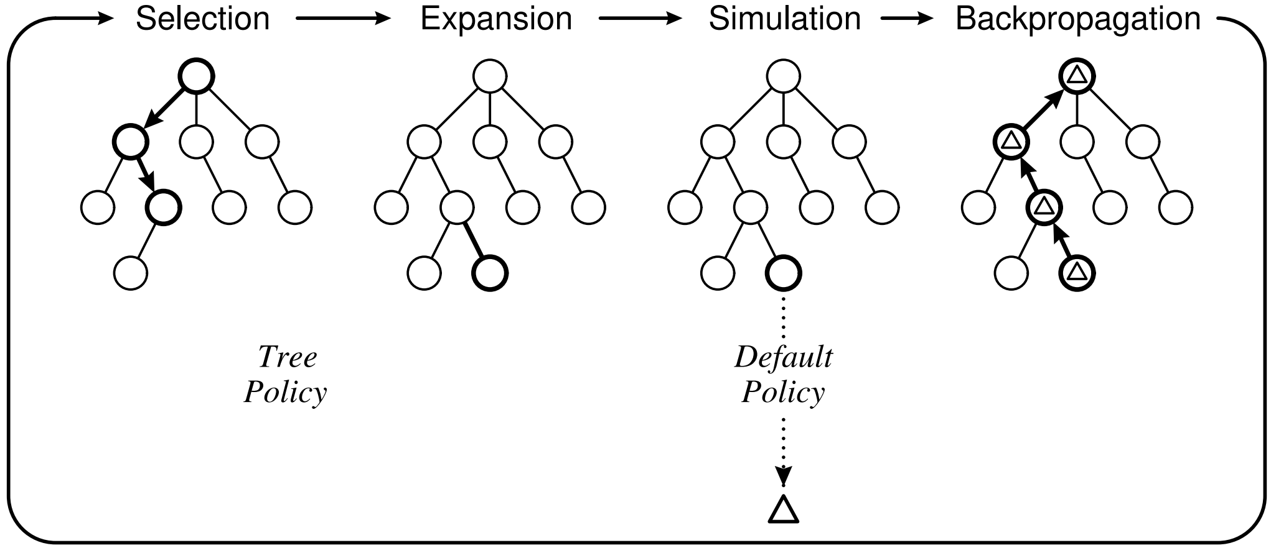
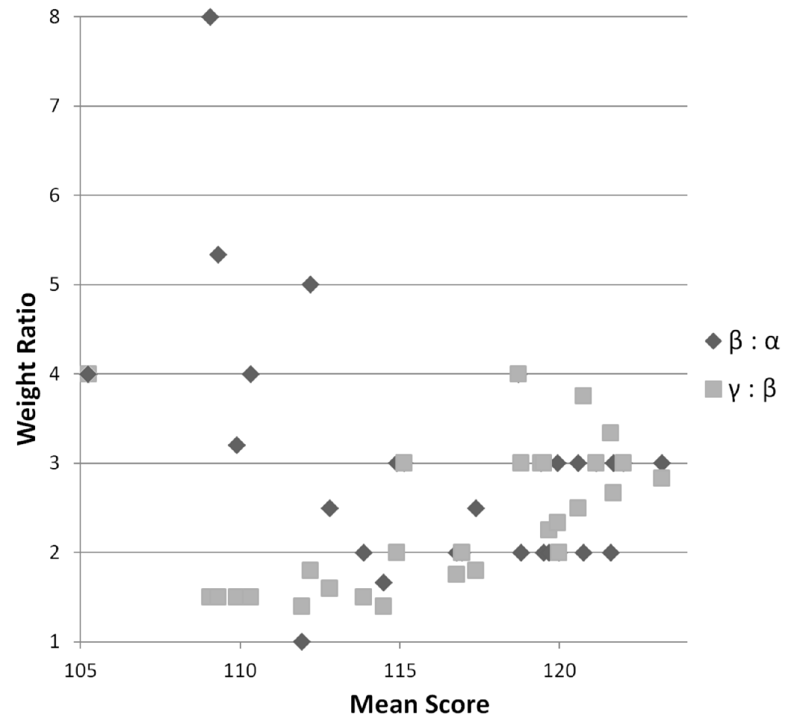
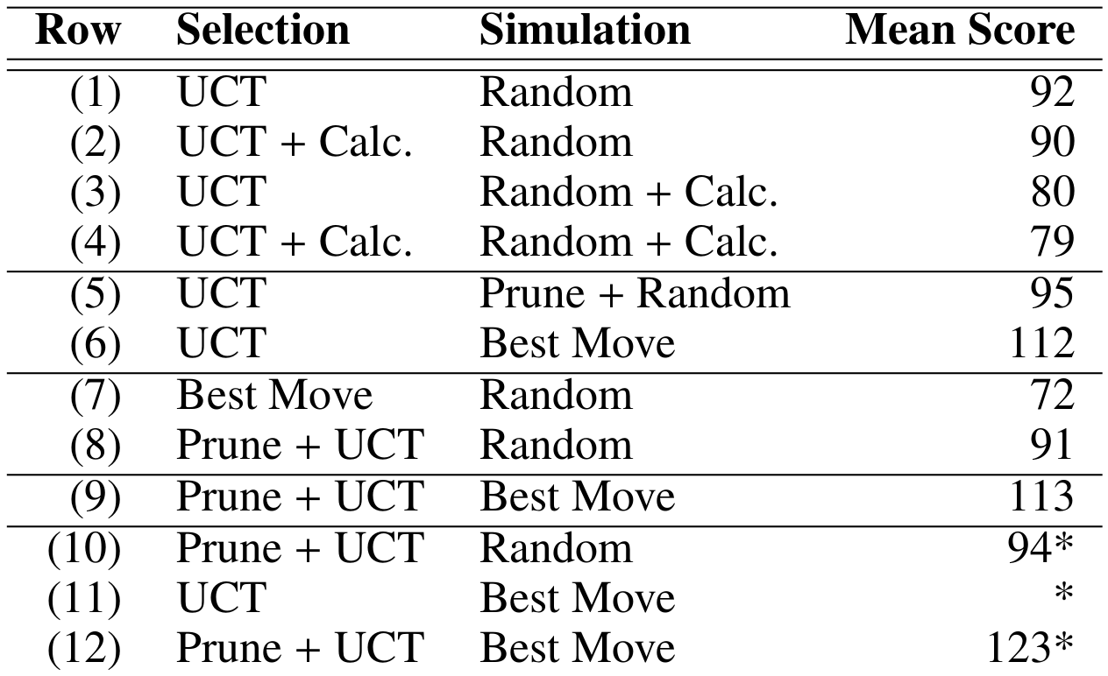
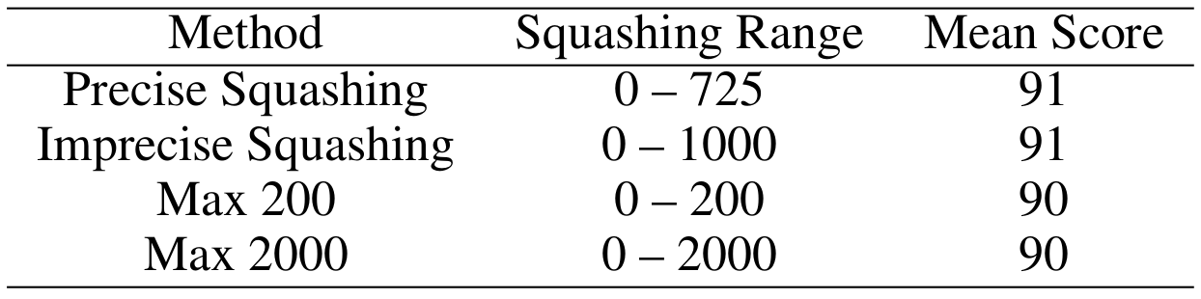
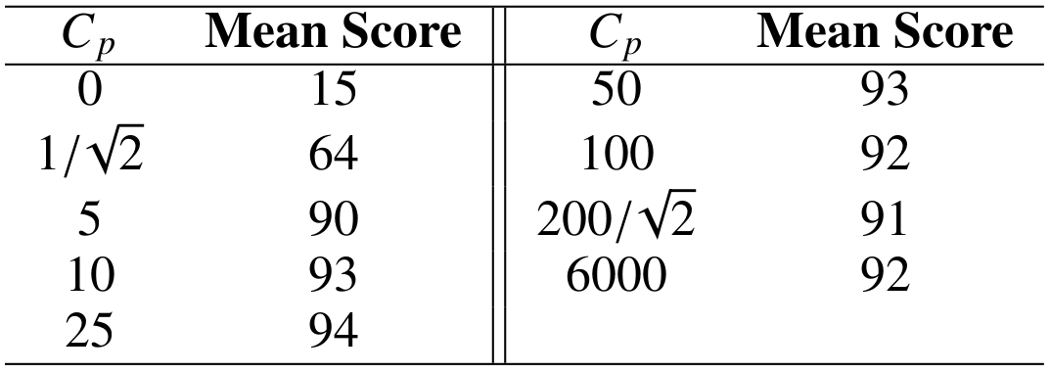
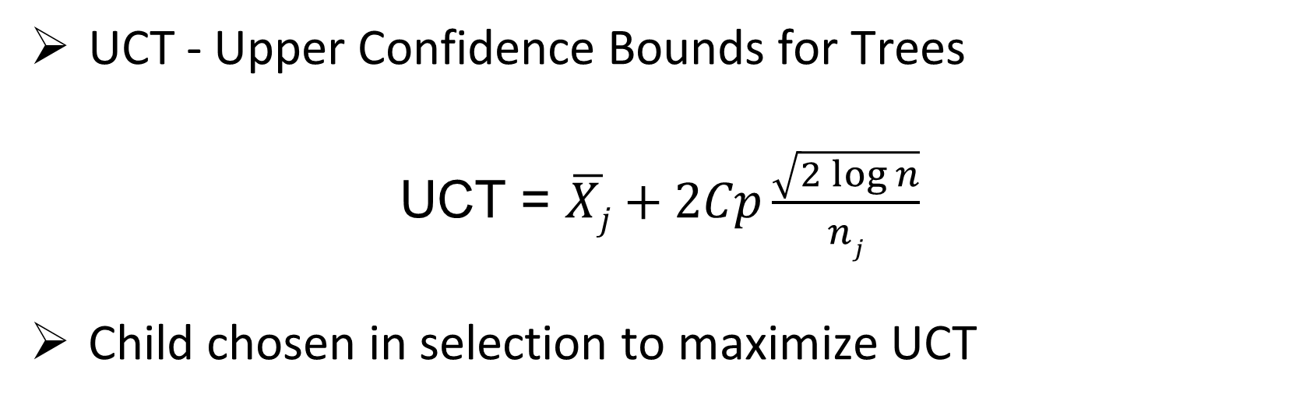
Using Domain Knowledge to Improve Monte-Carlo Tree Search Performance in Parameterized Poker Squares
Robert Arrington, Clay Langley, Steven Bogaerts
DePauw University Greencastle, IN {robertarrington_2015, claylangley_2017, stevenbogaerts}@depauw.edu
Abstract
Related Work
MCTS Application to PPS
Experiments (cont.)
Poker Squares is a single-player card game played on a 5x5 grid, in which a player attempts to create as many high-scoring Poker hands as possible. As a stochastic single-player game with an extremely large state space, this game offers an interesting area of application for Monte-Carlo Tree Search (MCTS). This paper describes enhancements made to the MCTS algorithm to improve computer play. These enhancements include pruning in the selection stage, and a greedy simulation algorithm. These enhancements make extensive use of domain knowledge in the form of a state evaluation heuristic. Experimental results demonstrate both the general efficacy of these enhancements and their ideal parameter settings.
Domain Knowledge
Card counting for 4-card hand
Likelihood array
A-priori probabilities
α,β,Γ 1,2,3 card hand weights
Modified Selection through Pruning
Heuristic score threshold
Hard pruning children
Limit maximum % by count pruned
Modified Simulation
Pruning strategy like selection
Best move
α,β,Γ for Each Resulting Mean Score
Monte-Carlo Tree Search (MCTS)
Experiments
β : α and Γ : β for Each Resulting Mean Score
Selection and simulation results over 2,000 games
Selection
balance (see UCT below) goals of exploration and exploitation to select a node for further consideration
Expansion
a previously unconsidered child of the selected node is randomly chosen
Simulation
a game is played from child to completion
standard MCTS, entirely random moves
Backpropagation
update all nodes on the path up to the root
Effects of score squashing
Conclusions
Significant improvements in performance, overcoming the added costs, are attainable with:
Carefully Tuned Domain Knowledge
Pruning in Selection
Best Move Simulation
UCT - Upper Confidence Bounds for Trees
UCT = $\overline{Xj}+2Cp\frac{\sqrt{2\log{n}}}{nj}$
Child chosen in selection to maximize UCT
Effect of C_{p} Values With No Squashing
Acknowledgement
This project was funded by the National Science Foundation. Grant number:CNS-xxxxxx and DePauw University Internal Grant Committee

