Slide 1





Academic Certification System
based on
Blockchain Technology
SUSTECH
REPORT 1
程蕴玉
任博涛
黎原朝

Slide 2

●●●●●●
●●●●●●
●●●●●●
●●●●●●
Academic Certification System
01
Introduction
02
Techniques
03
System Design
04
Future Work

Slide 3
Introduction
PART.1

Slide 4
Introduction
Compare
Paper certification
Digital certification

Slide 5
Introduction
Related work
Digital academic certificates through an application based on blockchain(2017, MIT and Central New Mexico Community College)
Only use blockchain
publish a digital academic certification open source standard called Blockcert
A digital certificate system based on Ethereum blockchain(2020, HKUST)
Use blockchain and smart contract

Slide 6
Techniques
PART.2

Slide 7
Techniques
Random number
Transactions
Timestamp
Hash of previous Block
Random number
Transactions
Timestamp
Hash of previous Block
Random number
Transactions
Timestamp
Hash of previous Block
Blockchain
Decentralization
Openness
PoW: Consensus mechanism

Slide 8
Techniques
Smart Contract
Ethereum: a decentralized global state machine
Solidity: Turing-complete languages of smart contract
Smart Contract: a kind of program execute in blockchain
Execution: Execute in EVM and cost gas

Slide 9
System Design
PART.3

Slide 10
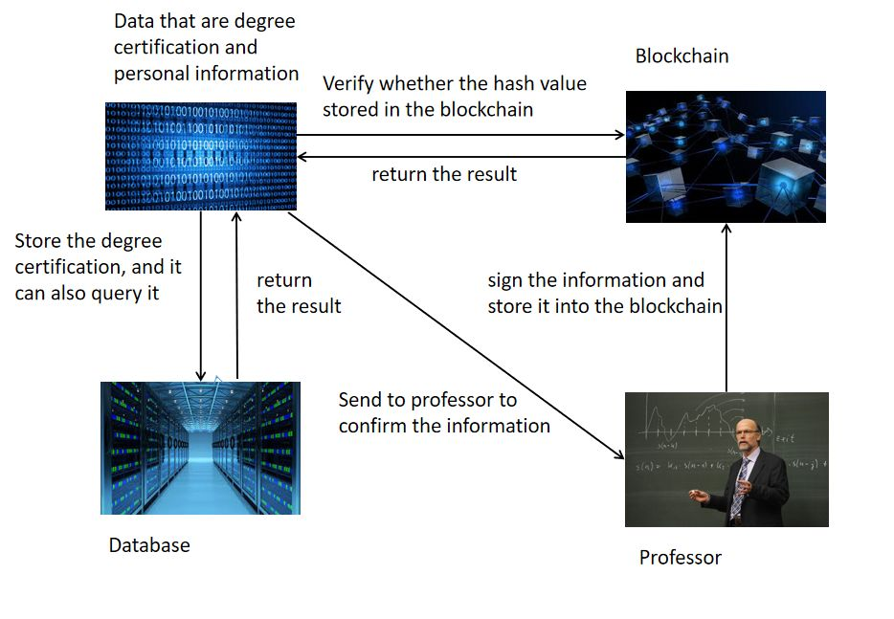
System Design
Store
Authenticator(Professor) sign the certification
Authenticator store the certification into the database of university
Authenticator store the hash value of certification into the blockchain

Slide 11
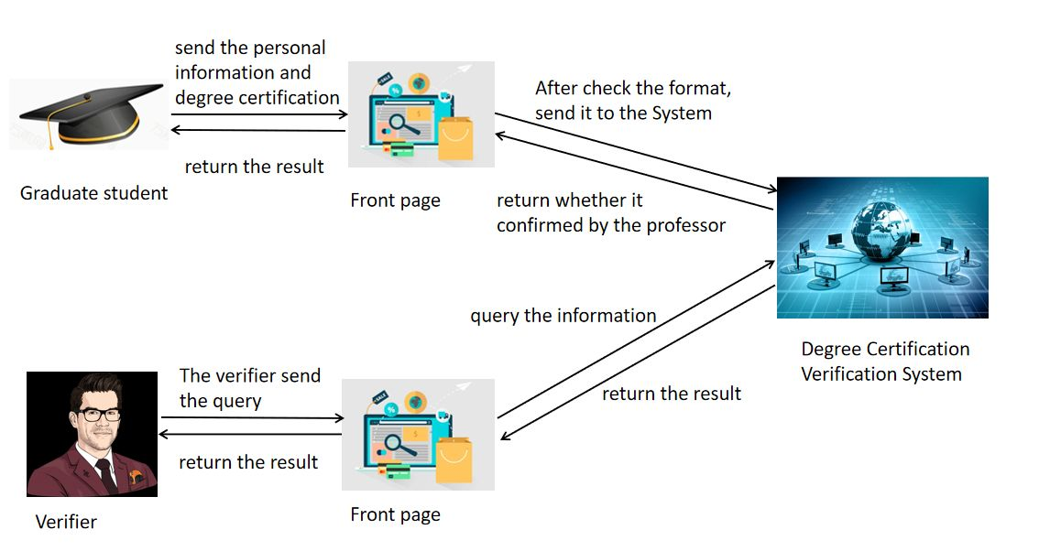
System Design
Verify
Verifier search the academic certification in Certification Authority(University)
Verifier search the hash of certification in blockchain
Verifier compare with the hash values of 1 and 2.

Slide 12
System Design
Innovation: credit rating
Credit rating is an indicator of the reliability of the CA(certification authority)
Each certification of a CA be used, will make the rating of the CA higher.
Verifier can check the rating of the CA

Slide 13
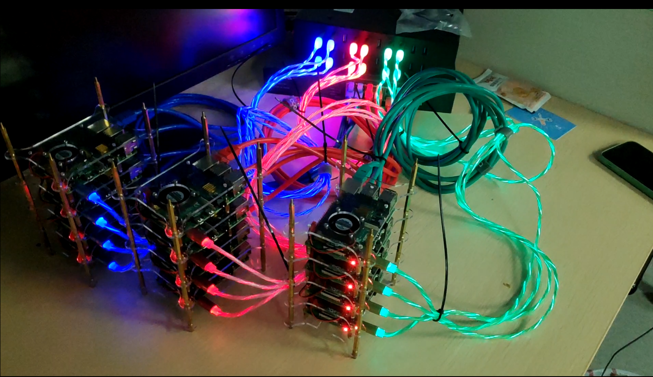
System Design
Addition: Raspberry Pi Cluster
A cluster with 13+ raspberry pi 4b

Slide 14
Future work
PART.4

Slide 15
Future work
Plan
Complete the smart contract
Deploy the system into cluster

