Slide 1





Academic Certification System
based on
Blockchain Technology
SUSTECH
REPORT 1
程蕴玉
任博涛
黎原朝

Slide 2

●●●●●●
●●●●●●
●●●●●●
●●●●●●
Academic Certification System
01
Introduction
02
Techniques
03
System Design
04
Future Work

Slide 3
Introduction
PART.1

Slide 4
Introduction
The degree certification is always an important part for a college student. However, it is very difficult to ensure the authenticity of the certification. So, the digital degree certification is created. Digital degree certification can be stored in the school's database. However, it has another problem: someone may hack into the school's database and modify it viciously.
To solve this problem, we can use the blockchain. Blockchain has two big features: authenticity and traceable. Once we store the certification's hash value into a blockchain, it almost can not be modified by other user. Once we want to verify this certification, we can hash it and find whether it occurred in the blockchain. So, we can implement this system base on blockchain, such as Ethereum. In the Ethereum, we can also create several smart contract to do these transaction. So, by using Ethereum, we can ensure the authenticity of the degree certification.
PART.1

Slide 5
Introduction
Compare
Paper certification
Digital certification
Digital certification with blockchain
1. may be falsify by someone
2. difficult to preserve(may be lost)
3. inconvenience
1. convenient
2. may be modified by someone(such as hacker)
1. authenticity and traceable
2. difficult to modified by someone

Slide 6
Introduction
Related work
Digital academic certificates through an application based on blockchain(2017, MIT and Central New Mexico Community College)
Only use blockchain
publish a digital academic certification open source standard called Blockcert
A digital certificate system based on Ethereum blockchain(2020, HKUST)
Use blockchain and smart contract

Slide 7
Introduction
creation part
We will add a credit level system, that can record the dgree certification's credit. When the certification is viewed by lots of companies and give high rate of it, the credit will increase, otherwise, the credit will decrease. Other verifiers can consider the credits as an important index to evaluate the degree certification.

Slide 8
Techniques
PART.2

Slide 9
Techniques
Random number
Transactions
Timestamp
Hash of previous Block
Random number
Transactions
Timestamp
Hash of previous Block
Random number
Transactions
Timestamp
Hash of previous Block
Blockchain
Decentralization
Openness
PoW: Consensus mechanism

Slide 10
Techniques
Smart Contract
Ethereum: a decentralized global state machine
Solidity: Turing-complete languages of smart contract
Smart Contract: a kind of program execute in blockchain
Execution: Execute in EVM and cost gas

Slide 11
System Design
PART.3

Slide 12
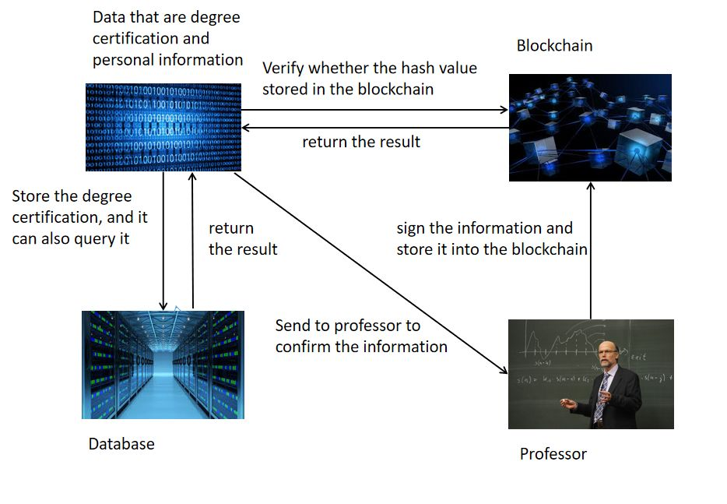
System Design
Store
Authenticator(Professor) sign the certification
Authenticator store the certification into the database of university
Authenticator store the hash value of certification into the blockchain

Slide 13
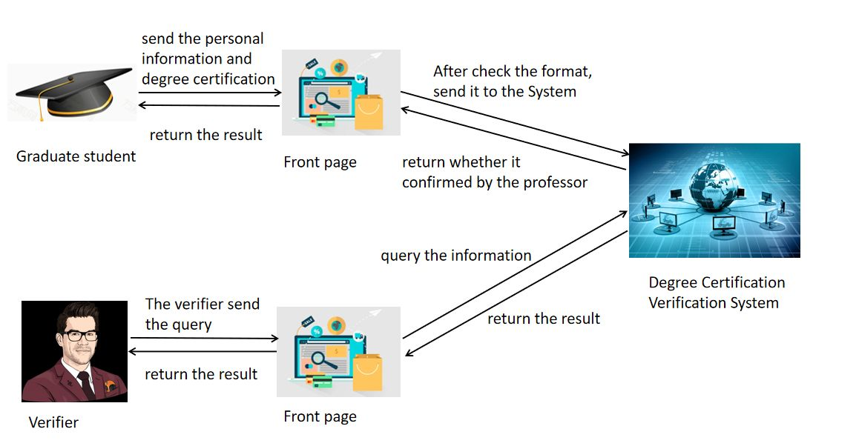
System Design
Verify
Verifier search the academic certification in Certification Authority(University)
Verifier search the hash of certification in blockchain
Verifier compare with the hash values of 1 and 2.

Slide 14
System Design
Innovation: credit rating
Credit rating is an indicator of the reliability of the CA(certification authority)
Each certification of a CA be used, will make the rating of the CA higher.
Verifier can check the rating of the CA

Slide 15
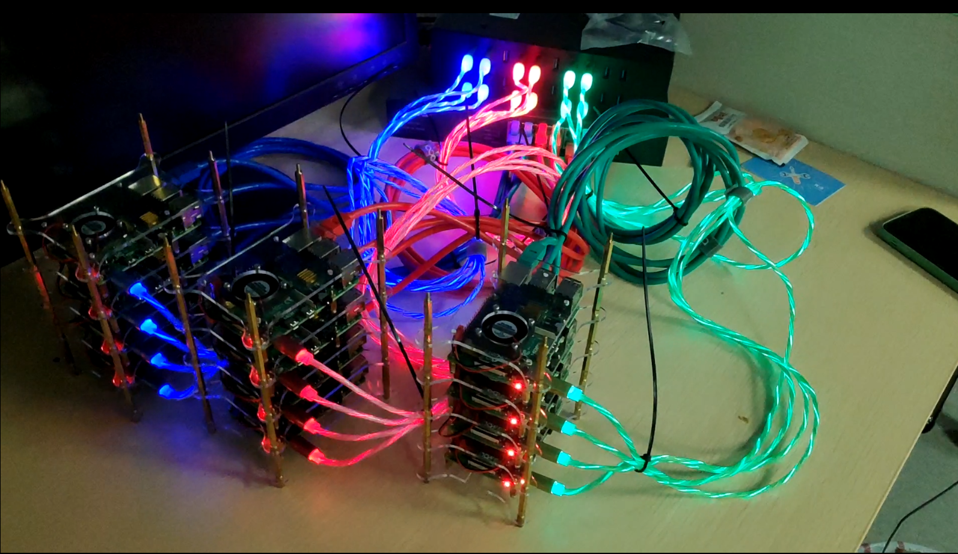
System Design
Addition: Raspberry Pi Cluster
A cluster with 13+ raspberry pi 4b

Slide 16
Future work
PART.4

Slide 17
Future work
Plan
Complete the smart contract
Deploy the system into cluster

