Slide 1


Credential Delegation System
Using Intel SGX
Part A

Slide 2
Catalogue
1
4
Introduction
Plan
Concept of credential delegation
Introduction to TEE and SGX
Future plan of each phase.
2
Background
Technical background
Related work
3
System Design
Details of credential delegation system and its enhancement.

Slide 3
Introduction
Delegation
Owners delegate their credentials to delegatees.

Slide 4
Introduction
TEE and Intel SGX
TEE
…
Intel SGX
…

Slide 5
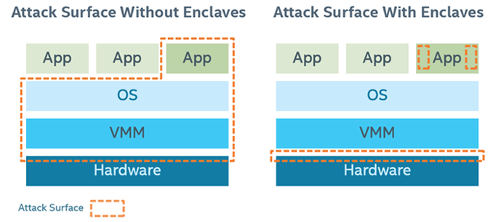
Background
Intel SGX

Slide 6
Background
Enclave and ocall/ecall
Enclave is protected by
Processor Reserved Memory (PRM)
App
Ocall/Ecall
OS/VMM
Processor
SGX
Memory
Enclave

Slide 7
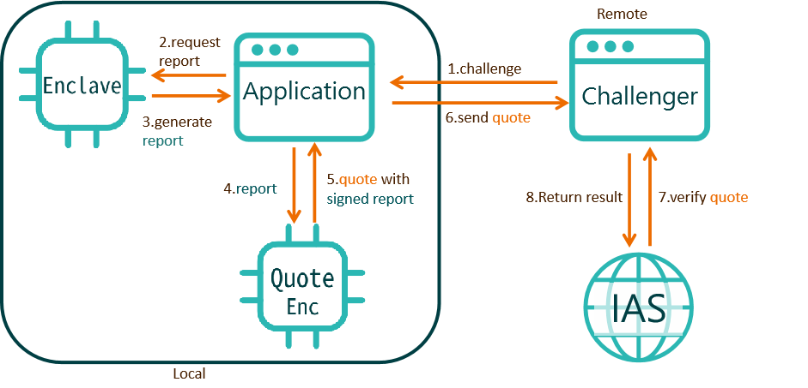
Background
Attestation

Slide 8
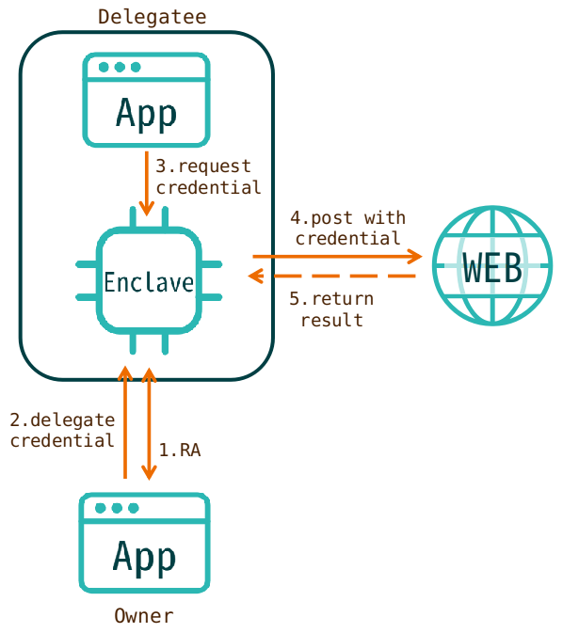
System Design
Basic Function

Slide 9
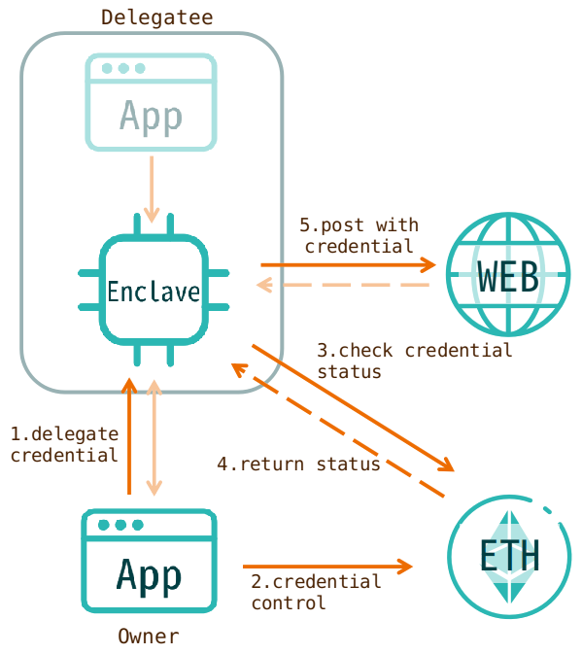
System Design
Enhanced with Ethereum

