Slide 1







App
App
Quote
Enc

Slide 2
App
Remote
1. send credential
2.request report
1.challenge
Application
Challenger
3.generate report
6.send quote
4.report
5.quote with signed report
8.Return result
7.verify quote
IAS
Local

Slide 3
Delegatee
App
3.request
credential
1. send credential
4.post with credential
WEB
5.return result
2.delegate
credential
1.RA
Owner

Slide 4
Delegatee
App
3.request
credential
1. send credential
4.post with credential
WEB
5.return result
2.delegate
credential
1.RA
ETH
Owner

Slide 5
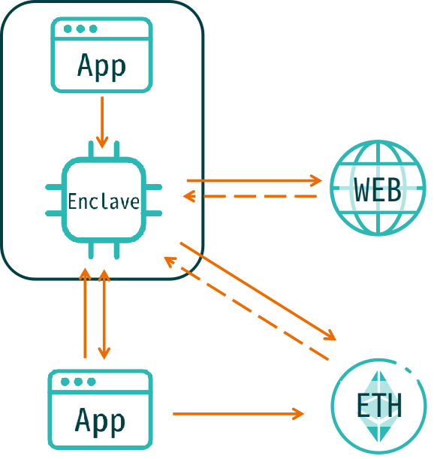
Delegatee
App
1. send credential
5.post with credential
WEB
3.check credential status
1.delegate
credential
4.return status
ETH
2.credential
control
Owner

Slide 6
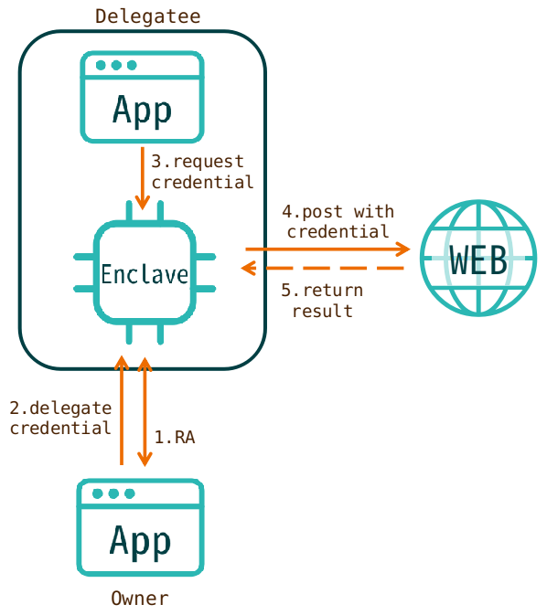
Picture

Slide 7
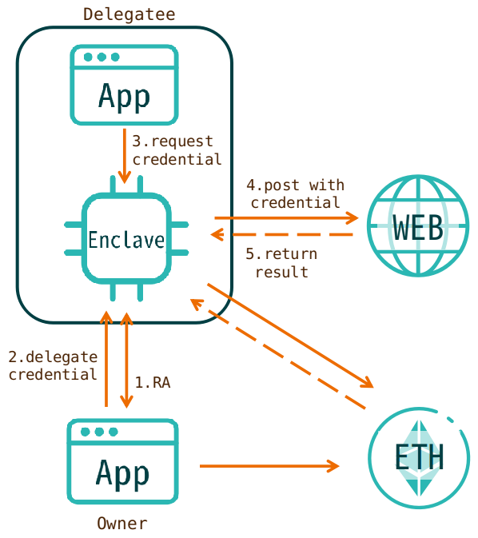
Picture

Slide 8
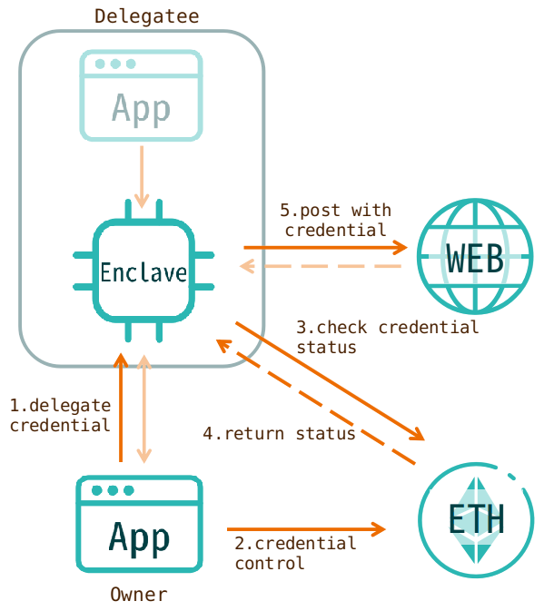
Picture

Slide 9
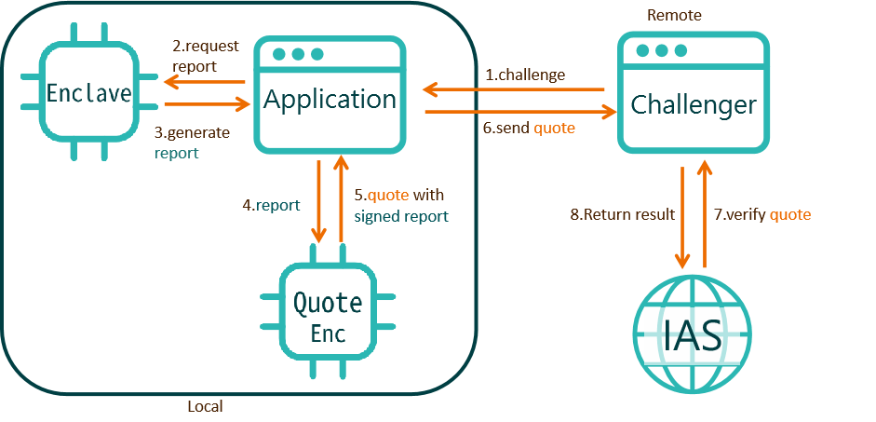
Picture

