Slide 1


Credential Delegation System
Using Intel SGX
Part A

Slide 2
Catalogue
1
4
Introduction
Plan
Concept of credential delegation
Introduction to TEE and SGX
Future plan of each phase.
2
Background
Technical background
Related work
3
System Design
Details of credential delegation system and its enhancement.

Slide 3
Introduction
Delegation
Owners delegate their credentials to delegatees.

Slide 4
Introduction
TEE and Intel SGX
TEE
…
Intel SGX
…

Slide 5
Background
Enclave and ocall/ecall
Enclave is protected by
Processor Reserved Memory (PRM)
Enclave Page Cache (EPC).
Ocalls/Ecalls are the only interfaces between Application and Enclave
App
Ocall/Ecall
OS/VMM
Processor
SGX
Memory
Enclave

Slide 6
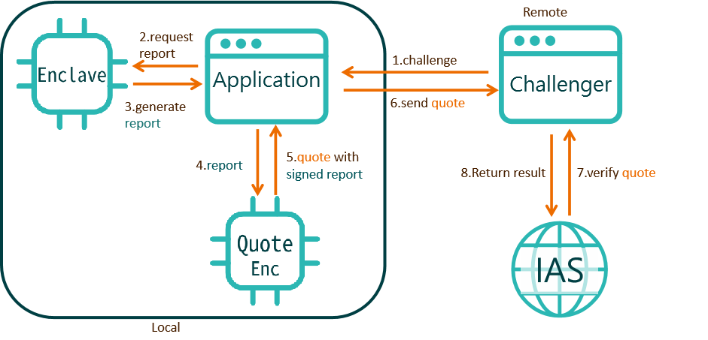
Background
Attestation
To verify the enclave information of creation, load, and code execution.

Slide 7
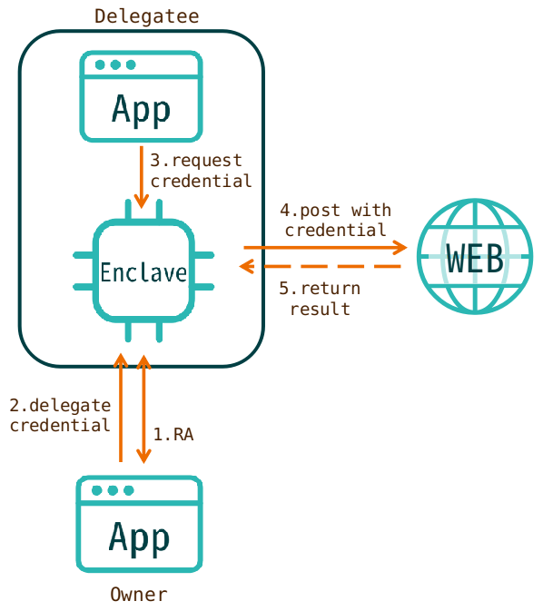
System Design
Basic Function

Slide 8
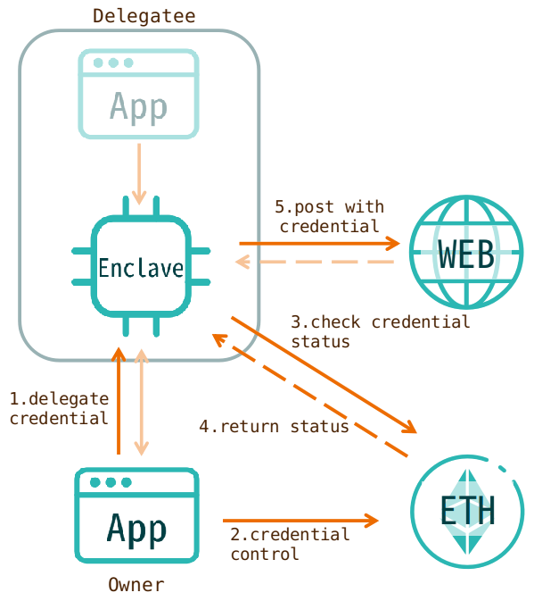
System Design
Enhanced with Ethereum

Slide 9
Plan
Phase 1 (Week 7)
Basic knowledge
Basic system design
Try functions of Intel SGX
Phase 2 (Week 12)
The dynamic delegation protocol
Implement delegation process
Enhanced with ethereum
Phase 3 (Week 17/18)
Implement the system
(Optional) Implement a ethereum enhanced system.

