Slide 1







App
App
Quote
Enc

Slide 2
Delegatee
App
3.request
credential
1. send credential
4.post with credential
WEB
5.return result
2.delegate
credential
1.RA
Owner

Slide 3
Delegatee
App
3.request
credential
1. send credential
4.post with credential
WEB
5.return result
2.delegate
credential
1.RA
ETH
Owner

Slide 4
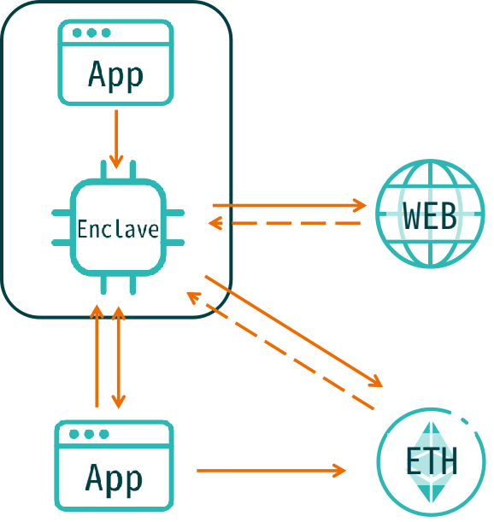
Delegatee
App
1. send credential
5.post with credential
WEB
3.check credential status
1.delegate
credential
4.return status
ETH
2.credential
control
Owner

Slide 5
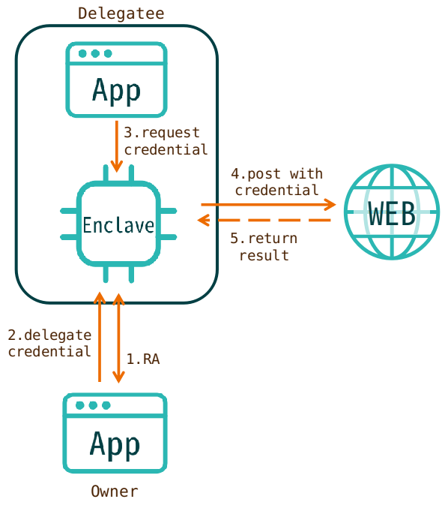
Picture

Slide 6
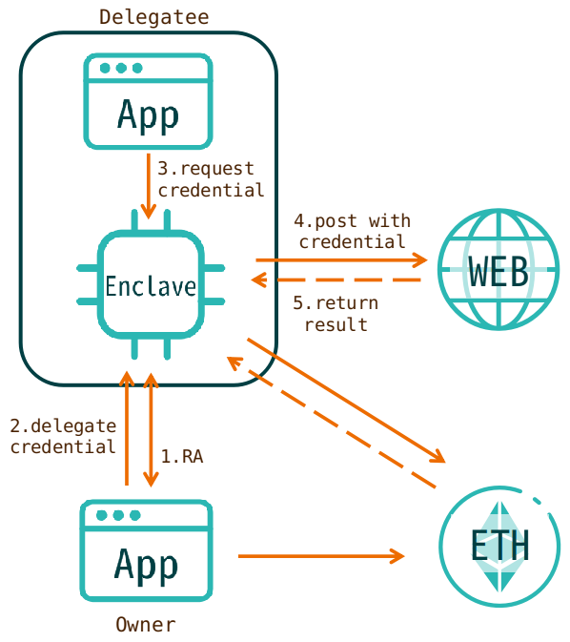
Picture

Slide 7
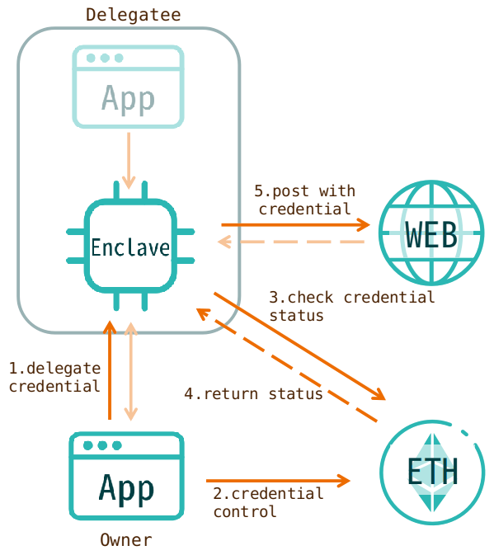
Picture

