Slide 1


Credential Delegation System
Using Intel SGX
Part A

Slide 2
Catalogue
1
Introduction
Concept of credential delegation
Introduction to TEE and SGX
2
Background
Technical background
Related work
3
System Design
一些简介

Slide 3
Introduction
Delegation
Owners delegate their credentials to delegatees.

Slide 4
Introduction
TEE and Intel SGX
TEE
…
Intel SGX
…

Slide 5
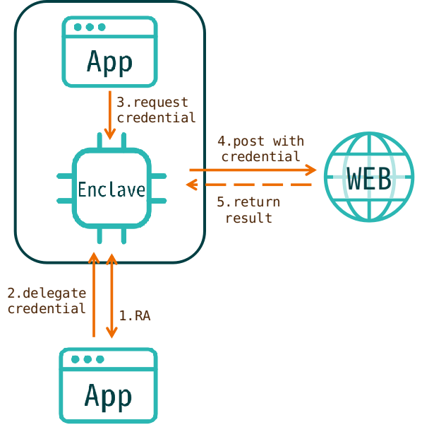
System Design
TEE and Intel SGX

Slide 6
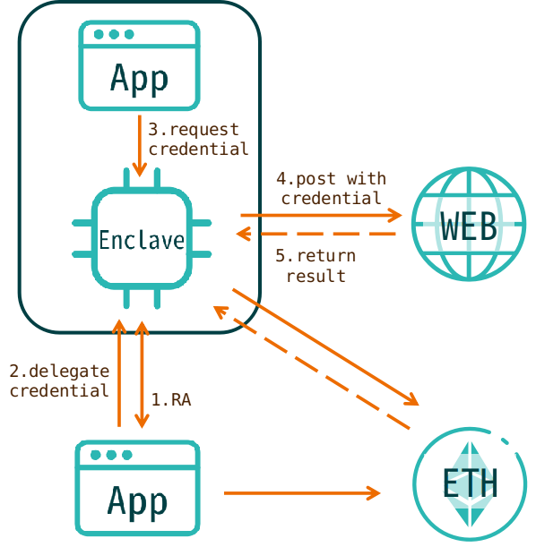
System Design
TEE and Intel SGX

Slide 7
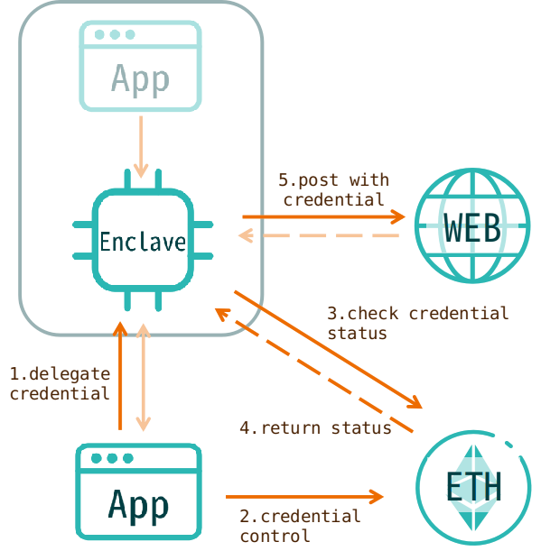
System Design
TEE and Intel SGX

