Slide 1

Movie
MMovie
Nowadays , as we can see , with the rapidly development of movie industry , it’s very convenient for us to watch movies .

Slide 2


Slide 3


Slide 4


Slide 5
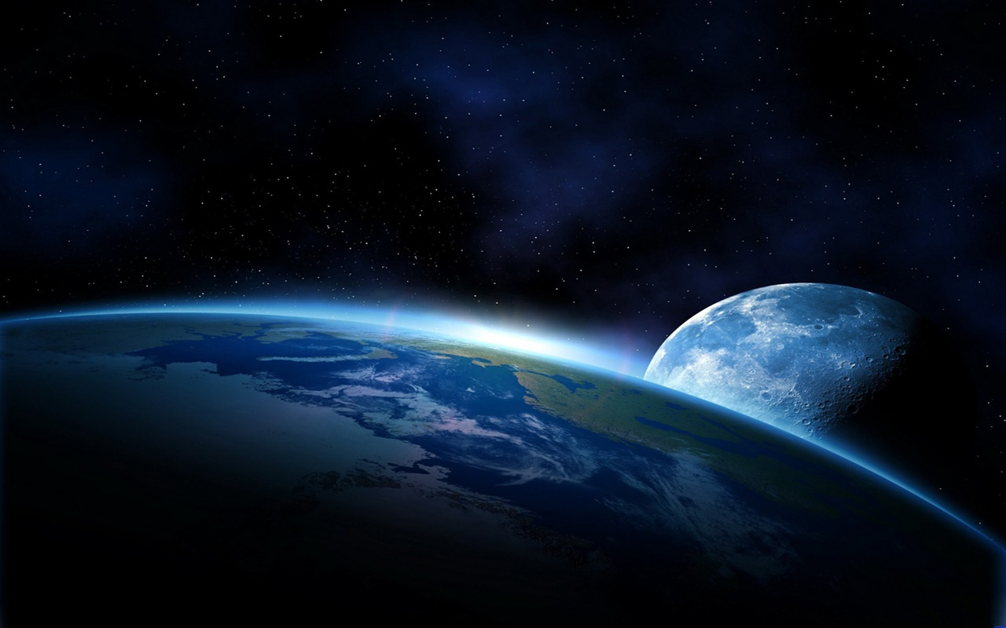

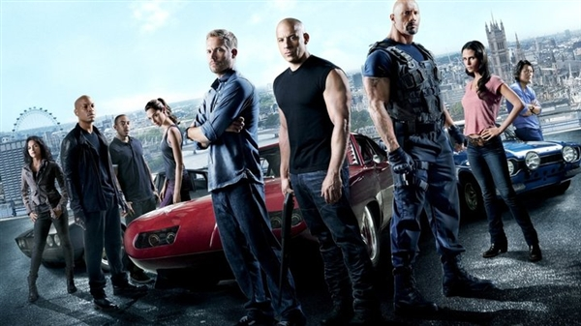
Action Movies
Action movie , which is known as action-adventure film, is full of breath-taking action and audio-visual tension, having thrilling events, continuous movement and the astonishing speed.
s

Slide 6
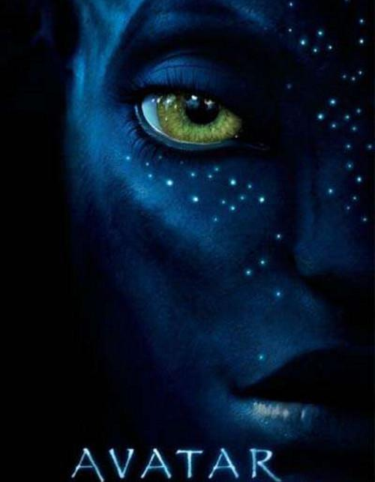

Science fiction movie
Science fiction movie is a film genre that uses science fiction: science-based depictions of phenomena that are not necessarily accepted by mainstream science .
Science fiction movies are often along with futuristic elements such as spacecrafts , robots like pacific rim , alien worlds like the Avatar , super power like The Avengers.

Slide 7



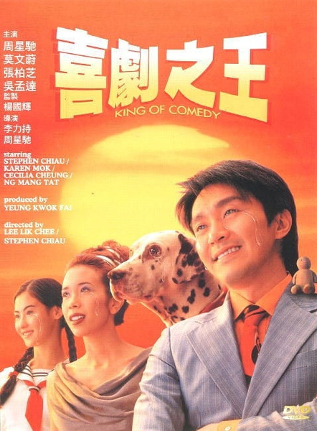
Comedy
Comedy is a type of drama, with exaggeration(夸张), ingenious structure, witty lines and the description of character , causing people to laugh , affirm the normal life and good ideal .
Comedy conflict generally ends with the victory of the hero(主人公),and comedy always have a good end or a happy end .Unlike our own life, we often get a bad end . So we will feel relaxed and comfortable when watching comedy. Anyway , happiness is the most important.

Slide 8


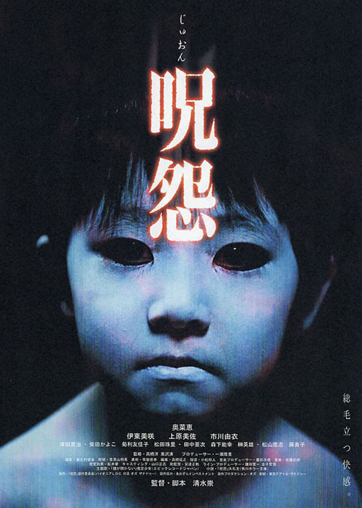

Thriller
Thiller is a kind of movie using a lot of performing skills,such as the horrific scene and audition , to cause the audience to feel afraid.

Slide 9

In Conclusion , movies make life colorful and help people reflect on their own life .
That’s all , thank you.

