Slide 1
Raster to Vector
2023.03.06.

Slide 2
Algorithm
Floodfill using BFS
Find edge
Simplify edge

Slide 3






Floodfill using BFS

Slide 4


Floodfill using BFS

Slide 5



Find edge

Slide 6

Find edge

Slide 7
Research objective and follow-up study
2023.03.06.

Slide 8
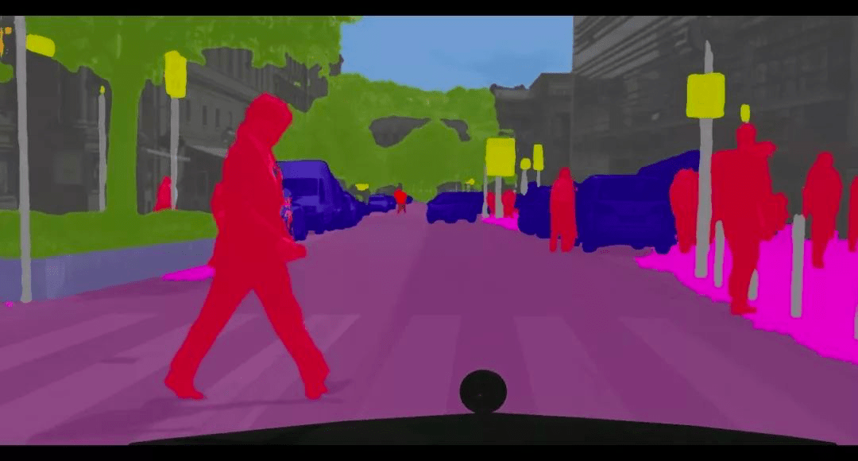
Research objective

Slide 9
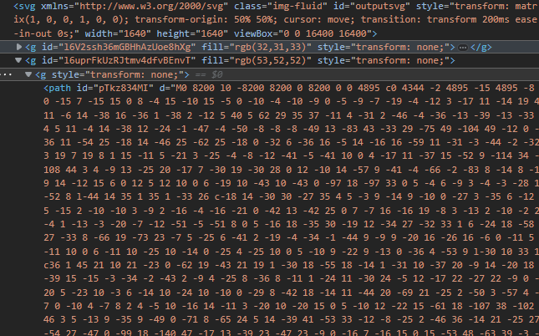
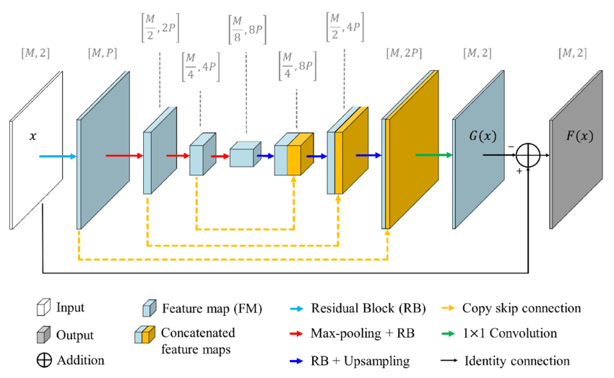
Follow-up study
New training method + How effective?

