Slide 1

Session 22 / Analytics Track
Robust Clustering Analysis of Genes Related to Age-related Macular Degeneration using RNA-Seq
Presenter: Brayan Gutierrez
Brayan Gutierrez¹, Dr. Rinki Ratnapriya², Dr. Arko Barman¹ • ¹Rice University, ²Baylor College of Medicine
Notes:
Use this as the cover slide. Keep the title concise and place track/session information in the lower cards.

Slide 2
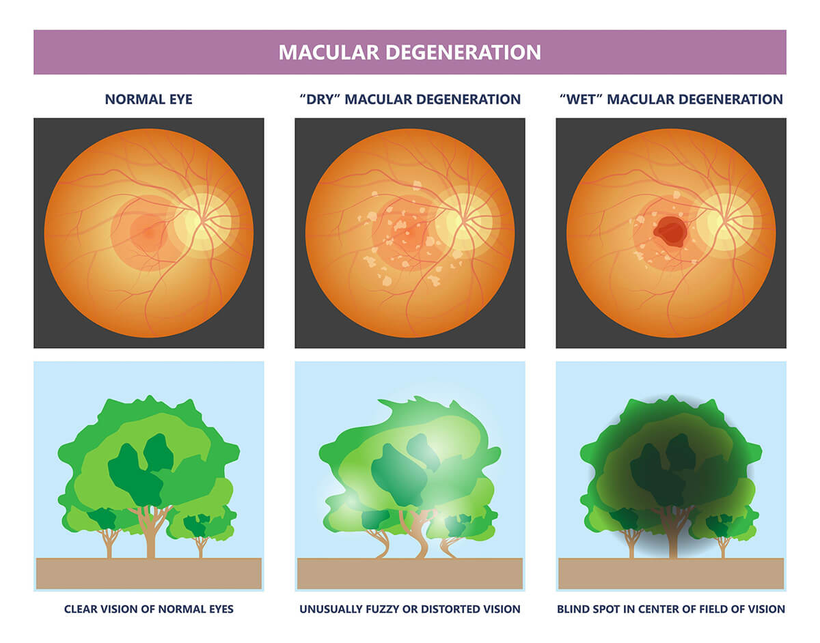
Motivation
AMD is a leading cause of vision loss
Disease driven by coordinated gene networks
Need network-based analysis beyond single genes
IEEE ICHI 2026
Minneapolis, MN • June 1–3, 2026
Notes:
Good default for dense content. Keep the left side as narrative and the right side as structured evidence.

Slide 3
Challenges
High dimensional RNA-seq data
Noise and heterogeneity
Linear correlation is insufficient
IEEE ICHI 2026
Minneapolis, MN • June 1–3, 2026
Notes:
Good default for dense content. Keep the left side as narrative and the right side as structured evidence.

Slide 4
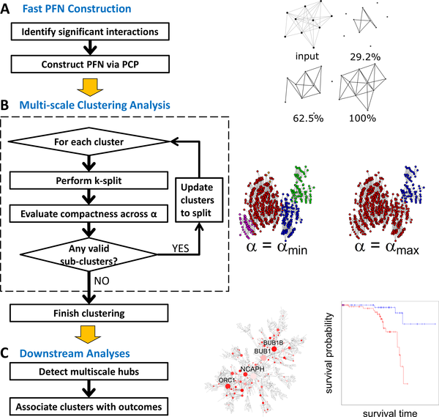
Contributions
Generalized MEGENA framework
Use of information-theoretic similarity metrics
Module quality metrics
Stability testing
Differential Module Eigengene (DME) analysis
IEEE ICHI 2026
Minneapolis, MN • June 1–3, 2026
Notes:
Good default for dense content. Keep the left side as narrative and the right side as structured evidence.

Slide 5
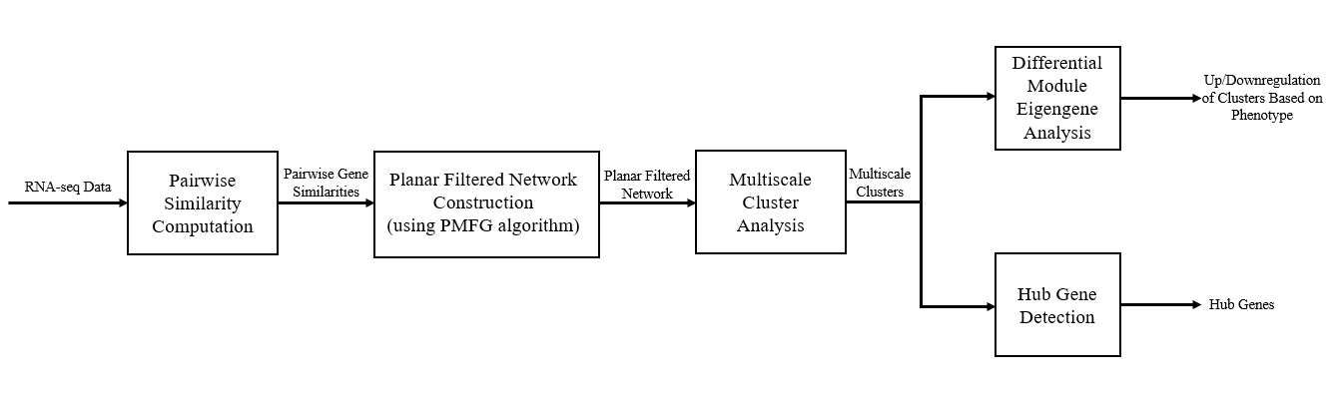
Pipeline Overview
IEEE ICHI 2026
Minneapolis, MN • June 1–3, 2026
Notes:
Good default for dense content. Keep the left side as narrative and the right side as structured evidence.

Slide 6
Data Set
105 controls, 61 late-stage AMD patients
81 curated genes from ML study
IEEE ICHI 2026
Minneapolis, MN • June 1–3, 2026
Notes:
Good default for dense content. Keep the left side as narrative and the right side as structured evidence.

Slide 7
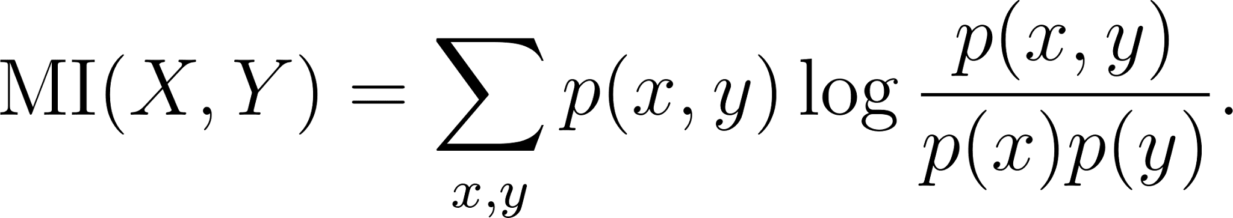
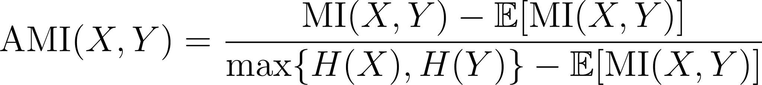
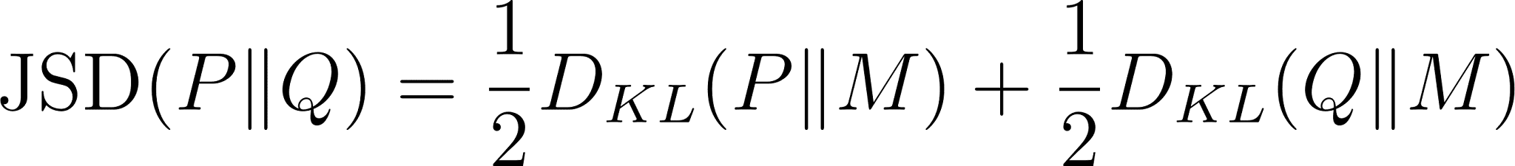
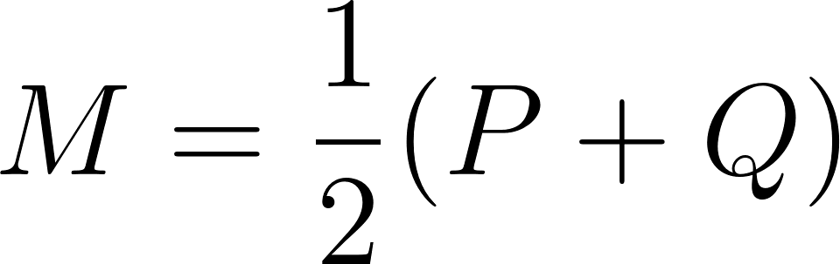
Similarity Metrics
Mutual Information:
Adjusted Mutual Information (AMI):
Jensen-Shannon Divergence (JSD):
IEEE ICHI 2026
Minneapolis, MN • June 1–3, 2026
Notes:
Good default for dense content. Keep the left side as narrative and the right side as structured evidence.

Slide 8
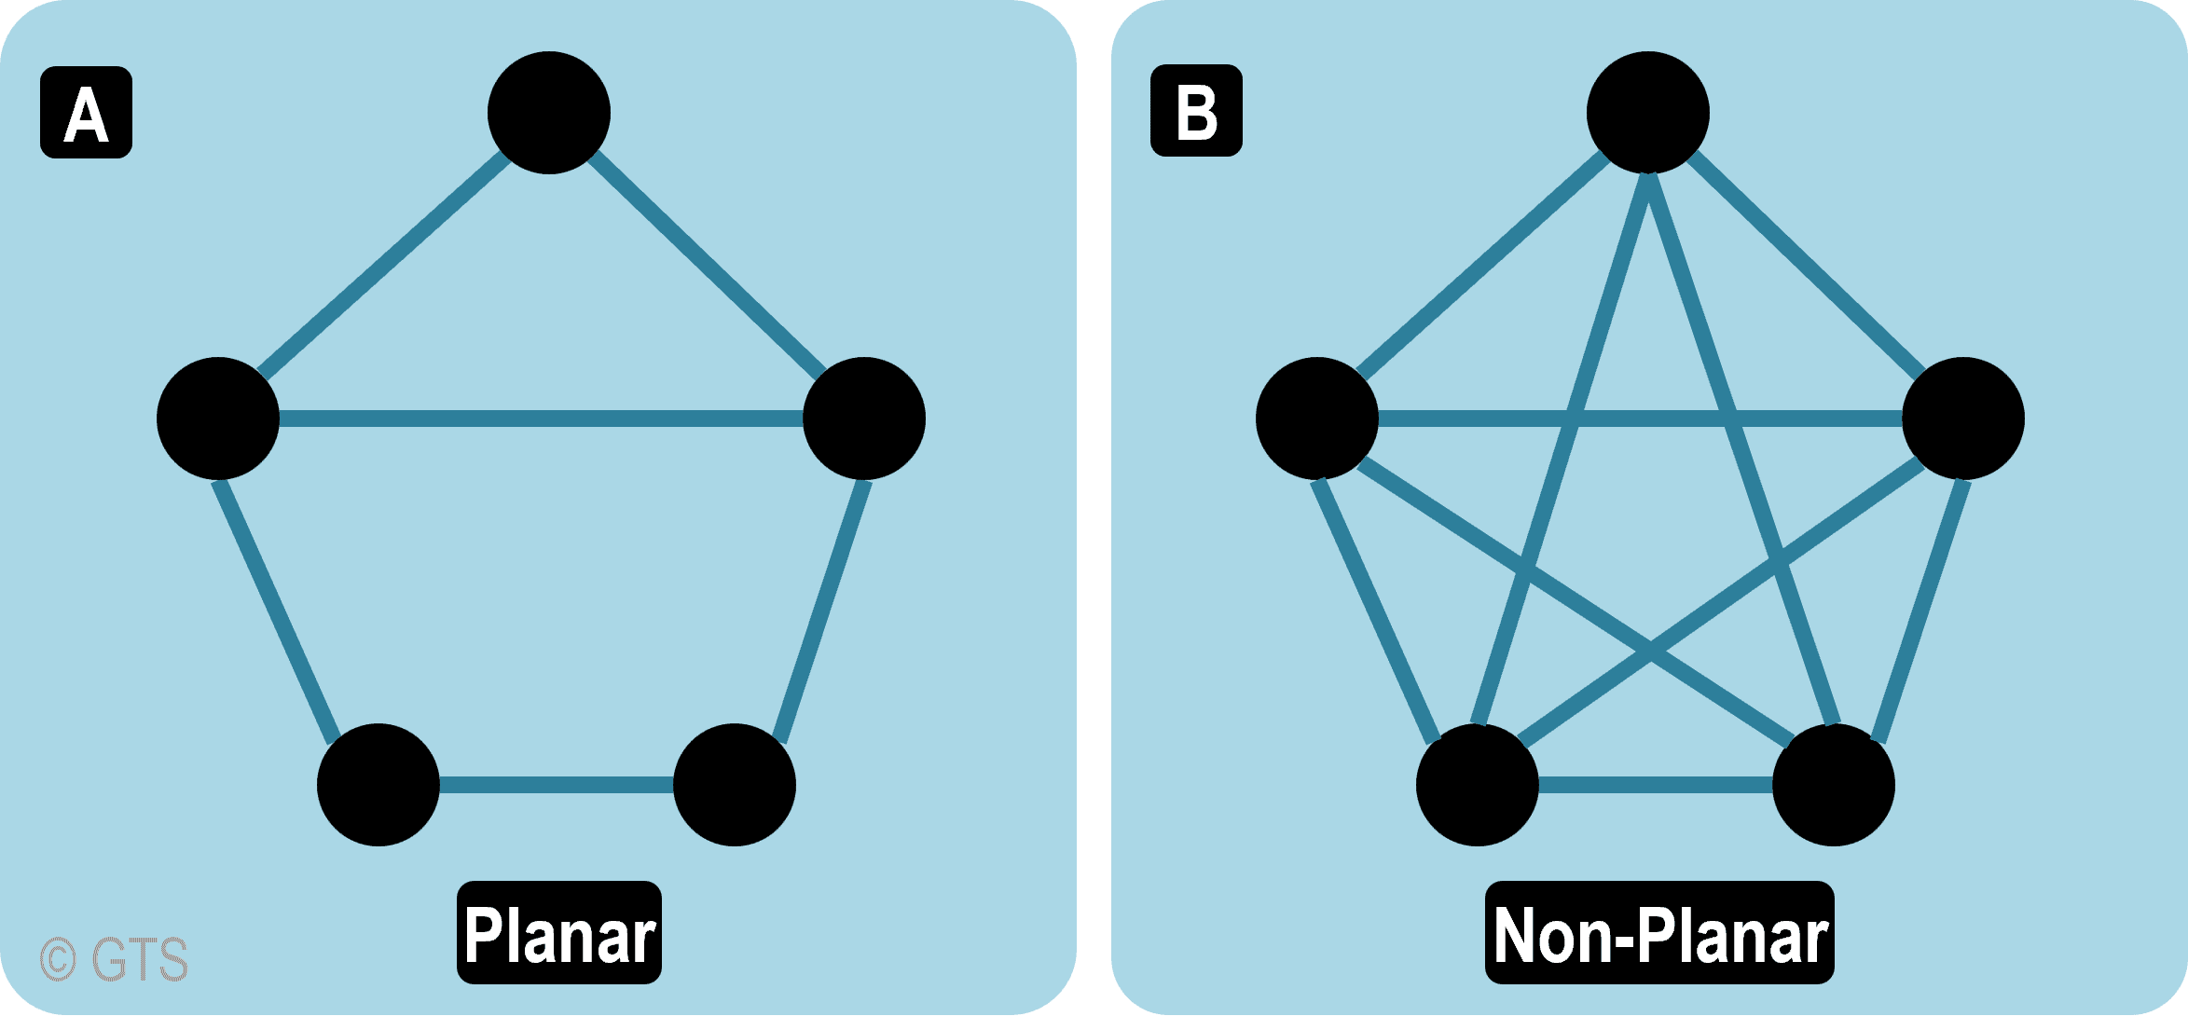
Network Construction
Planar Filtered Network (PFN)
Sparse graph preserving strongest relationships
IEEE ICHI 2026
Minneapolis, MN • June 1–3, 2026
Notes:
Good default for dense content. Keep the left side as narrative and the right side as structured evidence.

Slide 9
Multiscale Clustering
Groups genes with similar expression patterns into clusters
Finds gene networks that may work together in shared pathways
Detect both large modules and smaller nested submodules
Helps identify hub genes that may play central regulatory
IEEE ICHI 2026
Minneapolis, MN • June 1–3, 2026
Notes:
Good default for dense content. Keep the left side as narrative and the right side as structured evidence.

Slide 10
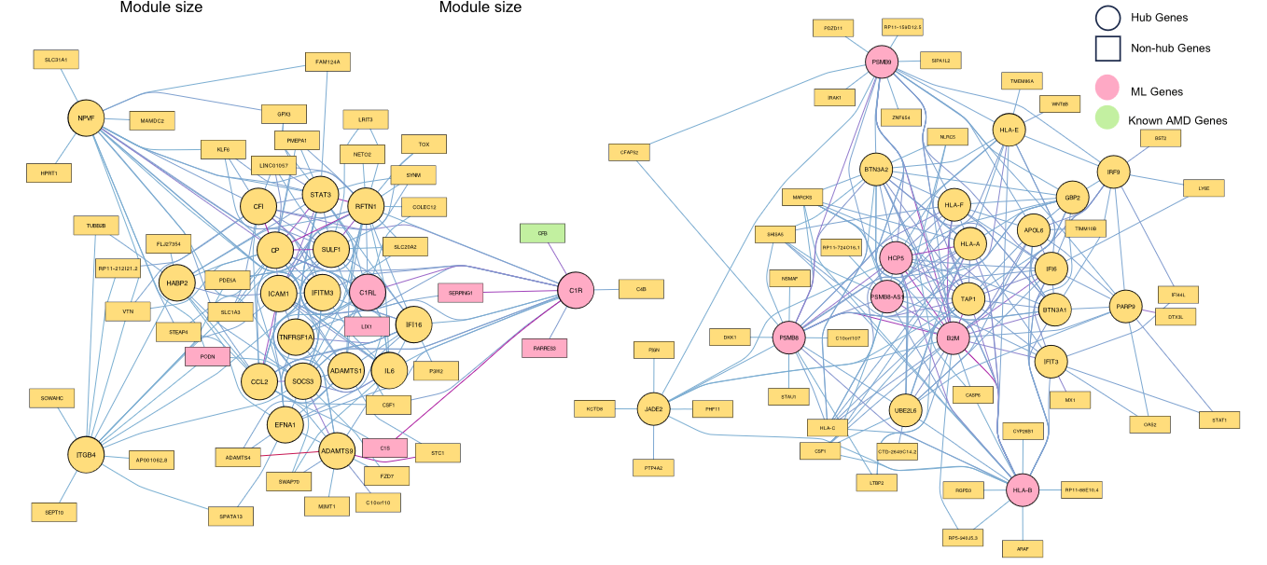
Hub Genes
Highly connected genes within a gene network
May play important regulatory roles in biological pathways
Can help identify genes linked to disease mechanisms
Potential targets for future biological or therapeutic study
IEEE ICHI 2026
Minneapolis, MN • June 1–3, 2026
Notes:
Good default for dense content. Keep the left side as narrative and the right side as structured evidence.

Slide 11
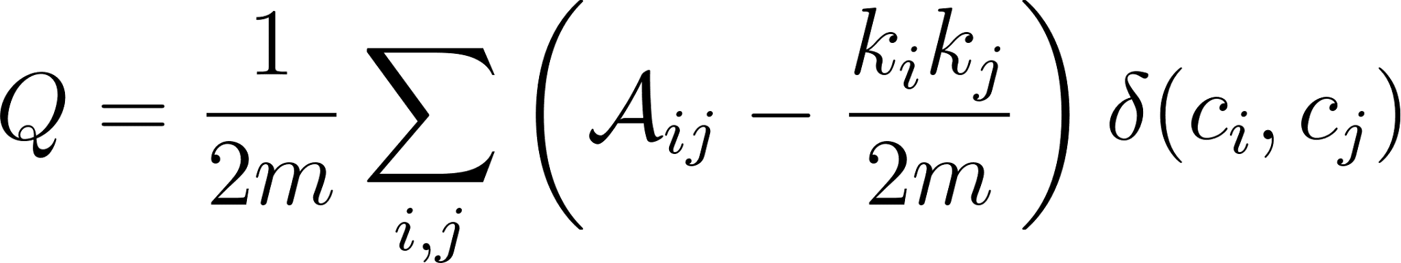
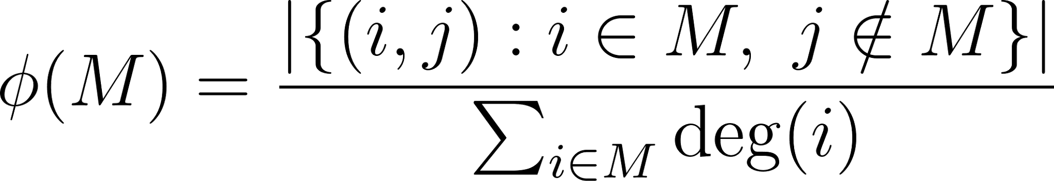
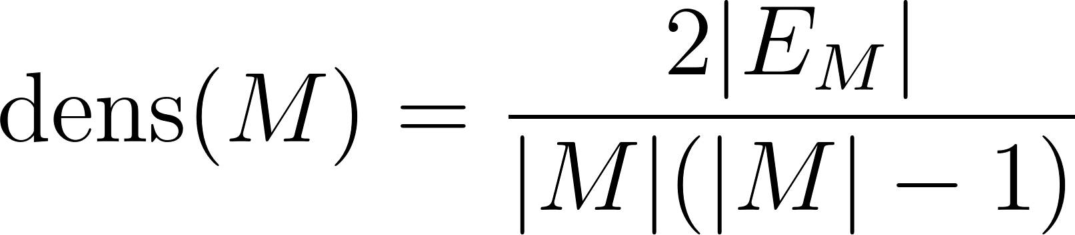
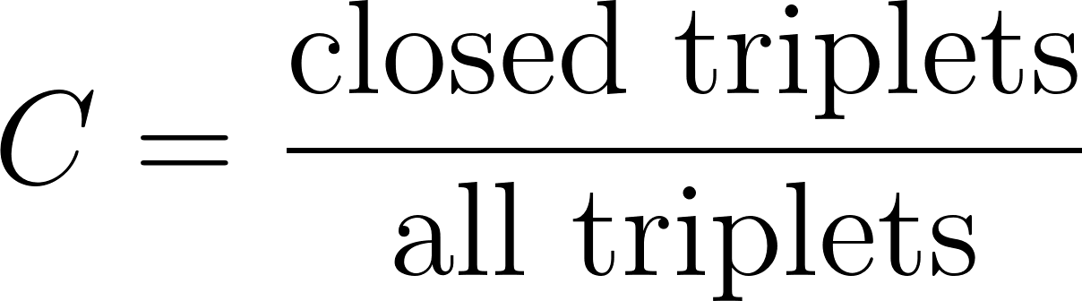
Module Quality Metrics
Modularity:
Conductance:
Density:
Transitivity:
IEEE ICHI 2026
Minneapolis, MN • June 1–3, 2026
Notes:
Good default for dense content. Keep the left side as narrative and the right side as structured evidence.

Slide 12
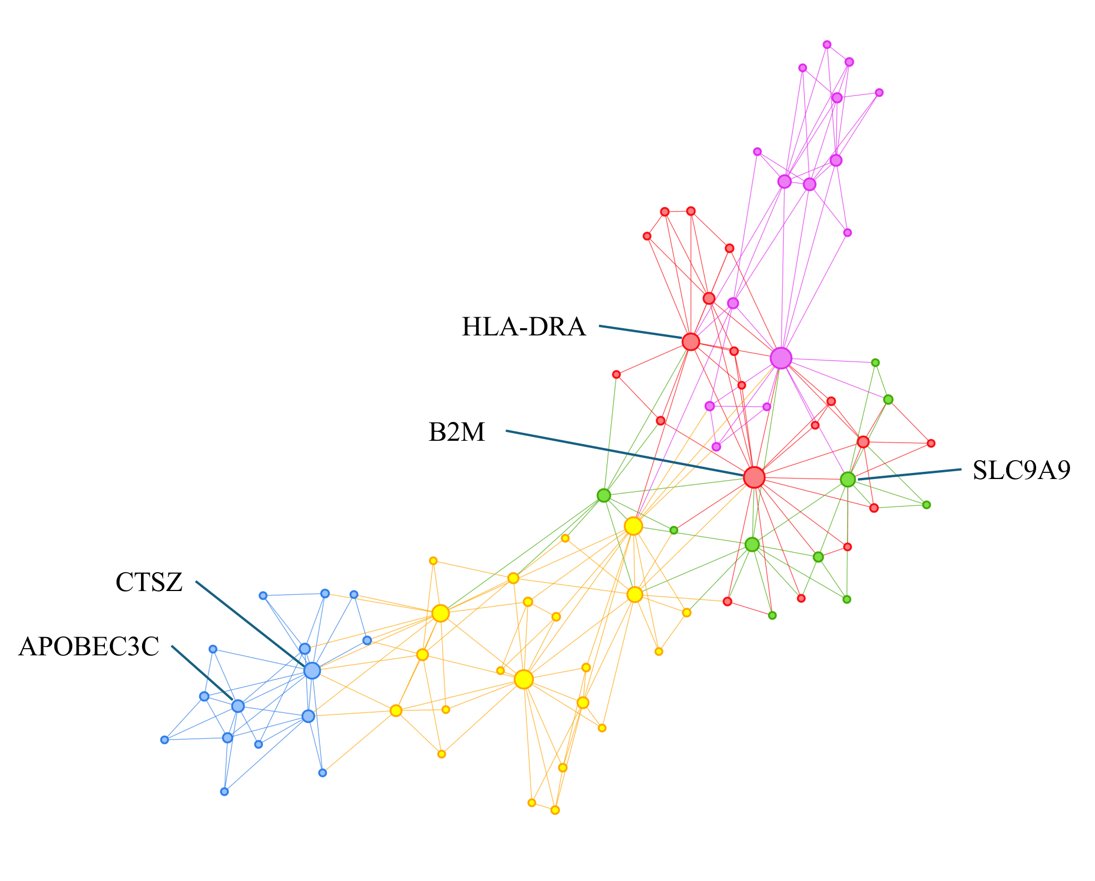
Results
Control + Late AMD
IEEE ICHI 2026
Minneapolis, MN • June 1–3, 2026
Notes:
Good default for dense content. Keep the left side as narrative and the right side as structured evidence.

Slide 13
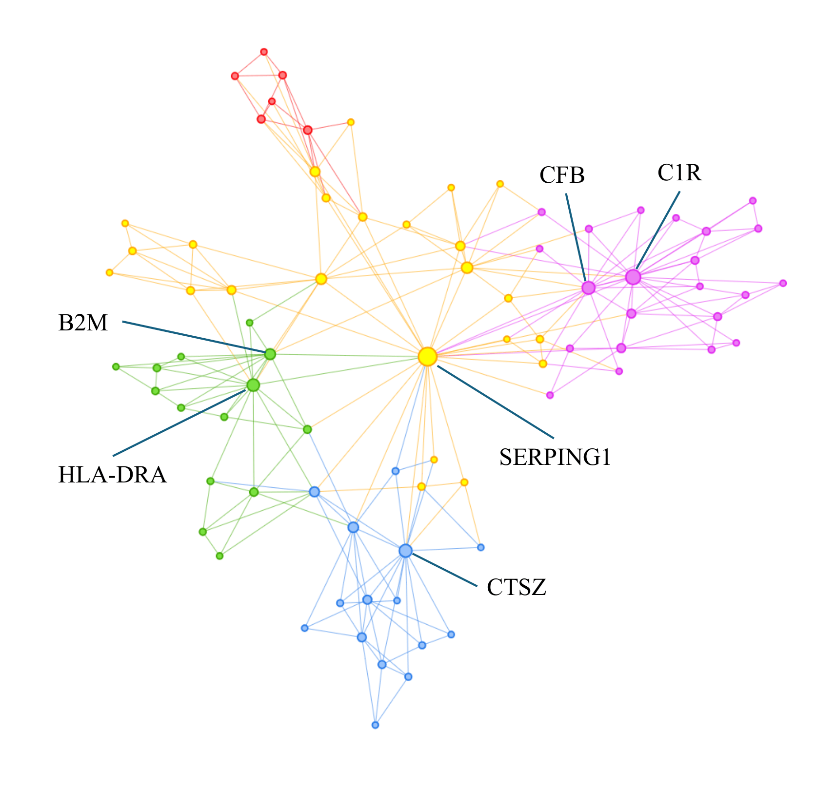
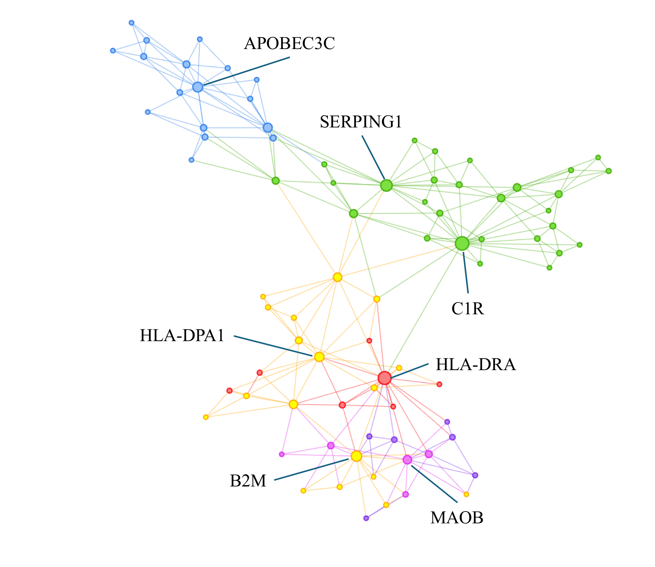
Cohort Comparison
Control
Late AMD
IEEE ICHI 2026
Minneapolis, MN • June 1–3, 2026
Notes:
Good default for dense content. Keep the left side as narrative and the right side as structured evidence.

Slide 14
Stability Testing
Add 419 random genes (total 500)
Gene | Combined Cohort | Control Cohort | Disease Cohort
C1R | 99 | 94 | 93
HLA-DRA | 84 | 70 | 81
SERPING1 | 84 | 43 | 94
B2M | 66 | 64 | 46
CFB | - | - | 65
CTSZ | 17 | - | 59
APOBEC3C | 56 | 39 | -
HLA-DPA1 | - | 21 | -
MAOB | - | 13 | -
SLC9A9 | 1 | - | -
IEEE ICHI 2026
Minneapolis, MN • June 1–3, 2026
Notes:
Good default for dense content. Keep the left side as narrative and the right side as structured evidence.

Slide 15
DME Analysis
Eigengene is the first principal component of a module
Module | Control | Late | T-statistic | p | FDR
C1_2 | -1.25903 | 2.167177 | -4.86804 | 7.05E-06 | 7.05E-06
C1_3 | -1.07429 | 1.849189 | -5.15719 | 2.47E-06 | 6.14E-06
C1_4 | -1.45326 | 2.501514 | -5.0518 | 3.68E-06 | 6.14E-06
C1_5 | -1.02543 | 1.76508 | -5.22561 | 1.46E-06 | 6.14E-06
C1_9 | 1.186797 | -2.04285 | 4.934329 | 5.72E-06 | 7.05E-06
IEEE ICHI 2026
Minneapolis, MN • June 1–3, 2026
Notes:
Good default for dense content. Keep the left side as narrative and the right side as structured evidence.

Slide 16
Biological Insights
Hub Gene | What It Does | Why It Matters in AMD | Cohort
HLA-DRA | Helps immune cells recognize threats and activate immune responses | Suggests inflammation and immune activity are central in AMD | Control + Late
B2M | Supports immune signaling and antigen presentation | Points to chronic immune dysregulation in diseased retina | Control + Late
C1R | Helps activate the body’s natural first-line immune defense | Overactivation of this defense pathway may help drive retinal damage in AMD | Control + Late
SERPING1 | Controls and limits complement activity | Important because it may help protect the retina by controlling excess immune activity | Control + Late
CFB | Helps activate an immune defense pathway linked to AMD | May point to processes that become important in later-stage AMD | Late
IEEE ICHI 2026
Minneapolis, MN • June 1–3, 2026
Notes:
Good default for dense content. Keep the left side as narrative and the right side as structured evidence.

Slide 17
Contributions
Nonlinear similarity improves networks
Robust hub detection
Multiscale modeling
IEEE ICHI 2026
Minneapolis, MN • June 1–3, 2026
Notes:
Good default for dense content. Keep the left side as narrative and the right side as structured evidence.

Slide 18
Limitations
Sample size
Curated gene set
Future: multi-omics, single-cell data
IEEE ICHI 2026
Minneapolis, MN • June 1–3, 2026
Notes:
Good default for dense content. Keep the left side as narrative and the right side as structured evidence.

Slide 19
Conclusion
Robust framework for network-based gene analysis in AMD
IEEE ICHI 2026
Minneapolis, MN • June 1–3, 2026
Notes:
Good default for dense content. Keep the left side as narrative and the right side as structured evidence.

Slide 20
References
Ratnapriya R. et al., 2019 — Nature Genetics Retinal transcriptome and eQTL analyses identify genes associated with AMD
Ma K. et al., 2025 — npj Genomic Medicine Explainable ML and transcriptomics reveal immune signatures in AMD
Langfelder P. and Horvath S., 2008 — BMC Bioinformatics WGCNA: weighted gene co-expression network analysis
Song W.-M. and Zhang B., 2015 — PLOS Computational Biology MEGENA: multiscale gene co-expression network analysis
Morabito S. et al., 2023 — Cell Reports Methods hdWGCNA for high-dimensional transcriptomics
IEEE ICHI 2026
Minneapolis, MN • June 1–3, 2026
Notes:
Good default for dense content. Keep the left side as narrative and the right side as structured evidence.

Slide 21
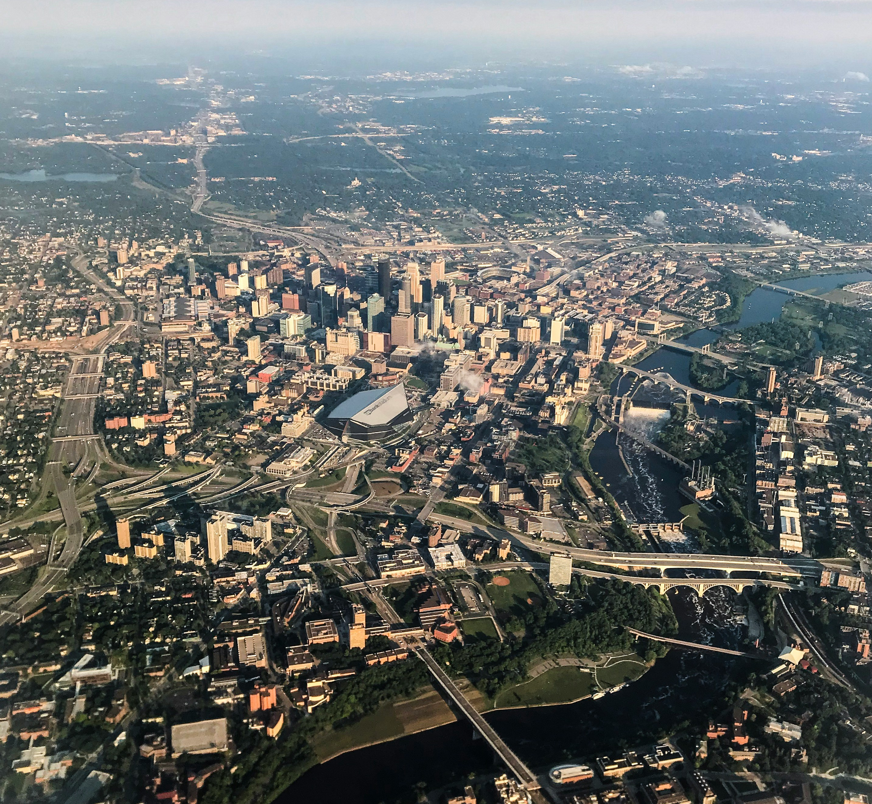

Thank you
Questions?
Brayan Gutierrez
Rice University
bag5@rice.edu
Notes:
Use this as the final Q&A slide. Keep contact details short and readable from the back of the room.

