Slide 1
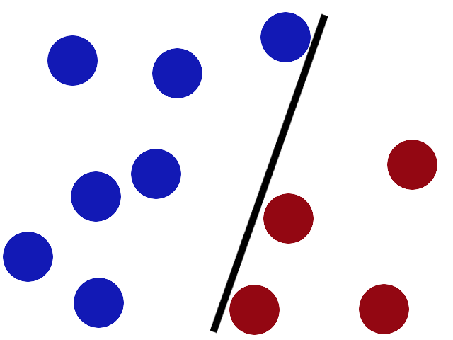
SUPPORT VECTOR MACHINES

Slide 2
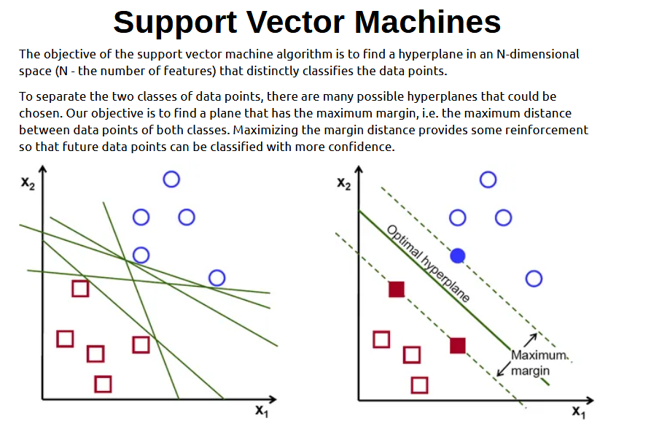

Slide 3
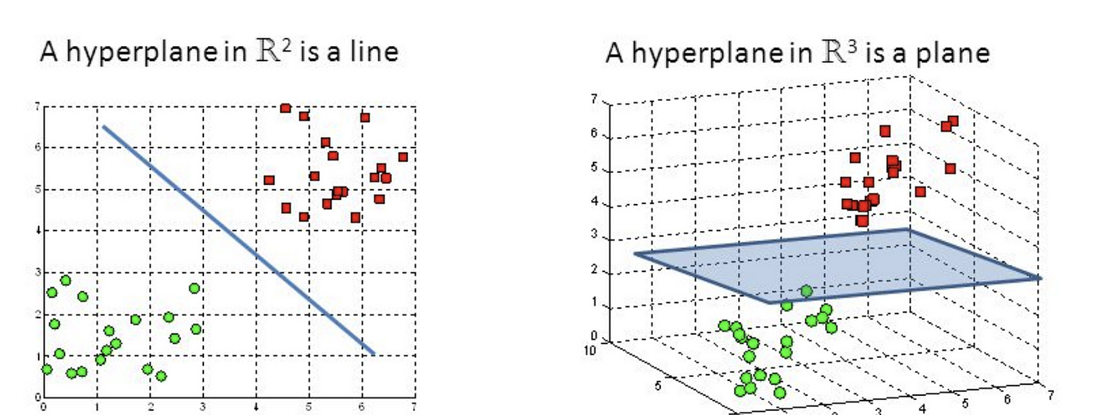
HYPERPLANES
The dimension of the hyperplane is determined by the number of features in the data. For instance, with two features, the hyperplane is a line, while with three features, it becomes a two-dimensional plane. Visualizing hyperplanes becomes increasingly challenging as the number of features exceeds three.
Hyperplanes are decision boundaries that help classify the data points. Data points falling on either side of the hyperplane can be attributed to different classes. ​

Slide 4
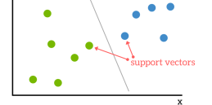
Support Vectors
Support vectors are data points that are closer to the hyperplane and influence the position and orientation of the hyperplane, deleting the support vectors will change the position of the hyperplane. Using these support vectors, we maximize the margin of the classifier

Slide 5
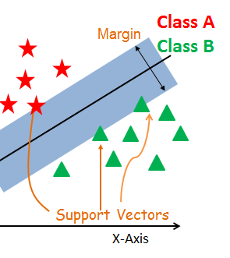
Classification
We apply the sigmoid function to an output of a linear function, which If the transformed value is greater than a predefined threshold (usually 0.5) then it transforms the value into a range between 0 and 1.
In SVM, instead of using a threshold of 0.5, we use a threshold of 1 and -1. If the output is greater than 1, the data point is associated with one class, and if the output is less than -1, it's associated with another class.

Slide 6
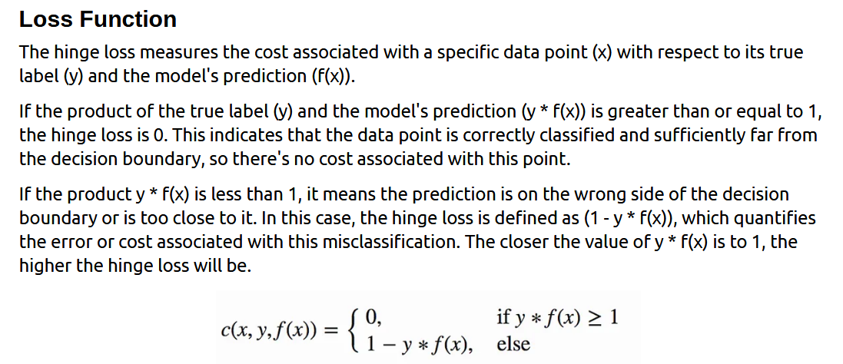

Slide 7
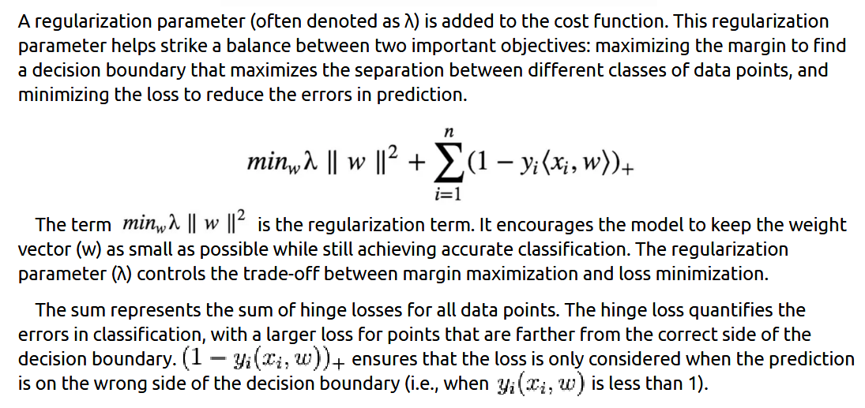

Slide 8
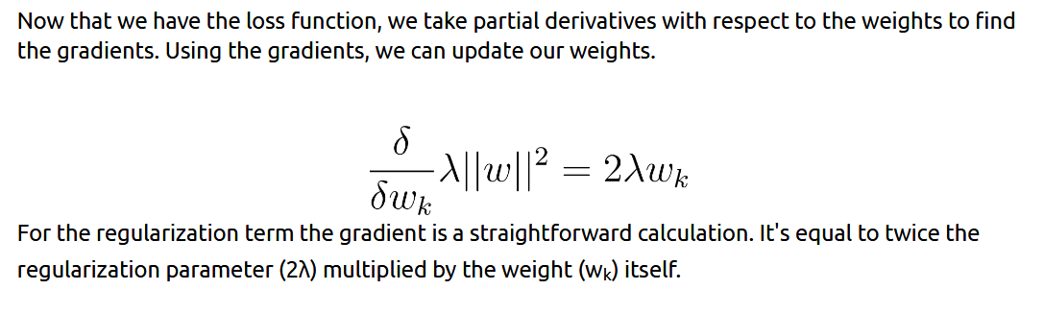

Slide 9
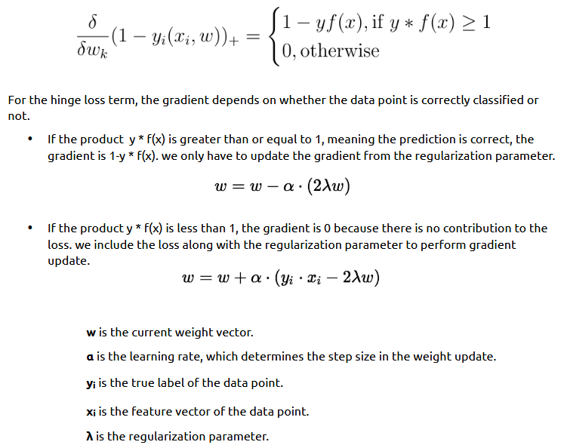

Slide 10
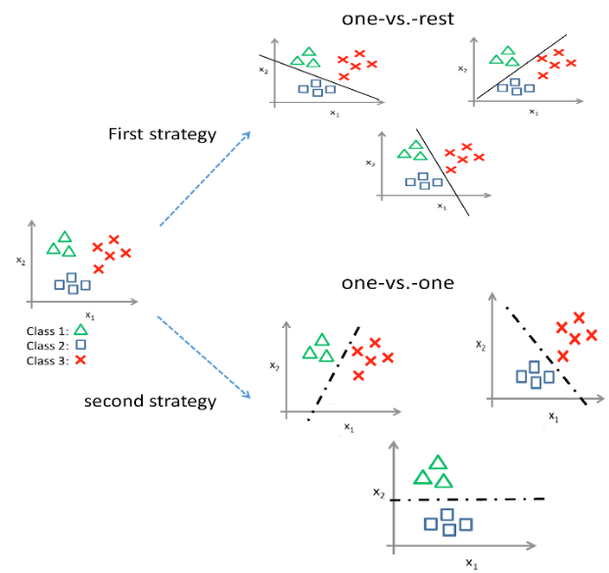
SVM for more than two classes.
(OvR) It involves splitting the multi-class dataset into multiple binary classification problems. A binary classifier is then trained on each binary classification problem and predictions are made using the model that is the most confident.
(OvO) One-vs-one splits a multi-class classification dataset into binary classification problems. The one-vs-one approach splits the dataset into one dataset for each class versus every other class.

Slide 11
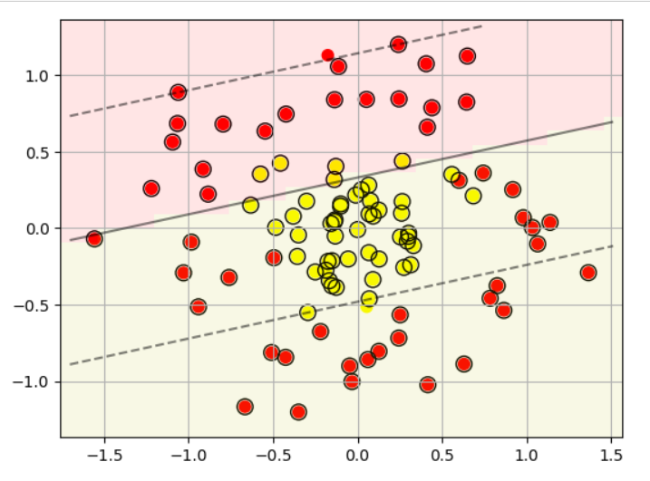
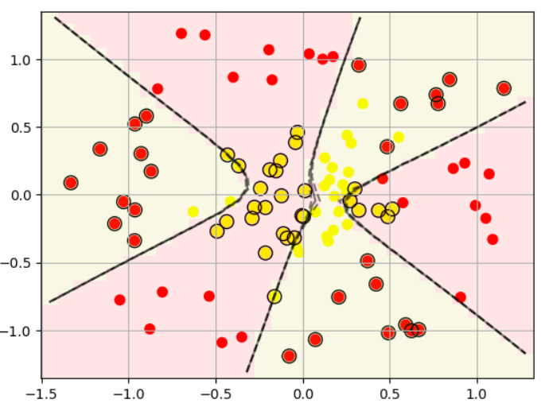
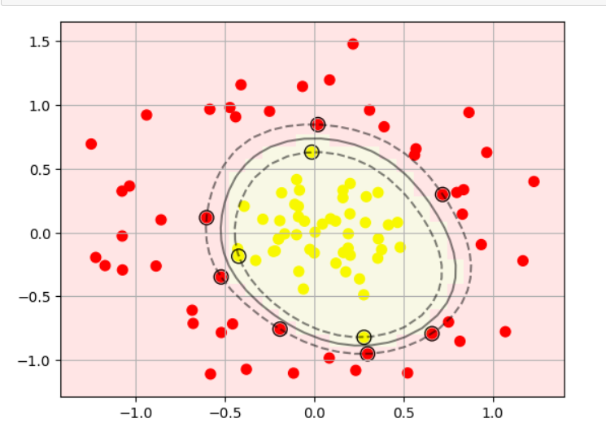
Kernel Trick.
The Kernel trick refers to a technique that allows the correct functioning of SVM on those data that are not linearly separable, that is, data that cannot be easily divided with a straight line. This allows SVMs to handle more complex data and find nonlinear patterns more effectively.
SVC(kernel='linear')
SVC(kernel='sigmoid')
SVC(kernel='rbf')

