Slide 1
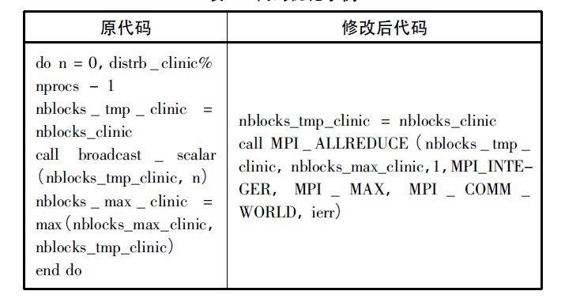
domain.f90 +431
提速6s

Slide 2
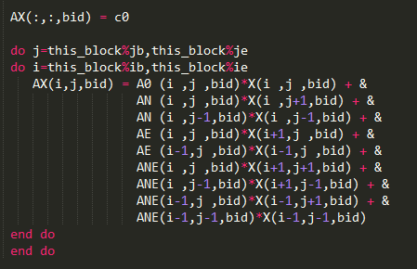
This PCG function is used to solve the equation Ax = b, where the operator A is a matrix of nine-point stencils , and b is a vector of barotropic distribution.
barotropic operator
Boundary_2d_dbl：两维场量的边界通信;
Impvmixt:垂直混合计算;
Impvmixt_correct:垂直混合计算修正;
Global_sum_dbl：计算全局和;
Notes:
POP模式计算量主要集中在显示时间积分三维斜压部分
二维正压：三维斜压

Slide 3
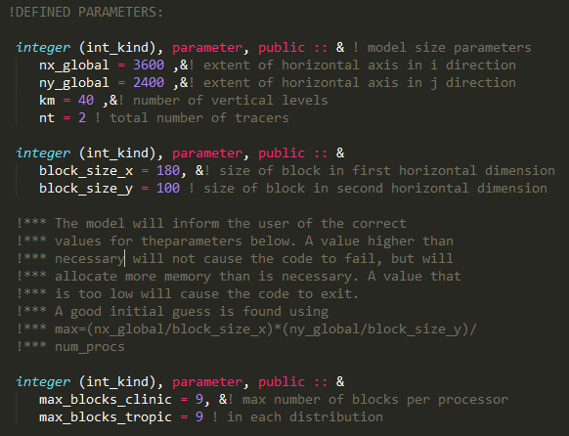
domain_size

Slide 4
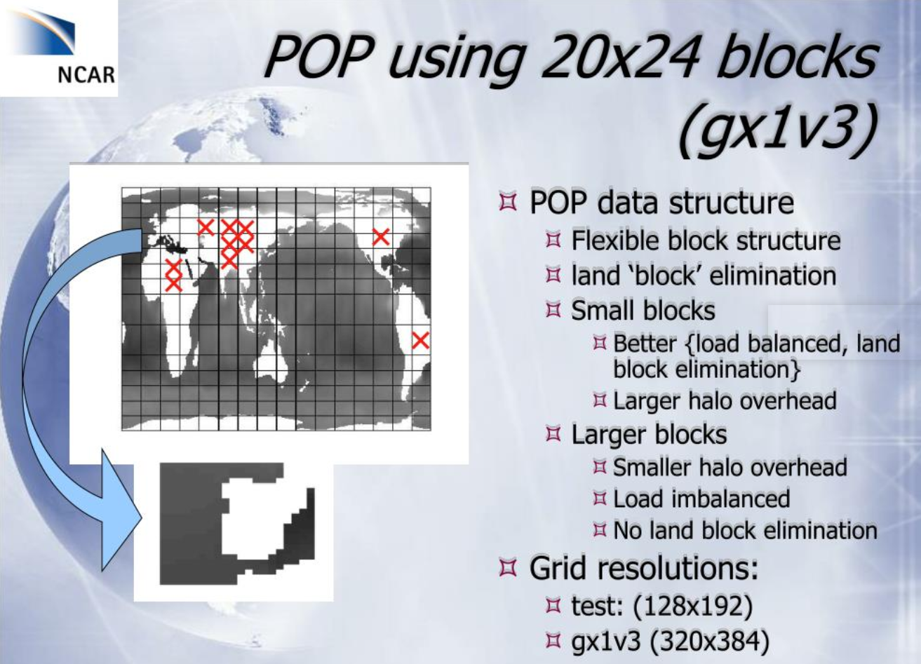
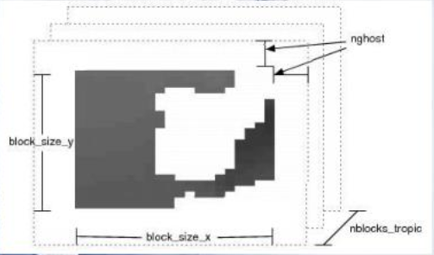

Slide 5
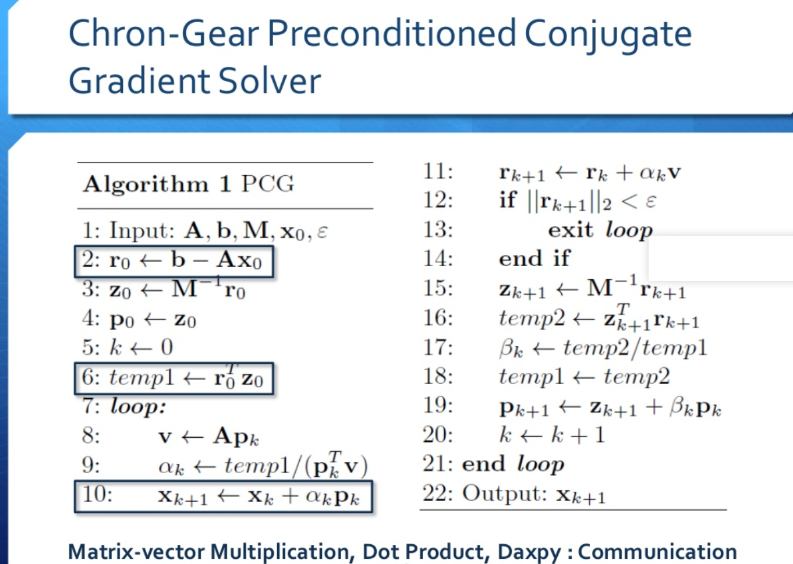
Notes:
https://www.slideshare.net/hongtaocai33/cgpop-analysis-and-optimization

Slide 6
boundary_2d_real/update_ghost_cells
1、post receives
2、fill send buffer and post sends
buf_ew_snd(:,:,i,n) = ARRAY(ib_src:ie_src,:,src_block)
ew MSG
3、call MPI_WAITALL(in_bndy%nmsg_ew_rcv, rcv_request, rcv_status, ierr)
4、unpack the recv buffer into ghost cells
ARRAY(ib_dst:ie_dst,:,dst_block) = buf_ew_rcv(:,:,k,n)
1、post receives
2、fill send buffer and post sends
buf_ns_snd(:,:,i,n) = ARRAY(:,jb_src:je_src,src_block)
ns MSG
3、call MPI_WAITALL(in_bndy%nmsg_ew_rcv, rcv_request, rcv_status, ierr)
4、unpack the recv buffer into ghost cells
ARRAY(:,jb_dst:je_dst,dst_block) = buf_ns_rcv(:,1:nghost,k,n)

Slide 7
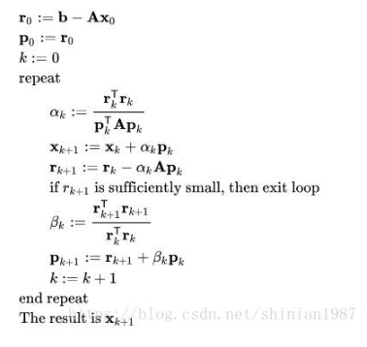
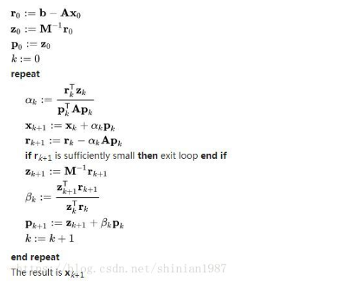

Slide 8
优化点：
global_sum56个线程重复计算了

