Slide 1

CONTENTS
1
1 Initial Design
3
3 New Design
2
2 Problems
4
4 Comparison

Slide 2
Initial Design

Slide 3
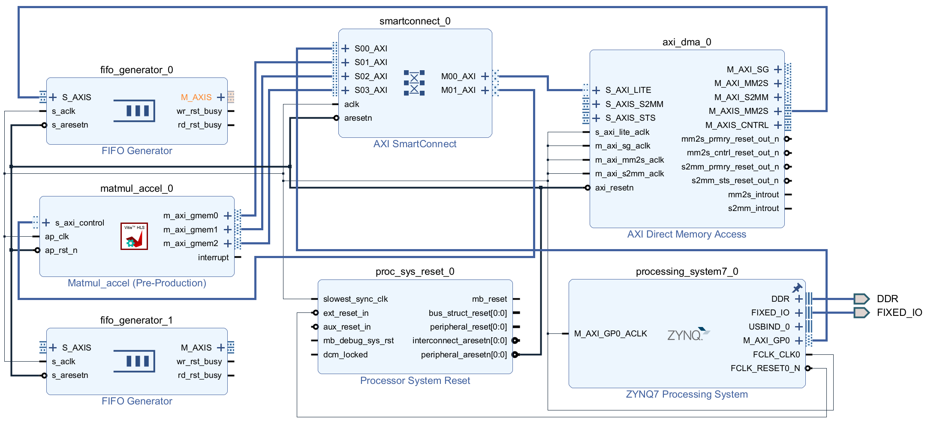
Initial Design
The ARM core was required to move matrix data by individually reading and writing DDR address space.
The DMA controller autonomously handles data transfer in hardware mode.
The CPU merely configures relevant registers and issues start commands without participating in actual data movement.
FIFO Generator were usd as BRAM to preventing underflow of the back-end computing module and overflow of front-end high-speed data

Slide 4
Problems

Slide 5
Problems
The designed IP adopts the GMEM direct DDR access architecture.
Our first design was based on AXI4-Stream streaming architecture.
DMA and FIFO modules were unnecessary, we need a new design, which fit our IP core.

Slide 6
New Design

Slide 7
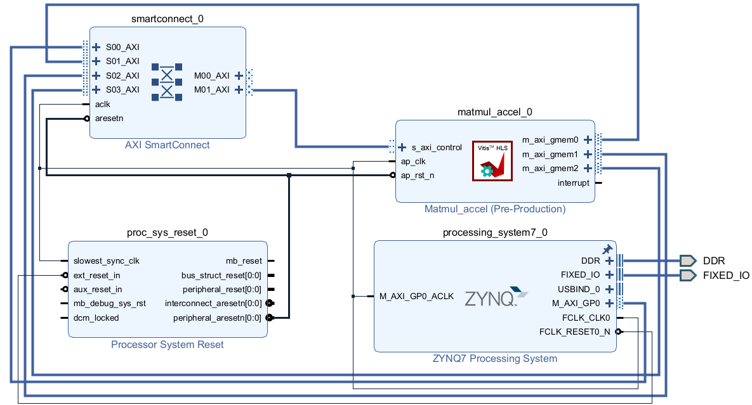
New Design
The ARM core initializes test matrices A and B within the DDR memory space;
It configures register parameters of the matmul accelerator via the AXI-Lite bus and triggers hardware computation;
Leveraging three independent GMEM master buses, the matmul IP directly accesses DDR to autonomously load input data, execute parallel matrix multip-lication, and write calculation results back to DDR;
An interrupt signal is asserted once computation completes;
After receiving the interrupt, the ARM reads the resulting matrix from DDR and verifies correctness by comparing it against results from serial software-based computation.

Slide 8
Comparison

Slide 9
Comparison
GMEM direct DDR access architecture
AXI4-Stream streaming architecture
It consumes hardware resources of DMA controller, dual FIFO and AXI4-Stream interconnect, leading to high utilization of LUT and FF as well as enlarged hardware footprint.
Data rate mismatch between upstream and downstream modules is resolved by FIFO buffering, which introduces potential timing risks.
Extra latency is incurred from packet encapsulation/de-encapsulation and repeated data access across FIFO.
DMA and FIFO modules are eliminated with only AXI interconnect retained, which reduces logic overhead and improves resource efficiency.
Shortened datapath and simplified timing constraints facilitate timing closure under high operating frequency.
The accelerator IP accesses DDR on demand; overhead from protocol packaging and FIFO read/write is removed to cut down overall computation latency.
For the matrix multiplication scenario in this project, FIFO fails to boost acceleration performance and instead degrades overall throughput. FIFO-based speedup is only applicable to streaming pipeline-oriented algorithms.

