Slide 1
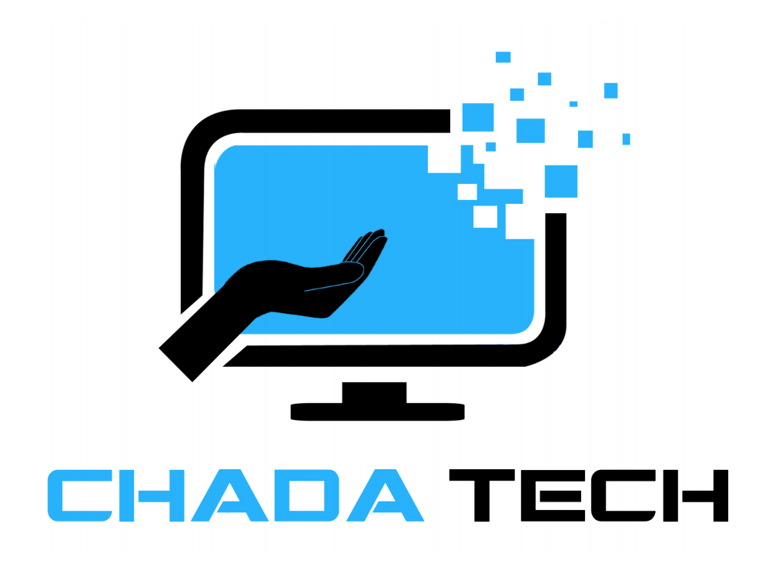
Scrum-Agile vs. waterfall Chada Tech
Braydon Woodward

Slide 2
Introduction
Today, we delve into a critical aspect of project management – the choice between Scrum-Agile and Waterfall methodologies.
Understanding these approaches is vital for making informed decisions that impact project success.

Slide 3
Scrum-agile roles
Product Owner
Scrum Master
Developer
Tester
Define and prioritize the product backlog.
Communicate the project vision and goals
Make decisions on feature implementation based on business value.
Provide clarification and answer questions from the development team.
Facilitate Scrum events.
Remove obstacles or impediments that hinder the team.
Ensure the team adheres to Scrum practices and principles.
Act as a coach to help the team continuously improve.
Participate in Scrum events.
Collaborate to implement user stories.
Write code for delivering a product increment.
Collaborate with team members to ensure a successful end product.
Participate Scrum events.
Develop and execute test cases to validate features.
Work with the development team to resolve issues.
Collaborate with the team to ensure the product meets quality standards.

Slide 4
Agile sdlc overview
Life Cycle
Planning - Setting project goals, defining features, and establishing priorities.
Development* - Actively creating the product, with the development team writing code and building features.
Testing* - Verifying and validating the developed features to ensure they meet quality standards.
Deployment - Releasing the product incrementally or in its entirety.
Review - Reflecting on the completed work during the sprint or project.
*Happening simultaneously.

Slide 5
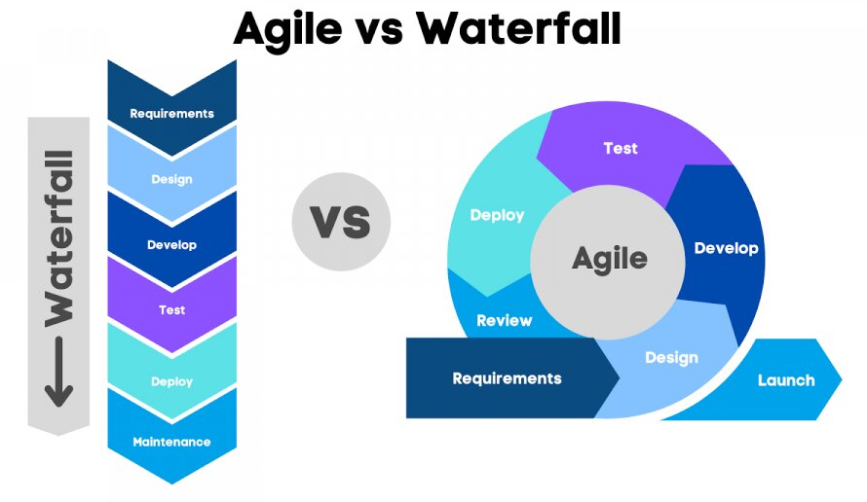
Waterfall vs. Agile Approach
Retrieved from: Linkedin.com

Slide 6
Waterfall Development Process
Life Cycle
Requirements - A comprehensive phase gathering and defining project objectives and client needs.
Design - Creating a detailed blueprint or design for the entire system.
Implementation - The actual coding and development of the project.
Testing - Verifying and validating the developed software meets predefined requirements and quality standards.
Deployment - Releasing the completed product to users or clients.

Slide 7
Agile’s strength VS waterfall
Adaptability
Agile: Enables continuous adjustment based on evolving requirements reducing the impact of changes on the project.
Waterfall: A rigid, linear approach that limits the capacity of mid-project adjustments.
Collaboration
Agile: Promotes ongoing client involvement and transparency within the team which enhances client satisfaction and software quality.
Waterfall: Client involvement is concentrated at the beginning and end of the project and different development teams are isolated.
Concurrent Testing
Agile: Parallel testing and development allow for quicker feedback and identifies and addresses issues proactively.
Waterfall: Testing is not done until the end of development, allowing for series issues that may be hard, or even impossible, to remedy.

Slide 8
Factors for consideration
Project Complexity - Agile suits dynamic and complex projects, while Waterfall may be suitable for well-defined, less complex endeavors.
Client Involvement - Agile emphasizes ongoing client participation, while Waterfall involves clients at arms-length.
Need for Flexibility - Agile excels in adapting to changing requirements, while Waterfall may face challenges adapting to mid-project changes.
Need for Collaboration - Agile's collaborative nature supports constant communication between stakeholders, while Waterfall may limit or isolate communication between different departments.

Slide 9
References
Cobb, C. G.(2015). The Project Manager's Guide to Mastering Agile : Principles and Practices for an Adaptive Approach. Wiley.
Datavalley. (2023). Waterfall Vs Agile: Which is better for You and Why?. Linkedin, https://www.linkedin.com/pulse/waterfall-vs-agile-which-better-you-why-datacademy-cloud/
Kumar, S. (2024). Waterfall Model – Software Engineering. GeeksforGeeks, https://www.geeksforgeeks.org/waterfall-model/

