Slide 1
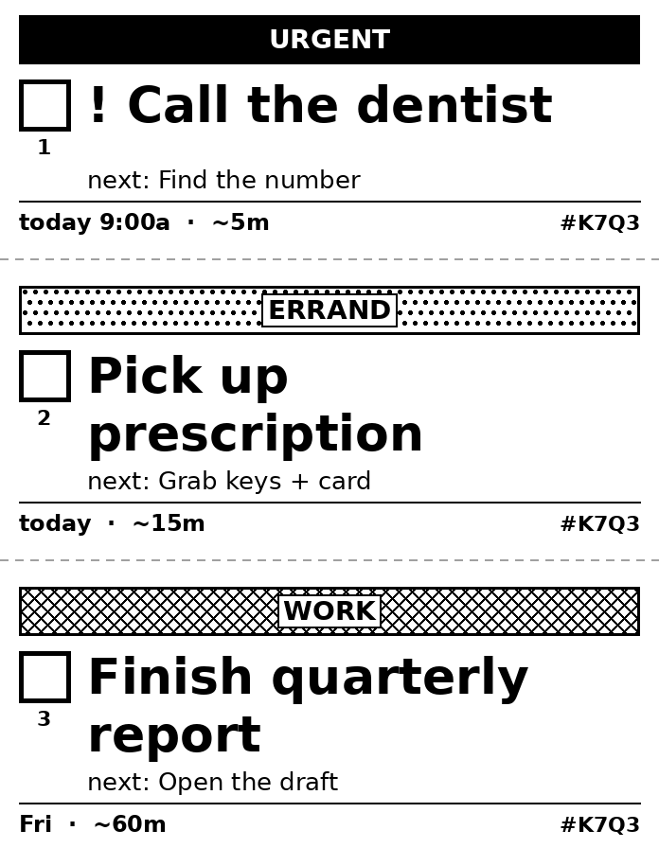
Next Box
Your to-do list, on paper you can hold.
A paper-first to-do system for ADHD brains: thermal labels, colored tags and photo read-back, connected to the apps you already use.
Product overview and pitch · v0.9.6 · nextbox.braznarkel.com
Notes:
Next Box prints your to-do list on small labels and stickers, made for people with ADHD. You check things off with a pen, take a photo, and your list updates itself.

Slide 2
THE PROBLEM
To-do apps are built for brains that remember to open them
Out of sight, out of mind
Too much at once
For many people with ADHD, a task inside an app on a locked phone may as well not exist. To-do apps depend on you remembering to open them.
A screen holding 47 overdue tasks in red is overwhelming, and that feeling stops people before they start.
Paper works, but it doesn't sync
Guilt, not help
Sticky notes and paper planners are visible and satisfying to check off. But they get lost, they go stale, and they never match your phone.
Most apps say 'OVERDUE' in red. For someone who already struggles with time, that reads as shame, not as a nudge.
Next Box · Your to-do list, on paper you can hold.
2
Notes:
Most productivity tools assume executive function the user may not have. The fix isn't a better app. It's getting the list out of the phone and into the room.

Slide 3
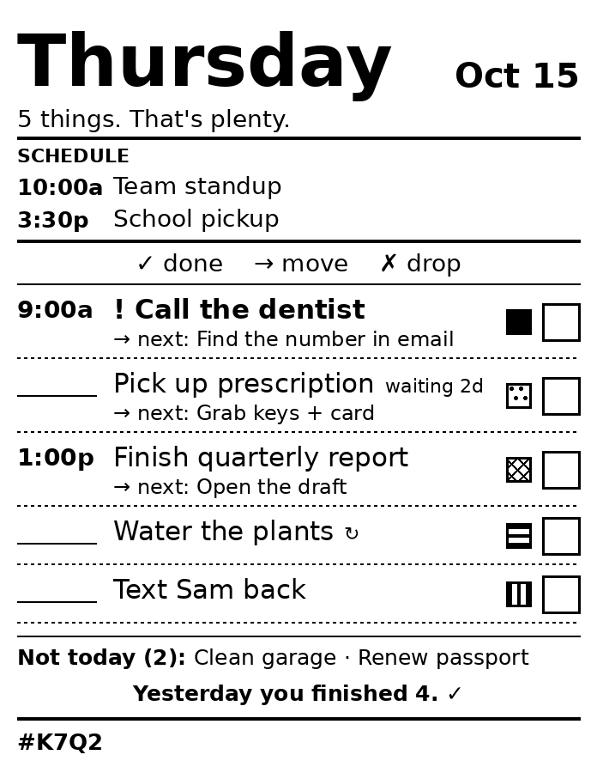
THE SOLUTION
Put the list in the room, and keep it in sync
Next Box connects the to-do app you already use to a small label printer. With one tap it prints today's list, or one sticker per task to put where the task happens: on the fridge, the front door, the laptop. Check boxes with a pen, take a photo, and Next Box marks those tasks done in your app. You don't have to type them in.
Not another to-do app.
Next Box adds paper on top of the app you already use: Todoist, Notion, Google Tasks and others, or its own simple built-in list.
Next Box · Your to-do list, on paper you can hold.
3

Slide 4
HOW IT WORKS
Plan → Print → Do → Snap
1 Plan
2 Print
3 Do
4 Snap
Add tasks in Next Box's own list or in your usual app. Type a whole brain dump at once.
Tap to print the daily list, stickers, tear-off strips or one big 'just one thing' card.
Stick it where you'll see it. Check boxes, arrow things to tomorrow, cross out what's dropped.
Take a photo. Next Box reads your pen marks, shows what it found, and updates your list.
Read-back works on every print: each box has a row number, and the label code ties the photo to exactly what was printed.
Next Box · Your to-do list, on paper you can hold.
4

Slide 5
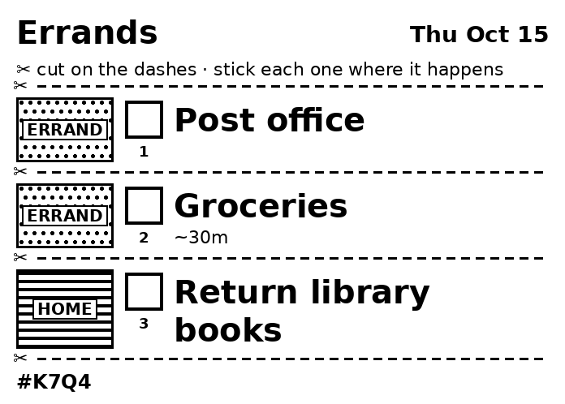
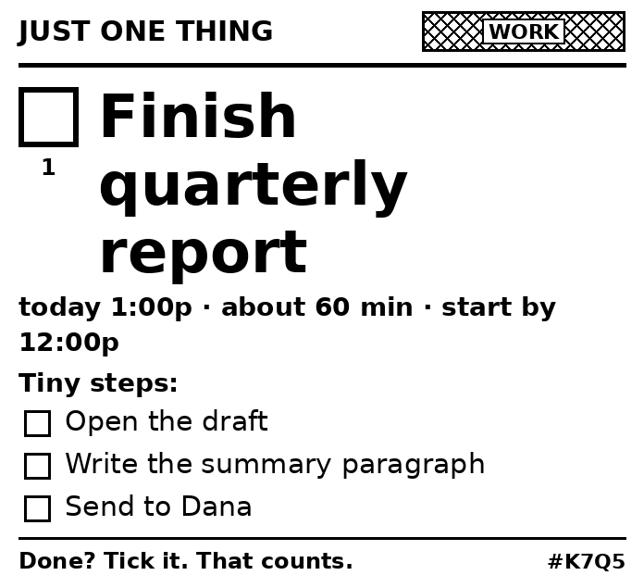
WHAT IT PRINTS
Four formats, one tap each
Daily ticket
Stickers
Tear-off strips
Just one thing
Today on one label: your calendar, up to 5 tasks, the next tiny step for each, and yesterday's wins.
One task per sticker with a tag color band, cut apart, to put where the task happens.
A list on one label with dashed cut lines. Tear off one task at a time.
For overwhelming days: one task, printed huge, with tiny steps and a 'start by' time.
Next Box · Your to-do list, on paper you can hold.
5
Notes:
These are real renders from the Next Box code, not mockups.

Slide 6
DESIGNED FOR ADHD
Every default is chosen to lower the barrier to starting
Five things, not fifty The daily ticket shows at most 5 tasks. The rest go in a small 'Not today' line, so they aren't forgotten but don't take over.
Gentle words It says 'waiting 3d', not 'OVERDUE'. Repeating tasks move ahead instead of piling up.
The next tiny step Under each task: the first small action ("Open the draft"). Starting is the hard part.
Wins first "Yesterday you finished 4. ✓" is printed on today's ticket.
Brain dump Type everything at once, one task per line. Next Box understands #tags, !priority, 'tomorrow 3pm', '~15m' and 'every weekday'.
Colored tags you can see Red for urgent, yellow for errands, blue for calls and more. Each tag prints as its own pattern, so color shows up even on a black-and-white printer.
Paper you can touch Checking a real box with a real pen gives a small reward that tapping a screen doesn't.
One automatic print, by design Nothing prints unless you ask, except today's list, once a day, when you walk into your office (through Home Assistant).
Next Box · Your to-do list, on paper you can hold.
6

Slide 7
COLORED TAGS WITHOUT COLOR INK
Color that works on a black-and-white printer
Thermal printers only print black. Next Box gives each tag color two jobs:
red · #urgent
orange · #orange
Routing. Load red labels in one printer and white in another. Urgent stickers come out on red labels automatically.
Pattern. On any roll, each color prints as its own pattern: red is solid, yellow is dots, green is stripes, purple is crosshatch, and so on. You can tell tags apart at a glance.
Your colors. Tags match your Todoist labels or calendar categories by name, so a tag keeps the same color everywhere.
yellow · #errand
green · #home
blue · #call
pink · #pink
purple · #work
Next Box · Your to-do list, on paper you can hold.
7

Slide 8
CLOSE THE LOOP
Take a photo of the paper and your app updates
Mark it up. ✓ done → move to tomorrow ✗ drop. The legend is printed on every daily ticket.
Snap it. Take a photo from the phone app. AI vision reads each numbered box.
Review it. Next Box shows what it found before changing anything, and you confirm.
Safe by default. Dropping a task never deletes it without an explicit yes.
Read-back found 3 marks
✓ Call the dentist → done
→ Pick up prescription → tomorrow
✗ Text Sam back → drop?
[ Apply ] [ Fix one ]
Next Box · Your to-do list, on paper you can hold.
8

Slide 9
WORKS WITH WHAT YOU ALREADY USE
Connect your to-do app and calendar, or use the built-in list
TO-DO APPS
CALENDARS
Next Box's own list Built in, no account needed
Todoist Ready
Any CalDAV list Ready: Nextcloud, Fastmail, Synology, Zoho, older iCloud lists
Notion Ready: any database with a title and a checkbox or status column
Asana Ready: tasks assigned to you
Google Tasks Built; switches on after a one-time Google sign-in setup
Microsoft To Do Built; switches on after a one-time Microsoft sign-in setup
TickTick Built; switches on after a one-time TickTick sign-in setup
Apple Reminders, Things, Any.do, Google Keep Not possible: they don't let other apps connect
Any calendar link (.ics) Ready: Google, iCloud, Outlook and school or work calendars
CalDAV calendars Ready
Google Calendar, Outlook Built; switch on after the one-time sign-in setup
Tasks stay in your app. Next Box reads them live and never makes a copy. Calendars are read-only and print as a SCHEDULE box on the daily ticket.
Next Box · Your to-do list, on paper you can hold.
9

Slide 10
PRINTS ON ALMOST ANYTHING
From a $60 label printer to the office laser printer
Brother QL / PT label printers QL-800 series can print red ink too
ESC/POS receipt printers Epson, Star, most 58/80 mm printers
ZPL label printers Zebra and compatibles
TSPL label printers TSC, Munbyn, iDPRT, Xprinter
Anything installed on the computer Dymo, Rollo and USB printers, through CUPS
Any home or office printer 'Print on paper' makes a Letter or A4 PDF with real-size stickers and cut lines
Next Box · Your to-do list, on paper you can hold.
10

Slide 11
BUILT FOR TRUST
Privacy and safety are part of the design
Your tasks stay where they are Tasks from a linked app are read live and never copied into Next Box. Calendars are read-only and never stored.
Invite-only No open sign-up. Every new person needs a one-time invite code.
Secrets sealed To-do app tokens are encrypted at rest. Passwords are hashed. Secrets never appear in logs or debug bundles.
You own your data Download everything as one file, or delete your account yourself.
Deleting needs a yes No task is ever deleted, even from a photo, without you confirming it.
Anonymous feedback The feedback board doesn't show who posted. Only one protected table links a post to a person.
Safe links Calendar and server addresses people type are checked so they can't point Next Box at private networks.
Honest data notice Everyone agrees, in plain words, to exactly what the admin can see.
Next Box · Your to-do list, on paper you can hold.
11

Slide 12
A COMPLETE APP, NOT A SCRIPT
Accounts, households and admin tools are already built
FOR EVERYONE
FOR ADMINS
• Profile page, full settings, light and dark theme, text size
• Phone bottom tab bar, installable on the home screen, offline banner
• Getting-started guide for new people, plus help, privacy, terms, about and 404 pages
• Sign in with username or email, change password, signed-in devices
• Households: families or teams share printers; each person keeps their own list.
• Roles: person, household admin, superadmin. The protected owner account can never be locked out.
• Super admin panel: every person, search and filters, reset passwords, sign out devices, bulk actions, CSV export. It shows task counts, never task text.
• Every admin action is recorded in an audit log.
• Built-in health check (`nextbox doctor`) and a 'new version available' banner.
Next Box · Your to-do list, on paper you can hold.
12

Slide 13
WHO IT'S FOR
People whose plans live better on paper than on a screen
Adults with ADHD
Paper-planner people
Often estimated at about 4–5% of adults in the US, and many more undiagnosed. They are underserved by screen-only productivity tools.
People who already buy planners, sticky notes and label makers, and want them to stay in sync.
Busy households
Small teams and makers
Families who share chores and errands, and teens building routines.
Workshops, kitchens and front desks where a printed ticket beats a screen.
Next Box · Your to-do list, on paper you can hold.
13
Notes:
The adult ADHD prevalence figure is a commonly cited estimate; check the latest source before using it in a pitch to investors.

Slide 14
WHY NEXT BOX IS DIFFERENT
It works with today's tools instead of replacing them
To-do apps (Todoist, TickTick, Things) Great lists, but screen-only. Next Box works with them instead of replacing them.
Paper planners and sticky notes Tangible but disconnected. Next Box adds sync, tags and read-back.
DIY receipt-printer to-do hacks Hobby projects that print a list. None read the paper back, work with many apps, or design for ADHD.
ADHD apps (timers, body doubling) Help with focus in the moment. Next Box is the physical planning layer and works next to them.
Only Next Box does all of these:
✓ Paper you can stick up
✓ Sync with real apps
✓ Read back from a photo
✓ Designed for ADHD
✓ Any printer
Next Box · Your to-do list, on paper you can hold.
14

Slide 15
BUSINESS MODEL (OPTIONS)
Several ways to earn, still to be decided
Hosted subscription
Starter kit
Label refills
Free self-hosted edition
Monthly plan for the cloud version: linked apps, photo read-back and calendars.
A label printer bundled with Next Box, set up out of the box.
Colored label rolls and sticker sheets, matched to the tag colors.
For tinkerers. It builds trust and community.
Label refills add recurring revenue that follows usage: the more someone relies on Next Box, the more labels they print.
Next Box · Your to-do list, on paper you can hold.
15

Slide 16
WHERE WE ARE TODAY
A working product, live with real users
Live beta
Version 0.9.6
Tested
Self-hosted
Running at nextbox.braznarkel.com through Cloudflare, invite-only.
Python and FastAPI server, PostgreSQL database, web app for phone and desktop.
150+ automated tests, run against both SQLite and PostgreSQL.
Runs on one home PC today. A cloud version is on the roadmap.
Built so far: built-in list and 8 to-do app connections, 3 calendar types, 5 printer families plus paper PDF, 4 print formats, photo read-back, accounts, invites, households, super admin panel, data export, account deletion, legal pages and a phone-ready web app.
Next Box · Your to-do list, on paper you can hold.
16

Slide 17
ROADMAP
From home beta to a product people pay for
Now
Live beta with invited testers. First real prints on the Brother QL-1110NWB.
Next
Turn on Google, Microsoft and TickTick sign-in. Print straight from a phone. Publish the braznarkel.com homepage.
Later
Cloud hosting, AI 'break it down' into tiny steps, a focus timer, color printing on paper.
Launch
Legal review of the privacy policy and terms, pricing, and a starter-kit partner.
Next Box · Your to-do list, on paper you can hold.
17

Slide 18
Get the list out of the phone.
And into the room, where it gets done.
Try the beta: nextbox.braznarkel.com (invite only)
Braznarkel · braznarkel.com

